Slide 1



chapter 9
evaluation techniques

Slide 2
Evaluation Techniques
Evaluation
  tests usability and functionality of system
  occurs in laboratory, field and/or in collaboration with users
  evaluates both design and implementation
  should be considered at all stages in the design life cycle

Slide 3
Goals of Evaluation
assess extent of system functionality
assess effect of interface on user
identify specific problems

Slide 4
Evaluating Designs
Cognitive Walkthrough
Heuristic Evaluation
Review-based evaluation

Slide 5
Heuristic Evaluation
Proposed by Nielsen and Molich.
usability criteria (heuristics) are identified
design examined by experts to see if these are violated
Example heuristics
  system behaviour is predictable
  system behaviour is consistent
  feedback is provided
Heuristic evaluation `debugs' design.

Slide 6
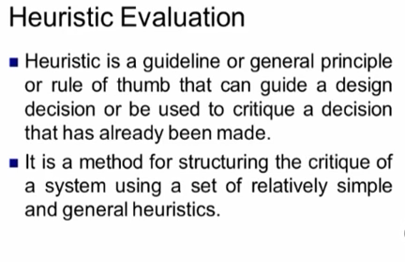

Slide 7
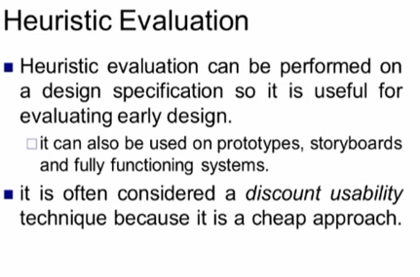

Slide 8
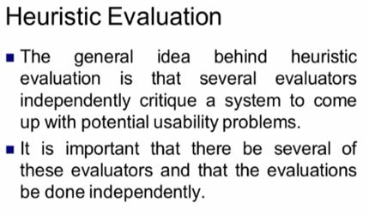

Slide 9
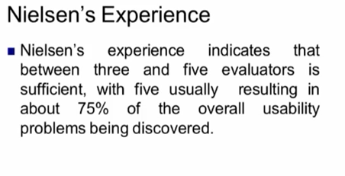

Slide 10
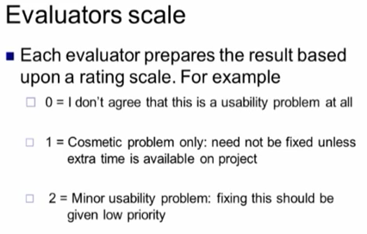

Slide 11
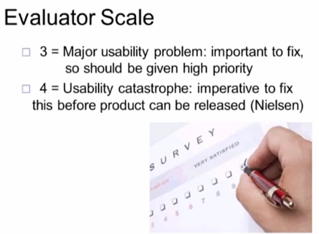

Slide 12
