Slide 1
Integration

Slide 2
Contents
Introduction
Importance of the Integration Approach
Integration Frequency—Phased or Incremental
Incremental Integration Strategies
Daily Build and Smoke Test
Key Points

Slide 3
Introduction
The term “integration” refers to the software development activity in which you combine separate software components into a single system.
On small projects, integration might consist of a morning spent hooking a handful of classes together.
On large projects, it might consist of weeks or months of hooking sets of programs together.
Integration is something different from testing, it should be viewed as an independent activity.

Slide 4
Introduction
The topic of integration is entangled with the topic of construction sequence.
The order in which you build classes or components affects the order in which you can integrate them.
You can’t integrate something that hasn’t been built yet.

Slide 5
Importance of the Integration Approach
If you construct and integrate software in the wrong order, it’s harder to code, harder to test, and harder to debug.
If none of it will work until all of it works, it can seem as though it will never be finished.
It too can collapse under its own weight during construction, the bug count might seem intractable, progress might be invisible, or the complexity might be crushing, even though the finished product would have worked.

Slide 6
Integration Frequency— Phased or Incremental?
Programs are integrated by means of
The phased approach
The incremental approach.

Slide 7
Phased Integration
Phased integration follows these well-defined steps, or phases:
Design, code, test, and debug each class.
Combine the classes into one massive big system.
Test and debug the whole system.

Slide 8
Phased Integration
One problem with phased integration is that when the classes in a system are put together for the first time, new problems inevitably surface and the causes of the problems could be anywhere.
Since you have a large number of classes that have never worked together before, the culprit might be a poorly tested class, an error in the interface between two classes, or an error caused by an interaction between two classes.
All classes are a suspect in this scenario.

Slide 9
Phased Integration
The uncertainty about the location of any of the specific problems is compounded by the fact that all the problems suddenly present themselves at once.
Phased integration can’t begin until late in the project, after all the classes have been developer tested.
When the classes are finally combined and errors surface at once, programmers immediately go into panic.

Slide 10
Phased Integration
For small programs phased integration might be the best approach.
If the program has only two or three classes, phased integration might save you time, but in most cases, another approach is better.

Slide 11
Incremental Integration
In incremental integration, you write and test a program in small pieces and then combine the pieces one at a time.
In this one-piece-at-a-time approach to integration, you follow these steps:
Develop a small, functional part of the system. It can be the smallest functional part, the hardest part, a key part, or some combination. Thoroughly test and debug it. It will serve as a skeleton on which to hang the muscles, nerves, and skin that make up the remaining parts of the system.
Design, code, test, and debug a class.
Integrate the new class with the skeleton. Test and debug the combination of skeleton and new class. Make sure the combination works before you add any new classes. If work remains to be done, repeat the process starting at step 2.

Slide 12
Incremental Integration
Occasionally, you might want to integrate units larger than a single class.
If a component has been thoroughly tested, for example, and each of its classes put through a mini-integration, you can integrate the whole component and still be doing incremental integration.
As you add pieces to it, the system grows and gains momentum

Slide 13
Incremental Integration
Some benefits are
Errors are easy to locate
You get improved progress monitoring
You will improve customer relations
The units of the system are tested more fully.

Slide 14
Incremental Integration Strategies
With phased integration, you don’t have to plan the order in which project components are built.
All components are integrated at the same time, so you can build them in any order as long as they’re all ready.

Slide 15
Incremental Integration Strategies
With incremental integration, you have to plan more carefully.
Most systems will call for the integration of some components before the integration of others.
Planning for integration thus affects planning for construction; the order in which components are constructed has to support the order in which they will be integrated.

Slide 16
Incremental Integration Strategies
Incremental integration strategies come in a variety of shapes and sizes, and none is best in every case.
The best integration approach varies from project to project.
Some incremental integration strategies are
Top down integration
Bottom up integration
Feature oriented integration

Slide 17
Top Down Integration
In top-down integration, the class at the top of the hierarchy is written and integrated first.
The top is the main window, the object that contains main() in Java, WinMain() for Microsoft Windows programming, or similar.
Stubs have to be written to exercise the top class.
Then, as classes are integrated from the top down, stub classes are replaced with real ones.

Slide 18
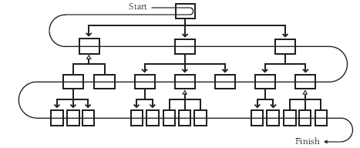
Top Down Integration

Slide 19
Top Down Integration
An advantage of top-down integration is that the control logic of the system is tested relatively early.
All the classes at the top of the hierarchy are exercised a lot so that big, conceptual, design problems are exposed quickly.

Slide 20
Top Down Integration
Another advantage of top-down integration is that, if you plan it carefully, you can complete a partially working system early in the project.
If the user-interface parts are at the top, you can get a basic interface working quickly and flesh out the details later.
The morale of both users and programmers benefits from getting something visible working early.

Slide 21
Bottom-Up Integration
In bottom-up integration, you write and integrate the classes at the bottom of the hierarchy first.
Adding the low-level classes one at a time rather than all at once is what makes bottom-up integration an incremental integration strategy.
You write test drivers to exercise the low-level classes initially.
As you add higher-level classes, you replace driver classes with real ones.

Slide 22
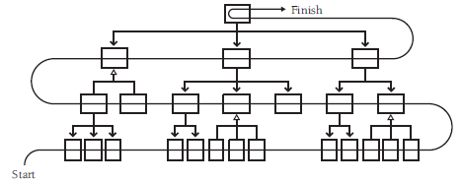
Bottom-Up Integration

Slide 23
Bottom-Up Integration
Bottom-up integration restricts the possible sources of error to the single class being integrated, so errors are easy to locate.
Integration can start early in the project.

Slide 24
Feature-Oriented Integration
Another approach is to integrate one feature at a time.
The term “feature” is just an identifiable function of the system you’re integrating.
If you’re writing a word processor, a feature might be displaying underlining on the screen or reformatting the document automatically something like that.

Slide 25
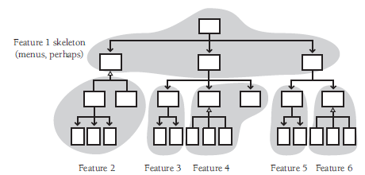
Feature-Oriented Integration

Slide 26
Feature-Oriented Integration
Feature-oriented integration usually start with a skeleton you’ve chosen for its ability to support the other features.
In an interactive system, the first feature might be the interactive menu system.
You can hang the rest of the features on the feature that you integrate first.
Components are added in “feature trees,” as hierarchical collections of classes that make up a feature.
Integration is easier if each feature is relatively independent.

Slide 27
Key Points
The construction sequence and integration approach affect the order in which classes are designed, coded, and tested.
A well-thought-out integration order reduces testing effort and eases debugging.
Incremental integration comes in several varieties, and, unless the project is trivial, any one of them is better than phased integration.
The best integration approach for any specific project is usually a combination of top-down, bottom-up, risk-oriented, and other integration approaches.
Daily builds can reduce integration problems, improve developer morale, and provide useful project management information.

Slide 28
Readings
[Chapter 29] Code Complete: A Practical Handbook of Software Construction by Steve McConnell, Microsoft Press; 2nd Edition (July 7, 2004). ISBN-10: 0735619670

