Slide 1
Test Cases
SE401: Software Quality Assurance and Testing

Slide 2
Outline
Testing
Test selection
Writing test cases
Test Execution

Slide 3
Testing
There is a massive misunderstanding about testing: that it improves software. It doesn't!
Weighing yourself doesn't reduce your weight
Going to the doctor doesn't make you healthy.
Those things help to identify problems that you might choose to resolve. Testing does too.
The testing does not make the product better, even though it's part of a process that does make a product better.

Slide 4
Test selection

Slide 5
Test cases
A test case, is a set of conditions under which a tester will determine whether an application, software system or one of its features is working as it was originally established for it to do.
Test cases are often referred to as test scripts, particularly when written – when they are usually collected into test suites.
A Test Case is a set of actions executed to verify a particular feature or functionality of your software application.

Slide 6
Test cases
A test case is a description of a specific interaction that a tester will have in order to test a single behavior of the software.
Test cases are very similar to use cases, in that they are step-by-step narratives which define a specific interaction between the user and the software.
A typical test case is laid out in a table, and includes:
A unique name and number
A requirement which this test case is exercising
Preconditions which describe the state of the software before the test case
Steps that describe the specific steps which make up the interaction
Expected Results which describe the expected state of the software after the test case is executed

Slide 7
Test cases
Test cases must be repeatable.
Good test cases are data-specific, and describe each interaction necessary to repeat the test exactly.

Slide 8
Writing test cases
First you must understand the language fundamentals
Sizes and limits of variables, platform specific information
Second, you must understand the domain
Read the requirements
Think like a user – what possible things do they want to do
Think about possible “mistakes”; i.e. Invalid input
Think about impossible conditions or input
What is the testing intended to prove?
Correct operation – gives correct behavior for correct input
Robustness – responds to incorrect or invalid input with proper results
User acceptance – typical user behavior
Write down the test cases

Slide 9
Writing Good Test Cases
Test Cases need to be simple and transparent
Create Test Case with end user in mind
Avoid test case repetition
Do not Assume
Stick to the Specification Documents.
Ensure 100% Coverage
Make sure you write test cases to check all software requirements mentioned in the specification document.
Product Coverage
Risk Coverage
Requirements Coverage
Test Cases must be identifiable.
Name the test case id such that they are identified easily while tracking defects or identifying a software requirement at a later stage.
Implement Testing Techniques
It's not possible to check every possible condition in your software application
Testing techniques help you select a few test cases with the maximum possibility of finding a defect

Slide 10
Writing Good Test Cases
Boundary Value Analysis (BVA)
testing of boundaries for specified range of values.
Repeatable and self-standing
The test case should generate the same results every time no matter who tests it

Slide 11
Writing a test case
While drafting a test case do include the following information
The description of what requirement is being tested
Inputs and outputs or actions and expected results
Test case must have an expected result.
Verify the results are correct
Testing Normal Conditions
Testing Unexpected Conditions
Bad (Illegal) Input Values
Boundary Conditions

Slide 12
Writing test cases
Cover all possible valid input
Try multiple sets of values, not just one set of values
Permutations of values
Check boundary conditions
Check for off-by-one conditions
Check invalid input
Illegal sets of value
Illegal input
Impossible conditions
Totally bad input
Text vs. Numbers, etc.

Slide 13
Writing test cases
Beware of problems with comparisons
How to compare two floating numbers
Never do the following: float a, b; . . . if (a == b)
Is it 4.0000000 or 3.9999999 or 4.0000001 ?
What is your limit of accuracy?

Slide 14
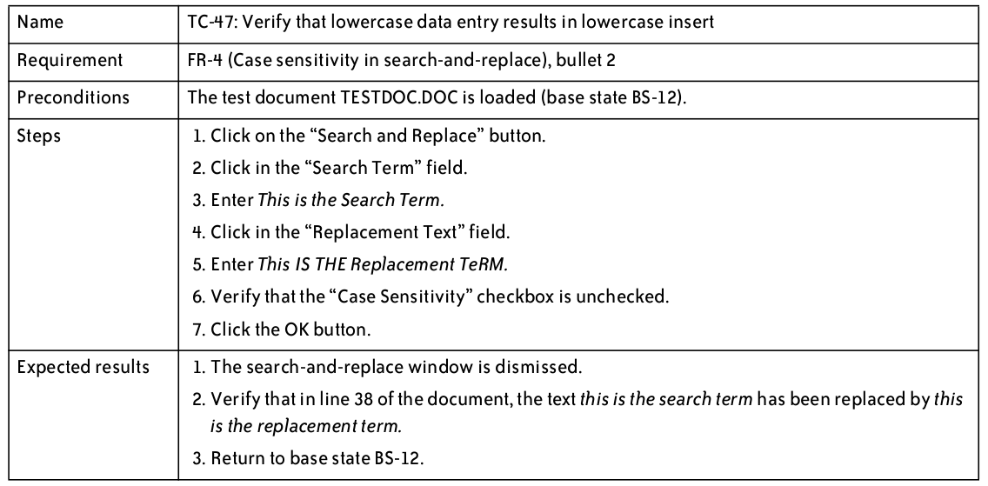
Test Cases – Good Example

Slide 15
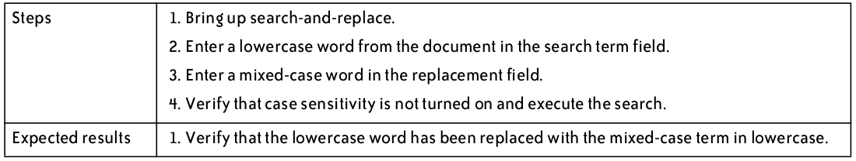
Test Cases – Bad Example

Slide 16
Test cases
Why we write test cases?
The basic objective of writing test cases is to validate the testing coverage of the application.
Keep in mind while writing test cases that all your test cases should be simple and easy to understand.
For any application basically you will cover all the types of test cases including functional, negative and boundary value test cases.

Slide 17
Trustworthy tests
Test one thing at a time per test method.
10 small tests are much better than 1 test 10x as large.
Each test method should have few (likely 1) assert statements.
If you assert many things, the first that fails stops the test.
You won't know whether a later assertion would have also failed.
Tests should avoid logic.
minimize if/else, loops, switch, etc.
avoid try/catch
If it's supposed to throw, use expected= ... if not, let JUnit catch it.
Torture tests are okay, but only in addition to simple tests.
A torture test is a hardware assessment of a digital device where the device is run at or near full capacity for an extended length of time. The results of the torture test are studied and used to ensure system reliability under normal conditions.

Slide 18
Test Execution
The software testers begin executing the test plan after the developers deliver the alpha build, or a build that they feel is feature complete.
The alpha should be of high quality—the developers should feel that it is ready for release, and as good as they can get it.
There are typically several iterations of test execution.
First, focus on new functionality
Then, regression test to make sure that a change to one area of the software has not caused any other part of the software
Regression testing usually involves executing all test cases which have previously been executed
There are typically at least two regression tests for any software project

Slide 19
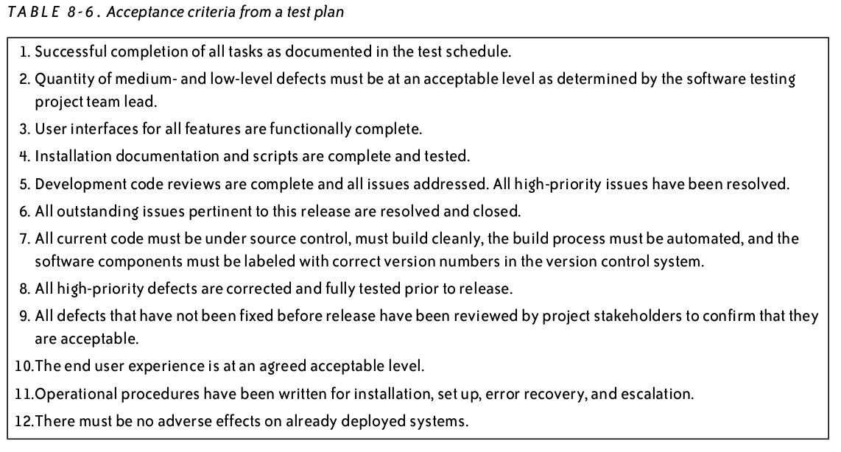
Test Execution
When is testing complete?
No defects found
Or defects meet acceptance criteria outlined in test plan

Slide 20
Automating Test Execution
Designing test cases and test suites is creative
Like any design activity: A demanding intellectual activity, requiring human judgment
Executing test cases should be automatic
Design once, execute many times
Test automation separates the creative human process from the mechanical process of test execution

Slide 21
Scaffolding
Code produced to support development activities (especially testing)
Not part of the “product” as seen by the end user
May be temporary (like scaffolding in construction of buildings)
Includes
Test harnesses, drivers, and stubs
Example:
JUnit – test harness
Eclipse – IDE, scaffolding, JUnit built in

Slide 22
Scaffolding ...
Test driver
A “main” program for running a test
May be produced before a “real” main program
Provides more control than the “real” main program
To drive program under test through test cases
Test stubs
Substitute for called functions/methods/objects
Test harness
Substitutes for other parts of the deployed environment
Ex: Software simulation of a hardware device
Notes:
Terminology note: “Harness” is also commonly used to refer to all three parts, a test driver, stubs, and replacements for other components.

Slide 23
Stubs

Slide 24
Drivers

Slide 25
Smoke Tests
A smoke test is a subset of the test cases that is typically representative of the overall test plan.
Smoke tests are good for verifying proper deployment or other non invasive changes.
They are also useful for verifying a build is ready to send to test.
Smoke tests are not substitute for actual functional testing.

Slide 26
Summary
Goal: Separate creative task of test design from mechanical task of test execution
Enable generation and execution of large test suites
Re-execute test suites frequently (e.g., nightly or after each program change)
Scaffolding: Code to support development and testing
Test drivers, stubs, harness, including oracles
Ranging from individual, hand-written test case drivers to automatic generation and testing of large test suites
Capture/replay where human interaction is required

