Slide 1
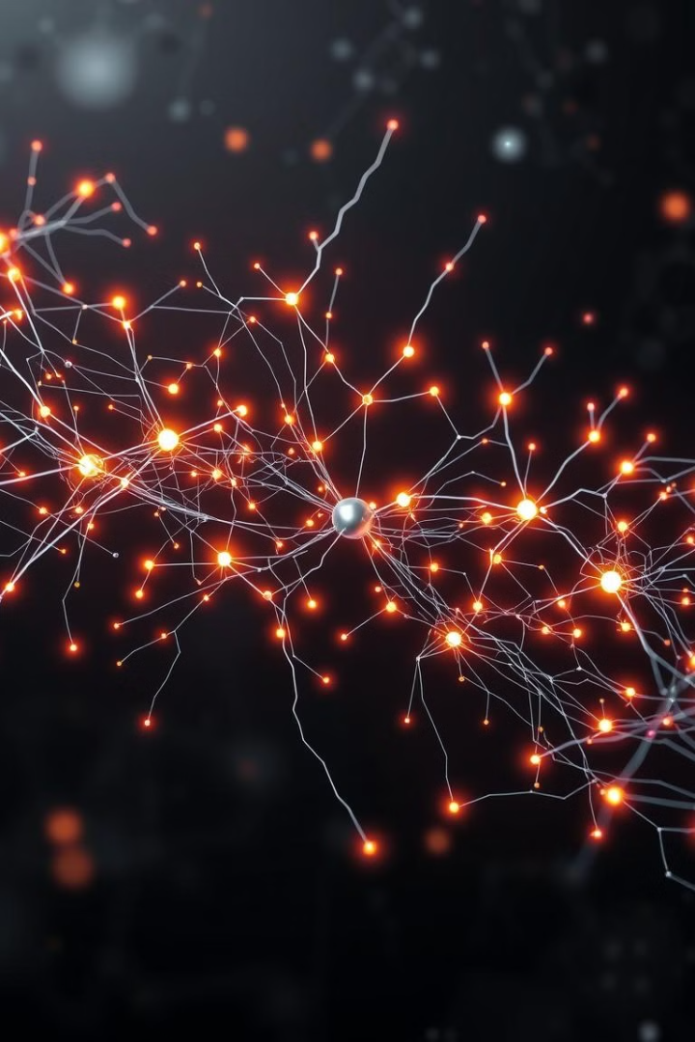
Regression and Classification with ANN and CNN
MUHAMMAD HAMZA TAHIR
Sp23-Bai-035
Ahmad Haseeb Butt
Sp23-Bai-006
Ahmad Sameen
Sp23-Bai-004

Slide 2
Datasets
ANN
Regression task
Classification task
California Housing
Loan Data
20,640 samples, 8 features
44,988 samples, 12 features
CNN
Classification task
Caltech-256
30,607 images in total, random size, RGB
256 Categories

Slide 3
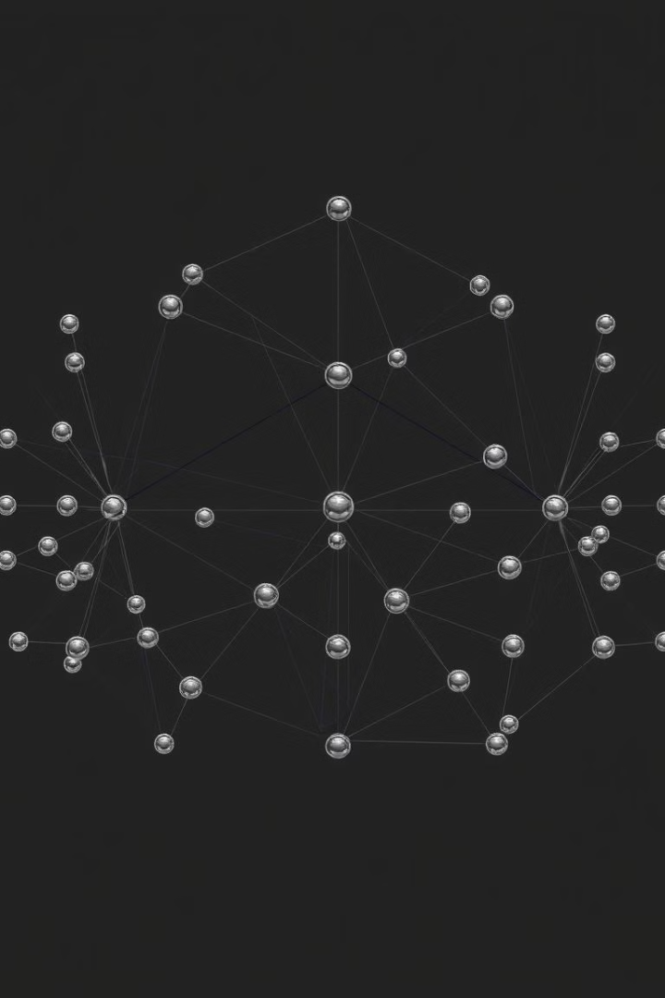
PyTorch ANN (Regression)
1
Input Layer
2
Hidden Layers
8 neurons
1st Hidden Layer
64 neurons with ReLU
2nd Hidden Layer
32 neurons with ReLU
3rd Hidden Layer
16 neurons with ReLU
3
Output Layer
1 neuron (linear activation)

Slide 4
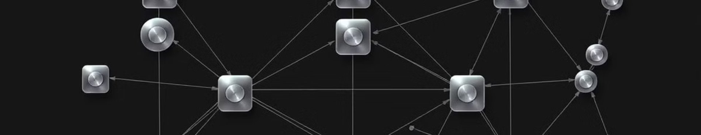
PyTorch ANN (Classification)
1
Input Layer
2
Hidden Layers
3
Output Layer
12 neurons
1st Hidden Layer
10 neurons with ReLU
2nd Hidden Layer
19 neurons with ReLU
3rd Hidden Layer
20 neurons with ReLU
2 neurons (softmax activation)

Slide 5
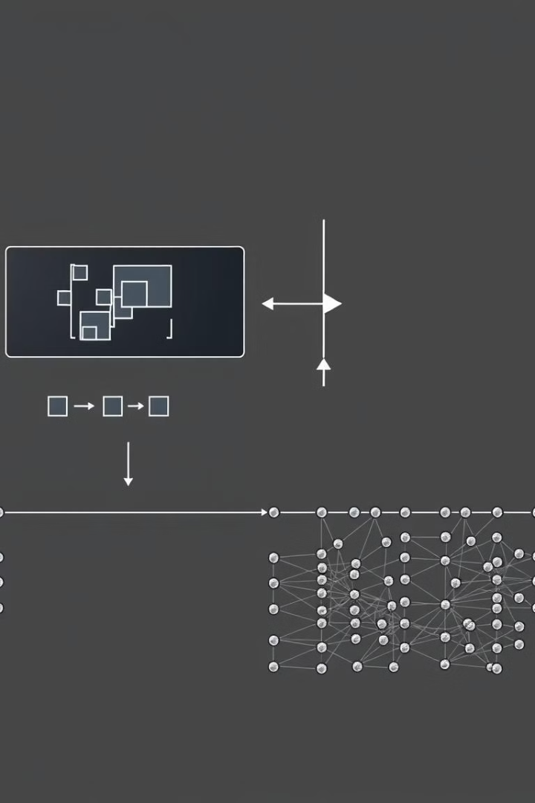
Keras CNN (Classification)
1
Convolutional Layers
2
Pooling Layers
[Conv2D(32), Conv2D(64)
Conv2D(128)]
MaxPooling2D (2x2)
3
Fully Connected Layers
Dense(256 with Relu), Dense(256 with softmax)

Slide 6
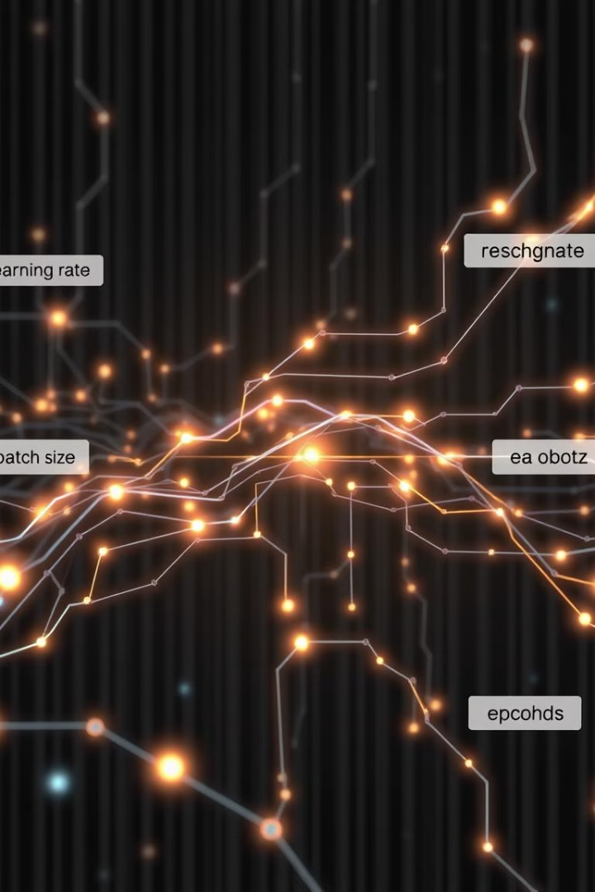


Training Configurations
Learning Rates
Batch Size
0.1 (Regression), 0.01 (ANN), default learning rate for the Adam optimizer in Keras is 0.001 (CNN)
32 for all tasks
Epochs
Regression - 100, ANN - 50, CNN - 10

Slide 7
Performance Metrics
Classification (CNN)
Epoch 10/10
Training: Accuracy: 50.5%, loss: 1.6808
Validation: Accuracy: 24.36% Loss: 4.3203
Regression (ANN)
Epoch 100/100
Training Loss: 0.2370, Validation Loss: 0.2735
Classification (ANN)
Epoch 50/50
Training Loss: 0.6

Slide 8
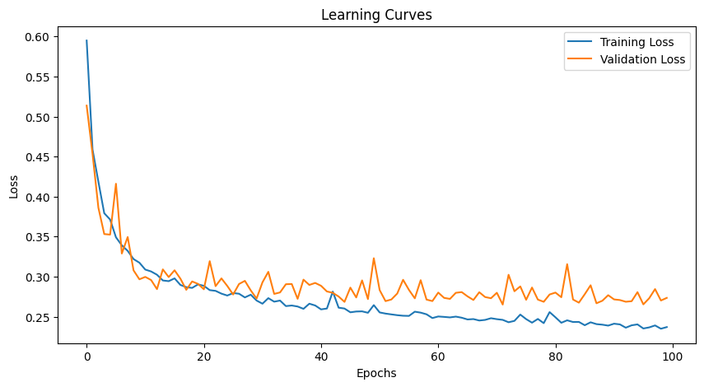
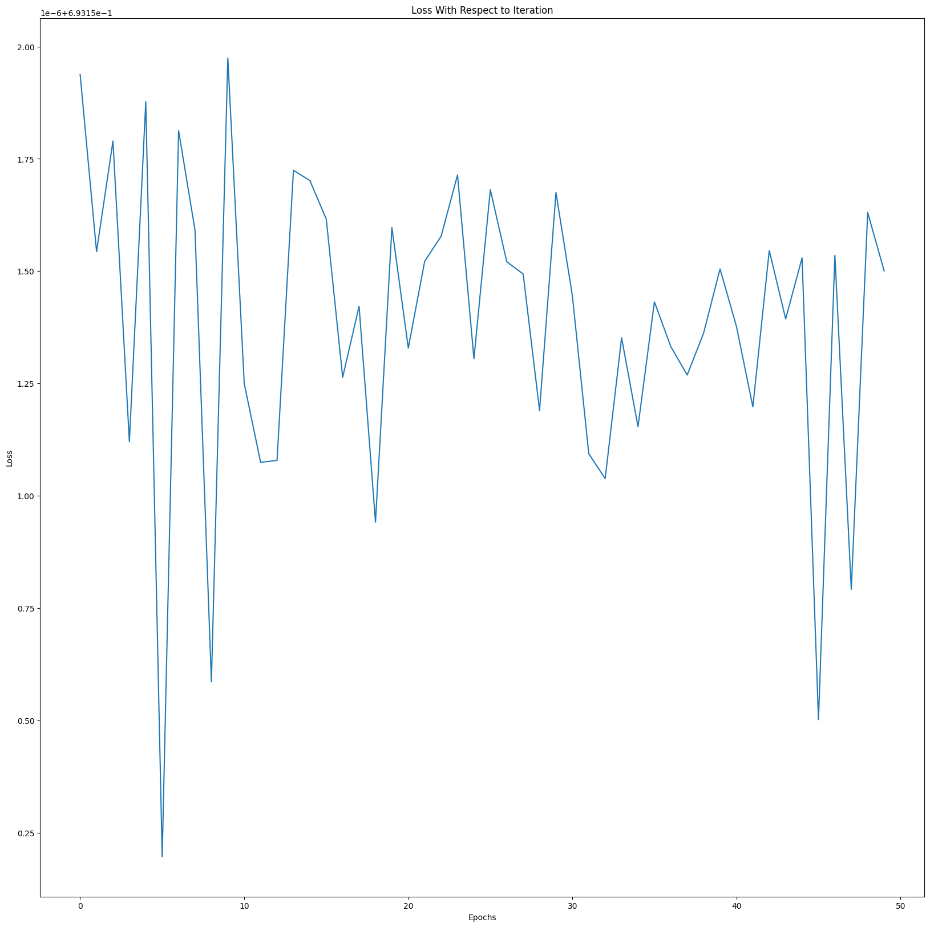
Learning Curves
ANN Regression
ANN Classification

Slide 9
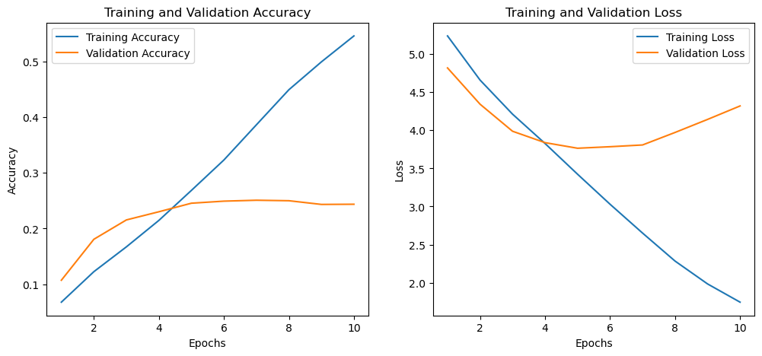
CNN Classification

Slide 10
Confusion Matrix
ANN Regression
Evaluation Metrics:
Mean Squared Error (MSE): 0.2735
Mean Absolute Error (MAE): 0.3532
R² Score: 0.7913

Slide 11
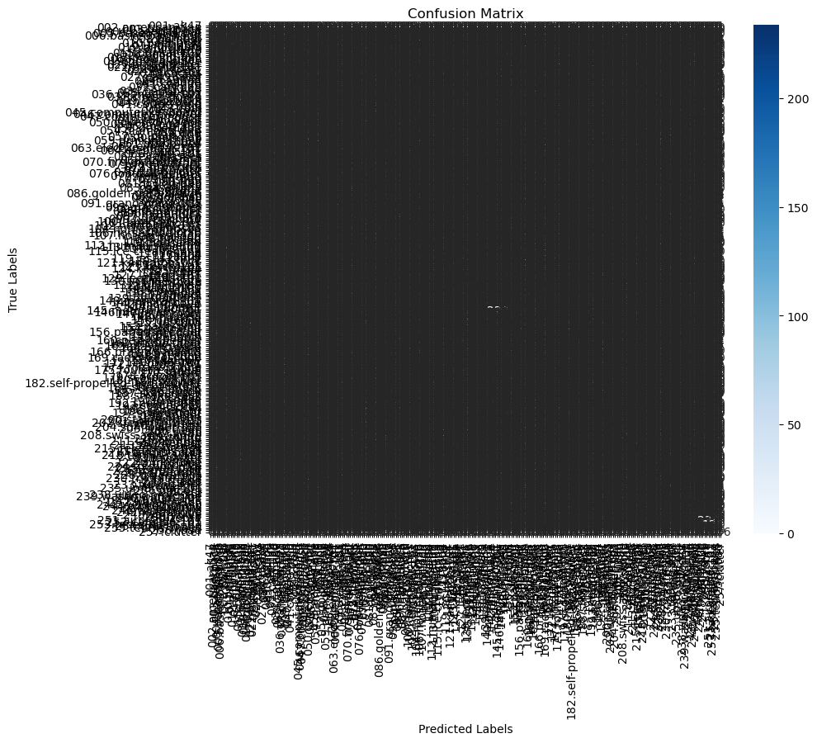
CNN Classification

Slide 12
Results Comparison
Model
Dataset / Task
Key Hyperparams
Final Metric
Training Time
PyTorch ANN (Reg)
California Housing
LR=0.1, Epoch=100
MSE = 0.2735; MAE=0.3
~5 min
PyTorch ANN (Class)
Loan
LR=0.01, Epoch=50
Accuracy = 82.4%
~10 min
Keras CNN (Class)
Caltech-256
LR=0.0001, Epoch=10
Accuracy = 50. 5%
~55 min

