Slide 1

Hammad Nadeem 150162
Hamza Talat 150328
Muhammad Faisal 140154
Dr. Mirza Omer Beg
Development Project
Spring 2019

Slide 2
Project Overview
Cache simulator designed with the aim of measuring the performance difference between various prefetching techniques and eviction policies.
Cache size, mapping and eviction polices are user specified.

Slide 3
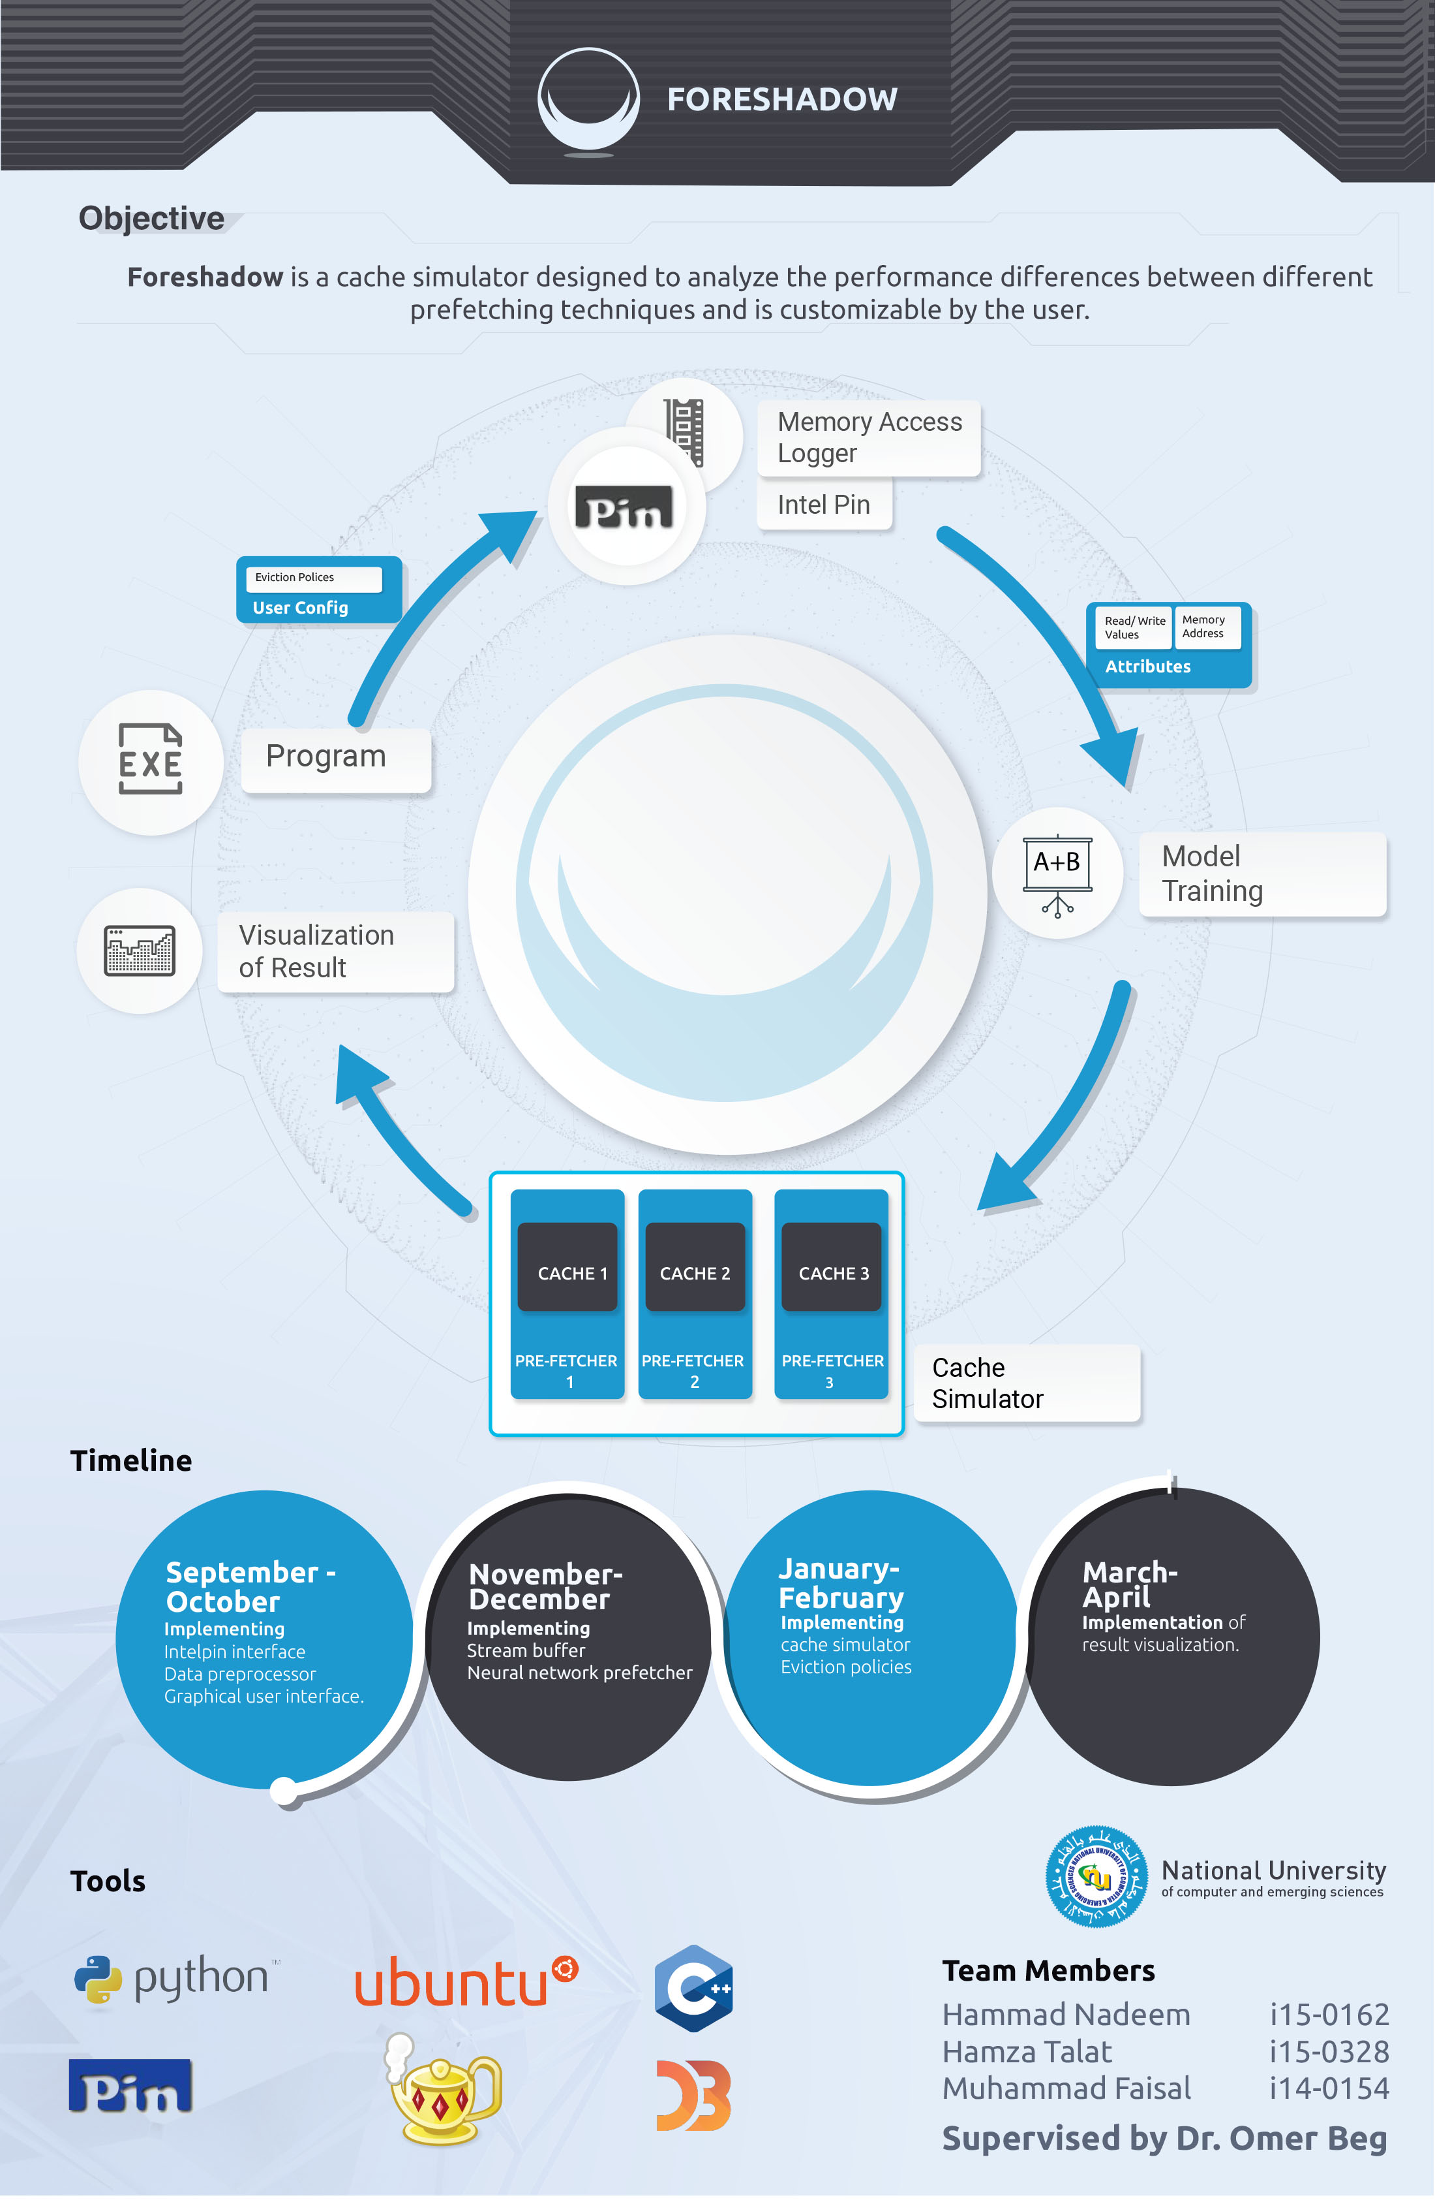
Poster

Slide 4
Completed Objectives
Simulator.
Stream buffer prefetcher.
Six eviction policies.
Graphical user interface.
Data cleaning.

Slide 5
Objectives Remaining
Perceptron learner prefetcher.
Neural network prefetcher.
Obtaining memory traces.
Performance analysis.

Slide 6
Demonstration

