Slide 1
Rule Based Classification to Forecast Potential Customer Revenue
Dataset
sales_ID | concept_type | city_name | season_number | price
A0CX001 | concept_A | city_A | S_1 | 253,5360293
A0CX002 | concept_B | city_A | S_1 | 220,202696
A0CX003 | concept_A | city_A | S_2 | 252,0708278
A0CX004 | concept_B | city_B | S_1 | 396,9426227
A0CX005 | concept_B | city_B | S_1 | 314,7081905
A0CX006 | concept_B | city_B | S_1 | 244,5006203
A0CX007 | concept_B | city_A | S_1 | 220,0195458
A0CX008 | concept_A | city_A | S_1 | 225,4713162
A0CX009 | concept_B | city_B | S_1 | 251,5213773
A0CX010 | concept_B | city_Other | S_1 | 242,9133187
A0CX011 | concept_B | city_Other | S_1 | 277,253978
A0CX012 | concept_C | city_Other | S_1 | 213,9145397
A0CX013 | concept_C | city_B | S_1 | 227,5897534

Slide 2
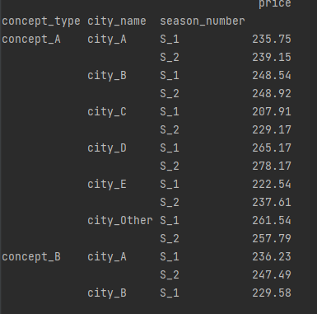
STEP-1: The dataset is imported, and the necessary libraries are imported. New sales definitions are created using all the variables that affect the sales quantity.
import numpy as np import pandas as pd df = pd.read_excel ("datasets/miuul_gezinomi.xlsx")
df.groupby(["concept_type", "city_name", "season_number"] ) .agg({"price": "mean"})
As a result, the average price is calculated for each concept, city, and season combination.

Slide 3
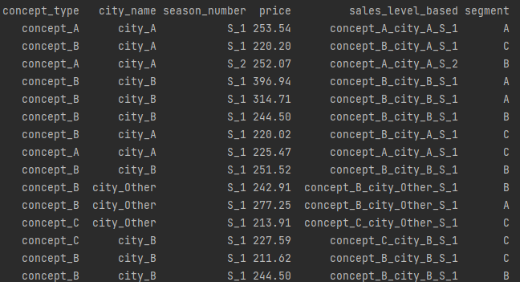
STEP-2: Each match is defined as a persona and each persona is segmented based on the price.
df["sales_level_based"]=
df[["concept_type","city_name", "season_number"]].agg(lambda x: '_'.join(x, axis=1)
df["segment"]= pd.qcut(df["price"], 4, ["D", "C", "B", "A"])
As a result, all the data is reduced to a single variable, and segments are created.

Slide 4
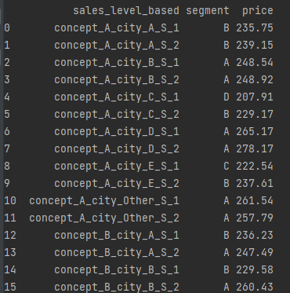
STEP-3: The dataset is transformed into its final form for our use. When new customer information arrives, it is written into the dataset accordingly, and price predictions are made.
df = df[["sales_level_based", "segment", "price"]]

Slide 5


Example: Ali will go on vacation with Concept C, in City A, during Season 2, while Buğra will go on vacation with Concept B, in City C, during Season 1. What is the approximate revenue for these customers?
new_customer="concept_C_city_A_S_2"
df[df["sales_level_based"]==new_customer]
new_customer="concept_B_city_C_S_1"
df[df["sales_level_based"]==new_customer]
Considering the options in their orders, new incoming customers are expected to bring approximately 240 units of revenue for Ali and 200 units of revenue for Buğra.

