Slide 1
GsuNET
Galatasaray University Networking and Event Tracking System
Final Project Presentation - Completed Implementation
Endüstri Mühendisliği: Başar Saraç, Berkay Çadırcı
Bilgisayar Mühendisliği: Hamza Yakar, Mert Samet Kayacıoğlu, Edipcan Erol
Galatasaray Üniversitesi - Aralık 2025

Slide 2
Proje Özeti
✅ Tam işlevsel bir kulüp ve etkinlik yönetim platformu geliştirildi
✅ React frontend + FastAPI backend ile modern web uygulaması
✅ PostgreSQL veritabanı + Redis cache/queue sistemi
✅ 4 farklı kullanıcı rolü (Student, Club Manager, Advisor, Admin)
✅ Rol tabanlı yetkilendirme (RBAC) ve JWT authentication
✅ Background task processing (ARQ) ve cron jobs
✅ Responsive tasarım ve çoklu dil desteği (TR/EN/FR)
✅ Docker containerization ile deployment

Slide 3
Tamamlanan Temel Özellikler
Etkinlik ve Kulüp Yönetimi
• Etkinlik oluşturma ve yönetimi
• Etkinlik onay sistemi (Advisor)
• Etkinliklere kayıt olma
• Kulüpleri takip etme
• Kulüp üyelik talepleri
• Sadece üyelere özel etkinlikler
Sistem Özellikleri
• Bildirim sistemi (event reminders)
• Oda/salon rezervasyonu
• Haftalık program takvimi
• Kullanıcı yönetimi (Admin)
• Sponsorluk yönetimi
• Çoklu dil desteği

Slide 4
Sistem Mimarisi - Gerçekleşen
🏗️ Three-Tier Architecture (Client-Server Model)
⚛️ Frontend: React 19.x + Vite + TailwindCSS + React Router
🚀 Backend: FastAPI 0.104.1 + Uvicorn (async ASGI server)
💾 Database: PostgreSQL 15 + SQLAlchemy ORM + Alembic migrations
🔄 Cache/Queue: Redis 8.4 + ARQ (async background tasks)
🔐 Security: JWT authentication, bcrypt password hashing, RBAC
📦 Deployment: Docker + Docker Compose (5 containers)
🌐 API Documentation: OpenAPI/Swagger (auto-generated)

Slide 5
Kullanılan Teknolojiler
Frontend Stack
• React 19.2.0 - UI framework
• Vite 7.2.4 - Build tool
• TailwindCSS 4.1.18 - Styling
• React Router 7.10.1 - Routing
• Axios 1.13.2 - HTTP client
• React Hot Toast - Notifications
Backend Stack
• FastAPI 0.104.1 - Web framework
• PostgreSQL 15 - Database
• SQLAlchemy 2.0.23 - ORM
• Redis 8.4 - Cache/Queue
• ARQ 0.26.1 - Background tasks
• Pydantic 2.5.0 - Validation

Slide 6
Veritabanı Tasarımı - 10 Tablo
👥 Users - Kullanıcılar ve roller (student/club_manager/advisor/admin)
🏢 Clubs - Kulüp profilleri ve yöneticileri
📅 Events - Etkinlikler (status: pending/approved/rejected/cancelled/completed)
🏫 Rooms - Odalar ve salonlar (kapasite, özellikler)
📋 RoomSchedule - Oda rezervasyonları ve zaman blokları
✅ EventRegistration - Kullanıcı-etkinlik kayıtları
🔔 Notifications - Bildirimler (8 farklı tip)
🤝 ClubJoinRequest - Kulüp üyelik talepleri
💼 Sponsorships - Sponsorluk yönetimi

Slide 7
Backend Gerçekleştirimi
✅ RESTful API: 7 ana route modülü (auth, events, clubs, rooms, schedule, notifications, users)
✅ Authentication: JWT token-based (7-day expiration)
✅ Authorization: Rol bazlı erişim kontrolü (decorator-based)
✅ Validation: Pydantic schemas ile input/output validation
✅ ORM: SQLAlchemy models ve relationships
✅ Background Tasks: ARQ worker ile asenkron bildirimler
✅ Scheduled Jobs: Günlük event reminder (cron: 9:00 AM)
✅ Error Handling: Detaylı HTTP exception responses

Slide 8
Frontend Gerçekleştirimi
✅ Single Page Application (SPA) - React ile geliştirildi
✅ Rol bazlı sayfa erişimi ve dinamik navigasyon
✅ 15+ ana sayfa (Login, Events, Clubs, Admin Panel, vb.)
✅ Context API ile global state management (Auth, Language)
✅ Responsive tasarım - Mobile, Tablet, Desktop
✅ Form validation ve error handling
✅ Toast notifications (react-hot-toast)
✅ i18n - 3 dil desteği (TR/EN/FR), localStorage persistence

Slide 9
Önemli Özellikler - Detay
Sistem Özellikleri
• Room Scheduling: Weekly view, conflict detection, capacity-based recommendations
• Club Management: Member requests, approve/reject, follower system
• User Management: Admin panel, role editing, filtering
• Notifications: 8 types, read/unread status, event linking
• Multi-language: Dynamic switching, all UI elements translated
Etkinlik Özellikleri
• Event Creation: Form validation, room selection, capacity limits
• Event Approval: Advisor panel, approve/reject with reason
• Event Registration: One-click register, capacity check
• Event Cancellation: Background task (ARQ), bulk notifications
• Event Reminders: Daily cron job (3-day advance notice)

Slide 10
Güvenlik Gerçekleştirimi
🔐 JWT Authentication - Stateless, token-based authentication
🔑 Password Security - Bcrypt hashing (salt + hash)
🛡️ RBAC (Role-Based Access Control) - 4 seviye yetkilendirme
🚫 SQL Injection Prevention - SQLAlchemy ORM (parametrized queries)
🛡️ XSS Protection - React built-in escaping
🔒 CORS Policy - Configured for security
✅ Input Validation - Pydantic schemas ile tüm endpoint'lerde
📋 Foreign Key Constraints - Database integrity enforcement

Slide 11
Background Task Processing (ARQ)
✅ Redis-based async queue (ARQ 0.26.1)
✅ Worker process - 5 functions, 10 max concurrent jobs
✅ Event Cancellation Notifications - Async, non-blocking
→ 100+ users: Response time <100ms (was ~5 seconds)
✅ Event Reminder Notifications - Scheduled daily at 9 AM
→ Finds events 2.5-3.5 days away, sends reminders
✅ Cron Jobs - ARQ cron decorator (@cron)
✅ Job Retention - Results kept for 1 hour
✅ Health Checks - Redis connection monitoring

Slide 12
Karşılaşılan Zorluklar ve Çözümler
Teknik Zorluklar
• Room scheduling conflicts → Overlap detection algorithm
• Event capacity management → Database constraints + validation
• Performance (100+ notifications) → ARQ background tasks
• Role-based access → Decorator-based RBAC system
Uygulama Zorlukları
• Multi-language support → Context API + localStorage
• Database migrations → Alembic version control
• Docker networking → Docker Compose service dependencies
• Worker startup issues → ARQ CLI wrapper solution

Slide 13
Test ve Deployment
🐳 Docker Containerization - 5 containers (frontend, backend, db, redis, worker)
📦 Docker Compose Orchestration - Service dependencies, networks, volumes
🔄 Development Workflow - Hot reload (Vite + Uvicorn)
🗄️ Database Migrations - Alembic (version-controlled schema)
✅ API Testing - Swagger UI (/docs endpoint)
🏥 Health Checks - Database + Redis connection monitoring
📝 API Documentation - OpenAPI/Swagger auto-generated
🚀 Production Ready - Environment-based configuration

Slide 14
Sonuçlar ve Başarılar
✅ Fully functional club and event management platform
✅ Complete 3-tier architecture implementation
✅ 10-table normalized database with proper relationships
✅ Async background processing for scalability
✅ Comprehensive security implementation
✅ Modern, responsive UI with multi-language support
✅ Dockerized deployment for easy setup
✅ Well-documented API (OpenAPI/Swagger)
🎯 Ready for pilot testing with real users

Slide 15
Gelecek Geliştirmeler
📱 Mobile Application - React Native or PWA enhancement
🤖 AI-powered Event Recommendations - Machine learning based on user preferences
📊 Advanced Analytics Dashboard - Club performance metrics, attendance trends
🔔 Push Notifications - Web push for real-time updates
📧 Email Integration - Automated email notifications
🌐 Social Media Integration - Share events to social platforms
📅 Calendar Integration - Export to Google Calendar, iCal
🧪 Automated Testing - Unit tests, integration tests, E2E tests

Slide 16
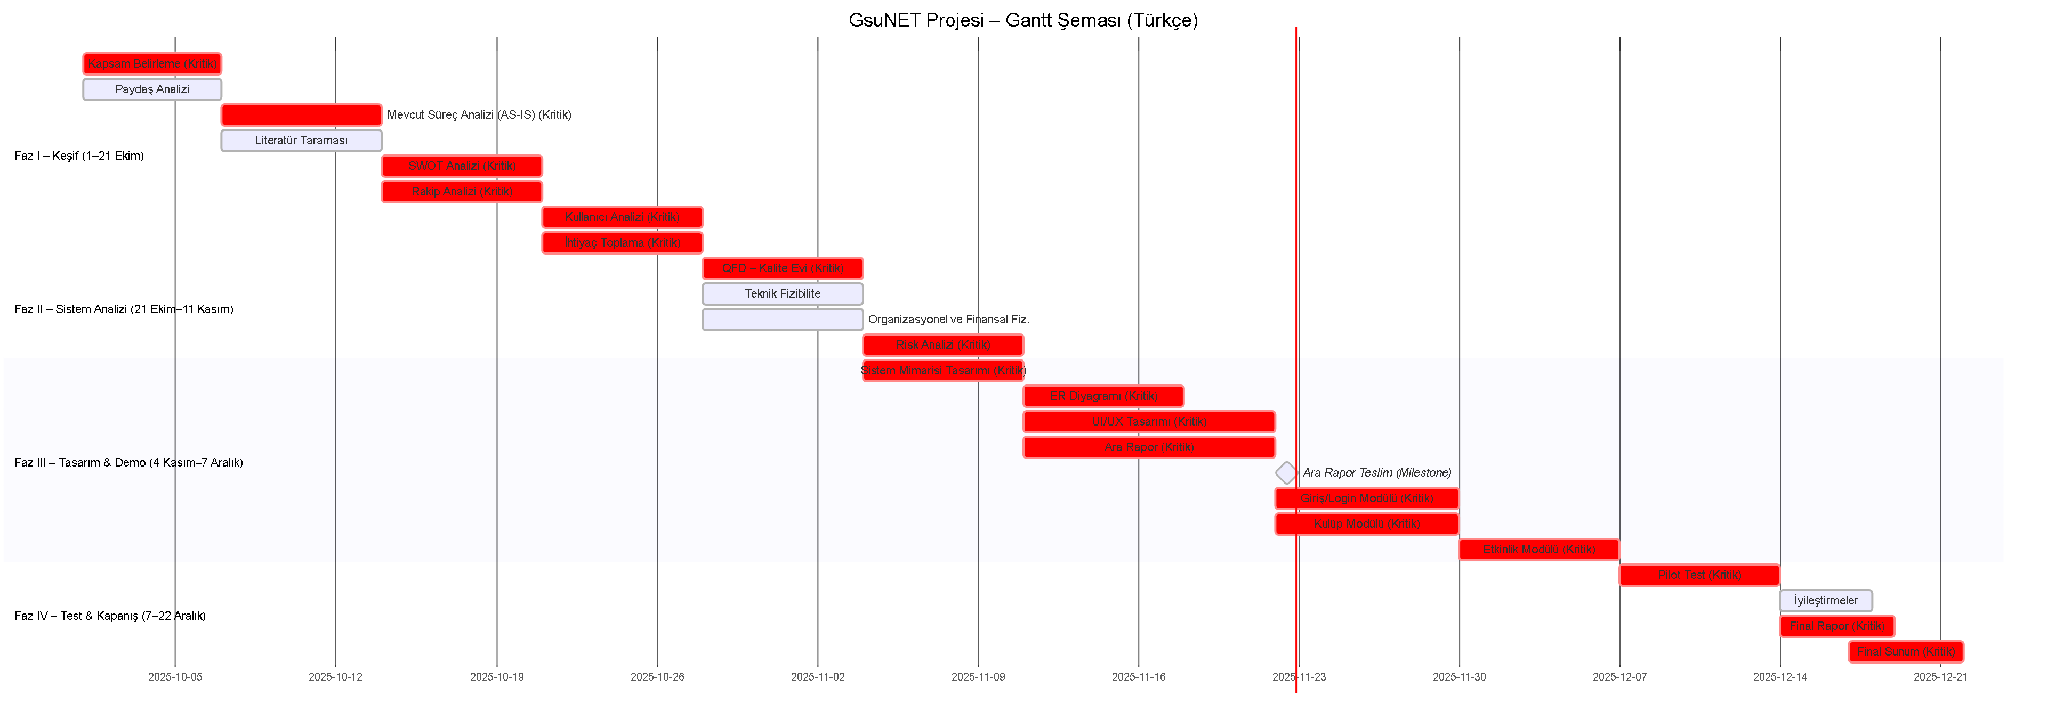
Proje Zaman Planı (Gantt)
12 haftalık geliştirme süreci

Slide 17
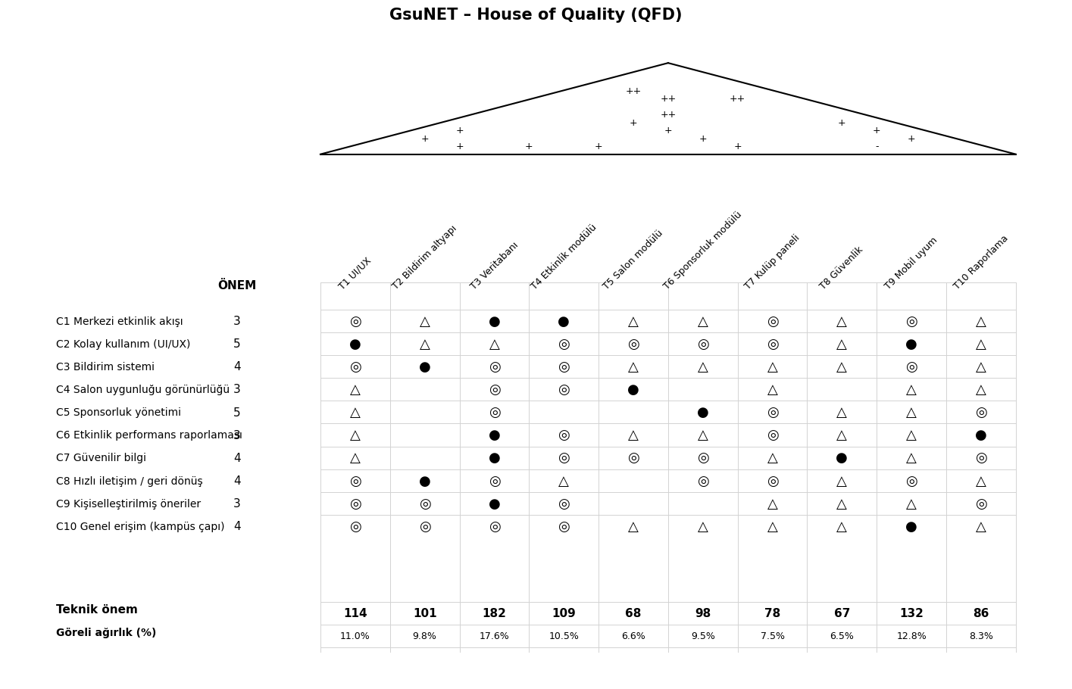
Kalite Evi (QFD)
Kullanıcı ihtiyaçlarından teknik gereksinimlere

Slide 18
Proje Akış Diyagramı
İteratif geliştirme süreci

Slide 19
Teşekkürler!
Sorularınız için hazırız
Galatasaray Üniversitesi
Mühendislik ve Teknoloji Fakültesi
INF493 Bitirme Projesi - Aralık 2025

