Slide 1


Condition variables and using predicates
CSE 437 – REAL TIME SYSTEM ARCHITECTURES

Slide 2

Condıtıon varıables
A condition variable is an object able to block the calling thread until notified to resume.
But there might be some problems about the synchronization problem between the threads when they have woken up.
That’s why we need to use predicate lambda function to be aware of that.

Slide 3
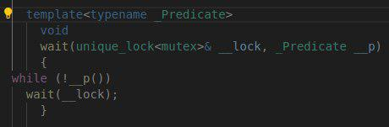
DON’T WAIT WITHOUT A CONDITION
A wait without a condition can miss a wakeup or wake up simply to find that there is no work to do.
Condition variables can be victims of two very serious issues: lost wakeup and spurious wakeup.

Slide 4
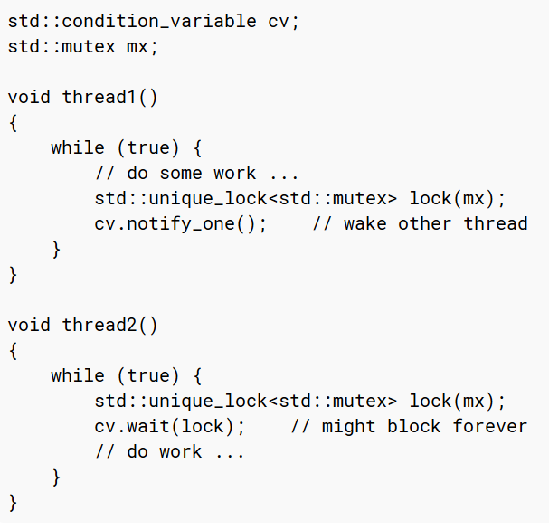
Bad – good Examples
If some other thread consumes thread1’s notification, thread2 can wait forever.

Slide 5
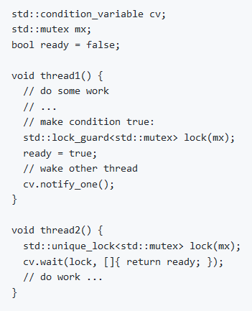
Bad – good Examples
If some other thread consumes thread1’s notification, thread2 can wait forever.

Slide 6
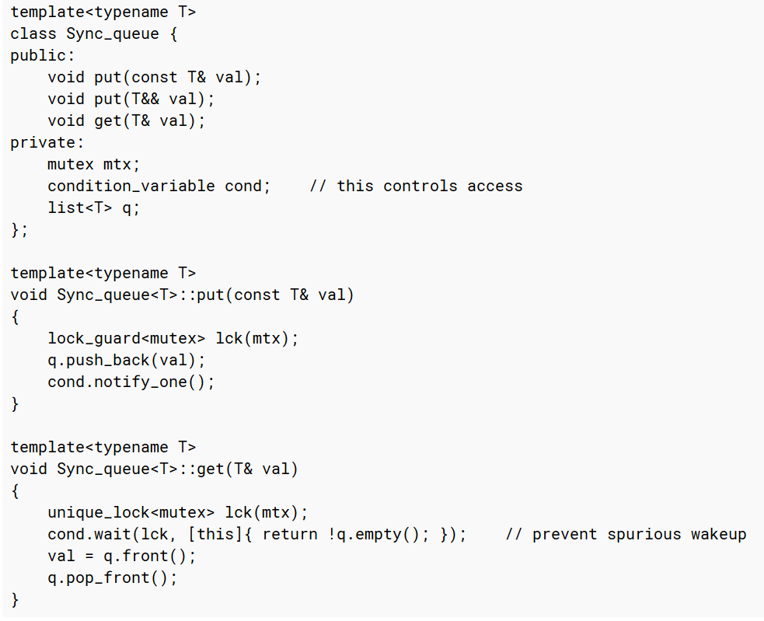
GOOD Example
If the queue is empty when a thread executing get() wakes up (e.g., because another thread has gotten to get() before it), it will immediately go back to sleep, waiting.

Slide 7
References
https://isocpp.github.io/CppCoreGuidelines/CppCoreGuidelines
https://thispointer.com/c11-multithreading-part-7-condition-variables-explained/
http://www.cplusplus.com/reference/condition_variable/condition_variable/

Slide 8
Group members
Hamza YOĞURTCUOĞLU – 171044086
Osman AKKUŞ – 151044055
Ahmet Yuşa TELLİ – 151044092

