Slide 1

Comparative Study: Transfer Learning vs. Training from Scratch on CIFAR-10
Transfer Learning Vs Training from Scratch
Name : Muhammad Hamza Zafar
Student ID : 22022247
Link for Colab File: https://colab.research.google.com/drive/1LHusZKMud6wRwGMHOwqVsFtHHw7DtAB3?usp=sharing
Link for Github Repo:

Slide 2
Table of Contents
Transfer Learning Vs Training from Scratch
Introduction of Topic
Overview of Transfer Learning
MobileNetV2 Pre-trained Model and Original Purpose
MobileNetV2 Architecture
Result/Data Visualization
Analysis
Areas of Improvement
Conclusion
References

Slide 3
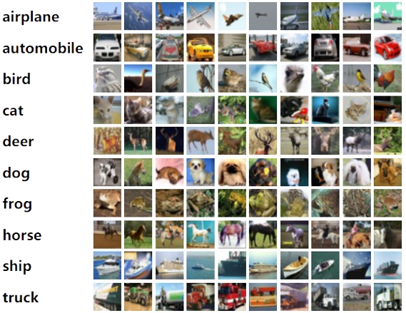
Introduction to CIFAR-10 Dataset:
Transfer Learning Vs Training from Scratch
A popular benchmark dataset in computer vision, the CIFAR-10 dataset consists of 60,000 images split into 10 classes, each with 32x32 pixels. The images in the dataset shows commonplace items and animals, enabling algorithms to learn and classify objects with limited pixel resolution. The dataset offers a common benchmark for assessing how well image classification algorithms work with lower-resolution, real-world images. For image classification, comparing and evaluating algorithms is crucial as it is important to identify which model performer is best. As this dataset is a benchmark it acts as a uniform standard to evaluate how well AI algorithms recognize and classify objects in images.
Fig 1.0

Slide 4
Brief overview of Transfer Learning
Transfer Learning Vs Training from Scratch
Transfer learning is a technique used in AI which involves applying knowledge from one problem's solution to another that is similar yet unrelated. Pre-trained models are already trained on large amount of data, it is used to apply its knowledge on another new problem which is related to the problem for which it is trained.
By using pre-trained model researcher can save time and computer power can there is no need to build model from scratch and trained it on large amount of dataset. These models have already learned features from millions of images to perform image recognition tasks.
Typically, pre-trained models, which have mastered useful features from a source task, serve as the foundation. Fine-tuning is then performed on the target task, adjusting the model's parameters to make it relevant to the new problem. This process can involve adapting the entire architecture or selectively using portions of the pre-trained model for feature extraction.
The applications of transfer learning span various domains, such as computer vision, natural language processing, and speech recognition. One notable advantage is its ability to enhance generalization performance and accelerate training by capitalizing on the knowledge acquired during the source task. Despite its benefits, transfer learning poses challenges, including selecting an appropriate source task, addressing domain differences, and determining the optimal strategy for model adaptation.

Slide 5
MobileNetV2 Pre-trained Model and Architecture
Transfer Learning Vs Training from Scratch
The lightweight deep learning architecture MobileNetV2 was selected due to its efficiency in terms of speed and accuracy.
Applications for embedded and mobile vision are the main a priority of its design.
MobileNetV2 was intended for mobile and edge devices with constrained processing resources. It is designed to offer effective feature extraction and classification in resource-constrained situations.
Although MobileNetV2 was designed for larger images, its structure may be adjusted to fit smaller images, such those in the CIFAR-10 dataset, making it a viable choice for transfer learning.
A transfer learning architecture called MobileNetV2, which was previously trained on ImageNet, is employed. The top layers of MobileNetV2 are eliminated, and a custom classifier is superimposed on top of the initial model. This customized classifier consisted of a Global Average Pooling layer, densely connected layers with ReLU activation, and a final Softmax output layer for each of the ten CIFAR-10 classifications. Prior to training the additional classifier, the underlying MobileNetV2 layers are frozen, and augmented data produced by techniques like flipping, shifting, and zooming is used.

Slide 6
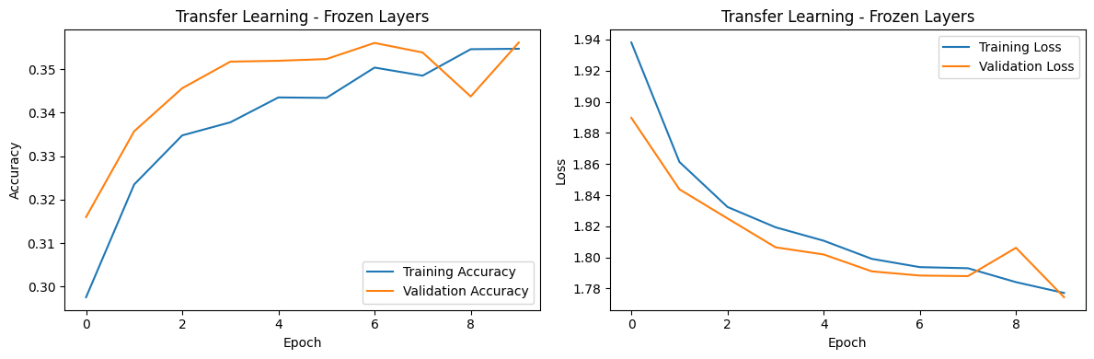
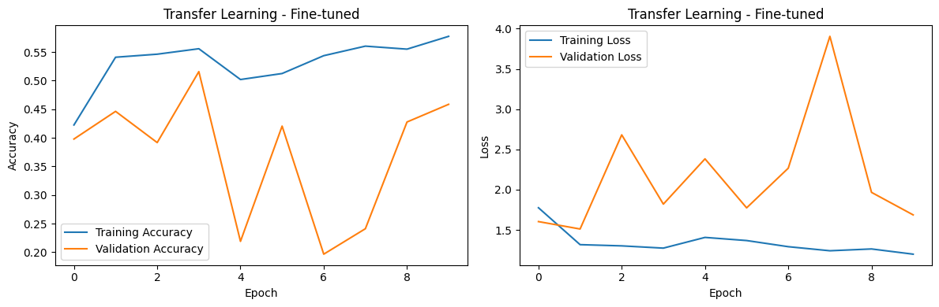
Results of Models Classification
Transfer Learning Vs Training from Scratch
The model with frozen layers achieved a training accuracy of around 35.5% and a test accuracy of approximately 35.6%.
After fine-tuning, the model's training accuracy significantly increased to about 57.7%, with a test accuracy of approximately 45.9%.
A model trained from scratch showed a training accuracy of approximately 71.2% and a test accuracy of around 71.5%.
Fine-tuning significantly improved the model's ability to adapt pre-trained features to the CIFAR-10 task, narrowing the accuracy gap between transfer learning and training from scratch.
Fig 2.0
Fig 3.0

Slide 7
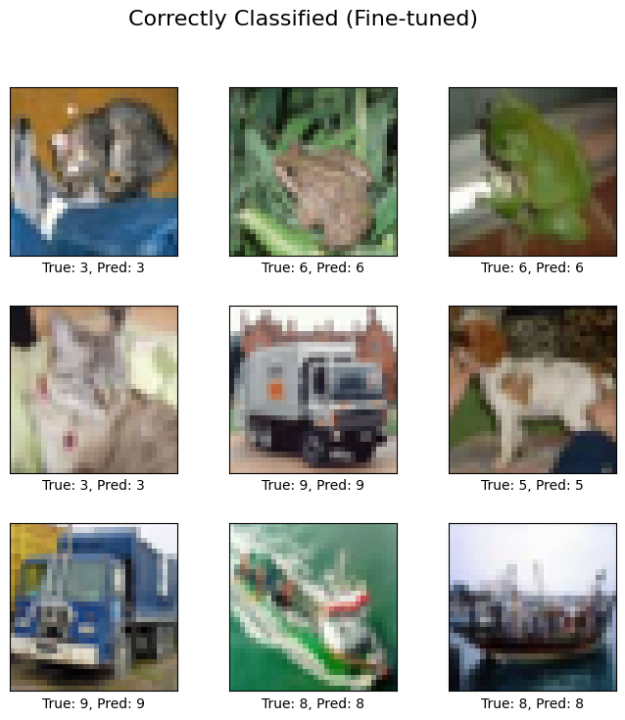
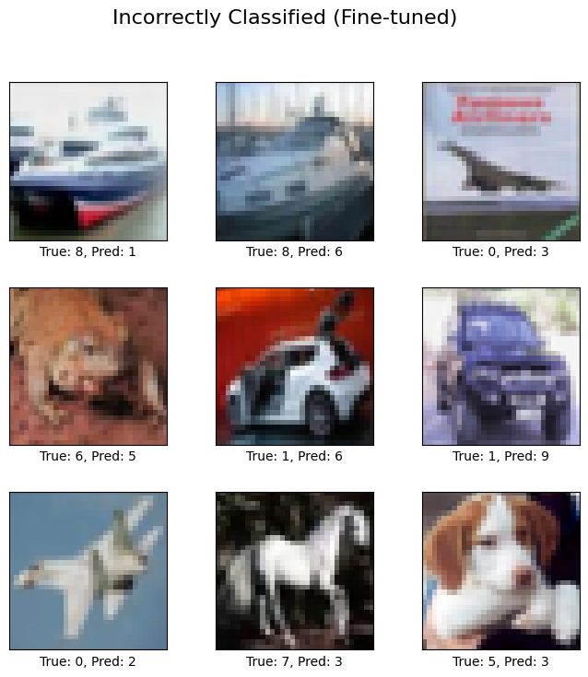
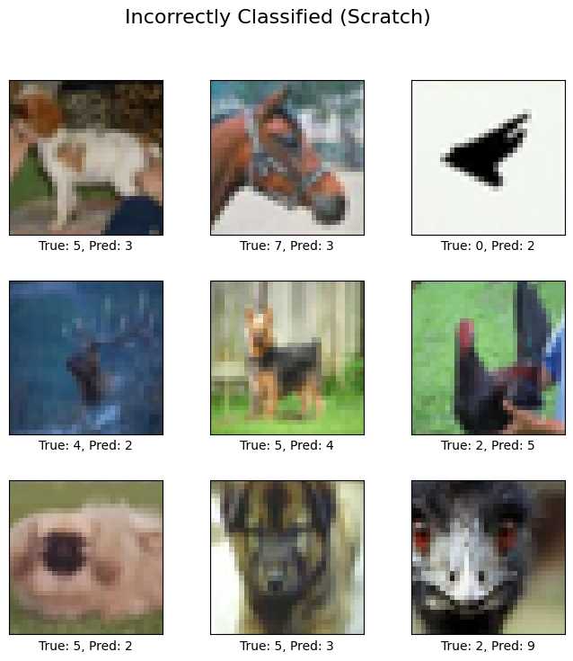
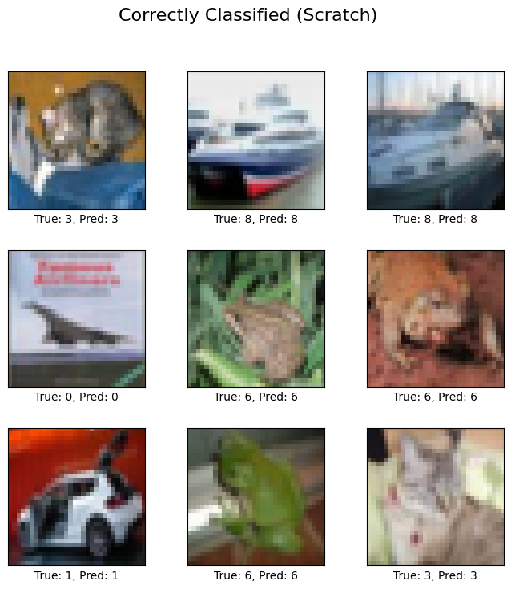
Visualization of Correct and Incorrect Classification
Transfer Learning Vs Training from Scratch
Visualization analysis provides important information about the advantages and disadvantages of each model. Through close inspection of correct predictions, one can learn about the models' strengths, and a thorough analysis of errors might reveal problems or indicate areas that need work.
Fig 4.0
Fig 5.0
Fig 6.0
Fig 7.0

Slide 8
Analysis
Transfer Learning Vs Training from Scratch
While the from-scratch model learned quickly, it finally got closer to being more accurate than both transfer learning methods.
Transfer learning models did not match the performance of the model trained from scratch, even though they started with pre-learned features and needed fewer iterations to converge.
A key factor for resource-constrained settings is that training with frozen and fine-tuned transfer learning models took less time and computational resources than training from scratch.

Slide 9
Limitations & Areas of Improvement
Transfer Learning Vs Training from Scratch
Limitations
The limited size of CIFAR-10, comprising 50,000 training and 10,000 test images, limits the model's capacity to broadly apply intricate patterns.
Issues with domain shift might occur when pre-trained models are biased or are trained on unrelated data to the target domain.
The complexity of CIFAR-10 might not adequately represent the complexities of the real world, which would limit the model's ability to learn.
Areas of Improvement
Assessing the model's resilience and adaptability will need looking at more challenging tasks or datasets.
Regularization techniques, domain adaptation, or additional fine-tuning on more relevant datasets can all help to lessen this issue.

Slide 10
Conclusion
Transfer Learning Vs Training from Scratch
When deciding between training from scratch versus transfer learning several criteria, including task complexity, computational resources, and dataset size, must be considered.
When pre-trained model was fine-tunned and the layer were kept unfrozen, the accuracy of model were increased.
Evaluation of the models' scalability and applicability to real-world events through experimentation on bigger and more varied datasets.
For best model performance, the decision between training from scratch and transfer learning should be based on available datasets, use cases, and computing limitations.

Slide 11
References
Transfer Learning Vs Training from Scratch
Transfer Learning Tutorial https://www.tensorflow.org/tutorials/images/transfer_learning
CIFAR-10 Homepage (https://www.cs.toronto.edu/~kriz/cifar.html)
MobileNetV2 Paper(https://arxiv.org/abs/1801.04381)
https://www.tensorflow.org/tutorials/images/transfer_learning#fine-tune_pre-trained_model
https://keras.io/api/applications/mobilenet/
https://towardsdatascience.com/review-mobilenetv2-light-weight-model-image-classification-8febb490e61c

