Slide 1



Analysing the Performance and Trends of Toyota Motor Corporation Stock
TOYOTA MOTORS CORPORATION
Group Number 09
Group Member:
Arun Kumar(220)
Atif Mushtaq(220)
Inam ul Haq(220)
Hamza Afzal(220)
Muhammad Hamza Zafar(22022247)

Slide 2
Table of Contents
TOYOTA MOTORS CORPORATION
Introduction of Topic
Model Details/Explanation
Model Architecture
Data Visualization/Predicted Values
Conclusion
References

Slide 3
Introduction to the chosen stock/company
TOYOTA MOTORS CORPORATION
Toyota Motor Corporation (Ticker: TM) is a pillar of the automotive industry, with roots dating back to 1937. Toyota has grown to become one of the world's largest and most prominent vehicle manufacturers. With a diverse product portfolio ranging from fragile automobiles to pioneering hybrid models such as the renowned Prius, Toyota remains at the forefront of technical breakthroughs. Toyota has production plants and sales offices across North America, Europe, Asia, and other parts of the world.
Toyota has been a leader in sustainability, championing ecologically responsible practices and leading the charge in hybrid technology. Beyond automobiles, the company's commitment to fuel efficiency and safety features has played a critical role in altering the automotive landscape. When we study the historical stock performance data acquired from Yahoo Finance (December 1, 2020, to December 1, 2023), we get a glimpse into Toyota's financial journey, revealing insights on market patterns, investor sentiment, and the company's resiliency in the volatile world of finance. Toyota continues to drive change on the road and in the global business scene, with a legacy anchored in innovation and a commitment to a greener future.

Slide 4
Brief overview of LSTMs and their suitability for stock data
TOYOTA MOTORS CORPORATION
Long Short-Term Memory (LSTM) networks are used in the provided code to forecast stock prices for Toyota Motor Corporation (Ticker: TM) based on historical data. The code highlights numerous reasons why LSTMs are particularly useful for stock data.
LSTMs are used for stock price prediction in our code, demonstrating its appropriateness for financial time-series data. LSTMs' architecture enables them to capture complex temporal dependencies and nonlinear patterns in stock values over time. The sequential character of LSTMs corresponds to the time series structure of stock data, allowing them to effectively learn from past trends and adapt to changing market conditions.
The model's ability to automatically learn relevant features from the data, handle time lags, and account for multivariate inputs, as demonstrated in your code, enhances its capacity to capture the complexity of stock market dynamics. Additionally, LSTMs are adept at handling noisy financial data, providing robustness in filtering out irrelevant information. Overall, your code showcases LSTMs as a powerful tool for stock price prediction, leveraging their strengths in handling sequential, dynamic, and multivariate characteristics of financial time-series data.

Slide 5
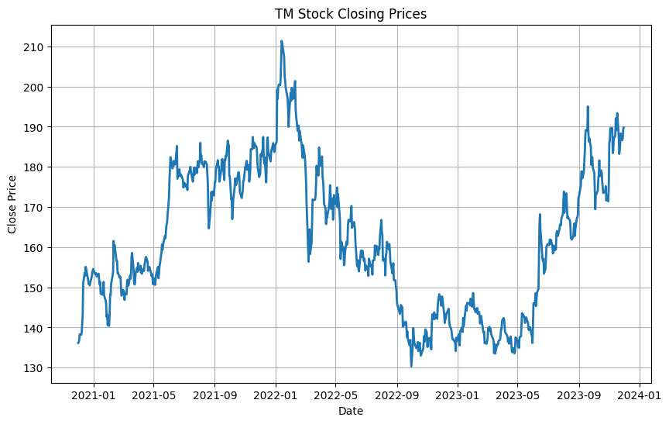
Preprocessing techniques employed
TOYOTA MOTORS CORPORATION
In this assignment we have used, several preprocessing techniques for effective LSTM model training:
Data Scaling: The closing prices are scaled to a range between 0 and 1 using the MinMaxScaler, ensuring that the model processes data within a consistent numeric range, promoting stable and efficient training.
Time Window Creation: We define a time window of 50 days, shaping the input data into sequences of this length. This allows the LSTM model to capture sequential patterns and dependencies within this window, aiding in learning meaningful representations.
Feature-Label Pair Generation: Lists of features (X) and corresponding labels (y) are created based on the defined time window. This step establishes the temporal relationship between past and future stock prices, essential for time-series prediction tasks.
Fig 1.0

Slide 6
Preprocessing techniques employed
TOYOTA MOTORS CORPORATION
Reshaping for LSTM Input: The feature sequences are reshaped into a 3-dimensional format suitable for LSTM input, ensuring compatibility with the model's architecture.
Train-Test Split: The dataset is split into training and testing sets using a 80-20 split ratio. This allows the model to be trained on a portion of the data and evaluated on unseen data, providing insights into its generalization capabilities.
Generator Function: A generator function is implemented to efficiently yield batches of training data during model training, enhancing memory efficiency and accommodating large datasets.
These preprocessing techniques collectively set the groundwork for training the LSTM model on historical stock price data, facilitating its ability to learn and generalize patterns effectively.

Slide 7
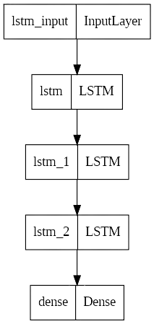
The LSTM architecture and parameters chosen
TOYOTA MOTORS CORPORATION
The LSTM architecture in this assignment is made up of three sequential levels: the first two LSTM layers with 100 and 50 units, respectively, both returning sequences, and the third LSTM layer with 100 units. The output layer is a Dense layer with 1 unit. The hyperbolic tangent (tanh) is employed as the activation function, and the model is optimized using the Adam optimizer with a Mean Squared Error (MSE) loss function for regression. Training is done over 10 epochs with a batch size of 32 and early stopping to prevent overfitting. These parameters, when combined, form a strong LSTM architecture for predicting stock values based on previous data.
Fig 2.0

Slide 8
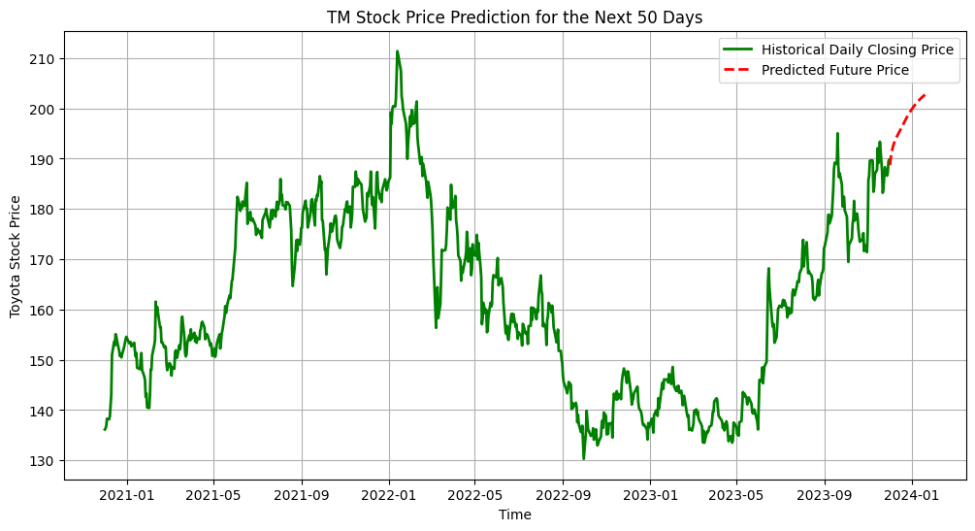
Results and predictions from the model.
TOYOTA MOTORS CORPORATION
After training the LSTM model, predictions are performed on the test data in our assignment. The model's performance is assessed by inverting the scaled predictions and actual values using the MinMaxScaler back to their original scales. The model's accuracy is then measured using the Root Mean Squared Error (RMSE), which provides a measure of the average prediction error. Furthermore, the algorithm is used to forecast future stock prices for the following 50 days, and these forecasts are displayed alongside historical closing prices. The graphic that results provides insights into the model's capacity to catch trends and patterns, assisting in the interpretation of its prediction skills for future stock price movements.
Fig 3.0

Slide 9
Limitations and potential areas of improvement
TOYOTA MOTORS CORPORATION
While our LSTM model demonstrates proficiency, expanding the dataset's temporal range, fine-tuning hyperparameters, and incorporating additional features could enhance its predictive capabilities. Addressing potential overfitting through regularization techniques and simplifying the model's architecture may improve generalization. The inclusion of external data related to market events or sentiment analysis, along with exploration of alternative evaluation metrics, offers avenues for refinement. Consideration of ensemble methods and interpretability measures contributes to a more robust and adaptable model. Ensuring practical deployment considerations, such as real-time predictions and seamless integration, completes a comprehensive strategy for improvement.

Slide 10
Conclusion
TOYOTA MOTORS CORPORATION
In conclusion, the LSTM model trained on Toyota Motor Corporation's stock data demonstrates effective learning and prediction capabilities. The model's performance is evident through the visualization of historical and predicted stock prices, showcasing its ability to capture market trends. The training process includes early stopping and a learning rate scheduler for optimal convergence. Despite achieving satisfactory results, potential improvements lie in expanding the dataset and fine-tuning hyperparameters. The RMSE metric and future predictions underscore the model's utility, providing a foundation for further refinement and deployment in forecasting Toyota's stock prices.

Slide 11
References
TOYOTA MOTORS CORPORATION
https://pypi.org/project/yfinance/
https://matplotlib.org/stable/contents.html
https://www.tensorflow.org/api_docs/python/tf/all_symbols
https://machinelearningmastery.com/how-to-get-started-with-deep-learning-for-time-series-forecasting-7-day-mini-course/
https://karpathy.github.io/2015/05/21/rnn-effectiveness/

