Slide 1
Floyd-Warshall Algorythm

Slide 2
Brief explanation (Serial code)
Floyd-Warshall is an algorithm for finding the shortest paths between all pairs of vertices in a weighted graph, with positive or negative edge weights (but without negative cycles). It is a dynamic programming algorithm that solves subproblems by computing the shortest path between each pair of vertices using only intermediate vertices from a subset of all vertices.
The algorithm maintains a matrix dist of size n x n, where n is the number of vertices in the graph. dist[i][j] is the shortest distance between vertices i and j. Initially, dist[i][j] is set to the weight of the edge between vertices i and j (if there is an edge), and dist[i][j] is set to infinity if there is no edge between i and j.

Slide 3
The algorithm then considers each vertex k in turn, and for each pair of vertices i and j, it checks whether the path from i to j through k is shorter than the path currently known from i to j. If it is, the algorithm updates the dist matrix with the new shortest path.
The algorithm runs in O(n^3) time, where n is the number of vertices in the graph. It is simple to implement and is guaranteed to find the shortest paths between all pairs of vertices, as long as there are no negative cycles in the graph.

Slide 4
In the code the function takes as input a pointer to the graph represented as a one-dimensional array of integers, and the number of vertices . The function modifies the input graph in place to represent the shortest path between all pairs of vertices.
The function iterates over all possible intermediate vertices k and updates the shortest path between vertices i and j as graph[ij] = min(graph[ij], graph[ik] + graph[kj]). The indices ik, kj, and ij are calculated to access the correct elements of the one-dimensional array.

Slide 5
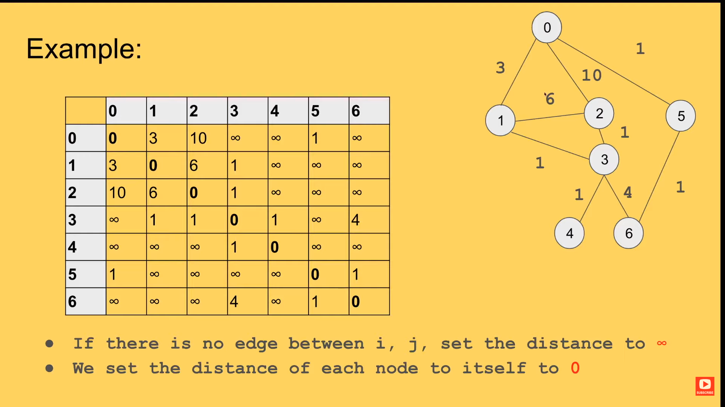
Example

Slide 6
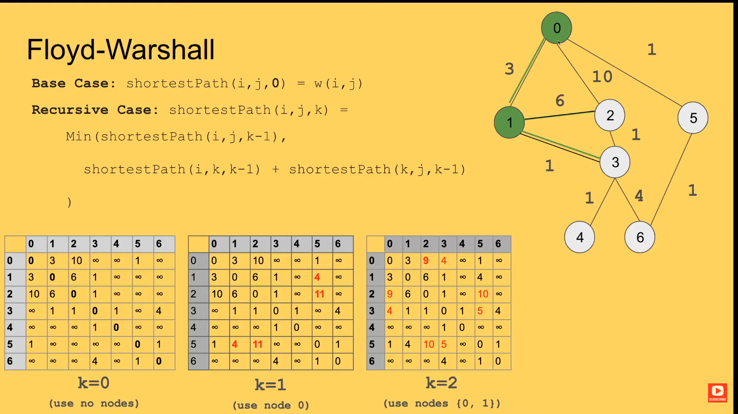

Slide 7
OpenMP
The OpenMP version of the Floyd-Warshall algorithm parallelizes the outermost loop using OpenMP's parallel for directive, which distributes the iterations of the loop across available threads. Each thread executes its assigned portion of the loop in parallel. The collapse clause is used to collapse the nested loops into a single loop, which allows OpenMP to distribute the work more evenly across threads.
The shared clause is used to specify that the graph matrix is shared among all threads, while the i, j, and k loop variables are private to each thread.
The schedule(static) clause specifies that the iterations are statically scheduled across threads, with each thread getting a contiguous subset of the loop iterations.
The code also includes a call to omp_get_wtime() before and after the floydWarshall function, which returns the current wall-clock time in seconds. This is used to calculate the elapsed time for the execution of the function.
The parallel region is before the outermost loop to increase the performance as the parallel region will be created only once.

Slide 8
CUDA
We allocate memory on the device for the graph using cudaMalloc and we copied the graph from the host to the device using cudaMemcpy . We did not use cudaMallocManaged as it caused lots of problems.
We perform the Floyd-Warshall algorithm on the device using CUDA kernels. The kernels execute in parallel on the GPU and are called in a nested loop structure to compute the shortest path matrix.
After executing the kernel we copied the resulting shortest path matrix from the device to the host using cudaMemcpy.
Free the memory allocated on the device using cudaFree.

Slide 9
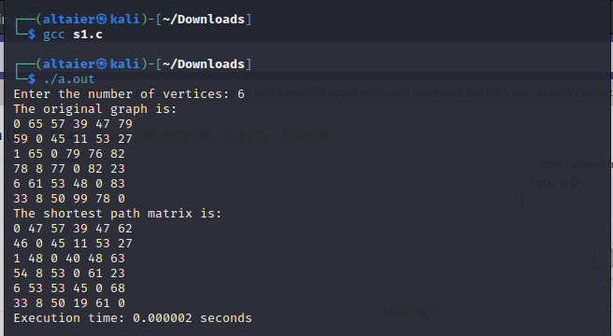
Test Case 1: -A: The serial version with 6 vertices

Slide 10
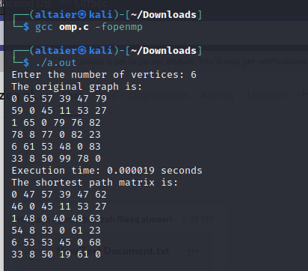
Test Case 1: -B: The omp version with 6 vertices:

Slide 11
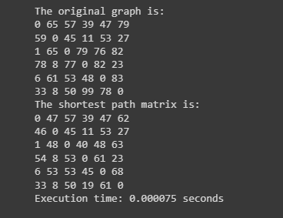
Test Case 1: -C: The CUDA version with 6 vertices.

Slide 12
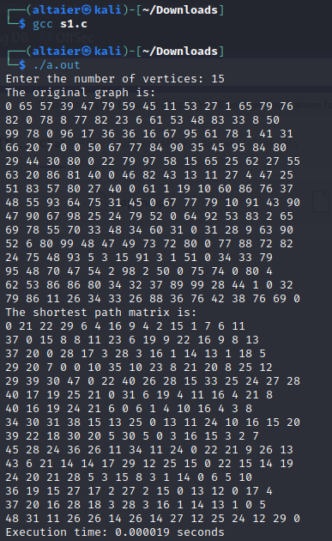
Test Case 2: -A: The serial version with 15 vertices

Slide 13
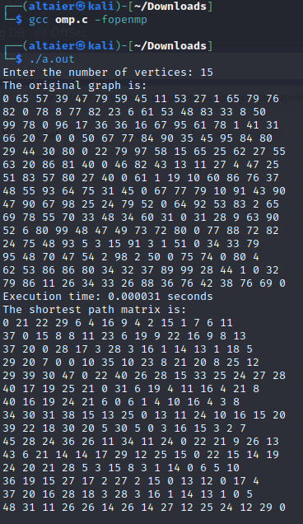
Test Case 2: -B: The omp version with 15 vertices:

Slide 14
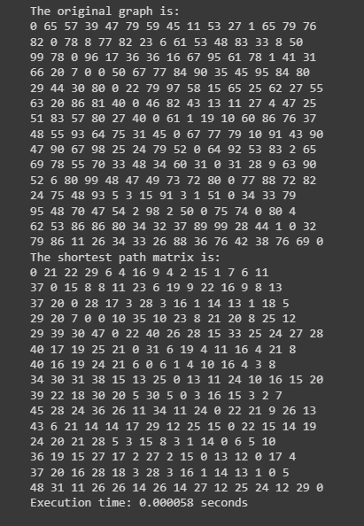
Test Case 2: -C: The CUDA version with 15 vertices.

Slide 15
Time Comparison
Code Version / Test Size | Vertices = 15 | Vertices = 6
Serial Version | 0.000019s | 0.000002s
OMP with 4 Threads | 0.000434s | 0.000356s
OMP with 8 Threads | 0.000419s | 0.000531s
CUDA | 0.000058s | 0.000075s

