Slide 1



Princess Sumaya University for Technology
King Hussein School for Computing Sciences
BridgeLocal
Empowering Jordanian Manufacturers
Prepared By:
Rafeeq Al-Shareef 20190179
Mohammad Abuayyash 20200560
Hussam Jabban 20200920
Hamzeh Nsirat 20190725
Supervised By: Dr. Raghda Hraiz

Slide 2
BridgeLocal
Empowering Jordanian Manufacturers
Problem Statement
Bridge Local aims to enhance market access for Jordanian local manufacturers by developing a web application that increases product visibility and streamlines the purchasing process. This platform seeks to boost local producers' growth and expand the local economy by offering high-quality local products to retailers and customers.

Slide 3
BridgeLocal
Empowering Jordanian Manufacturers
Our Approach
By enabling local manufacturers in Jordan, the Bridge Local online application aims at bridging this gap. It seeks to give businesses a strong platform on which to present their goods, interact with merchants directly, and thereby increase their market share. By streamlining the sales process of local products to retailers, this platform hopes to support the expansion of local businesses and provide retailers with a wide selection of goods.

Slide 4
BridgeLocal
Empowering Jordanian Manufacturers
Related Work
Faire
Jungleworks
RangeMe

Slide 5
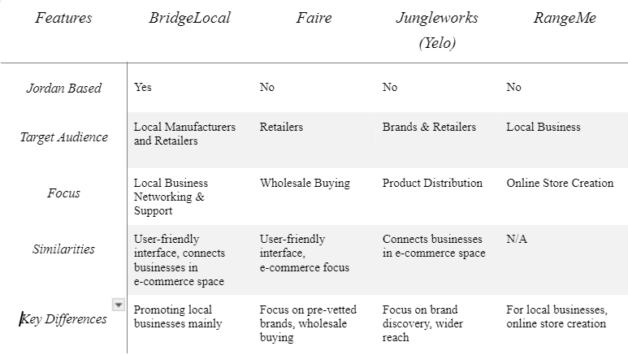
BridgeLocal
Empowering Jordanian Manufacturers
Related Work

Slide 6
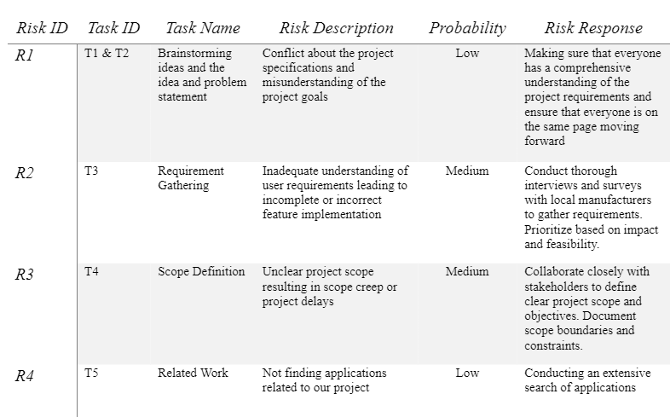
BridgeLocal
Empowering Jordanian Manufacturers
Project Plan

Slide 7
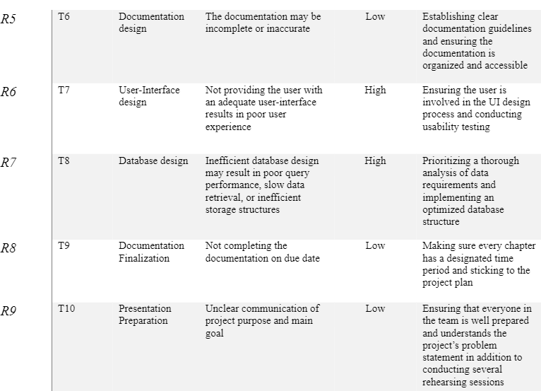
BridgeLocal
Empowering Jordanian Manufacturers
Project Plan

Slide 8



BridgeLocal
Empowering Jordanian Manufacturers
Stakeholders
Adminstrator
Retailer
Supplier

Slide 9

BridgeLocal
Empowering Jordanian Manufacturers
Functional Requirements
User Sign up
Apply Penalties
User Login
View Complaints
Dashboard
View Users
Forget Password
Upload Products
User Logout
View Profile Insights
Navigation Menu
Send Quotation
Request Quotation
View Dashboard
Monitor Purchase Status

Slide 10
BridgeLocal
Empowering Jordanian Manufacturers
Non-Functional Requirements
Usability
Performance
Security
Reliability
Scalability
Maintainability

Slide 11
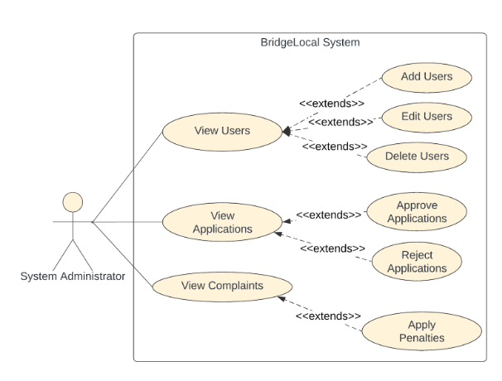
BridgeLocal
Empowering Jordanian Manufacturers
Use Case Diagrams

Slide 12
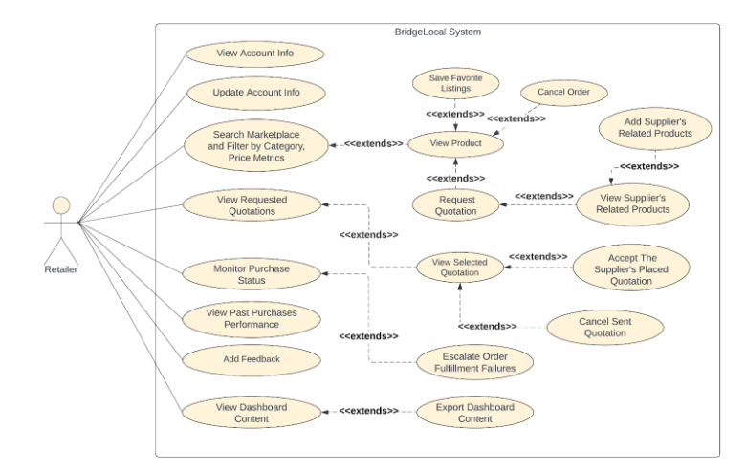
BridgeLocal
Empowering Jordanian Manufacturers
Use Case Diagrams

Slide 13
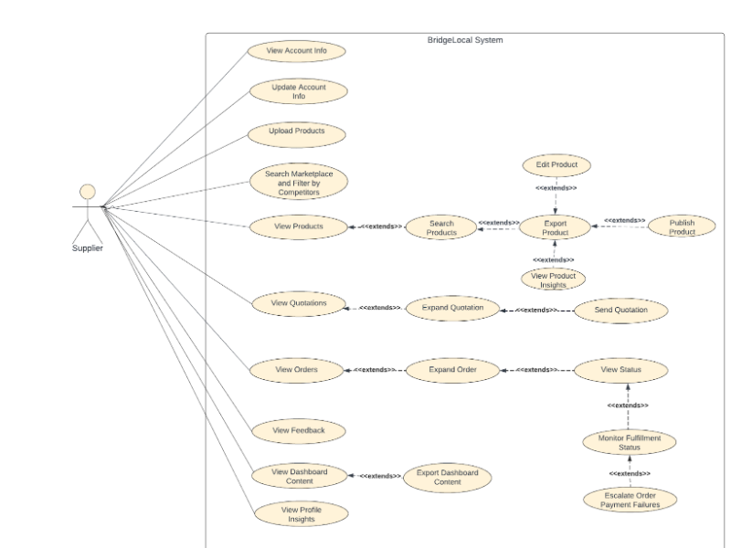
BridgeLocal
Empowering Jordanian Manufacturers
Use Case Diagrams

Slide 14
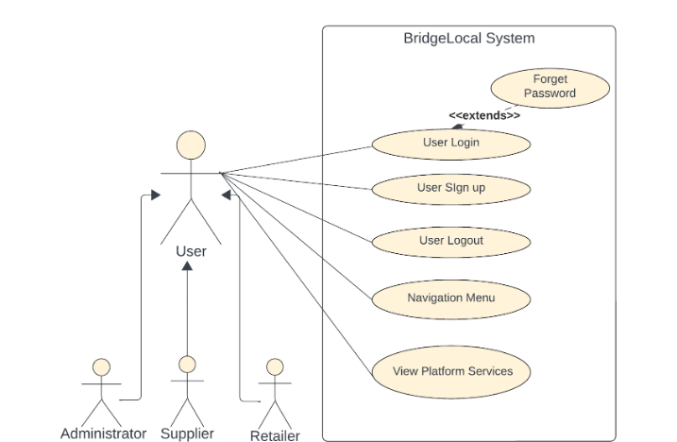
BridgeLocal
Empowering Jordanian Manufacturers
Use Case Diagrams

Slide 15
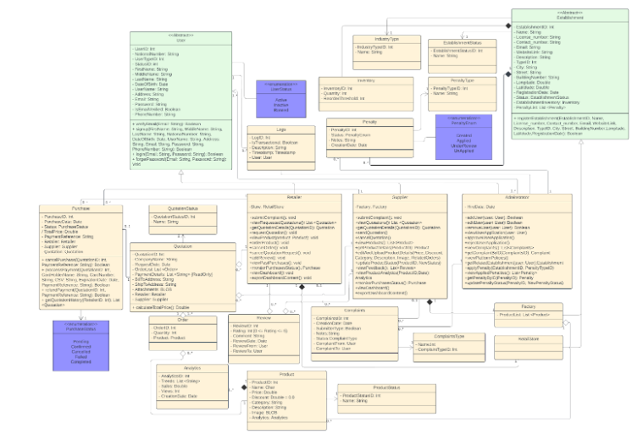
BridgeLocal
Empowering Jordanian Manufacturers
Class Diagram

Slide 16
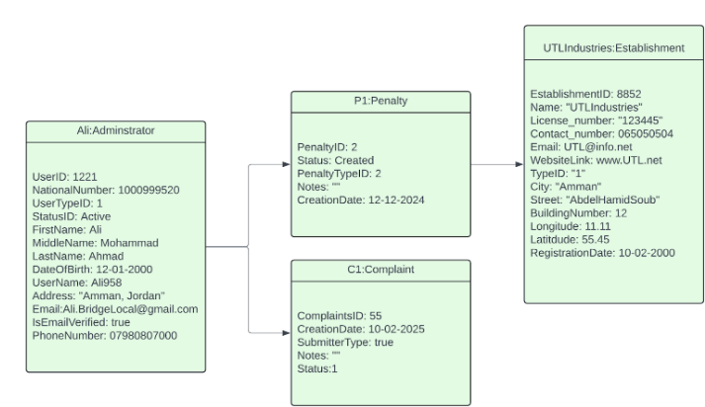
BridgeLocal
Empowering Jordanian Manufacturers
Object Diagrams

Slide 17
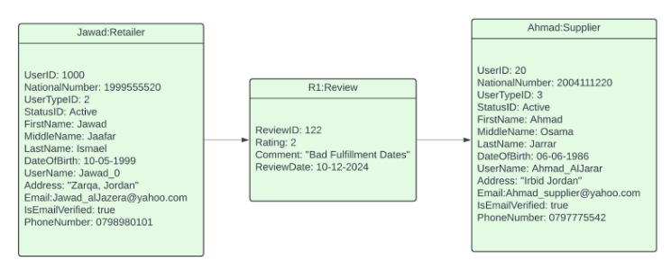
BridgeLocal
Empowering Jordanian Manufacturers
Object Diagrams

Slide 18
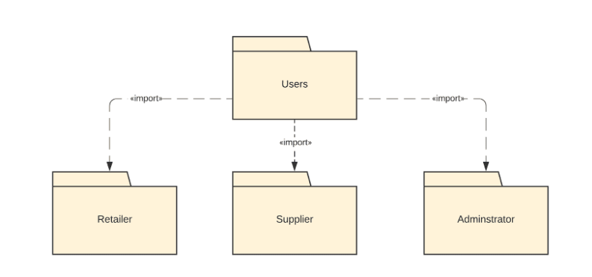
BridgeLocal
Empowering Jordanian Manufacturers
Package Diagrams

Slide 19
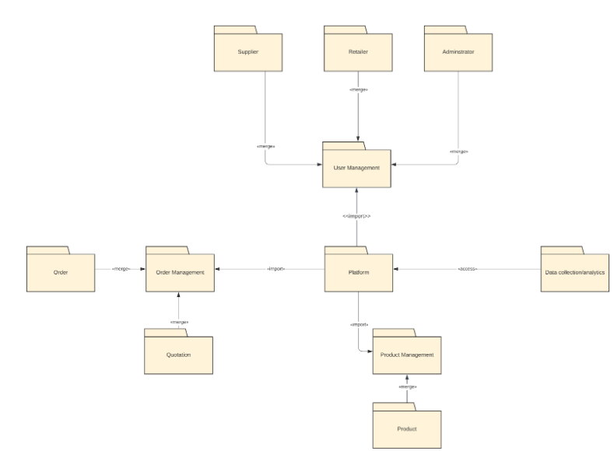
BridgeLocal
Empowering Jordanian Manufacturers
Package Diagrams

Slide 20
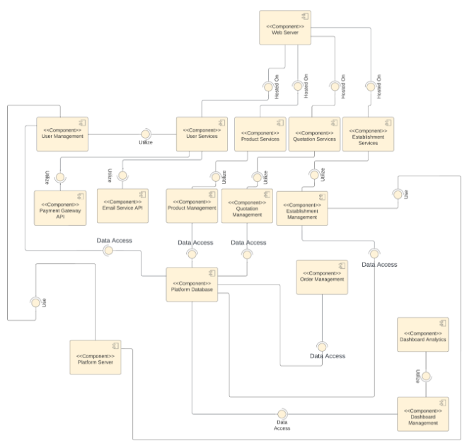
BridgeLocal
Empowering Jordanian Manufacturers
Component Diagram

Slide 21
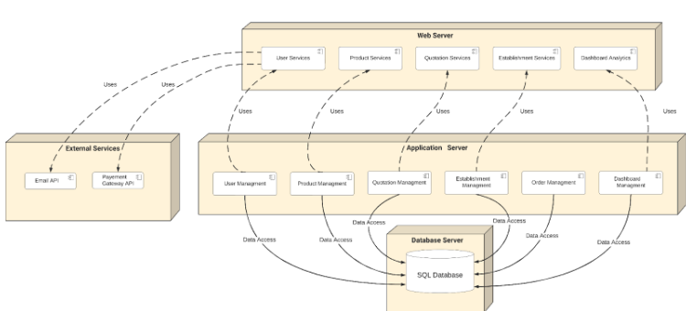
BridgeLocal
Empowering Jordanian Manufacturers
Deployment Diagram

Slide 22
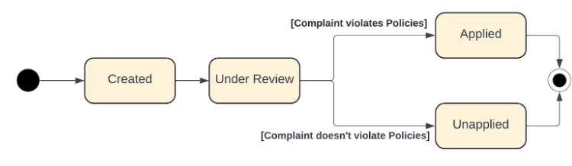
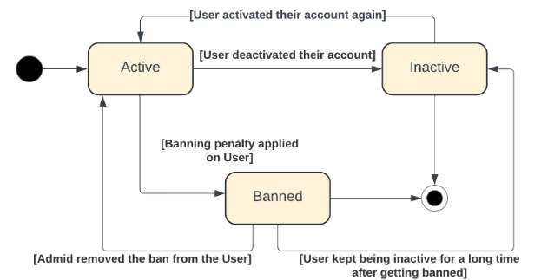
BridgeLocal
Empowering Jordanian Manufacturers
State Transitions Diagram

Slide 23
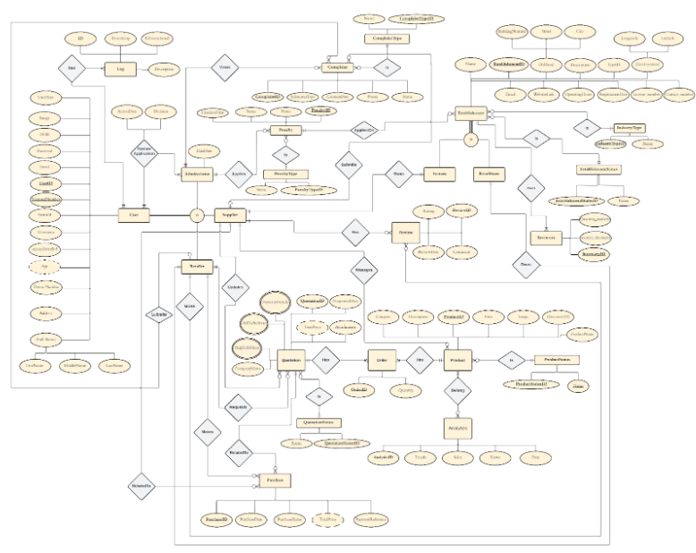
Princess Sumaya University for Technology
King Hussein School for Computing Sciences
Entity Relationship Diagram

Slide 24
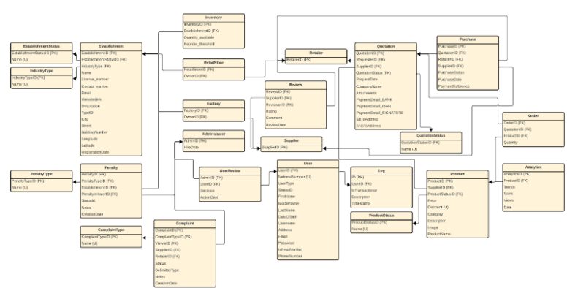
Princess Sumaya University for Technology
King Hussein School for Computing Sciences
Relational Schema

Slide 25

Princess Sumaya University for Technology
King Hussein School for Computing Sciences

Slide 26
Thanks!

