Slide 1
Bridging the Gap between Man and Machine
The Human Brain
Microprocessor System

Slide 2
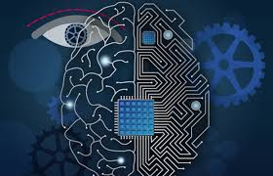
The figure to the right shows the human brain and a microprocessor chip.
The human brain can be considered as the powerhouse of the human body.
The microprocessor system is the powerhouse of the microcomputer.
The brain have similarities in the way they function, and deal with certain tasks.
In the accompanying slides, a detailed outline is provided showing the different
parts of the brain, and parts of the microprocessor which have similar
functionality.

Slide 3
The animation below provides a detailed view of
transistors in a microcomputer system. They provide
the lowest level of connection in the microprocessor
just like neurons in the brain. They are the building
blocks of a computer.
The animation above shows the neurons in the brain. They are responsible for
moving information in and out of the brain. Just like transistors they are
responsible for regulating the activities in the brain. They transmit information to
other neurons, muscles, and different body parts.

Slide 4
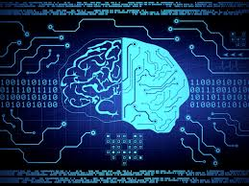
Information in the microprocessor is transferred using binary.
The same method is used in the brain to transfer information,
this can be drawn from the fact that information is transferred
in an all or none fashion.
When using binary encoding to transfer information in the
Microprocessor, the voltage levels are represented using 1’s
and 0’s which is the same method of functionality in the brain.

Slide 5
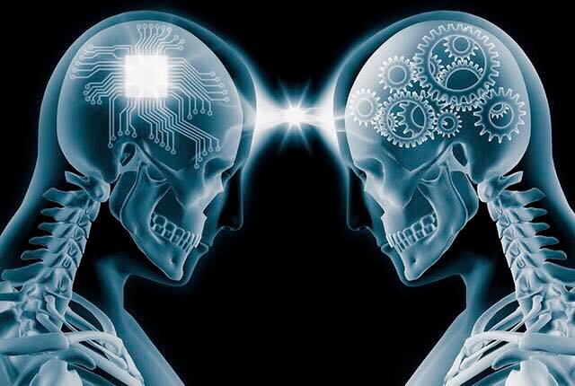
The neuroimmune system functions in a similar way as the
main memory-cache memory system. In the computer, when
a program requires memory access it checks the cache
memory first. If the content is not in the cache memory,
then it goes to the main memory, and put the content in the
cache afterwards. The neuroimmune
system remembers disease pathogens which have attacked
the immune system in the past. Hence making
it have a quicker response to the pathogen in the future.

Slide 6
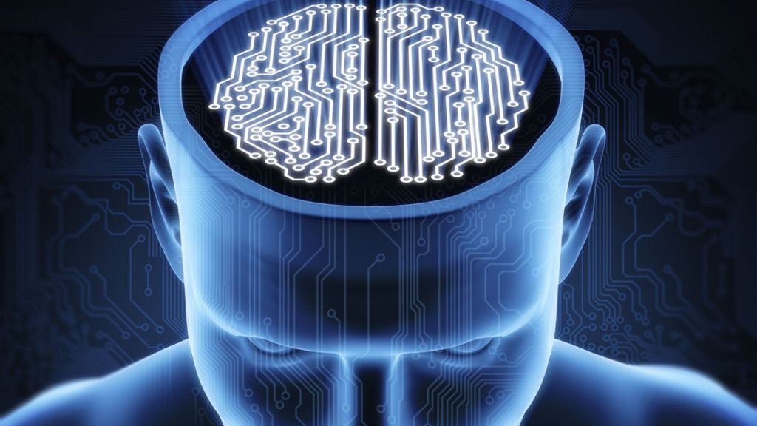
In order to save energy, the brain and microprocessor goes
to sleep. The human brain requires sleep for it to function
properly and at maximum capacity. In the ARM processor
you have the wait for event (WFE), and wait for interrupt
WFI. When the processor is idle it goes to sleep to save
power consumption. The WFI ,and WFE are required to take
it out of sleep state. This is similar to human brain, in that
we can either set an alarm clock to wake us up, or do it on
our own.

Slide 7
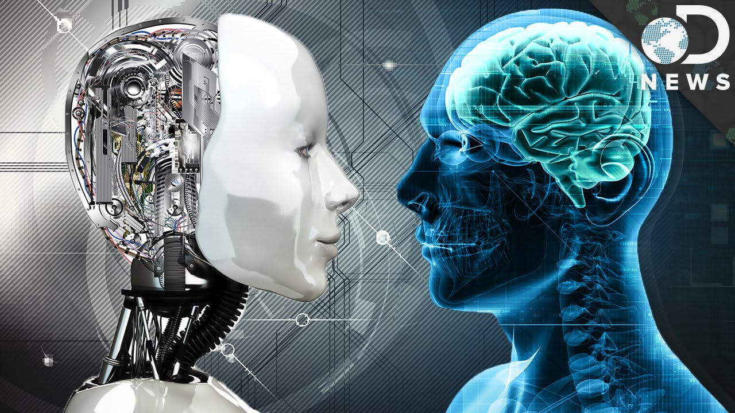
CONCLUSION

