Slide 1


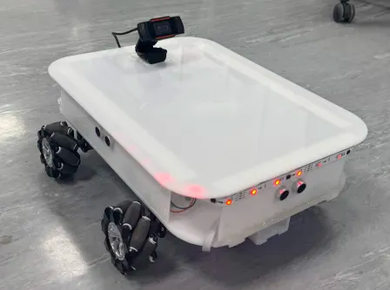
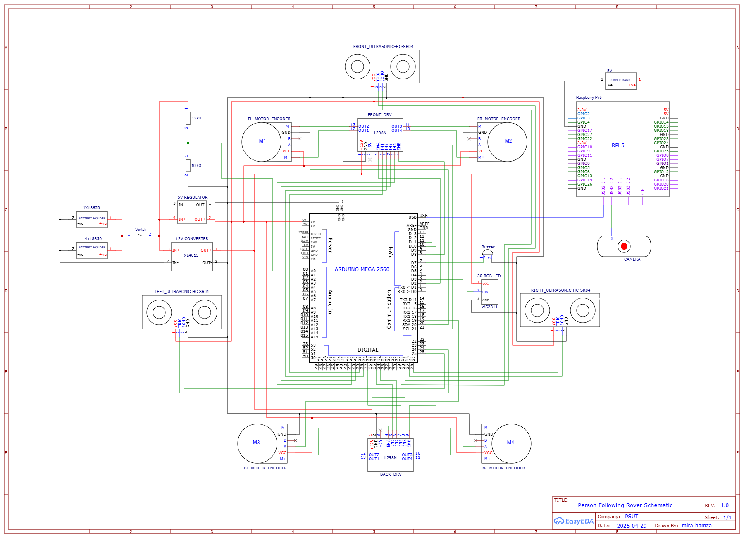
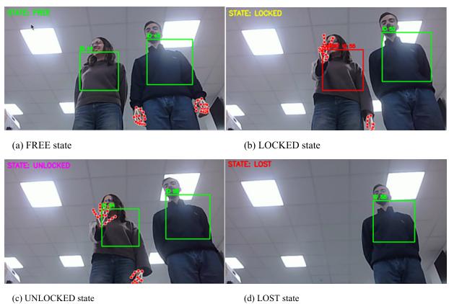
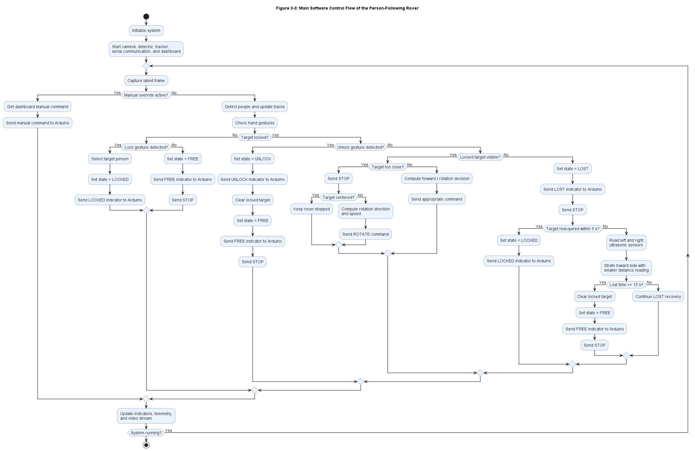
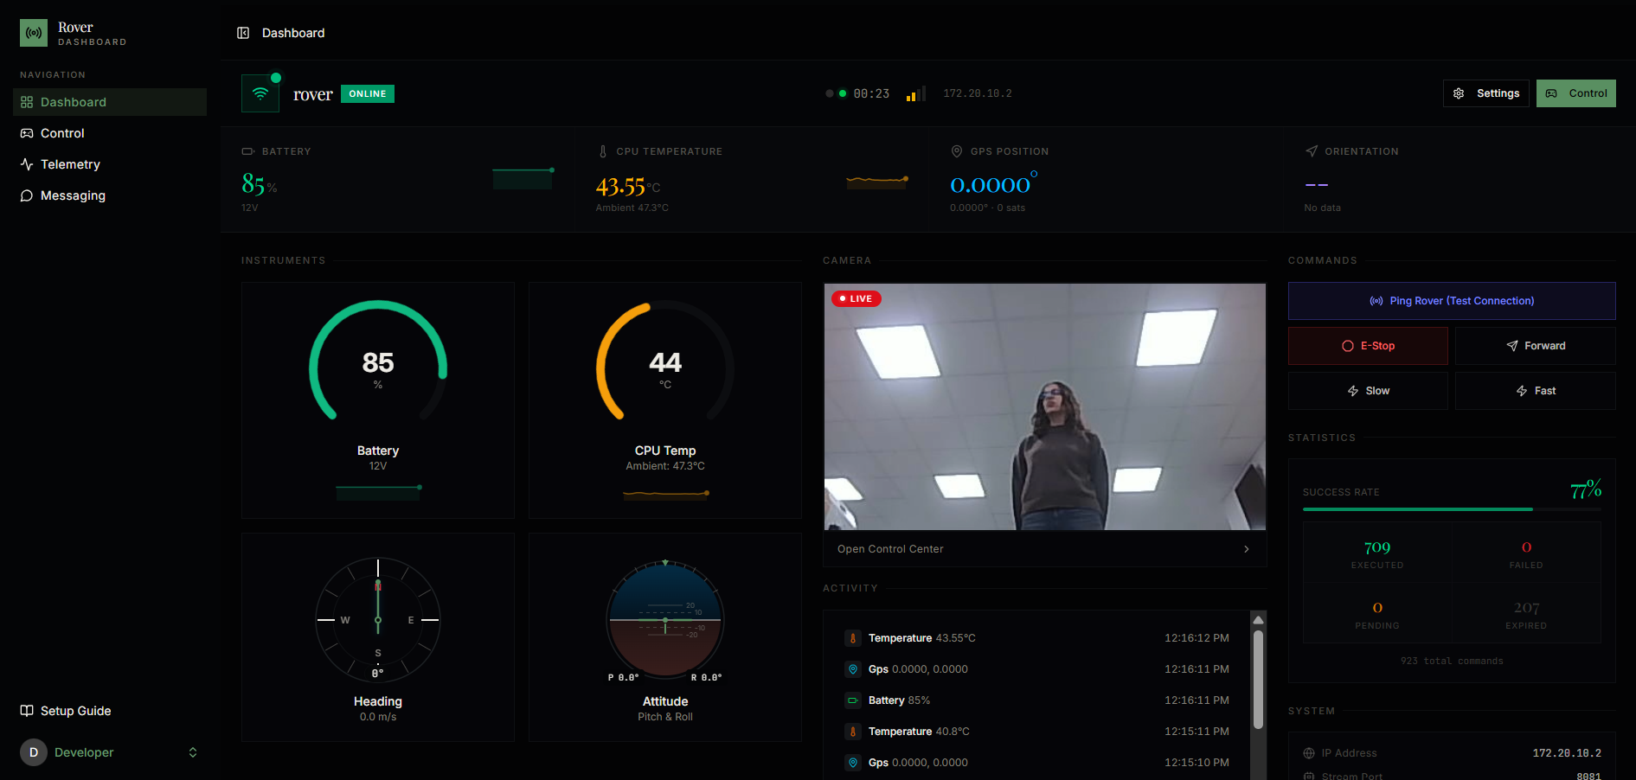
Design and Implementation of an IoT-Enabled Rover for Person Following
H. Bodair and M. Hindawi
Supervisor: Prof. Esam Qaralleh
Senior Design Project, Spring 2026
Introduction
This project presents an IoT-enabled mecanum-wheel rover designed to autonomously follow a selected person in an indoor environment using onboard vision. The motivation behind the system is to combine autonomous mobility, safe navigation, and remote monitoring into a single low-cost embedded platform. A Raspberry Pi 5 performs the high-level processing tasks, including person detection, target tracking, gesture-based locking and unlocking, movement decision-making, and dashboard communication. An Arduino Mega handles the low-level hardware tasks, including motor control, ultrasonic obstacle safety, battery telemetry, and LED/buzzer state feedback. The cloud dashboard allows users to view live video, monitor rover telemetry, and manually override autonomous control when needed.
Results
The prototype successfully detected and locked onto a target person, followed the target during straight and lateral movement, stopped when the target became too close, and activated obstacle stopping at 38 cm. The LOST state stopped the rover, activated LED/buzzer feedback, attempted recovery, and returned to FREE after timeout. The dashboard displayed telemetry, live video, rover status, and manual control. The rover operated for more than one hour during testing.
Figure 3: Final Assembled Prototype of the Person-Following Rover
Figure 4: Camera Detection and Tracking Output During Target Locking
Figure 5: IoT Dashboard Interface containing Telemetry
Design
The system is divided into three main layers: perception and decision-making, actuation and sensing, and IoT communication. The Raspberry Pi processes camera frames using YOLOv8n, ByteTrack, and MediaPipe hand landmarks. A peace-sign gesture locks the target, while an open-palm gesture unlocks it. Movement commands are sent to the Arduino through USB serial. The Arduino controls the mecanum wheels through L298N drivers, reads ultrasonic sensors for obstacle safety, monitors battery voltage, and controls the LED/buzzer indicators.
Figure 1: Person Following Rover (Hardware Schematic)
Figure 2: Main Software Control Flow of the Person-Following Rover
Conclusion
This project shows that person-following behavior can be achieved using affordable embedded hardware when vision, motion control, safety sensing, and IoT communication are integrated properly. The main value of the system is not only that the rover can follow a person, but that it can select the intended target through a natural gesture, operate with local safety decisions, and remain observable and controllable through a remote dashboard. This makes the design suitable as a foundation for indoor assistive, monitoring, and service-robot applications. Future development can focus on improving long-term target reacquisition, reducing dashboard video latency, and expanding obstacle coverage for safer operation in more complex environments.

