Slide 1
Tutorial 8
TCP Review
Slides by Han Kim

Slide 2
Overview
A tutorial to help with PA4
Start early! PA4 is HARD!!!
You have to implement a transport protocol
Topics for today:
  Introduction to PA4
  TCP review
TCP connection setup and shutdown
Sequence and ACK numbers
Retransmission
TCP segments
  TCP with Wireshark

Slide 3
Previous PAs
Client host
Server host
Client
Server
Notes:
Previous PAs focused on implementing a client or server..

Slide 4
Previous PAs
In previous PAs, we focused on implementing the client…
Client host
Server host
Client
Server
…or the server

Slide 5
PA4: Implement (Simplified) TCP
localhost
localhost
Sender
Receiver
Notes:
…but PA4 focuses on implementing the actual transport-layer protocol

Slide 6
PA4: Implement (Simplified) TCP
In PA4, we go one layer deeper and implement a transport protocol…
localhost
localhost
Sender
Receiver
…which will resemble TCP

Slide 7
PA4: Implement (Simplified) TCP
localhost
localhost
Sender
Receiver
- Congestion control
- Bidirectional
- Adaptive timeout
- ...
+ Simplicity
+ Fixed timeout
Notes:
Instead of full version of TCP, we will implement simplified version of TCP. This version doesn’t have congestion control or bidirectional data transfer. We’ll also use a fixed timeout.

Slide 8
PA4: Implement (Simplified) TCP
But do not worry too much
It is a simplified version of TCP
localhost
localhost
Sender
Receiver
- Congestion control
- Bidirectional
- Adaptive timeout
- ...
+ Simplicity
+ Fixed timeout
Many TCP features are removed

Slide 9
PA4: Implement (Simplified) TCP
localhost
localhost
sender
receiver
Notes:
This is our starting point. A sender and a receiver, with the protocol still to be implemented

Slide 10
PA4: Implement (Simplified) TCP
localhost
localhost
This is what we have at the beginning
The protocol is not implemented yet
sender
receiver

Slide 11
PA4: Implement (Simplified) TCP
localhost
localhost
sender
receiver
Notes:
The protocol logic lives inside the sender, so the actual implementation happens here

Slide 12
PA4: Implement (Simplified) TCP
localhost
localhost
sender
receiver
The protocol logic lives inside the sender, so the actual implementation happens here

Slide 13
PA4: Implement (Simplified) TCP
localhost
localhost
sender
receiver
Notes:
We’ll use UDP as the base for building STCP

Slide 14
PA4: Implement (Simplified) TCP
localhost
localhost
sender
receiver
UDP is used as the base for building STCP

Slide 15
PA4: Implement (Simplified) TCP
localhost
localhost
sender
receiver
+ Connection setup (SYN)
Notes:
First, we add connection setup using SYN

Slide 16
PA4: Implement (Simplified) TCP
localhost
localhost
1
sender
receiver
3
2
4
+ Connection setup (SYN)
+ Sequence number
Notes:
Next, we add sequence numbers to track the data and its order

Slide 17
PA4: Implement (Simplified) TCP
localhost
localhost
1
sender
receiver
3
2
3
4
+ Connection setup (SYN)
+ Sequence number
+ Retransmission
Notes:
We also add retransmission to recover lost packets

Slide 18
PA4: Implement (Simplified) TCP
localhost
localhost
sender
receiver
1
2
3
4
Notes:
So, when we put all these together, we get reliable and ordered delivery over UDP.
Now it starts to look like TCP

Slide 19
PA4: Implement (Simplified) TCP
localhost
localhost
At the end, we will have something that resembles TCP
sender
receiver
1
2
3
4

Slide 20
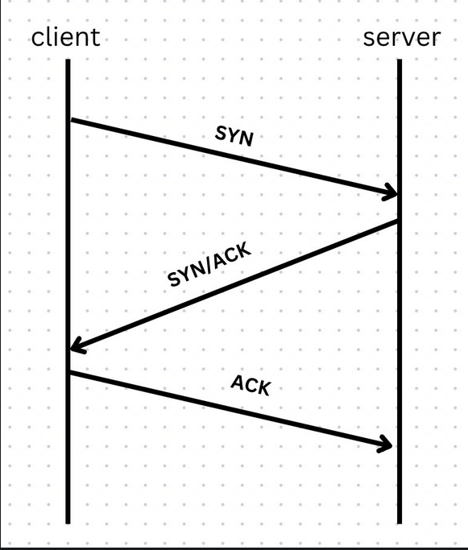
TCP Review: Connection Establishment
What additional information is sent with the SYN/ACK flags set
Why are the three steps necessary?
Notes:
1. Let’s review how TCP sets up a connection. What information do we send along with SYN and ACK flags?

Slide 21
TCP Review: Connection Establishment
What additional information is sent with the SYN/ACK flags set
Initial sequence number (ISN)
Why are the three steps necessary?
Notes:
We send an initial sequence number. This tells the other side where our byte number starts
Second question. Why do we need three steps?

Slide 22
TCP Review: Connection Establishment
What additional information is sent with the SYN/ACK flags set
Initial sequence number (ISN)
Why are the three steps necessary?
Client ⇒ Server (SYN)
Send client ISN to server
Server ⇒ Client (SYN/ACK)
Server confirms client ISN
Send server ISN to client
Client ⇒ Server (ACK)
Client confirms server ISN
Notes:
First the clients sends ISN. The server acknowledges it and send its own ISN. Then the client acknowledges the server’s ISN

Slide 23
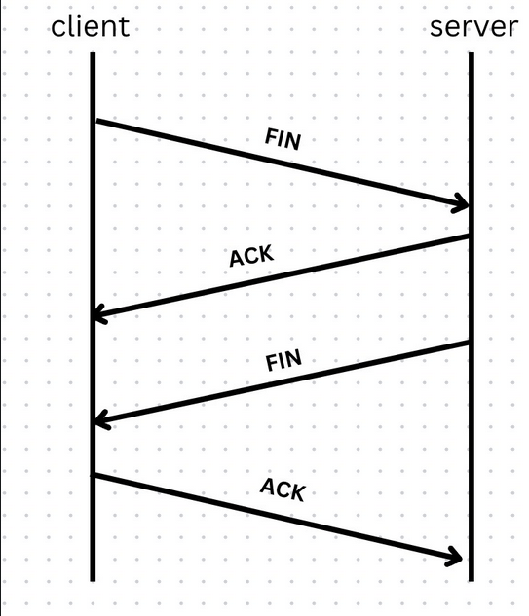
TCP Review: Connection Termination
Why are the four steps necessary?
Notes:
Now, let’s look at the connection termination. Why are the four steps necessary here?

Slide 24
TCP Review: Connection Termination
Why are the four steps necessary?
TCP is Full duplex: both sides can send data independently
Notes:
TCP lets both sides send data independently. So even if one side is done sending, the other side might still have data to send.

Slide 25
TCP Review: Connection Termination
Why are the four steps necessary?
TCP is Full duplex: both sides can send data independently
Client ⇒ Server (FIN)
Client has nothing more to send
Server ⇒ Client (ACK)
Server confirms client FIN
Server ⇒ Client (FIN)
Server has nothing more to send
Client ⇒ Server (ACK)
Client confirms server FIN
Notes:
The client sends FIN, and the server acknowledges it. When the server is also done sending, it sends its own FIN, and the client acknowledges that

Slide 26
TCP Review: Connection Termination
Why are the four steps necessary?
TCP is Full duplex: both sides can send data independently
Client ⇒ Server (FIN)
Client has nothing more to send
Server ⇒ Client (ACK)
Server confirms client FIN
Server ⇒ Client (FIN)
Server has nothing more to send
Client ⇒ Server (ACK)
Client confirms server FIN
Timing for 2 and 3 might be different

Slide 27
TCP Review: Retransmission
A timer is set for the first unacknowledged segment
When the timer expires we retransmit
Retransmit just one segment
Like Selective-Repeat
Cumulative ACKs
Like Go-Back-N
Four or more ACKs with the same number trigger retransmission without a timeout
Fast retransmission
Notes:
Now let’s look at retransmission. TCP keeps a timer for the oldest unacknowledged segment

Slide 28
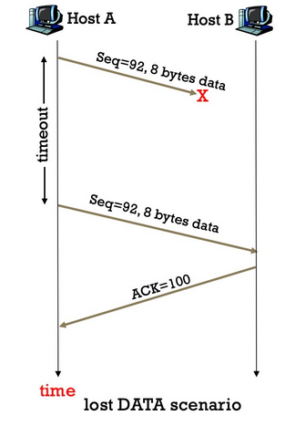
TCP Review: Retransmission
A timer is set for the first unacknowledged segment
When the timer expires we retransmit
Retransmit just one segment
Like Selective-Repeat
Cumulative ACKs
Like Go-Back-N
Four or more ACKs with the same number trigger retransmission without a timeout
Fast retransmission
Notes:
Here, the data segment sent by Host A gets lost. When the timer expires, the sender sends that segment again.

Slide 29
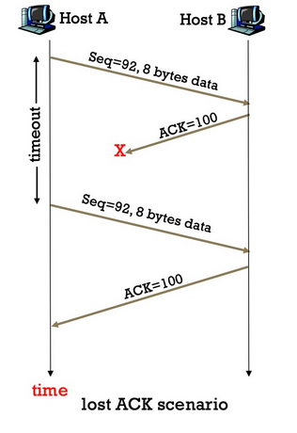
TCP Review: Retransmission
A timer is set for the first unacknowledged segment
When the timer expires we retransmit
Retransmit just one segment
Like Selective-Repeat
Cumulative ACKs
Like Go-Back-N
Four or more ACKs with the same number trigger retransmission without a timeout
Fast retransmission
Notes:
In this scenario, the data sent by Host A successfully arrives, but the ACK gets lost. The sender doesn’t know the data arrived, so it sends the segment again after the timeout

Slide 30
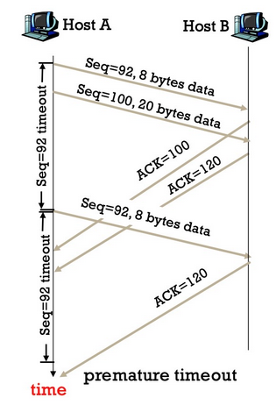
TCP Review: Retransmission
A timer is set for the first unacknowledged segment
When the timer expires we retransmit
Retransmit just one segment
Like Selective-Repeat
Cumulative ACKs
Like Go-Back-N
Four or more ACKs with the same number trigger retransmission without a timeout
Fast retransmission
Notes:
Here the timeout happens before the ACK arrives. Notice that the sender retransmits just the first unacknowledged segment

Slide 31
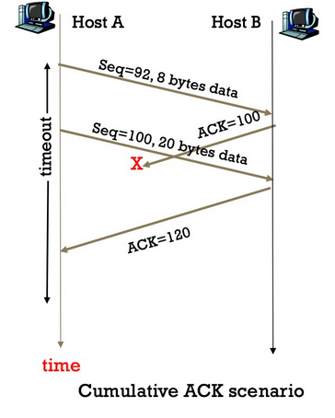
TCP Review: Retransmission (Module 4.7 p.6-15)
A timer is set for the first unacknowledged segment
When the timer expires we retransmit
Retransmit just one segment
Like Selective-Repeat
Cumulative ACKs
Like Go-Back-N
Four or more ACKs with the same number trigger retransmission without a timeout
Fast retransmission
Notes:
In this case, the ACK gets lost, but ACK 120 still arrives. Since ACKs are cumulative, ACK 120 confirms that all bytes up to 119 have arrived.

Slide 32
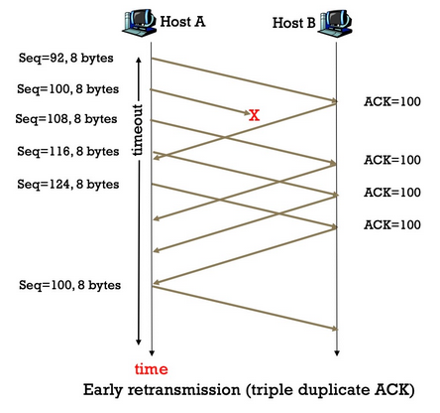
TCP Review: Retransmission
A timer is set for the first unacknowledged segment
When the timer expires we retransmit
Retransmit just one segment
Like Selective-Repeat
Cumulative ACKs
Like Go-Back-N
Four or more ACKs with the same number trigger retransmission without a timeout
Fast retransmission
Notes:
Here, the receiver keeps asking for byte 100. After three duplicate ACKS the sender retransmits the missing segment without waiting for a timeout. This is fast transmission

Slide 33
TCP Review: Flow Control
The receiver may be slower at receiving data than the sender is at sending data.
The receiver has a flow control window measured in bytes that will be advertised by the receiver.
PA4: Helpful slide decks
2023W tutorial 8 p.30-32
https://piazza.com/class/motaz7biau73cg/post/41
Notes:
The receiver might not keep up with the sender, so it advertises how many bytes it has room for. The sender uses that window to limit the data it sends.

Slide 34
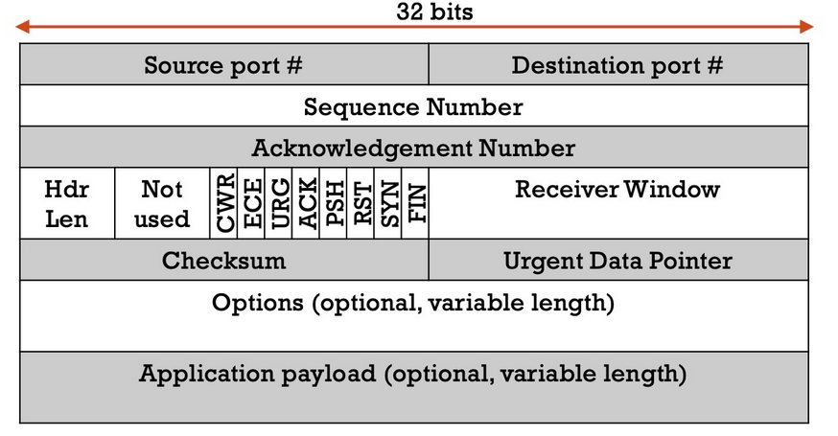
TCP Review: TCP Segments
Which fields are important for the following aspects of TCP?
Connection establishment
Notes:
Let’s look at the TCP header. Which fields are important to establish a connection?

Slide 35
TCP Review: TCP Segments
Which fields are important for the following aspects of TCP?
Connection establishment
Notes:
SYN starts the connection. The sequence number carries the ISN, and ACK confirms it using the acknowledgement number

Slide 36
TCP Review: TCP Segments
Which fields are important for the following aspects of TCP?
Connection termination
Notes:
What about connection termination?

Slide 37
TCP Review: TCP Segments
Which fields are important for the following aspects of TCP?
Connection termination
Notes:
We use FIN, ACK, and Acknowledgement Number. FIN indicates that the sender has finished sending data. The other side acknowledges it using the ACK flag and acknowledgement number

Slide 38
TCP Review: TCP Segments
Which fields are important for the following aspects of TCP?
In-order delivery and complete delivery
Notes:
Which fields help deliver all the data in the right order?

Slide 39
TCP Review: TCP Segments
Which fields are important for the following aspects of TCP?
In-order delivery and complete delivery

Slide 40
TCP Review: TCP Segments
Which fields are important for the following aspects of TCP?
Flow control
Notes:
Which field do we used for flow control?

Slide 41
TCP Review: TCP Segments
Which fields are important for the following aspects of TCP?
Flow control
Notes:
Receiver window tells the sender how much buffer space the receiver has available in bytes.

Slide 42
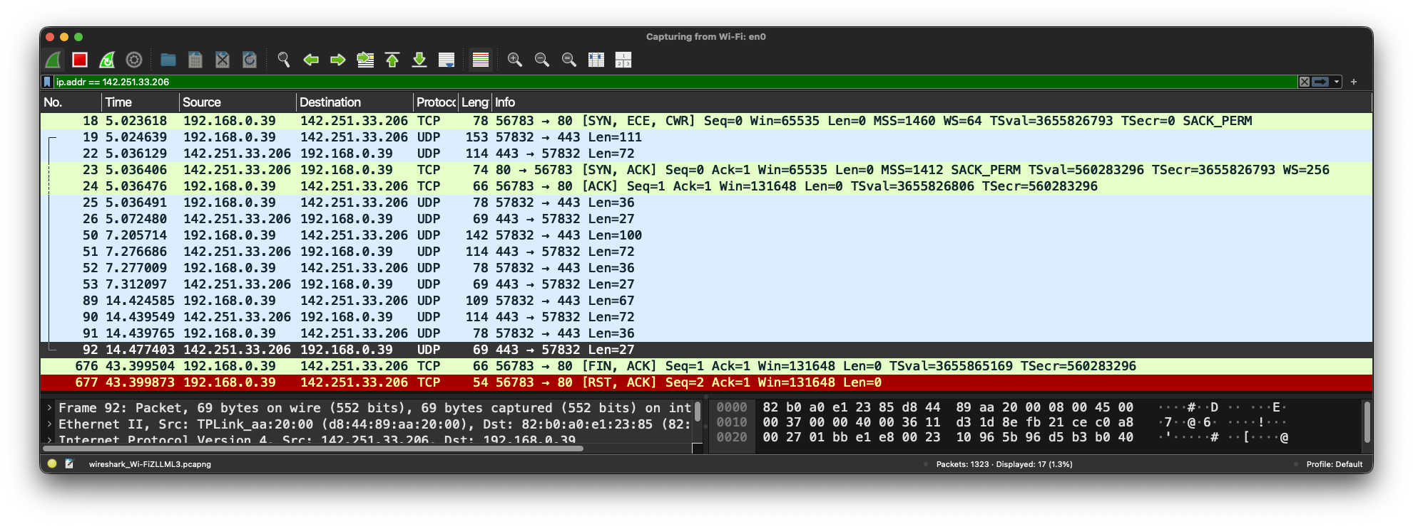
Demo: Using Wireshark to Following a TCP Conversation
http://google.com/generate_204:
client: request /generate_204
server: 204 (no content)
Notes:
We’ll show you a demo of using Wireshark to follow the TCP connection for this request. We request generate_204 and The server returns 204, with no response body

Slide 43
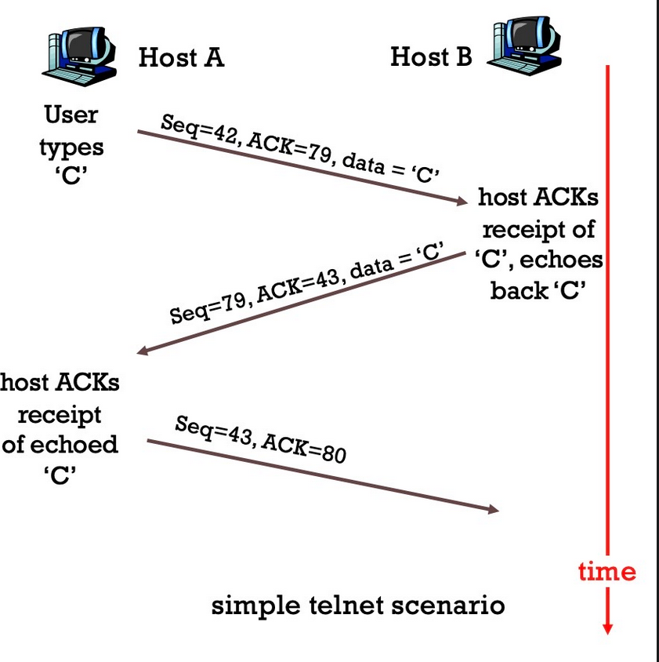
TCP Review: Seq #s & ACK #s
The sequence number of a segment is the sequence number of its first byte
ACKs correspond to the first sequence number not yet received
I.e., next expected Seq
ACK = Seq + len(data)
The receiver stores out-of-order packets in its own window
ACKs are cumulative
Notes:
The sequence number identifies the first byte in a segment. The ACK number tells us which byte the receiver expects next.
ACKs are cumulative. If data arrives out of order, the receiver buffers it and keeps acknowledging the first missing byte.

Slide 44
TCP Review: Seq #s & ACK #s Practice
Packet | Action | Seq # | ACK # | Data Size
A | Client sends data |  |  | 8
B | Server sends data and ACKs packet A |  |  | 16
C | Client ACKs packet B |  |  | 0
D | Server sends data |  |  | 8
E | Server sends data |  |  | 8
F | Client ACKs packet D |  |  | 0
G | Client sends data and ACKs packet E |  |  | 16
H | Server ACKs packet G |  |  | 0
Notes:
Now let’s do some practice. For each packet, work out the sequence and acknowledgement numbers using the action and data size. we’ll go through them one row at a time

Slide 45
TCP Review: Seq #s & ACK #s Practice
Packet | Action | Seq # | ACK # | Data Size
A | Client sends data | 100 | 200 | 8
B | Server sends data and ACKs packet A |  |  | 16
C | Client ACKs packet B |  |  | 0
D | Server sends data |  |  | 8
E | Server sends data |  |  | 8
F | Client ACKs packet D |  |  | 0
G | Client sends data and ACKs packet E |  |  | 16
H | Server ACKs packet G |  |  | 0

Slide 46
TCP Review: Seq #s & ACK #s Practice
Packet | Action | Seq # | ACK # | Data Size
A | Client sends data | 100 | 200 | 8
B | Server sends data and ACKs packet A | 200 | 108 | 16
C | Client ACKs packet B |  |  | 0
D | Server sends data |  |  | 8
E | Server sends data |  |  | 8
F | Client ACKs packet D |  |  | 0
G | Client sends data and ACKs packet E |  |  | 16
H | Server ACKs packet G |  |  | 0

Slide 47
TCP Review: Seq #s & ACK #s Practice
Packet | Action | Seq # | ACK # | Data Size
A | Client sends data | 100 | 200 | 8
B | Server sends data and ACKs packet A | 200 | 108 | 16
C | Client ACKs packet B | 108 | 216 | 0
D | Server sends data |  |  | 8
E | Server sends data |  |  | 8
F | Client ACKs packet D |  |  | 0
G | Client sends data and ACKs packet E |  |  | 16
H | Server ACKs packet G |  |  | 0

Slide 48
TCP Review: Seq #s & ACK #s Practice
Packet | Action | Seq # | ACK # | Data Size
A | Client sends data | 100 | 200 | 8
B | Server sends data and ACKs packet A | 200 | 108 | 16
C | Client ACKs packet B | 108 | 216 | 0
D | Server sends data | 216 | 108 | 8
E | Server sends data |  |  | 8
F | Client ACKs packet D |  |  | 0
G | Client sends data and ACKs packet E |  |  | 16
H | Server ACKs packet G |  |  | 0

Slide 49
TCP Review: Seq #s & ACK #s Practice
Packet | Action | Seq # | ACK # | Data Size
A | Client sends data | 100 | 200 | 8
B | Server sends data and ACKs packet A | 200 | 108 | 16
C | Client ACKs packet B | 108 | 216 | 0
D | Server sends data | 216 | 108 | 8
E | Server sends data | 224 | 108 | 8
F | Client ACKs packet D |  |  | 0
G | Client sends data and ACKs packet E |  |  | 16
H | Server ACKs packet G |  |  | 0

Slide 50
TCP Review: Seq #s & ACK #s Practice
Packet | Action | Seq # | ACK # | Data Size
A | Client sends data | 100 | 200 | 8
B | Server sends data and ACKs packet A | 200 | 108 | 16
C | Client ACKs packet B | 108 | 216 | 0
D | Server sends data | 216 | 108 | 8
E | Server sends data | 224 | 108 | 8
F | Client ACKs packet D | 108 | 224 | 0
G | Client sends data and ACKs packet E |  |  | 16
H | Server ACKs packet G |  |  | 0

Slide 51
TCP Review: Seq #s & ACK #s Practice
Packet | Action | Seq # | ACK # | Data Size
A | Client sends data | 100 | 200 | 8
B | Server sends data and ACKs packet A | 200 | 108 | 16
C | Client ACKs packet B | 108 | 216 | 0
D | Server sends data | 216 | 108 | 8
E | Server sends data | 224 | 108 | 8
F | Client ACKs packet D | 108 | 224 | 0
G | Client sends data and ACKs packet E | 108 | 232 | 16
H | Server ACKs packet G |  |  | 0

Slide 52
TCP Review: Seq #s & ACK #s Practice
Packet | Action | Seq # | ACK # | Data Size
A | Client sends data | 100 | 200 | 8
B | Server sends data and ACKs packet A | 200 | 108 | 16
C | Client ACKs packet B | 108 | 216 | 0
D | Server sends data | 216 | 108 | 8
E | Server sends data | 224 | 108 | 8
F | Client ACKs packet D | 108 | 224 | 0
G | Client sends data and ACKs packet E | 108 | 232 | 16
H | Server ACKs packet G | 232 | 124 | 0

