Slide 1
Tutorial 1
Playing with the Internet (Networking tools)
Slides by Han Kim

Slide 2
Introduction
TA_1
…
…
…
TA_2
…
…
…
Your turn!
Great opportunity to make study partners!

Slide 3
Introduction Example
Han Kim
BSc: Honours in Computer Science, SENG opt
Research Assistant in Systopia - Serverless
Loves console games!
Kevin Wang
PhD student in Systopia - network security
Ask me almost anything about:
  research, teaching, almost falling off a cliff in Iceland, Slay the Spire 2
Your turn!
Great opportunity to make study partners!

Slide 4
Tutorial Logistics & Before we start…
Tutorials are usually made up of several exercises
I will explain the exercises, maybe demo a few parts, then give you time to work
Tutorial attendance gives up to 2% bonus marks toward your final grade
A code will be shared at the start of the tutorial
Enter it in PrairieLearn and click “Save & Grade”
Tutorial slides will be shared via Google Drive
Includes hidden annotation
Feel free to ask questions anytime
Like this one

Slide 5
Overview
Understand how communication over a network works at a high level.
Learn how to read RFCs. (More in tutorial 3)
RFC 2229: A Dictionary Server Protocol
Do not memorize RFCs!
Experience using a server’s service without any app or browser
We will use netcat for this!
Try out some network tools
Learn basic Socket programming (More in tutorial 2)

Slide 6
Preparation: netcat
We will be using netcat: A simple CLI networking tool
Available by default on most Linux and macOS
Available on Windows via installation or WSL
Install WSL (Windows Subsystem for Linux) by following the manual:
MS Doc for installing WSL
Quick workaround:
Undergraduate Linux servers have netcat installed.
You can SSH into them using:
ssh <cwl>@remote.students.cs.ubc.ca

Slide 7
Exercise 1: Online Dictionaries
netcat

Slide 8
Exercise 1: Online Dictionaries
This box represents a running netcat program on our device
Netcat is one of the simplest networking tools
netcat

Slide 9
Exercise 1: Online Dictionaries
netcat
str

Slide 10
Exercise 1: Online Dictionaries
Netcat simply sends the string entered by the user to…
netcat
str

Slide 11
Exercise 1: Online Dictionaries
dict.org
netcat
str
Port
2628

Slide 12
Exercise 1: Online Dictionaries
… another device somewhere out on the network
dict.org
netcat
str
Port
2628

Slide 13
Exercise 1: Online Dictionaries
This device can be identified by the <Address, Port> pair
E.g. <dict.org, 2628>
dict.org
netcat
str
Port
2628

Slide 14
Exercise 1: Online Dictionaries
dict.org
netcat
Dict App
str
Port
2628

Slide 15
Exercise 1: Online Dictionaries
Applications run on these devices
dict.org
netcat
Dict App
str
Port
2628

Slide 16
Exercise 1: Online Dictionaries
They can receive input through ports
dict.org
netcat
Dict App
str
Port
2628

Slide 17
Exercise 1: Online Dictionaries
dict.org
netcat
Dict App
res
Port
2628

Slide 18
Exercise 1: Online Dictionaries
The application processes the input and returns a response
dict.org
netcat
Dict App
res
Port
2628

Slide 19
Exercise 1: Online Dictionaries
The application processes the input and returns a response
dict.org
netcat
Dict App
res
Port
2628

Slide 20
Exercise 1: Online Dictionaries
dict.org
netcat
Dict App
str(req) / res
Port
2628

Slide 21
Exercise 1: Online Dictionaries
RFCs define how requests and responses work
dict.org
netcat
Dict App
str(req) / res
Port
2628

Slide 22
Exercise 1: Online Dictionaries
Apps are usually built based on what is defined in the RFCs
dict.org
netcat
Dict App
str(req) / res
Port
2628

Slide 23
Exercise 1: Online Dictionaries
localhost
dict.org
netcat
Dict App
req / res
Port
2628

Slide 24
Exercise 1: Online Dictionaries
Since netcat is also running on a device, it has its own <Address, Port> pair as well
localhost
dict.org
netcat
Dict App
req / res
Port
2628

Slide 25
Exercise 1: Online Dictionaries
Reference to RFC 2229 in order to answer the following questions:
How many dictionaries does the server support?
What command would you use to discover the definition of the word “pemican”?
How many different dictionaries contain a definition of the word “protocol”?
What command would you use to find all the words that “sound like” the word “orange”?

Slide 26

Exercise 1: Online Dictionaries
Reference to RFC 2229 in order to answer the following questions:
How many dictionaries does the server support?
What command would you use to discover the definition of the word “pemican”?
How many different dictionaries contain a definition of the word “protocol”?
What command would you use to find all the words that “sound like” the word “orange”?

Slide 27
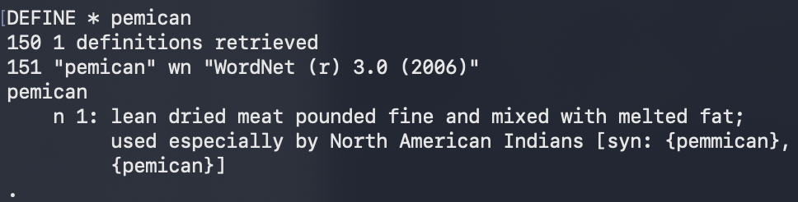
Exercise 1: Online Dictionaries
Reference to RFC 2229 in order to answer the following questions:
How many dictionaries does the server support?
What command would you use to discover the definition of the word “pemican”?
How many different dictionaries contain a definition of the word “protocol”?
What command would you use to find all the words that “sound like” the word “orange”?

Slide 28

Exercise 1: Online Dictionaries
Reference to RFC 2229 in order to answer the following questions:
How many dictionaries does the server support?
What command would you use to discover the definition of the word “pemican”?
How many different dictionaries contain a definition of the word “protocol”?
What command would you use to find all the words that “sound like” the word “orange”?

Slide 29

Exercise 1: Online Dictionaries
Reference to RFC 2229 in order to answer the following questions:
How many dictionaries does the server support?
What command would you use to discover the definition of the word “pemican”?
How many different dictionaries contain a definition of the word “protocol”?
What command would you use to find all the words that “sound like” the word “orange”?

Slide 30
Exercise 2: Connecting to the FTP service
File Transfer Protocol (FTP)
Another service on the internet!
One of the earliest Internet services – Not secure these days
Used for uploading/downloading files
Defined in RFC 959
USER anonymous # login as anonymous
PASS anonymous # password
PWD # print working directory
PASV # enter passive mode (mode for data transfer)
LIST # list files
QUIT # close connection

Slide 31
Exercise 2: Connecting to the FTP Service
localhost
ftp server
Port
21
netcat A
req / res
FTP App
netcat B
data

Slide 32
Exercise 2: Connecting to the FTP Service
localhost
ftp server
Port
21
netcat A
req / res
FTP App
netcat B
data
Entering passive mode creates a separate connection for data transfer

Slide 33
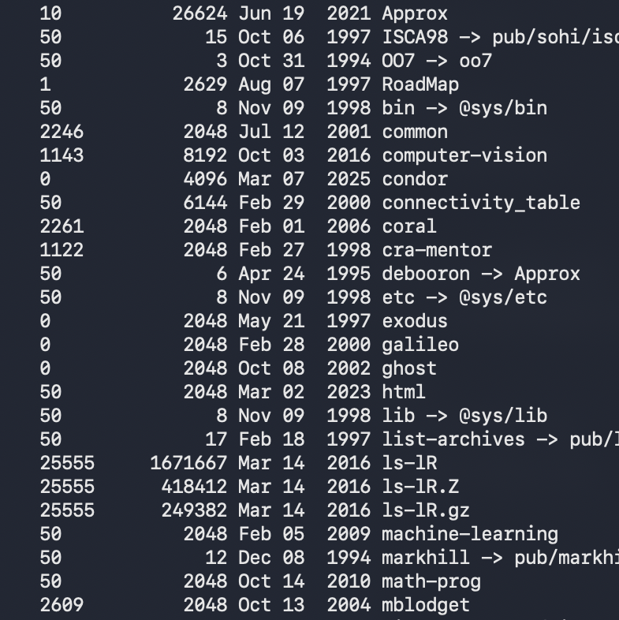
Exercise 2: Connecting to the FTP Service
netcat A
netcat B
USER anonymous
PASS anonymous
PWD
PASV
LIST
QUIT
ftp server
FTP App

Slide 34


Exercise 3: Connecting to a Web Server
example.com
Browser

Slide 35
Exercise 3: Connecting to a Web Server
We usually connect to web servers using web browsers
example.com
Browser
Much of the process is automated
(HTTP requests, HTML parsing, cookies, and multiple requests)

Slide 36
Exercise 3: Connecting to a Web Server
example.com
netcat

Slide 37
Exercise 3: Connecting to a Web Server
With netcat, we only have the ability to send and receive plain text one by one
example.com
netcat

Slide 38
Exercise 3: Connecting to a Web Server
We need CRLF mode, since HTTP expects \r\n instead of \n
However, this isn’t that strict these days.
Try just sending “Hello”. What happens?
Now, what happens if we follow the HTTP format?

Slide 39
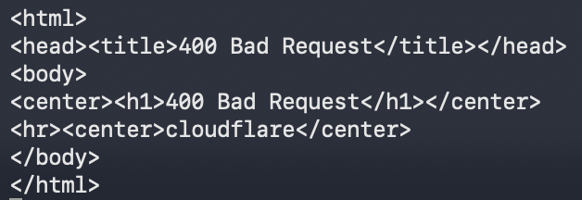
Exercise 3: Connecting to a Web Server
We need CRLF mode, since HTTP expects \r\n instead of \n
However, this isn’t that strict these days.
Try just sending “Hello”. What happens?
Now, what happens if we follow the HTTP format?

Slide 40
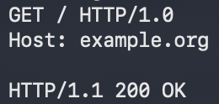
Exercise 3: Connecting to a Web Server
We need CRLF mode, since HTTP expects \r\n instead of \n
However, this isn’t that strict these days.
Try just sending “Hello”. What happens?
Now, what happens if we follow the HTTP format?

Slide 41
Exercise 4: Other useful network tools
ping
Checks connectivity and measures round-trip time (RTT)
Usage: ping <host>
Examples:
> ping google.com
PING google.com (142.251.46.78): 56 data bytes
64 bytes from 142.251.46.78: icmp_seq=0 ttl=114 time=9.561 ms
64 bytes from 142.251.46.78: icmp_seq=1 ttl=114 time=9.271 ms
64 bytes from 142.251.46.78: icmp_seq=2 ttl=114 time=14.182 ms
...

Slide 42
Exercise 4: Other useful network tools
traceroute / tracert
Description: Shows the path (hops) packets take to a destination
Usage: traceroute <host> (Windows: tracert)
Examples:
> traceroute google.com
traceroute to google.com (142.251.46.78), 64 hops max, 40 byte packets
1 206.87.103.253 (206.87.103.253) 6.437 ms 5.401 ms 5.237 ms
2 10.20.216.29 (10.20.216.29) 5.769 ms 8.072 ms 5.438 ms
3 a0-a34.net.ubc.ca (137.82.124.146) 5.622 ms 5.627 ms 5.695 ms
...

Slide 43
Exercise 4: Other useful network tools
dig
Description: DNS lookup (domain → IP)
Usage: dig <domain>
Examples:
> dig google.com
; <<>> DiG 9.10.6 <<>> google.com
;; QUESTION SECTION:
;google.com. IN A
;; ANSWER SECTION:
google.com. 261 IN A 142.251.46.78

Slide 44
Exercise 4: Other useful network tools
ip / ifconfig
Displays local network configuration (IP, interfaces)
Usage: ip a or ifconfig
Examples:
> ip a
1: lo: <LOOPBACK,UP,LOWER_UP>
inet 127.0.0.1/8
2: eno1: <BROADCAST,MULTICAST,UP,LOWER_UP>
inet 198.162.33.17/24
inet6 fe80::2eea:7fff:fe9e:5122/64
...

Slide 45
Exercise 5: Socket programming in Java
Sockets: Endpoint for communication between two programs over a network
Identified by the <IP Address, Port> pair
Important Clarification
A device is identified by an IP address
A specific process (program) is identified by a socket (IP + Port)
were sockets!
Socket programming is available in many languages
This course focuses on Java and C, starting with Java
Java Socket Tutorial

Slide 46
Exercise 5: Socket programming in Java (Client)
Socket socket = new Socket("localhost", 4444);
PrintWriter out = new PrintWriter(socket.getOutputStream(), true);
BufferedReader in = new BufferedReader(
new InputStreamReader(socket.getInputStream())
);
// send
out.println("Hello");
// receive
String response = in.readLine();
System.out.println(response);
// close
socket.close();

Slide 47
Exercise 5: Socket programming in Java (Server)
ServerSocket serverSocket = new ServerSocket(4444);
Socket clientSocket = serverSocket.accept();
BufferedReader in = new BufferedReader(
new InputStreamReader(clientSocket.getInputStream())
);
PrintWriter out = new PrintWriter(clientSocket.getOutputStream(), true);
// receive
String message = in.readLine();
// send
out.println("Echo: " + message);
// close
clientSocket.close();
serverSocket.close();

Slide 48
Exercise 5: Socket programming in Java (KnockKnock)
KnockKnockClient
KnockKnockServer
Port
4444
Client
req / res
Server
Protocol

Slide 49
Exercise 5: Socket programming in Java (KnockKnock)
KnockKnockClient
KnockKnockServer
Handles networking and I/O
Port
4444
Client
req / res
Server
Protocol
Defines the conversation logic

