Slide 1
Tutorial 2
TCP Sockets in Java
Slides by Han Kim

Slide 2
Overview
PA1 introduction
HIgh level overview of PA1 (+ Quick review of last tutorial’s exercise 1)
Sockets (Quick review of last tutorial’s exercise 5)
Echo Client/Sever Demo
Echo Client Code Reading
Debugging
Writing Tests
Wireshark

Slide 3
Tutorial 1 - Exercise 1: Online Dictionaries
localhost
dict.org
netcat
Dict App
req / res
Port
2628

Slide 4
Tutorial 1 - Exercise 1: Online Dictionaries
In our previous tutorial, we used the dictionary service with netcat
localhost
dict.org
netcat
Dict App
req / res
Port
2628

Slide 5
Programming Assignment 1
localhost
dict.org
PA1
Dict App
req / res
Port
2628

Slide 6
Programming Assignment 1
PA1 will use the dictionary service as well
localhost
dict.org
PA1
Dict App
req / res
Port
2628

Slide 7
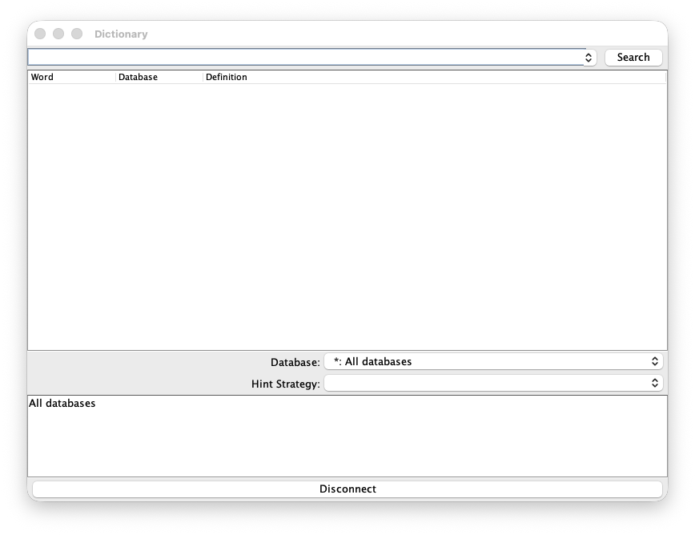
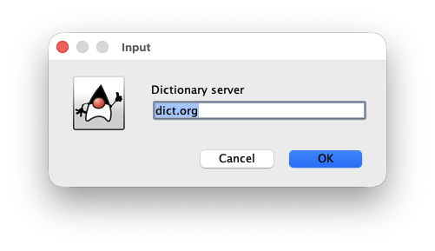

Slide 8
This is what you’ll see when you run PA1
Yay! You have a GUI
Here, we input the address of the dictionary server

Slide 9
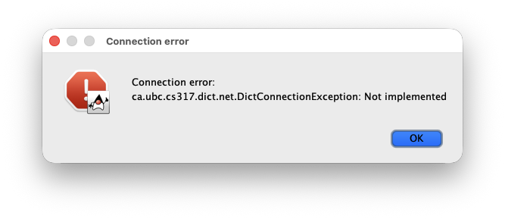

Slide 10
An error will pop up if you press OK

Slide 11
Programming Assignment 1
local
dict.org
PA1
Dict App
req / res
Port
2628

Slide 12
Programming Assignment 1
local
dict.org
PA1
Dict App
Port
2628

Slide 13
Programming Assignment 1
Why did the error pop up?
This part is not implemented!
It is your task to implement it
local
dict.org
PA1
Dict App
Port
2628

Slide 14
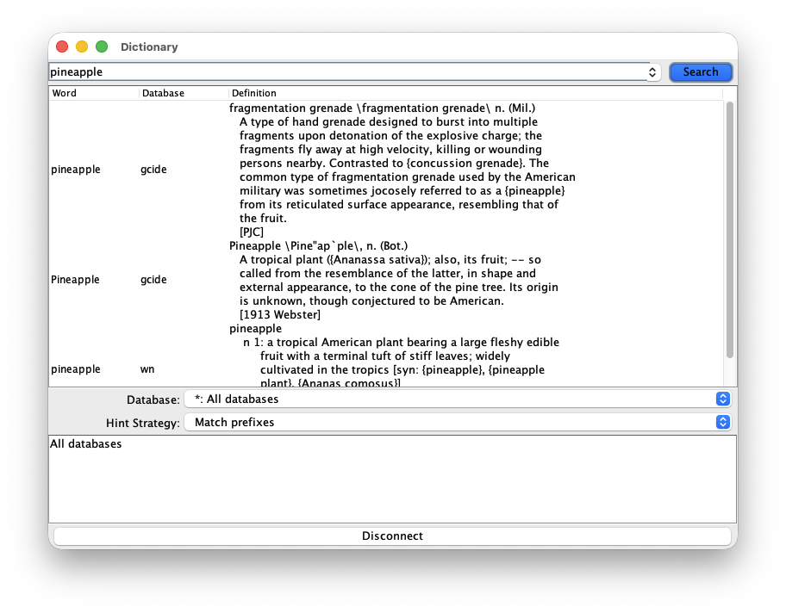

Slide 15
This is what it would look like if the implementation is complete

Slide 16
Programming Assignment 1
local
dict.org
getDefinition(“pineapple”)
PA1
Dict App
DEFINE * pineapple
res
Port
2628

Slide 17
Programming Assignment 1
If the GUI calls getDefinition(“pineapple”)
local
dict.org
getDefinition(“pineapple”)
PA1
Dict App
DEFINE * pineapple
res
Port
2628
DictionaryConnection.java should send a message asking a DICT server to define “pineapple”

Slide 18
Tutorial 1 - Exercise 5: Socket programming in Java
Sockets: Endpoint for communication between two programs over a network
Identified by the <IP Address, Port> pair
Important Clarification
A device is identified by an IP address
A specific process (program) is identified by a socket (IP + Port)
were sockets!
Socket programming is available in many languages
This course focuses on Java and C, starting with Java
Java Socket Tutorial

Slide 19
Tutorial 1 - Exercise 5: Socket programming in Java (Client)
Socket socket = new Socket("localhost", 4444);
PrintWriter out = new PrintWriter(socket.getOutputStream(), true);
BufferedReader in = new BufferedReader(
new InputStreamReader(socket.getInputStream())
);
// send
out.println("Hello");
// receive
String response = in.readLine();
System.out.println(response);
// close
socket.close();

Slide 20
Tutorial 1 - Exercise 5: Socket programming in Java (Server)
ServerSocket serverSocket = new ServerSocket(4444);
Socket clientSocket = serverSocket.accept();
BufferedReader in = new BufferedReader(
new InputStreamReader(clientSocket.getInputStream())
);
PrintWriter out = new PrintWriter(clientSocket.getOutputStream(), true);
// receive
String message = in.readLine();
// send
out.println("Echo: " + message);
// close
clientSocket.close();
serverSocket.close();

Slide 21
Demo: EchoClient & EchoServer
local
local
EchoClient
EchoServer
req / res
Port
2628

Slide 22
Exercise 1: Read EchoClient’s Code
Which line of code is necessary for creating a connection to the server?
After the initial Socket has been created, which 2 lines of code are needed to write a message to the server?
After the initial Socket has been created, which 2 lines of code are needed to read a message from the server?

Slide 23
Exercise 1: Read EchoClient’s Code
Which line of code is necessary for creating a connection to the server?
After the initial Socket has been created, which 2 lines of code are needed to write a message to the server?
After the initial Socket has been created, which 2 lines of code are needed to read a message from the server?
48 Socket echoSocket = new Socket(hostName, portNumber);

Slide 24
Exercise 1: Read EchoClient’s Code
Which line of code is necessary for creating a connection to the server?
After the initial Socket has been created, which 2 lines of code are needed to write a message to the server?
After the initial Socket has been created, which 2 lines of code are needed to read a message from the server?
48 Socket echoSocket = new Socket(hostName, portNumber);
49 PrintWriter out =
50 new PrintWriter(echoSocket.getOutputStream(), true);
60 out.println(userInput);

Slide 25
Exercise 1: Read EchoClient’s Code
Which line of code is necessary for creating a connection to the server?
After the initial Socket has been created, which 2 lines of code are needed to write a message to the server?
After the initial Socket has been created, which 2 lines of code are needed to read a message from the server?
48 Socket echoSocket = new Socket(hostName, portNumber);
49 PrintWriter out =
50 new PrintWriter(echoSocket.getOutputStream(), true);
60 out.println(userInput);
51 BufferedReader in =
52 new BufferedReader(
53 new InputStreamReader(echoSocket.getInputStream()));
61 in.readLine();

Slide 26
Debugging
Debugging is important in network programming
Failures are less intuitive to locate.
local
dict.org
PA1
Dict App
req / res
Port
2628

Slide 27
Debugging
Debugging is important in network programming
Failures are less intuitive to locate.
local
It could be…
dict.org
PA1
Dict App
req / res
Port
2628

Slide 28

Debugging
Debugging is important in network programming
Failures are less intuitive to locate.
local
dict.org
PA1
Dict App
req / res
Port
2628

Slide 29
Debugging
Debugging is important in network programming
Failures are less intuitive to locate.
local
dict.org
A bug within the client application
PA1
Dict App
req / res
Port
2628

Slide 30
Debugging
Debugging is important in network programming
Failures are less intuitive to locate.
local
dict.org
PA1
Dict App
req / res
Port
2628

Slide 31
Debugging
Debugging is important in network programming
Failures are less intuitive to locate.
local
dict.org
Network failure
E.g. Socket closed
PA1
Dict App
req / res
Port
2628

Slide 32
Debugging
Debugging is important in network programming
Failures are less intuitive to locate.
local
dict.org
PA1
Dict App
req / res
Port
2628

Slide 33
Debugging
Debugging is important in network programming
Failures are less intuitive to locate.
local
Network failure
E.g. Packet loss
dict.org
PA1
Dict App
req / res
Port
2628

Slide 34
Debugging
Debugging is important in network programming
Failures are less intuitive to locate.
local
dict.org
PA1
Dict App
req / res
Port
2628

Slide 35
Debugging
Debugging is important in network programming
Failures are less intuitive to locate.
local
dict.org
PA1
Dict App
Wrong port #
req / res
Port
2628

Slide 36
Debugging
Debugging is important in network programming
Failures are less intuitive to locate.
local
dict.org
PA1
Dict App
req / res
Port
2628

Slide 37
Debugging
Wrong address
Debugging is important in network programming
Failures are less intuitive to locate.
local
dict.org
PA1
Dict App
req / res
Port
2628

Slide 38
Debugging
Debugging is important in network programming
Failures are less intuitive to locate.
local
dict.org
PA1
Dict App
req / res
Port
2628

Slide 39
Debugging
Debugging is important in network programming
Failures are less intuitive to locate.
local
dict.org
Server down
PA1
Dict App
req / res
Port
2628

Slide 40
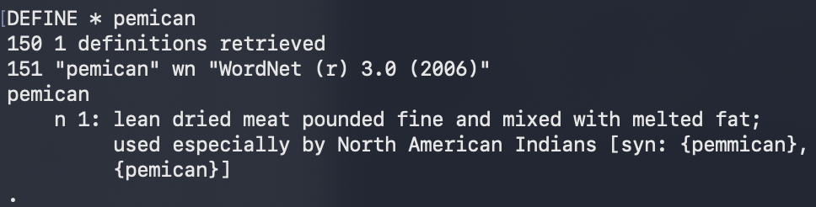
Debugging: Writing Tests - getDefinitions()
getDefinitions has roughly the following signature:
word is the word we want to define.
database is the dictionary database we are searching in.
we received the following response in tutorial 1:
Collection<Definition> getDefinitions(String word, Database database)

Slide 41
Debugging: Writing Tests - getDefinitions()
From the netcat response, we can expect the following getDefinitions call would return…
A collection including the following definition object:
Database wn = new Database("wn", "WordNet (r) 3.0 (2006)");
getDefinitions("pemican", wn);
word: "pemican"
database: "wn"
definition:
"pemican
n 1: lean dried meat pounded fine and mixed with melted fat;
used especially by North American Indians [syn: {pemmican},
{pemican}]"

Slide 42
Demo: Wireshark
A network analyzer tool
Used to capture and inspect packets on a network
Useful for debugging network programs and protocols
We can use it to see what messages are actually sent and received

