Slide 1
Tutorial 7
Debugging with GDB
Slides by Sage Drake

Slide 2
Tutorial Agenda
Discuss how to write and run automated tests for PA3
Re-introduce GDB
Discuss how to to use GDB with the PA3 tests

Slide 3
Writing Server Tests
Notes:
Since we are using C for PA3 onwards, we can no longer use JUnit for our test cases. For PA3, we provide you with a test structure and some initial tests. Let’s take a look at how those provided tests work.

Slide 4

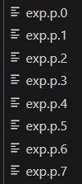
Files provided to you for testing
Inputs + corresponding expected outputs for 8 test cases
+
Bash script that runs the test cases
Notes:
If you take a look in the provided starter code for PA3, you will see these files which together provide automated testing functionality for your server.

Slide 5
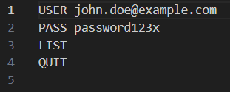
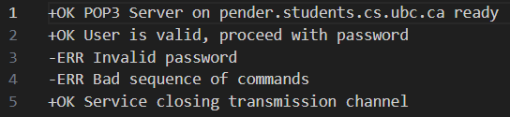
Functionality of test.sh
Send input file contents to the server
in.p.1
mypopd
out.p.1
Save server responses in output file
Notes:
Here’s an example of how test.sh runs a test case. First it runs your implementation of the mypopd server. It sends the the input file contents to the server. The server will interpret each line as a separate request, and send the corresponding response. test.sh saves these responses in an output file.

Slide 6
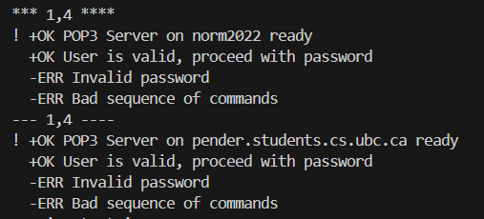
Functionality of test.sh
exp.p.1
Contains expected server output
out.p.1
Contains actual server output
diff
Notes:
Now we have two files containing the expected server output for this test case, and the actual server output.
We want to compare them to see if the server gave the expected output.
test.sh uses the diff command to do this comparison and prints the output to the terminal.
Note that unlike the Junit tests for PA1 and PA2, there is nothing obvious that says whether the test passed or failed. We have to look through the outputs of diff and decide whether the differences indicate incorrect server behaviour.
In this case, the only difference is the name of the machine on the first line (indicated by the !) which is fine, so we can call this a passing test.

Slide 7
Running test.sh
To run all the test cases: ./test.sh
To run a particular test case: ./test.sh <test number>

Slide 8
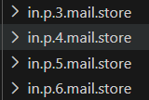

Functionality of test.sh
Some test cases also include the initial contents of mail.store:
as well as the expected contents of mail.store after running the test case:
Notes:
For some test cases, we don’t just want to look at the server responses to our commands - we also want to look at the effect that those commands had on the mailbox contents of the users. For instance, if we use the delete command, we want to check whether the specified email was deleted.
So, some of the test cases include a folder with the initial contents of the mailboxes for all users, and a folder with the expected contents of each user’s mailbox after the server runs the provided commands.
Any questions about the test functionality before we do an activity?

Slide 9
Your turn!
Construct your own test case(s) and run them using test.sh.
Keep in mind, these are the commands your server must support:
USER and PASS (plaintext password authentication)
STAT (message count information)
LIST (message listing) - with and without arguments
RETR (message content retrieval)
DELE (delete message)
RSET (undelete messages)
NOOP (no operation)
QUIT (session termination)
Notes:
Now it’s your turn to add at least one additional test case and run it using test.sh.
You can take a look at the test cases that are already provided to you, and think about what other cases you would want to test. Keep in mind the commands the server must support, and all the various orders in which these commands could be run.

Slide 10
A (Re-)introduction to GDB
Notes:
So, now that you can run tests for your program, you might find that one of your tests identifies a bug and you might want to use a debugger to help.

Slide 11
Fixing a bug in factorial program
Download and extract zip archive from tutorial 7 page
Compile and execute the program: make && ./fact
Test some input values
  e.g. for input = 5, we should get 5! = 5 x 4 x 3 x 2 x 1 = 120
Do you get the expected output?
Notes:
It might take a few minutes for students to download the file and run it

Slide 12
Finding the bug(s) using GDB
First load the program into the debugger: gdb fact
Then, make use of these GDB commands to find the bug:
Set a breakpoint: b <line number>
Start running the program: run <port number>
Print the value of a variable: p <variable>
Print values of multiple variables: p {<var1>, <var2>, <var3>}
Run the next line of code: n
Continue until the next breakpoint: c
Quit GDB: q
Notes:
This is a small bug, so you might be capable of solving it without the debugger. However, it’s a good idea to practice using gdb now with this smaller example, so when you do run into a crazy bug that requires a debugger, you’re already familiar with gdb.
Give students a few minutes to try out using GDB

Slide 13
Demo: Debugging with GDB
Notes:
Demo the process of debugging the factorial program with GDB.

Slide 14
Running tests while GDB is open
Notes:
So we talked about how to run the tests, and how to use GDB, but how can we use GDB to debug a particular test case?

Slide 15
Why can’t we just run “gdb ./test.sh” ?
Notes:
Give students a minute to think about it, then ask them to share

Slide 16
Why can’t we just run “gdb ./test.sh” ?
test.sh is a bash script, and gdb is for debugging C programs
test.sh is not the program we want to debug! We want to debug our server, ./mypopd.
Notes:
Ok so we can’t run gdb ./test.sh. How do we debug our test cases with gdb then? To understand this, we need to look more into the details of how test.sh runs the tests

Slide 17
What test.sh does
Runs the mypopd server:
Runs a netcat client:
So when we run test.sh, there will be three programs running:
test.sh
Client: netcat
Server: mypopd
Notes:
If we look at the test.sh code, we can see that it runs the ./mypopd program. It then runs netcat and has it connect as a client to the mypopd server.
This means we have three programs running when we run test.sh: test.sh itself, the mypopd server, and the netcat client.
The one we actually want to debug is mypopd

Slide 18
Simplest way to debug a test case:
Pipe in contents of input file
in.p.1
Client: netcat
Server: mypopd running in GDB
out.p.1
Pipe server responses into output file
Notes:
A simple way to do this is to bypass the test.sh script entirely, and instead run mypopd and netcat ourselves. This way we can choose to load mypopd into gdb before running it.

Slide 19
Demo: running a test case with GDB
Notes:
Demo this one before students try it themselves since this is a tricky one (the steps of what to do are on the next slide)

Slide 20
Steps to run a test case while using GDB:
Load mypopd into gdb: gdb ./mypopd
Set breakpoint(s): b <line number>
Run the popd server: run <port number>
In a separate terminal window, run a netcat client using one of the following:
  netcat localhost <port number> and then provide commands to the server manually
  netcat localhost <port number> < <input_file> to pipe in the contents of an input file
  netcat localhost <port number> > <output_file> to save the result to an output file
Compare the output to what you expected using one of the following:
  The diff command: diff <file1> <file2>
  A visual comparison tool like https://www.diffchecker.com/
Notes:
Have students try it out themselves and see if they can get it working

