Slide 1
자연어처리 실습
10/2 Word embeddings

Slide 2
Overview
This tutorial is three-fold as follows:
Word2vec - 80 min.
GloVe - 80 min.
ELMo - 80 min.
* 10 minutes break between each part.

Slide 3
Part 3. ELMo
Requirements
Colab
python3 package allennlp
https://github.com/hanjy1777/KAIST-NLP-tutorial/blob/master/part3/ELMo.ipynb
Source: https://www.mihaileric.com/posts/deep-contextualized-word-representations-elmo/

Slide 4
Part 3. ELMo
Contextualized word embeddings
I want to fly to the sky.
I caught a fly.

Slide 5
Part 3. ELMo
Contextualized word embeddings
ELMo (Embedding for Language Models)
- Peters, Matthew E., et al. "Deep contextualized word representations." Proceedings of NAACL-HLT. 2018.
BERT (Bidirectional Encoder Representations from Transformers)
- Devlin, Jacob, et al. "BERT: Pre-training of Deep Bidirectional Transformers for Language Understanding." Proceedings of the 2019 Conference of the North American Chapter of the Association for Computational Linguistics: Human Language Technologies, Volume 1 (Long and Short Papers). 2019.
OpenAI GPT (Generative Pre-Training)
- Radford, Alec, et al. "Improving language understanding by generative pre-training." URL https://s3-us-west-2. amazonaws. com/openai-assets/researchcovers/languageunsupervised/language understanding paper. pdf (2018).

Slide 6
Part 3. ELMo
Contextualized word embeddings
ELMo (Embedding for Language Models)
- Peters, Matthew E., et al. "Deep contextualized word representations." Proceedings of NAACL-HLT. 2018.
BERT (Bidirectional Encoder Representations from Transformers)
- Devlin, Jacob, et al. "BERT: Pre-training of Deep Bidirectional Transformers for Language Understanding." Proceedings of the 2019 Conference of the North American Chapter of the Association for Computational Linguistics: Human Language Technologies, Volume 1 (Long and Short Papers). 2019.
OpenAI GPT (Generative Pre-Training)
- Radford, Alec, et al. "Improving language understanding by generative pre-training." URL https://s3-us-west-2. amazonaws. com/openai-assets/researchcovers/languageunsupervised/language understanding paper. pdf (2018).

Slide 7
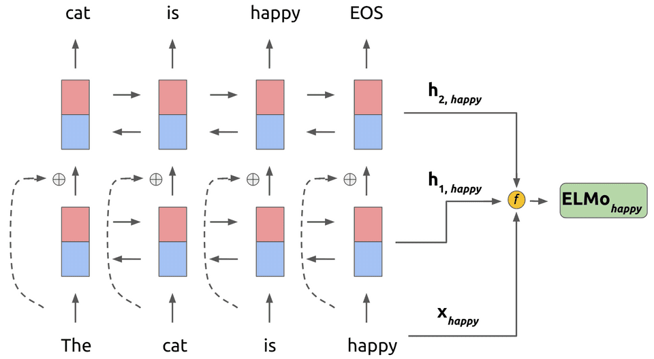
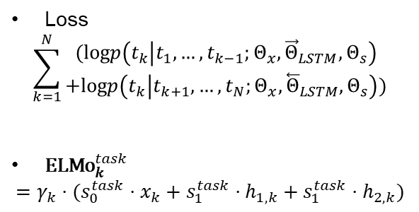
Part 3. ELMo
Loss
$$\sum_{k=1}^{N}{\begin{aligned}(\text{log}p\left(t_{k} | t_{1},…,t_{k−1};Θ_{x},{\vec{Θ}}_{LSTM},Θ_{s}\right) \\ +\text{log}p\left(t_{k} | t_{k+1},…,t_{N};Θ_{x},{\overset{⃖}{Θ}}_{LSTM},Θ_{s}\right))\end{aligned}}$$
${\text{ELMo}}_{k}^{task}$
$$=γ_{k}⋅(s_{0}^{task}⋅x_{k}+s_{1}^{task}⋅h_{1, k}+s_{1}^{task}⋅h_{2,k})$$
Source: https://www.mihaileric.com/posts/deep-contextualized-word-representations-elmo/

Slide 8
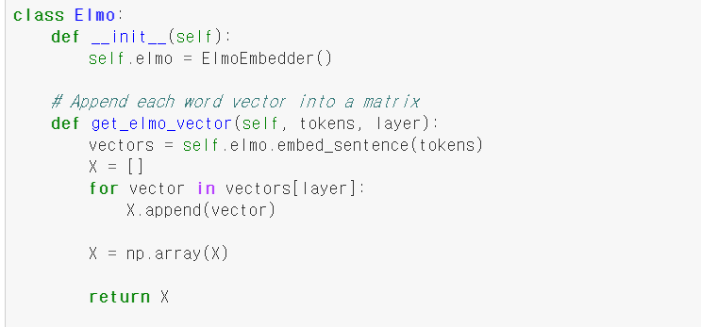
Part 3. ELMo
From AllenNLP package
Token: [“w1”, “w2”, …]
3 layers (token, LSTM1, LSTM2)
[[embedding of w1],
[embedding of w2], …]

Slide 9
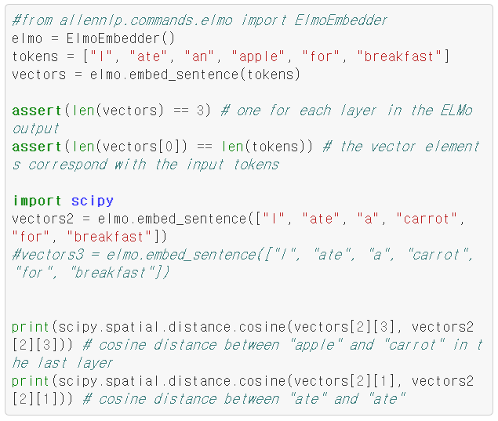
Part 3. ELMo

Slide 10
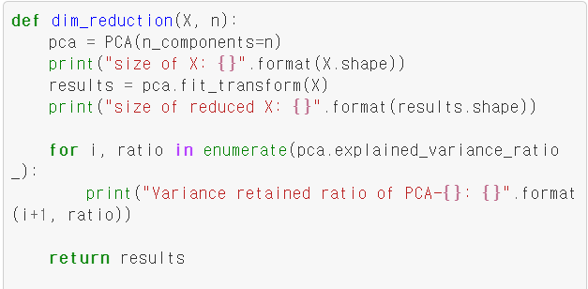
Part 3. ELMo

Slide 11
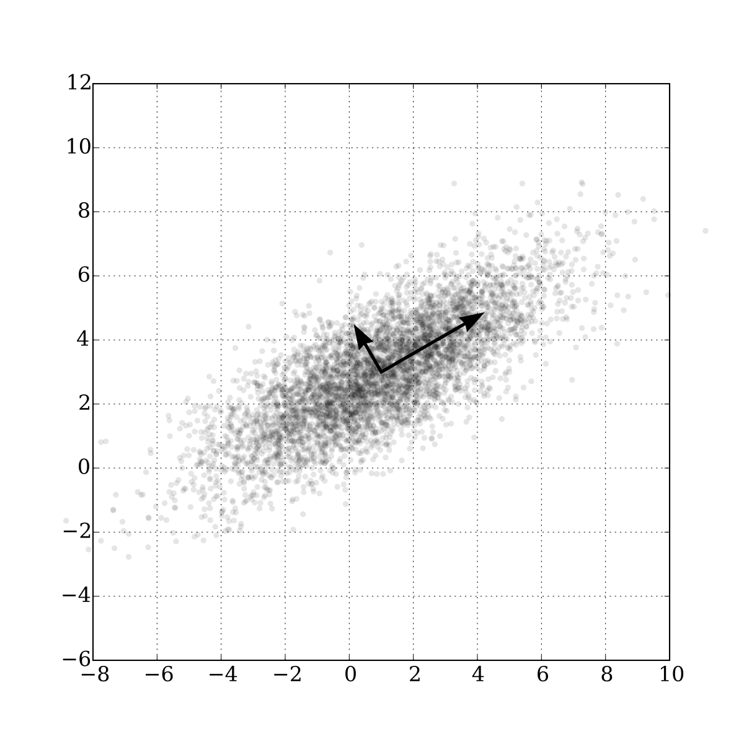
Part 3. ELMo
PCA (Principal Component Analysis)
Find the most distinctive feature.
(To have the highest variance)
Reduce dimensionality while preserving dominant information
Source: wikipedia

Slide 12
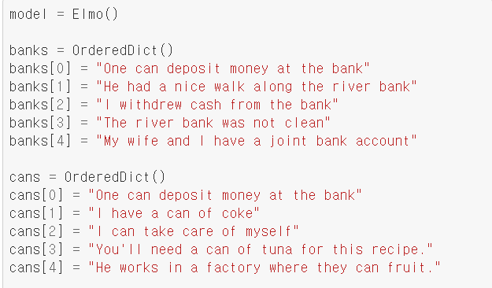
Part 3. ELMo
Generate the class

Slide 13
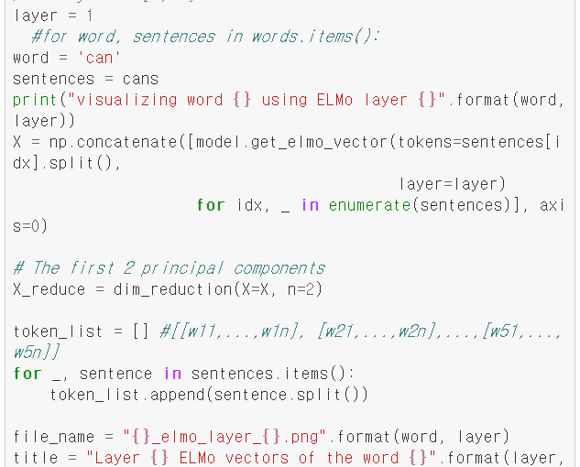
Part 3. ELMo
Choose the layer (token, LSTM1, LSTM2)
Set word and sentences

Slide 14
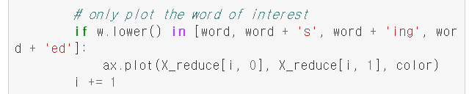
Part 3. ELMo

Slide 15
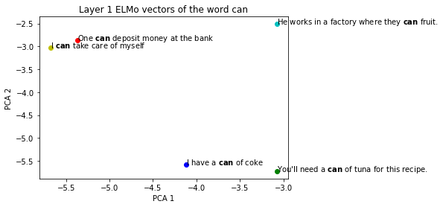
Part 3. ELMo

Slide 16
Reference
[1] Peters, Matthew E., et al. "Deep contextualized word representations." Proceedings of NAACL-HLT. 2018.
[2] https://towardsdatascience.com/visualizing-elmo-contextual-vectors-94168768fdaa
[3] https://github.com/hengluchang/visualizing_contextual_vectors/blob/master/elmo_vis.py
[4] https://github.com/kamujun/elmo_experiments/blob/master/elmo_experiment/notebooks/elmo_text_classification_on_imdb.ipynb

