Slide 1
Overview
On meeting on 17th of January during a meeting 4 new directories containing new data were presented.
Directories contained data in 4 categories:
  1 sample beiing tested without environemental noise
  1 sample beiing tested with environemental noise
  6 samples beiing tested with environemental noise
  (for nok examples 1 out of 6 was damaged)
  12 samples beiing tested with environemental noise
  (no NOK data)
  Additionally new data involved brakes with hydraulic action
  This drastically complicated the problem stated in Novemeber, where one sample was tested without the environment noise.
  All of the data is originally recorded in *.m4a format and all of the recordings needed to be converted into *.wav format
  On the right we see example set up photo with 6 samples being tested and microphones

Slide 2
Overview
The results on separting normal from abnormal samples in data without ambient noise were good
The results on separting normal from abnormal samples in data with ambient noise were good, however no general model that served all the cases was made
The reasons behind, data with ambient noise was hard to separate:
  Saving data with *.m4a extension – m4a is a lossy coding standard that is using the AAC – Advanced Audio Coding. AAC exploits two coding strategies to dramatically reduce the amount of data needed to represent high-quality digital audio:
    Signal components that are perceptually irrelevant are discarded
    Redundancies in the coded audio signal are eliminated
    For examples with 6 or 12 samples where only one of them is abnormal and in presence of strong ambient noise, the high frequencies in which abnormalities are visible might be discarded by the Advanced Audio Coding.
Advice is, to record samples in a lossless format such as FLAC (Free Lossless Audio Codec)

Slide 3
1 sample, environment noise off

Slide 4
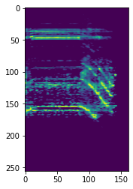
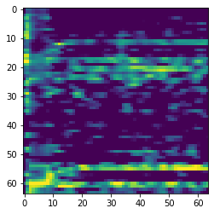
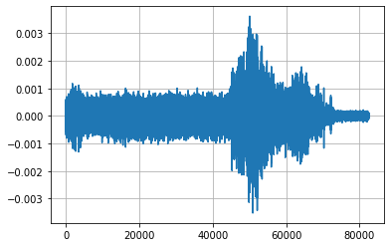
1. Results - 1 sample, environment noise off, database creation
There are 3 files with OK data for directory 1 and 3 files with NOK data, preprocessing goes as follows:
Signal data is processed into melspectrogram (after highpass filter), and then it is framed into window 64x64 pixels in mid-frequencies.

Slide 5
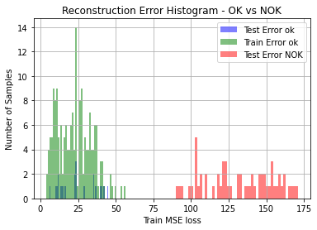
1. Results - 1 sample, environment noise off, database training
Training is done through 2D convolutional autoencoder. 4 layers in encoder and 4 layers in decoder. Loss function is Mean Squeared Error and optimizer is Adam.
OK data is divided into test and train. Test data is never presented to optimizer during training.
NOK data is never presented to optimizer.
We expect that after the training there is going to be a direct threshold value that can be used to divide NOK data from OK, but test and train subsets will have similar values.
That assumption is passed in given example.

Slide 6
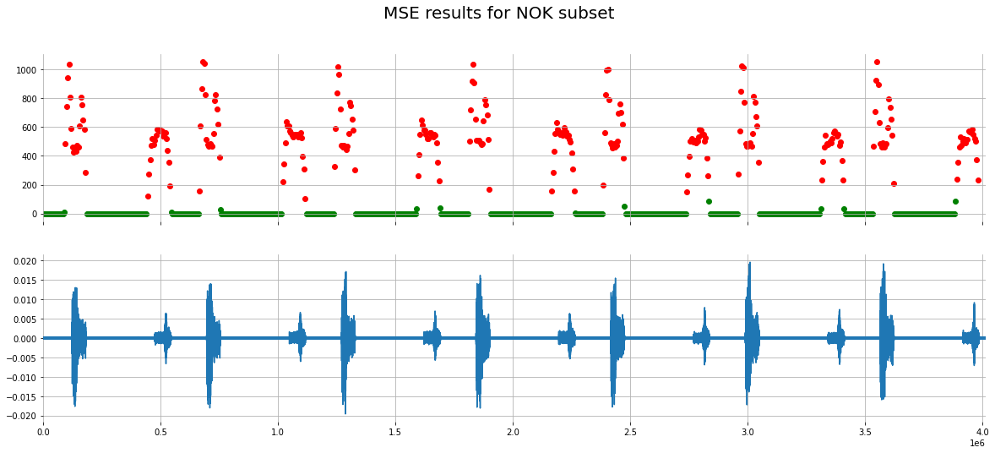
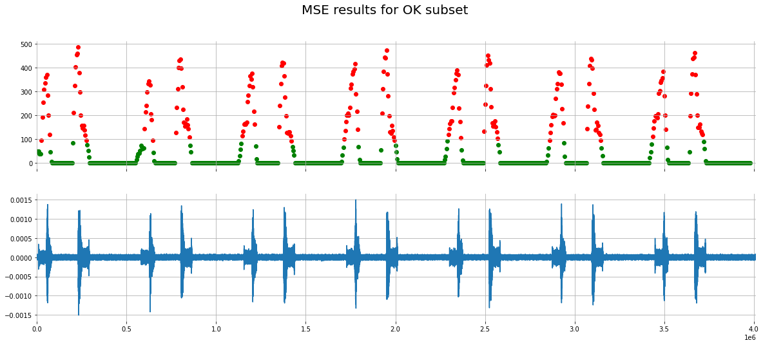
1. Results - 1 sample, environment noise off, constant surveillance
Since we do not have rpm or trigger event information we need to have constant measurment over time to verify if our test is in OK metrics.
We can see on the left that NOK data for apply is much higher than 500 threshold obtained by the OK data set.
Similar training we can create for release step and apply lower value of both during each step.
In this example that would not be necessary, the division between ok and nok is obtained.

Slide 7
1 sample, environment noise on

Slide 8
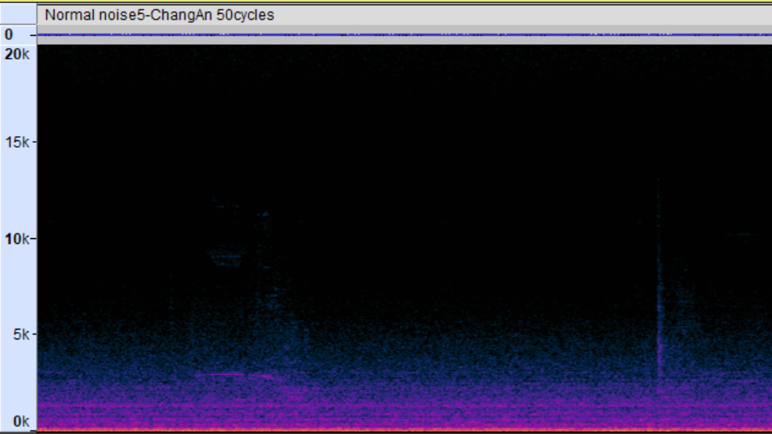
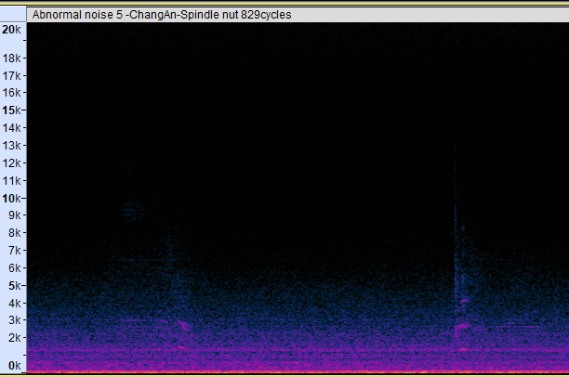
2. Results - 1 sample, environment noise ON, database creation
Noise present in the data prevents usage of previous method. For noisy data another approach was developed.
Abnormal noise have visible differences in initial moments of release phase. Probably metalic object is hiting another creating instance of noice visible in high frequencies, outside of ambient noise created by the anechoric chamber. I will use that phenomena for further analysis.
Little differenece compared to ok
Apply phase
Release phase
Visible differences in frequencies 4kHz to 8kHz

Slide 9
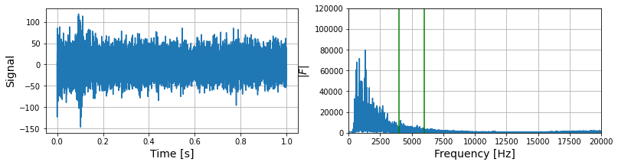
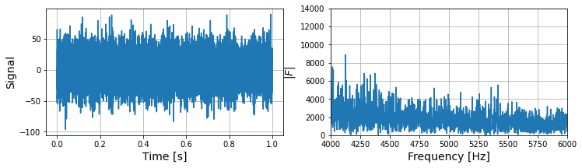
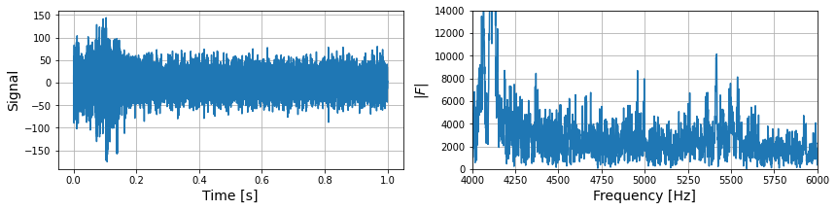
2. Results - 1 sample, environment noise ON, database creation
Idea is to create a spectral image of 1s of recording starting from the begining of realease phase and compare the abnormal noise with normal noise in frequency range 4000 to 6000
As we can extract some signal differences between the normal and abnormal sample, lets create a database out of fft output (fft output is going to be downsampled)
Normal
Abnormal

Slide 10
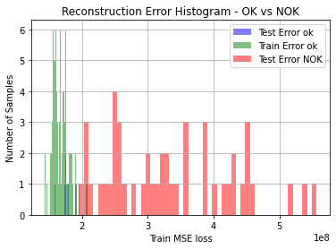
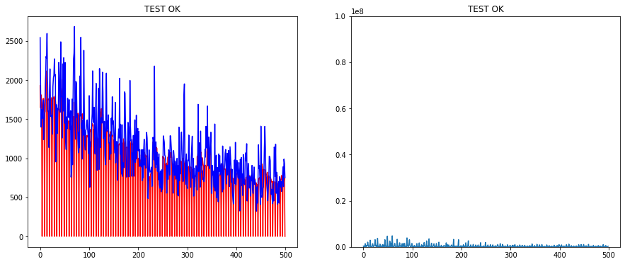
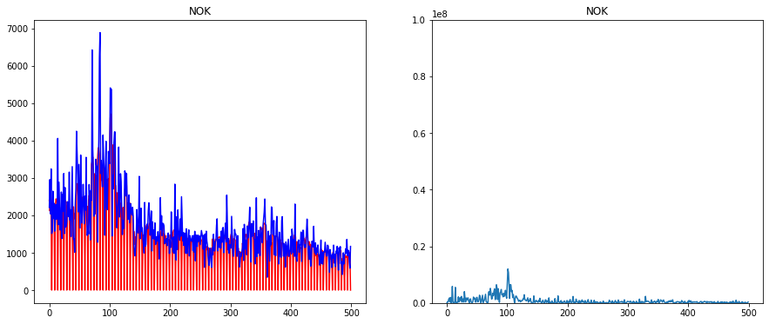
2. Results – 1D convolutional autoencoder - training
Database is traditionally split into Train/Test and NOK subsets.
Algorithm of choice – 1D autoencoder
Training was done throught 1D autoencoder architecture, result of training is showed on histogram.
As previously, we expect train and test results to yield similar ranges of reconstruction error and NOK results to be visibly different compared to the two.
Additionally, I present one example of data over reconstruction and difference between them, on for OK and one for NOK, below.
Difference compared to OK data

Slide 11
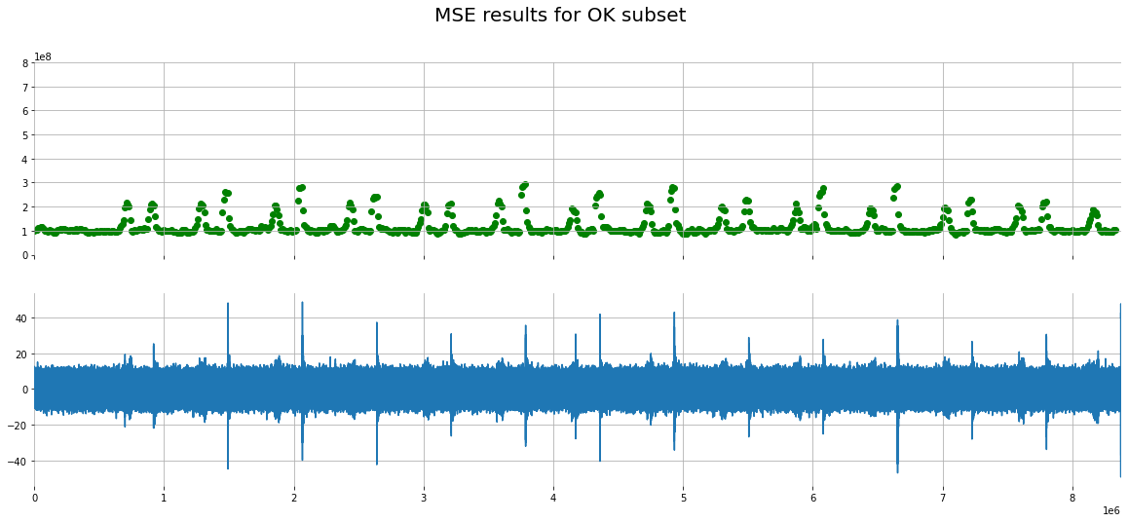
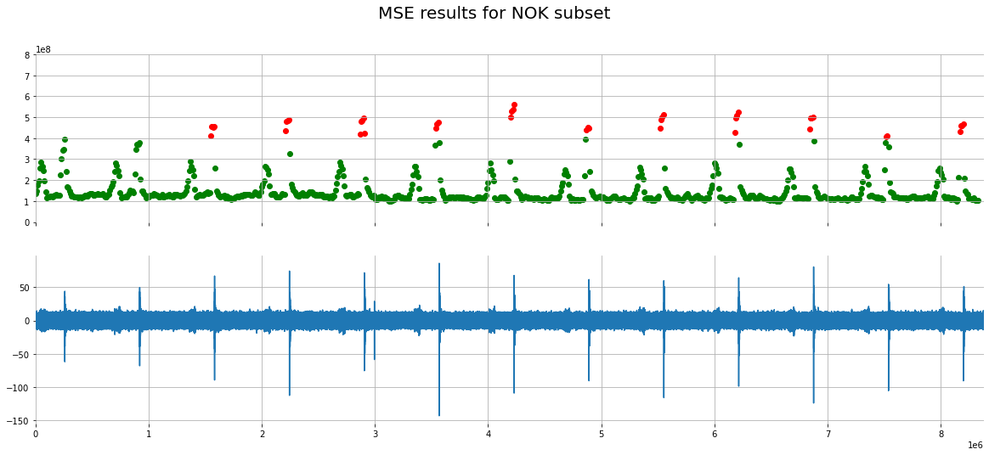

2. Results - 1D convolutional autoencoder - constant surveillence
Data is now trained so we would like to see how it behaves on a full recording of Normal and Abnormal noise.
We would like to see if solid thresholds can be created to separate OK from NOK data.
The threshold was set to 4x1*10^8
We can see that there is clear difference between the ok and nok samples

Slide 12
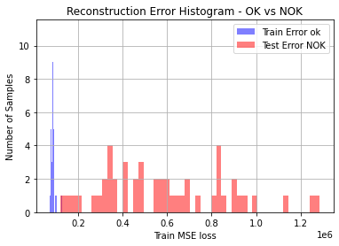
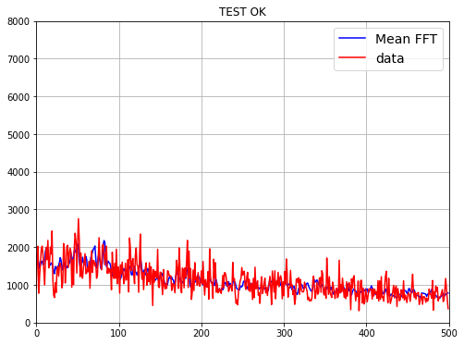
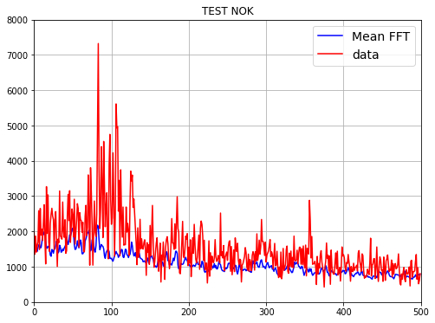
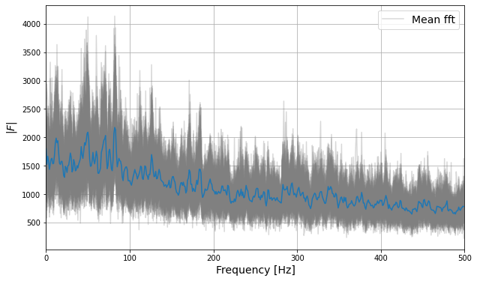
2. Results – mean regression - training
Database is traditionally split into Train/Test and NOK subsets.
Algorithm of choice – Mean Regression
Mean FFT was created out of all tests generated in directory 2 from FFTs narrowed to frequency range 4kHz to 6kHz derivied from 1s of recording in release phase.
MSE was used as a metric to compare difference between current recoring and mean.
Hypothesis is to find profound MSE value differences in given frequency range between normal and abnormal subsets

Slide 13
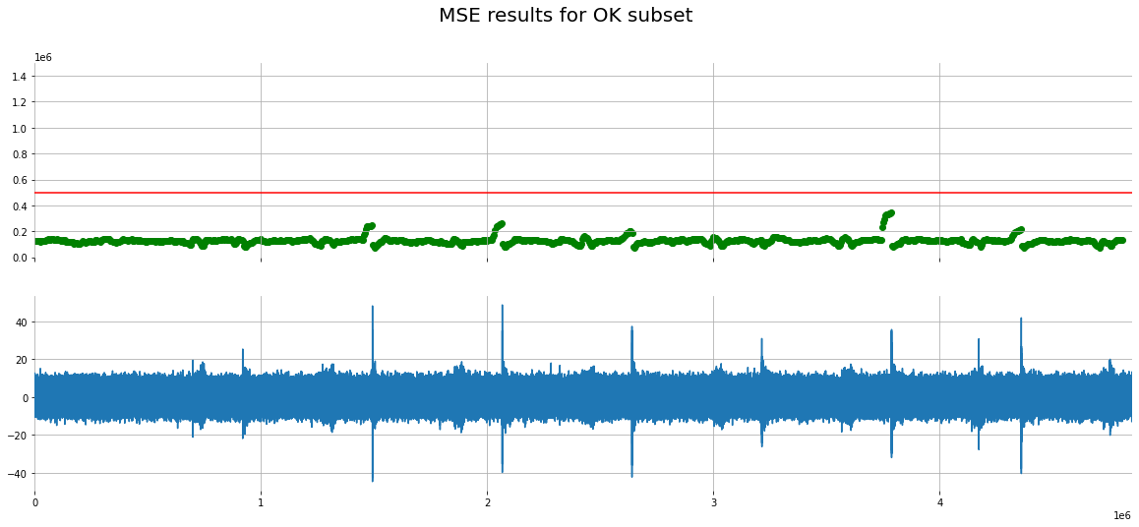
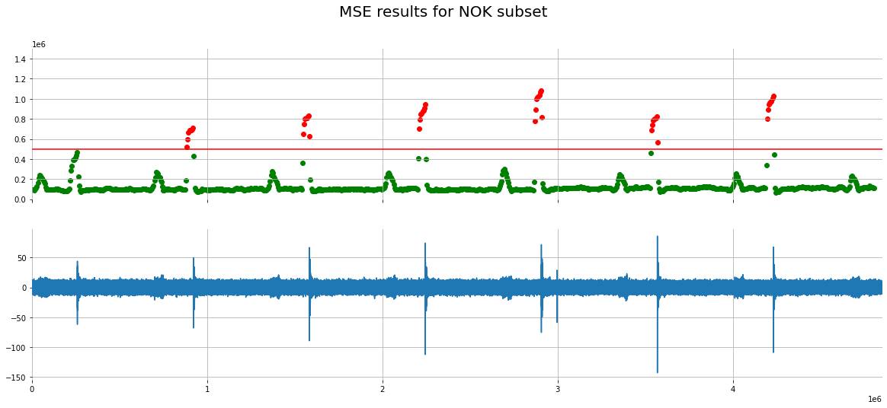
2. Results - mean regression - constant surveillence
Data is now trained so we would like to see how it behaves on a full recording of Normal and Abnormal noise.
We would like to see if solid thresholds can be created to separate OK from NOK data.
The threshold was set to 500000
We can see that there is clear difference between the ok and nok samples

Slide 14
6 samples, environment noise on

Slide 15
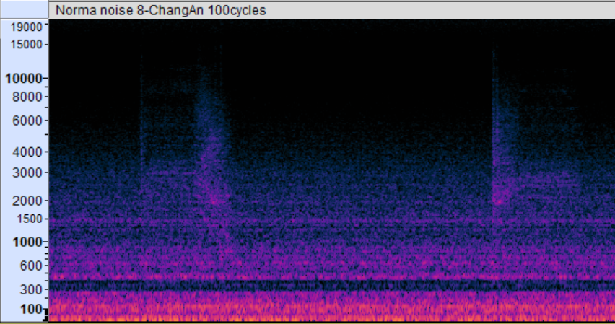
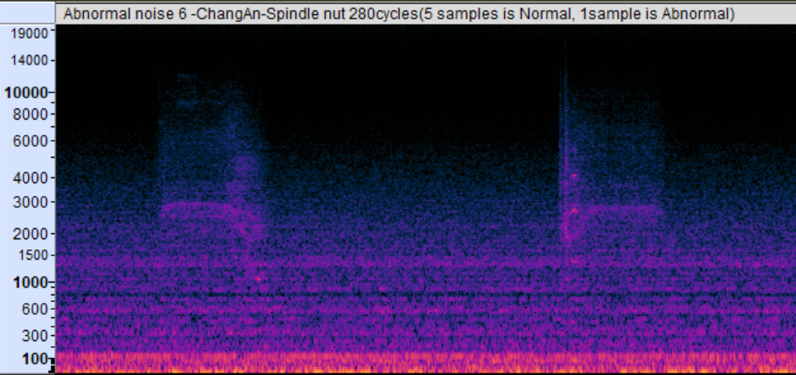
3. Results - 6 samples, environment noise ON, database creation
Noise present in the data prevents usage of autencoder. Identical approach was used as for 1 sample with noise
Abnormal noise have visible differences in initial moments of release phase. Probably metalic object is hiting another creating instance of noice visible in high frequencies, outside of ambient noise created by the anechoric chamber. I will use that phenomena for further analysis.
Apply phase
Release phase
Little differenece compared to ok
Visible differences in frequencies 4kHz to 8kHz

Slide 16
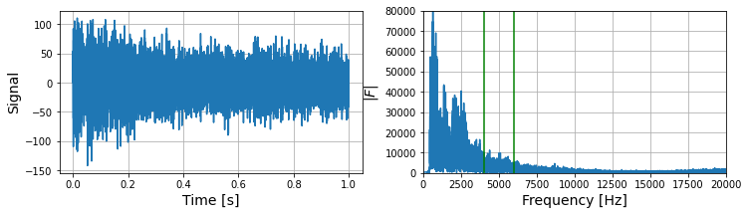
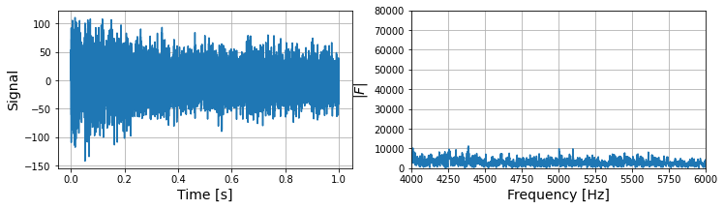
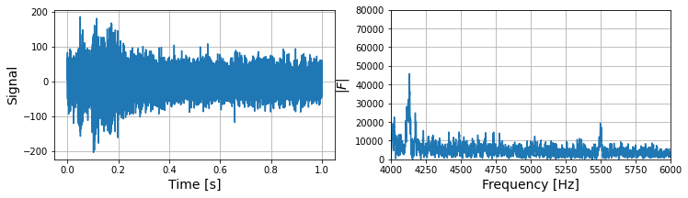
3. Results - 6 samples, environment noise ON, database creation
Idea is to create a spectral image of 1s of recording starting from the begining of realease phase and compare the abnormal noise with normal noise in frequency range 4000 to 6000
As we can extract some signal differences between the normal and abnormal sample, lets create a database out of fft output (fft output is going to be downsampled)
Normal
Abnormal

Slide 17
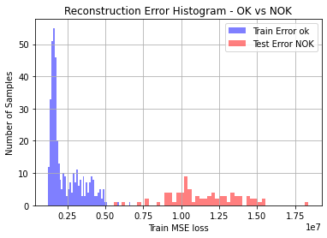
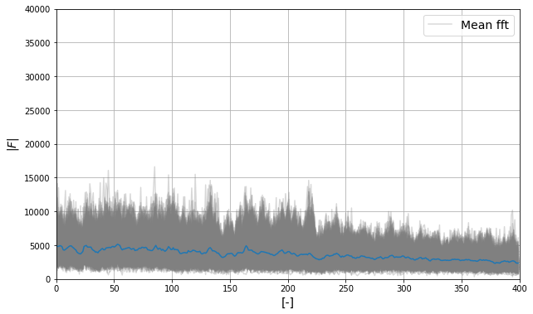
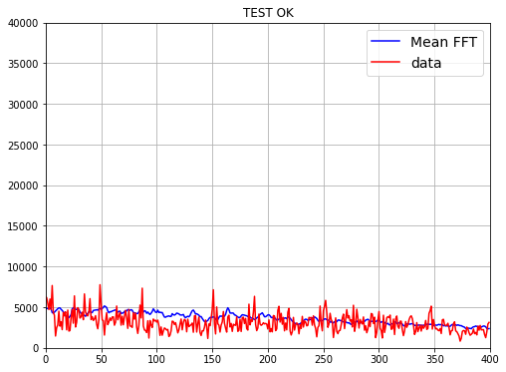
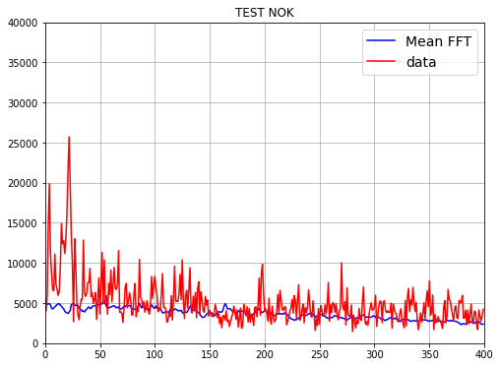
3. Results – mean regression - training
Database is traditionally split into Train/Test and NOK subsets.
Algorithm of choice – Mean Regression
Mean FFT was created out of all tests generated in directory 2 from FFTs narrowed to frequency range 4kHz to 6kHz derivied from 1s of recording in release phase.
MSE was used as a metric to compare difference between current recoring and mean.
Hypothesis is to find profound MSE value differences in given frequency range between normal and abnormal subsets

Slide 18
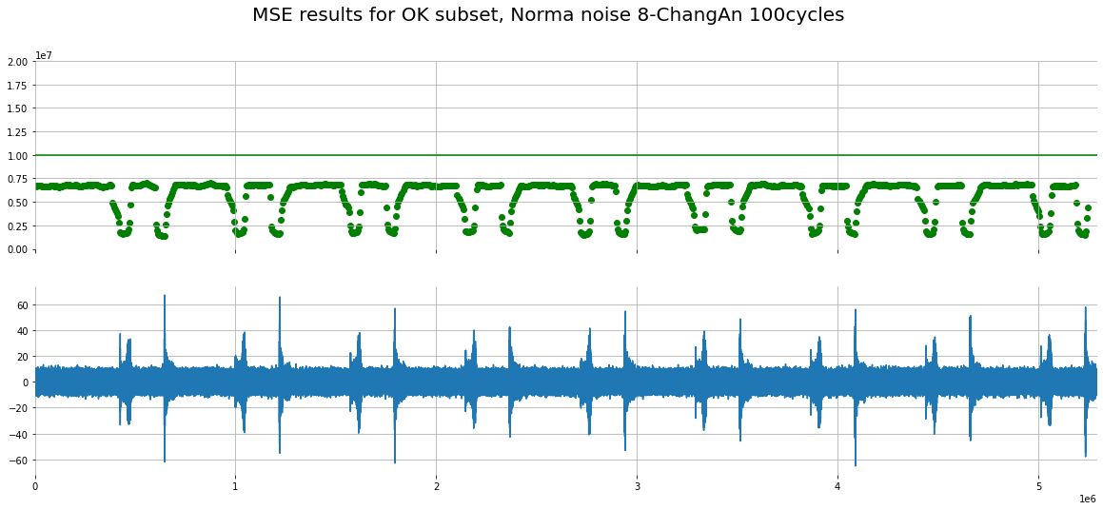
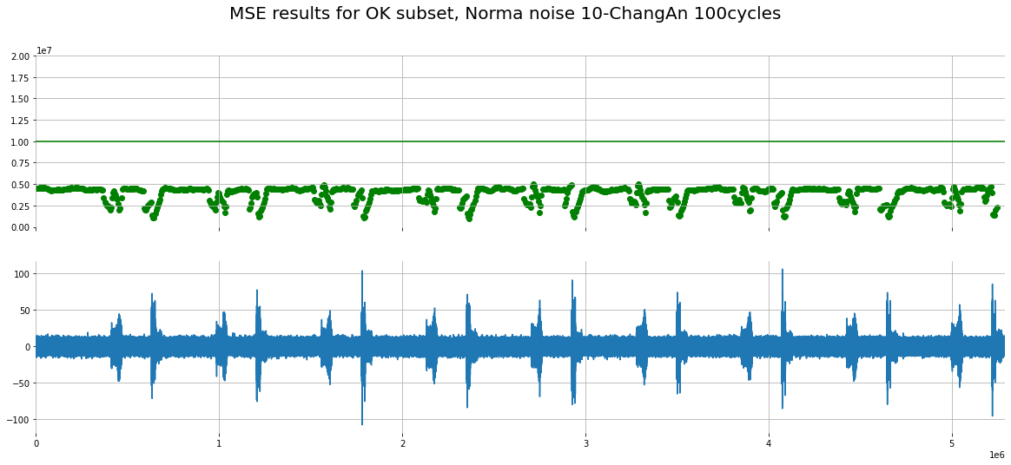
3. Results - mean regression - constant surveillence
Data is now trained so we would like to see how it behaves on a full recording of Normal and Abnormal noise.
We would like to see if solid thresholds can be created to separate OK from NOK data.
The threshold was set to 1.0e7
We can see that there is a very good, stable model behavior on ok cases without hydraulic pressure

Slide 19
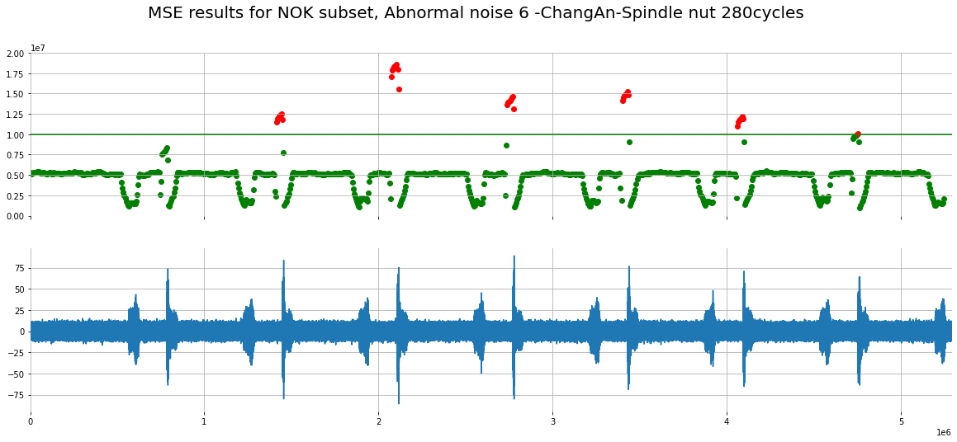
3. Results - mean regression - constant surveillence
Data is now trained so we would like to see how it behaves on a full recording of Normal and Abnormal noise.
We would like to see if solid thresholds can be created to separate OK from NOK data.
The threshold was set to 1.0e7
OK to NOK separation is very well visible

Slide 20
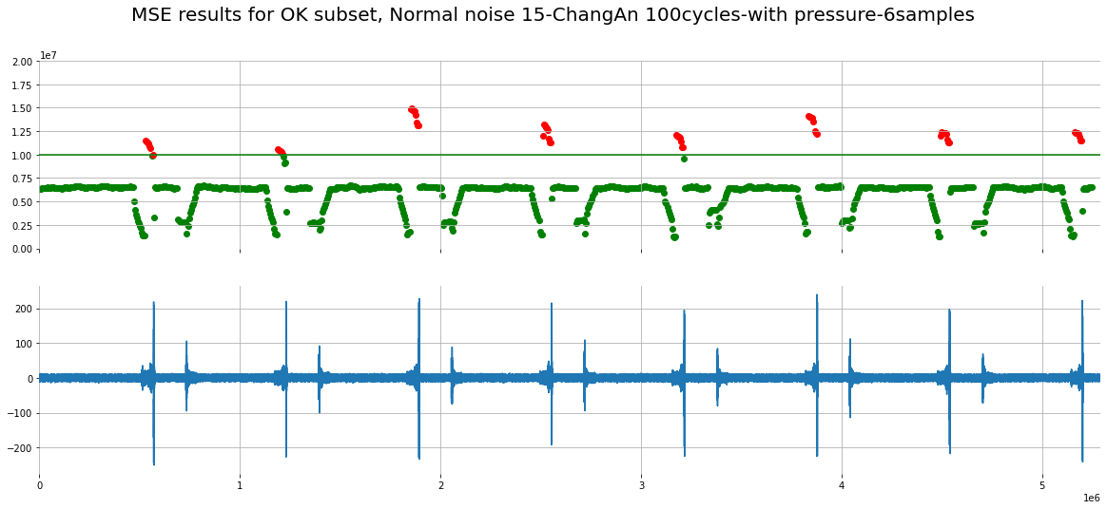
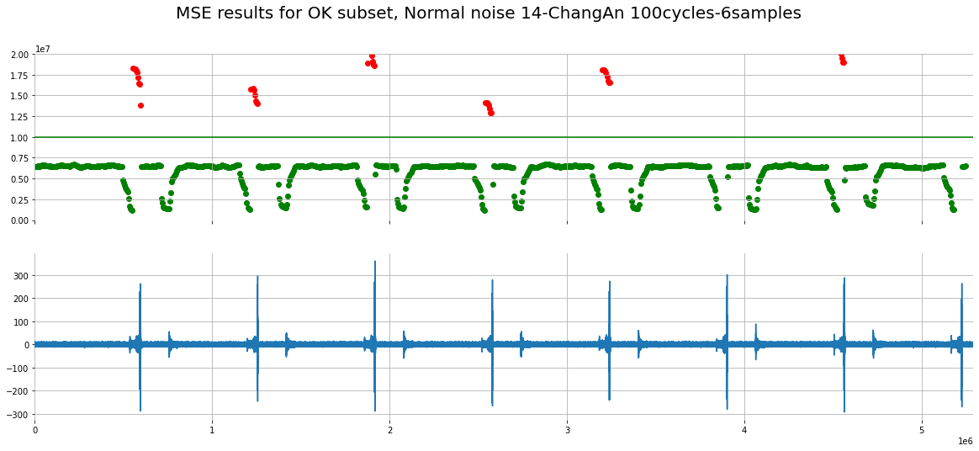
3. Results - mean regression - constant surveillence
There are problematic samples with pressure, the existing solution finds peaks in given frequency range in apply phase
These could be ruled out if we had mechanism to disregard the apply phase altogether
All of the NOK MSE errors are coming from apply phase, as in the True positive OK samples from before, here also the release phase is scored correctly as ok
This has to be worked again in the future, possibly for parts with pressure another model is to be created

Slide 21
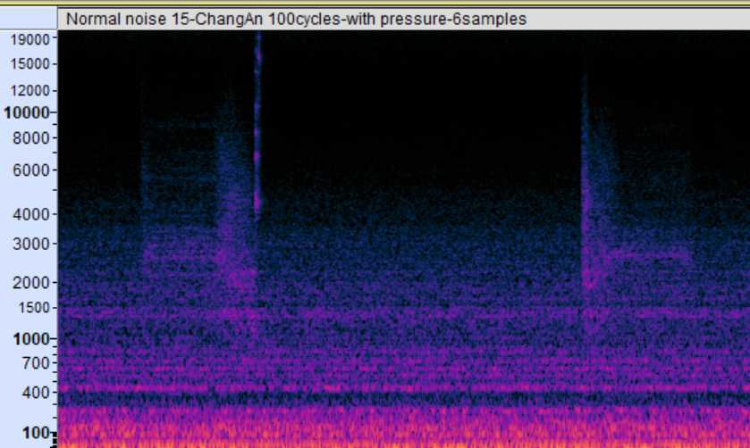
3. Results – pressure apply vs abnormal release
Normal pressured apply phase produces noise visible in high frequencies, which is seen as abnormal according to current approach
Idea to solve this problem could be: find a way to avoid testing apply phase or create additional model that will follow FFT pattern of a pressured apply (if the pressurization creates a pattern visible in FFT)
Apply phase,
Noise at the end
Release phase, typical abnormal pattern

Slide 22
3. Key takeouts
Presented algorithm gave very good prediction on separating normal sounds from abnormal ones.
Prediction outcome should be susceptible to changes in test environment, therefore we need to:
  Make sure microfone is always placed in similar place comapred to the sample as in test data
  We have only one working condition of environmental chamber – if other temperatures compared to the given are overlaying our signal – the prediction is going to get flawed.
If we manage to achieve high level of test and measurment repeatability we should be able to automatically and constantly moniter the test status through microphone.
We will allow the end user in the laboratory to set their own threshold for separation once the test setup is completed, it should be visible after few rounds of apply and relase phase what levels of error are achieved in reference to number of samples tested and amplitude of noise achieved due to the distance from microphone to samples.
For this iteration of script, current approach will not work with pressure samples.

Slide 23
Summary
We would like to handle the script to laboratory technicians. We would like to be part of the team during first trials of usage of script and react and adjust accordingly to end user opinions.
We have confidence that the approach will correctly detect anomalies in certain range of tests
Script can be running on a separate laptop with microphone connected to it through USB port.
In case of 5 consecutive threshold violation, script should be able to inform about the incident through an email.

Slide 24
Next steps
Trials should be conducted in laboratory with initial version of the script on unpressurized samples
Once trials are completed we can implement any potential issues
If solution is working we can implement cloud solutions in order to scale the script

Slide 25
Constant surveillance script
User manual
Ł. Dudzic | Bielsko, TCB | CAE | Division C | CDSN5

Slide 26
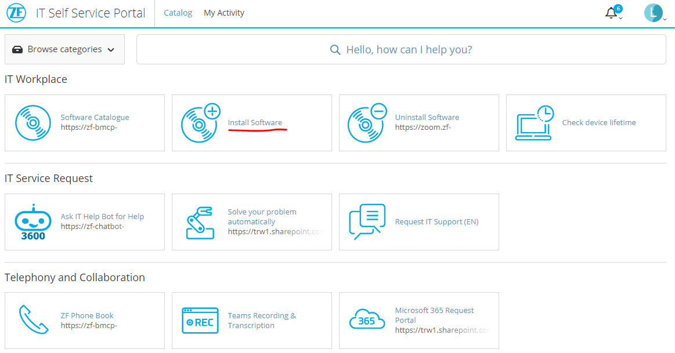
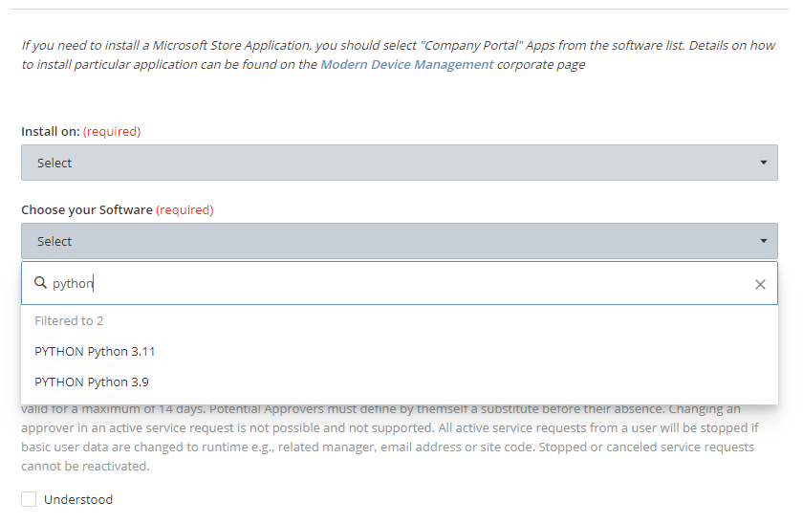
Constant surveillance script | User manual
Preparation – Install Python through HelpDesk
Python needs to be installed. The best way to install Python is to use the installation through HelpDesk:
Type in Python in field „Choose your Software” and choose the latest version:

Slide 27
Constant surveillance script | User manual
Preparation – Install Git
Install Git For Windows:
Find git installer webpage
Choose your Windows setup
Wait for the installer to download. Git license is GNU Public License version 2.0 which means it is free for corporate users

Slide 28
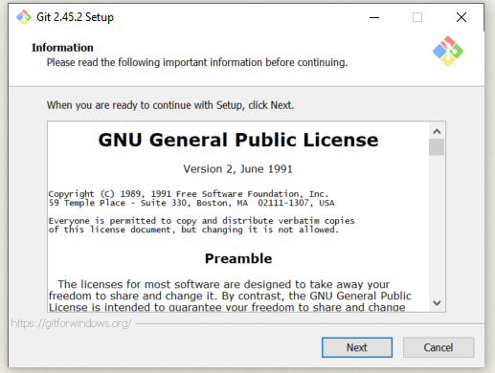
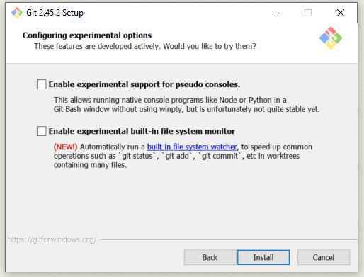
Constant surveillance script | User manual
Preparation – Install Git
Find the installer in downloads directory and double click it to execute. Accept the GNU General Public License. Do not change any of the default setting of the installer. Keep pressing „next” button, up untill you will have the „install” button, then press „install” button.

Slide 29
Constant surveillance script | User manual
Run bash file constant_surveillance_script.bat
Run the bash script by double clicking it just like any other self executable file.
If the file does not execute, it means there is an error, to solve the error run the file in command prompt and send the error message to Lukasz.Dudzic1@zf.com
Please note that there might be modules in the script that are not provided in the ZF Python installation package.
If script execution returns in error because of lack of one or more modules you need to install them using syntax:
Pip install missing_script_name

Slide 30
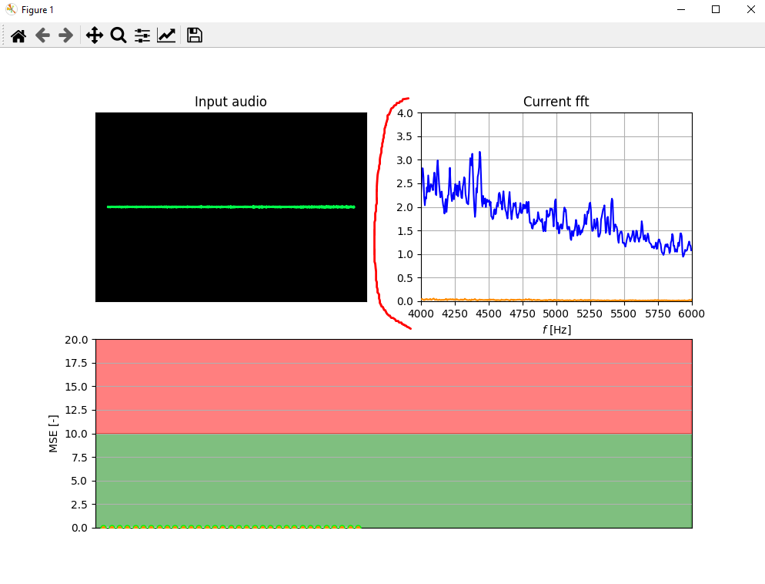
Constant surveillance script | User manual
Script initialization
Opening script will ask you for enter a numeric value for the amplitude parameter.
The default value is 0.001 but you are free to adjust it.
This parameter multiplies the mean FFT loaded from avgfft4 which was obtained through training.
The user is required to tune the parameter so that the orange line (current measured FFT) is at similar levels during the release phase compared to the blue line (mean FFT).
The motivation behind is that there is a different unit system, which requires the 0.001 parameter as a default, however, different number of calipers in test, and different distance from the samples to the microphone might require some more small adjustments to the parameter.
The parameter also multiplies the range of the y axis of the „Current fft” plot.

Slide 31
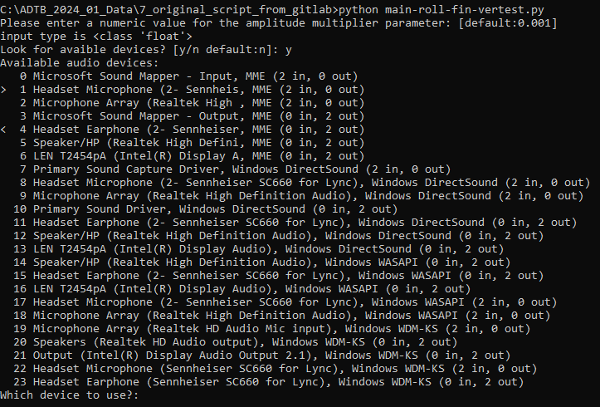
Constant surveillance script | User manual
Script initialization
The script then asks if you would like to look for avaible devices.
If no (default, please press enter), script will take device nr 1, which should be default input.
If „y” is typed instead, script will print all avaible options and ask to choose the device.
Whichever option chosen the script will inform you what device is being used and will inform you about its name and characteristics

Slide 32
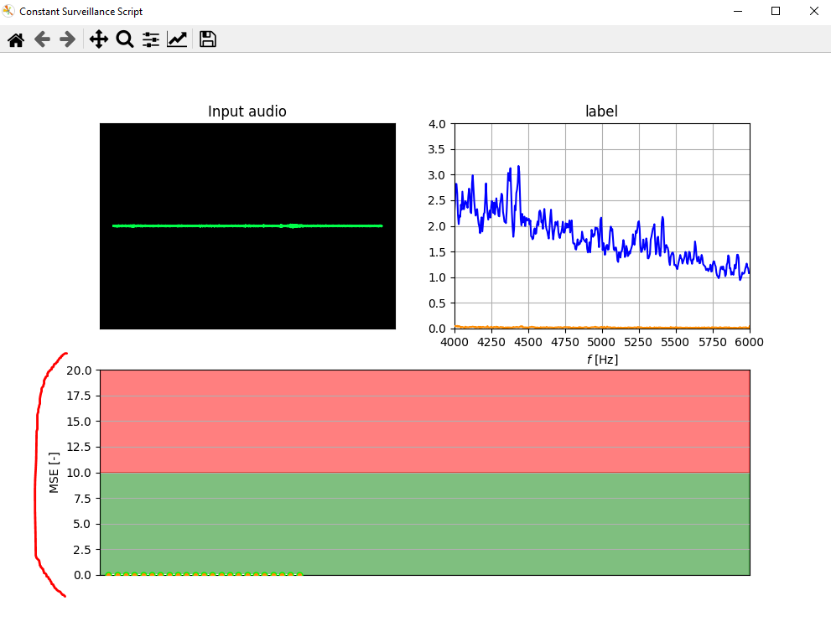
Constant surveillance script | User manual
Script initialization
The script then asks if for the threshold value [default:10000]. Threshold is also multiplied by the intial multiplier value.
Threshold is an important parameter because it provides boundary above which MSE will be consider an anomaly.
MSE is only going to be >0 if calculated from current FFT values greater that mean FFT. If current MSE is < than mean FFT it will yield 0.
This is an option for the user to set an error threshold, not every error is going to be an anomaly.

Slide 33

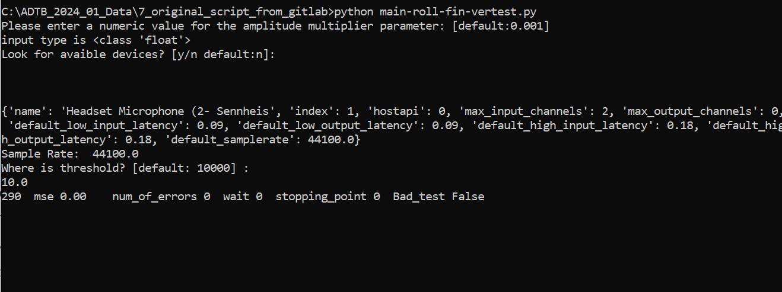
Constant surveillance script | User manual
Script running
Command prompt – information about current FFT and number of errors
Frontend – containing graphical information about the input data and current measurment

Slide 34
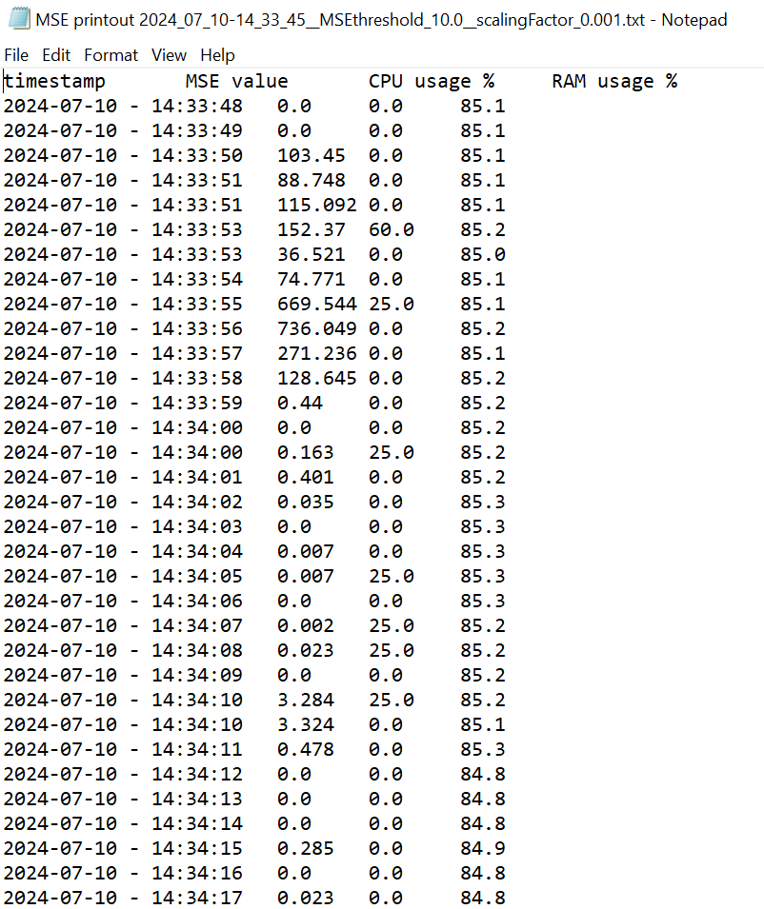
Constant surveillance script | User manual
Output txt
In the directory containing the Constant Surveillance scrip, directory „debug” will be created containing output data from the script.
The output contains MSE error and time of its measurment, as well as some performance measures of the hardware.
If needed this output might in the future be connected to SQL server that would inform through Power BI about potential anomalies.
We also keep information about the used scaling facror and threshold in the title

Slide 35
Practice and Application

Slide 36
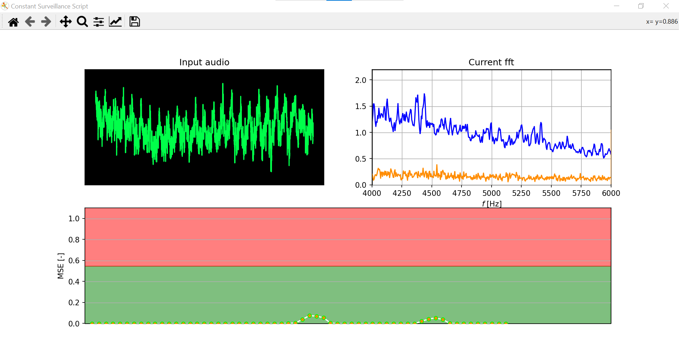
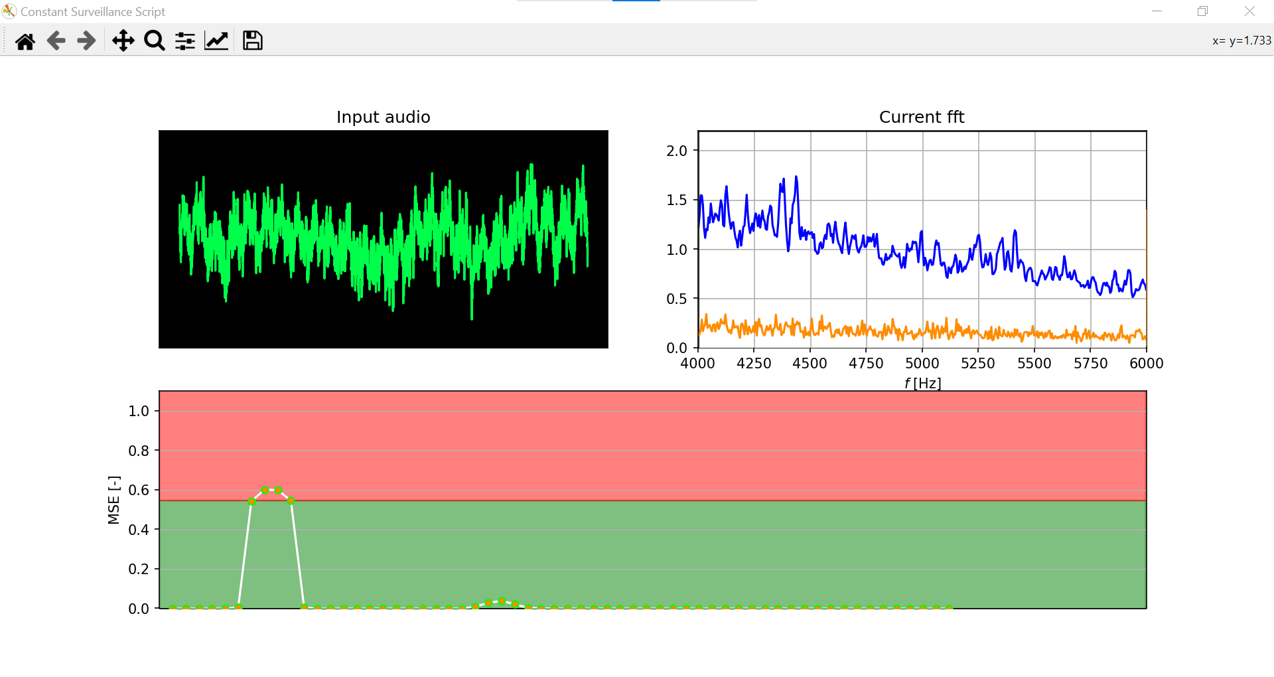
Run the script in ATC
Actual Combat-1
Install 6 normal noise calipers in the environmental chamber, also prepare a caliper with abnormal noise.
Run the environmental chamber and set the temperature to 50℃.
Start monitoring the sound of 6 normal noise calipers.
The monitoring software recorded the sound of every movement, but it did not exceed the limit, so the alarm did not sound.
The monitoring script continues to run. I replaced the original normal noise caliper with a abnormal noise one.
6 normal noise calipers
replace 1 abnormal noise caliper
Limit
current MSE
Apply
Release
Apply
Release

Slide 37
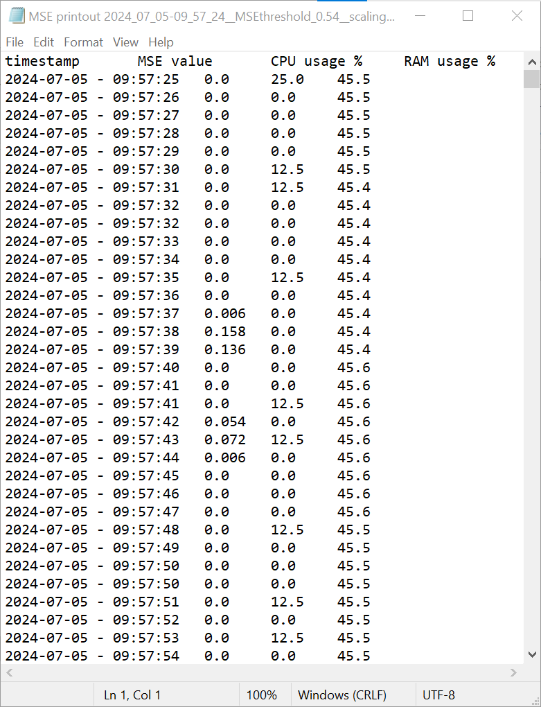
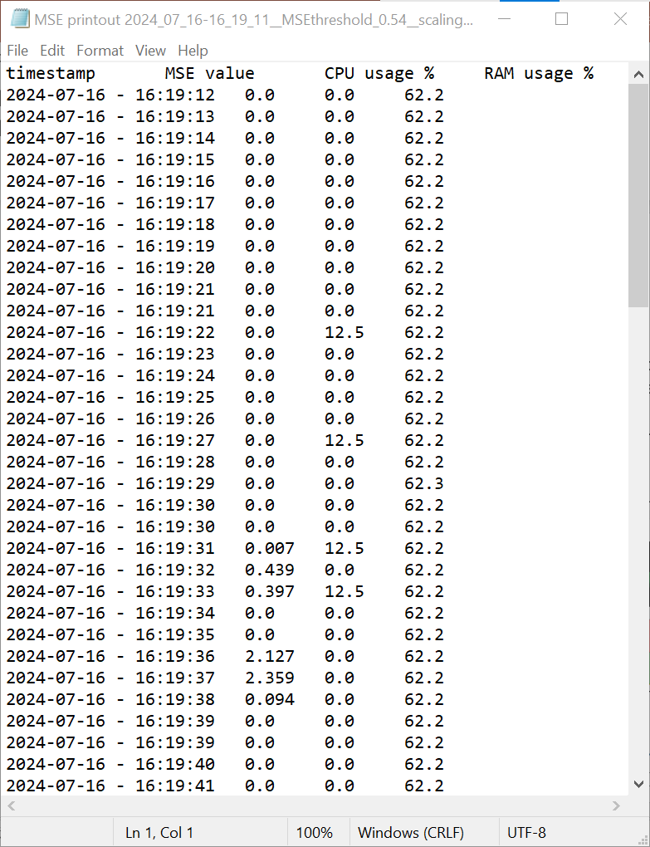


Run the script in ATC
Actual Combat-2
The monitoring system is deployed in the NVH test.
There are 12 calipers in the NVH test, and the temperature box is turned on to keep the calipers at 50℃.
There was no abnormal noise at the beginning of the NVH test, but as the number of cycles increased, some calipers would produce abnormal noise.
After more than 20,000 cycles, we can find that the MSE value has changed significantly. At this time, the NVH test equipment also detected abnormal noise from one caliper.
Apply
Release
Apply
Release
500 cycles
After 20k cycles

Slide 38
Run the script in ATC
Problems encountered in actual combat
Do not issue an alert when the current MSE value exceeds the limit.
——This issue is still being processed.
The monitoring script suddenly stops while running
——Change the test computer‘s battery management to high performance mode.
During the NVH test, 3 samples had abnormal noises which were not detected by our software.
——The abnormal noise in the abnormal noise audio we provided last year occurred near the 4200Hz frequency band. However, the NVH test currently being run has abnormal noise in the 2000Hz frequency band. Lukasz modified the “mean FFT file”

Slide 39
Next steps
Apply this function to future NVH tests to further verify its reliability.
——Do abnormal noises from different sources exist in different frequency bands? (Actuator / Spindle Nut / Pad…)

