Slide 1
SERVERLESS COMPUTING
SPAR NL ANALYSIS
Members: DAVID HAN, ELLIE ZHENG, HUSSEIN DAWOD
https://www.microsoft.com/en/customers/story/1607488243744944969-spar-nl-readies-future-retail-with-azure-integration-services#exec-summary-section

Slide 2
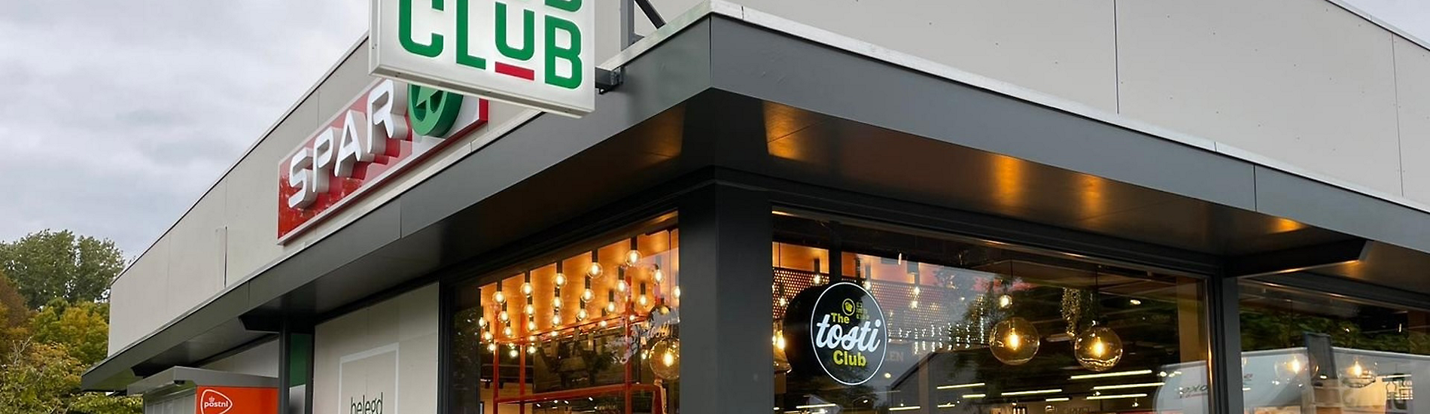
Business problems behind replacing the previous integration system
Limited flexibility
Poor visibility
Slow troubleshooting
Cloud migration barriers
Demand for scaling

Slide 3
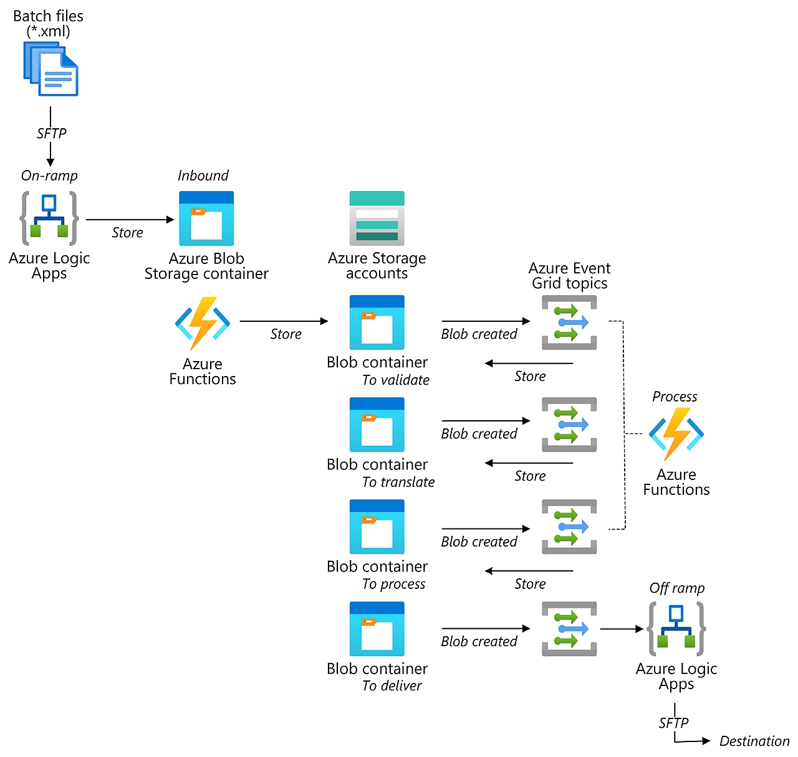
How the main Azure components work together
Azure Logic Apps
Azure Blob Storage
Azure Route Events
Azure Functions
Azure File Sync

Slide 4
Why different workloads require different hosting choices

Slide 5
The trade-offs between usage base costs and response time

