Slide 1
null
1
2
3
null
3
2
3
null
3
2
3
2
2

Slide 2
n
1
2
3
n
2
3
n
3
n

Slide 3
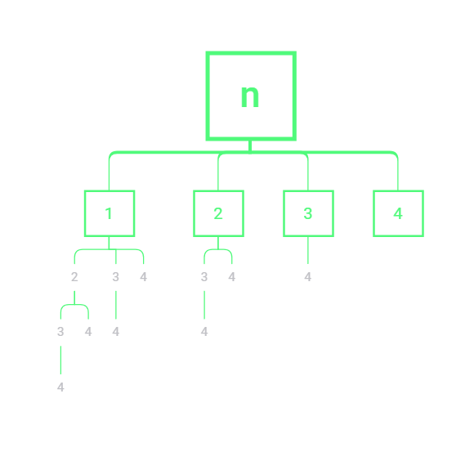

Slide 4
1
2
3
4
5

Slide 5
public class _78_SubCollections { private List<List<Integer>> resList = new ArrayList<>(); private List<Integer> tempList = new ArrayList<>(); public List<List<Integer>> subsets(int[] nums) { for(int i = 0; i <= nums.length; i++) { helper(0, i, nums); } return resList; } public void helper(int ptr, int size, int[] arr) { if(ptr == size) { resList.add(new ArrayList<>(tempList)); return; } for(int i = ptr; i < arr.length; i++) { tempList.add(arr[i]); helper(i + 1, size, arr); tempList.remove(tempList.size() - 1); } } }

Slide 6
private List<List<Integer>> resList = new ArrayList<>(); private List<Integer> tempList = new ArrayList<>(); public List<List<Integer>> subsets(int[] nums) { helper(0, nums); return resList; } public void helper(int ptr, int[] arr) { resList.add(new ArrayList<>(tempList)); for(int i = ptr; i < arr.length; i++) { tempList.add(arr[i]); helper(i + 1, arr); tempList.remove(tempList.size() - 1); } }

Slide 7
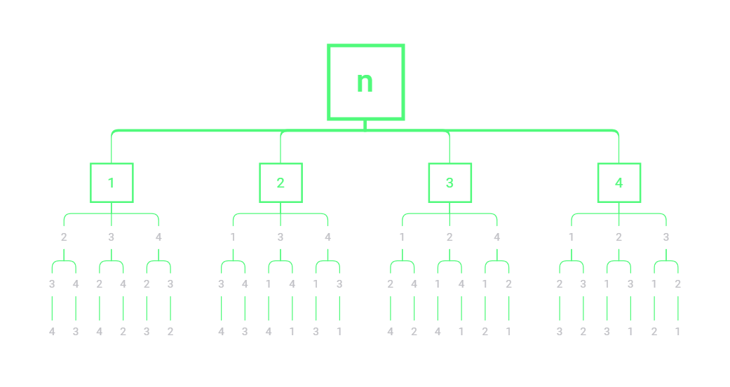
private List<List<Integer>> res = new ArrayList<>(); private List<Integer> tempList = new ArrayList<>(); public List<List<Integer>> permute(int[] nums) { helper(0, nums); return res; } public void helper(int index, int[] nums) { if(index == nums.length) { res.add(new ArrayList(tempList)); return; } for(int i = index; i < nums.length; i++) { tempList.add(nums[i]); helper(index + 1, nums); tempList.remove(tempList.size() - 1); } }

Slide 8
子集
全排列
private List<List<Integer>> resList = new ArrayList<>(); private List<Integer> tempList = new ArrayList<>();
public List<List<Integer>> subsets(int[] nums) { helper(0, nums); return resList; }
public void helper(int ptr, int[] arr) { resList.add(new ArrayList<>(tempList)); for(int i = ptr; i < arr.length; i++) { tempList.add(arr[i]); helper(i + 1, arr); tempList.remove(tempList.size() - 1); } }
private List<List<Integer>> res = new ArrayList<>(); private List<Integer> tempList = new ArrayList<>(); public List<List<Integer>> permute(int[] nums) { helper(0, nums); return res; } public void helper(int index, int[] nums) { if(index == nums.length) { res.add(new ArrayList(tempList)); return; } for(int i = index; i < nums.length; i++) { tempList.add(nums[i]); helper(index + 1, nums); tempList.remove(tempList.size() - 1); } }

