Slide 1
Best Business choice in Toronto
By: Han

Slide 2
Introduction
Based on what I did in week 3 for segmenting and clustering neighbourhood in Toronto, I will then explore that which choice would be the best choice to operate businesses in Toronto. Toronto is one of the biggest city in Canada. The population and people's common venues (performances) are important factors for us to choose one business. Through python, I will decide which type of business is the most popular in Toronto.

Slide 3
Objectives
Find the best business choice
Which type of business is the most popular in Toronto

Slide 4
Data Description
Toronto neighborhood data
Latitude and longitudes about each neighborhood in Toronto
Postal code for each neighborhood in Toronto

Slide 5
Methodology
Collect Data
Explore and Understand the Data
Data preparation and preprocessing
Modeling
Evaluation and Testing

Slide 6
Methodology
Web Scrapping
K-means Clustering

Slide 7
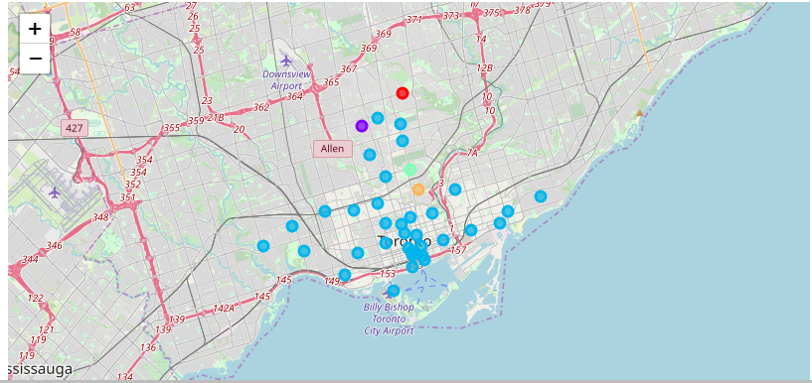
Results: Business Gathering

Slide 8
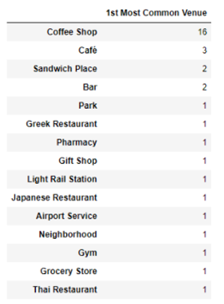
Results: Most Common venue

Slide 9
Conclusion
Coffee shops are the most popular venues in Toronto, in line with Canadian culture.
If open a new business in Toronto, coffee shop would be the most prime choice.

