Slide 1

Predicting Depression from Mental Health Survey Data using Deep Learning

Slide 2

Problem Statement
The goal of this project is to predict whether an individual may experience depression based on various factors such as demographic information, lifestyle choices, and medical history. By leveraging deep learning, the model will be able to identify patterns in the data that could indicate a higher likelihood of depression

Slide 3
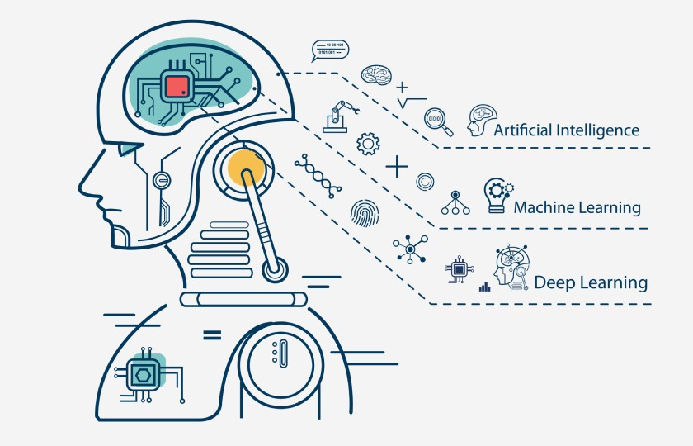
Basic info
Handle Missing Values
Features Eng
Encode Categorical Variables – oneHot and label
Features Scale
Skewness chcek
Outlier detection and solveing
Date Inbalance – reshapeing

Slide 4
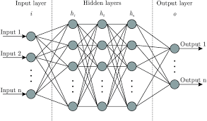
X and y
Train _test_split 80 and 20.
Model buliding

Slide 5
