Slide 1
Credit Card Customer Churn Prediction
Springboard DSC Capstone Project
Han Xiong
May, 2023

Slide 2
Data Science Method
1
2
3
4
5
Problem
Identification
Data
Wrangling
Exploratory
Data
Analysis
Preprocessing
Modeling

Slide 3
Problem Identification
homogenization of bank products
Churn Early Warning Model
Predict potential churned customers
Maintain customer relationships
customers churn
Cost of acquiring new customers >> maintaining old customers

Slide 4
Data Wrangling
Attrition_Flag | Customer_Age | Gender | Dependent_count | Education_Level | Marital_Status | Income_Category | Card_Category | Months_on_book | Total_Relationship_Count | Months_Inactive_12_mon | Contacts_Count_12_mon | Credit_Limit | Total_Revolving_Bal | Avg_Open_To_Buy | Total_Amt_Chng_Q4_Q1 | Total_Trans_Amt | Total_Trans_Ct | Total_Ct_Chng_Q4_Q1 | Avg_Utilization_Ratio
Existing Customer | 45 | M | 3 | High School | Married | $60K - $80K | Blue | 39 | 5 | 1 | 3 | 12691 | 777 | 11914 | 1.335 | 1144 | 42 | 1.625 | 0.061
Existing Customer | 49 | F | 5 | Graduate | Single | Less than $40K | Blue | 44 | 6 | 1 | 2 | 8256 | 864 | 7392 | 1.541 | 1291 | 33 | 3.714 | 0.105
Existing Customer | 51 | M | 3 | Graduate | Married | $80K - $120K | Blue | 36 | 4 | 1 | 0 | 3418 | 0 | 3418 | 2.594 | 1887 | 20 | 2.333 | 0
Existing Customer | 40 | F | 4 | High School | Unknown | Less than $40K | Blue | 34 | 3 | 4 | 1 | 3313 | 2517 | 796 | 1.405 | 1171 | 20 | 2.333 | 0.76
Existing Customer | 40 | M | 3 | Uneducated | Married | $60K - $80K | Blue | 21 | 5 | 1 | 0 | 4716 | 0 | 4716 | 2.175 | 816 | 28 | 2.5 | 0
10127 customers information: personal information, account information, transaction information
dropped off client number column and NaiveBayesClassifier_attribution columns
Target feature: attrition flag
5 Categorical features:
Gender,Education_Level,Marital_Status,Income_Category,Card_Category
14 Numerical features:
Customer_Age,Dependent_count,Months_on_book,Total_Relationship_Count,Months_Inactive_12_mon,Contacts_Count_12_mon,Credit_Limit,Total_Revolving_Bal,Avg_Open_To_Buy,Total_Amt_Chng_Q4_Q1,Total_Trans_Amt,Total_Trans_Ct,Total_Ct_Chng_Q4_Q1,Avg_Utilization_Ratio

Slide 5
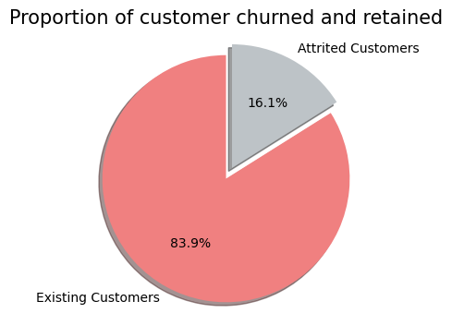
Exploratory Data Analysis
imbalanced binary classification

Slide 6
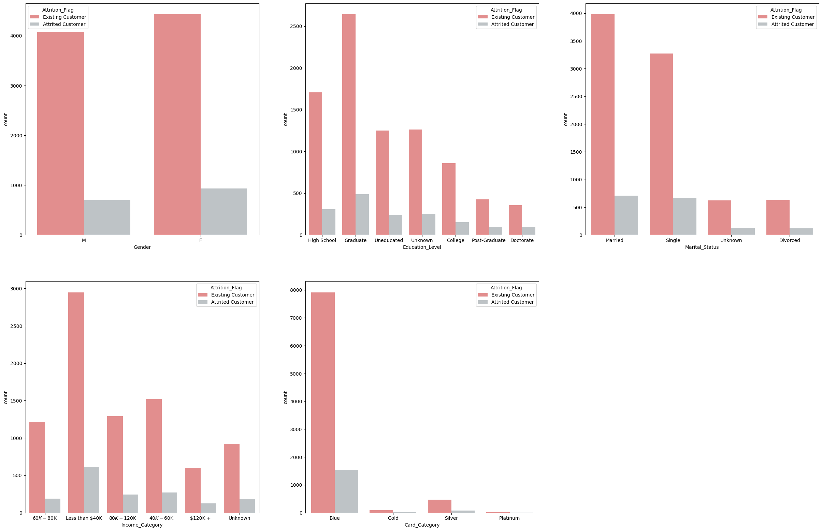
Exploratory Data Analysis
Frequency Distributions of Categorical Features
Categorical variables provide us our customer profile information.
Categorical variables do not appear to be significant factors in determining whether customers will churn.

Slide 7
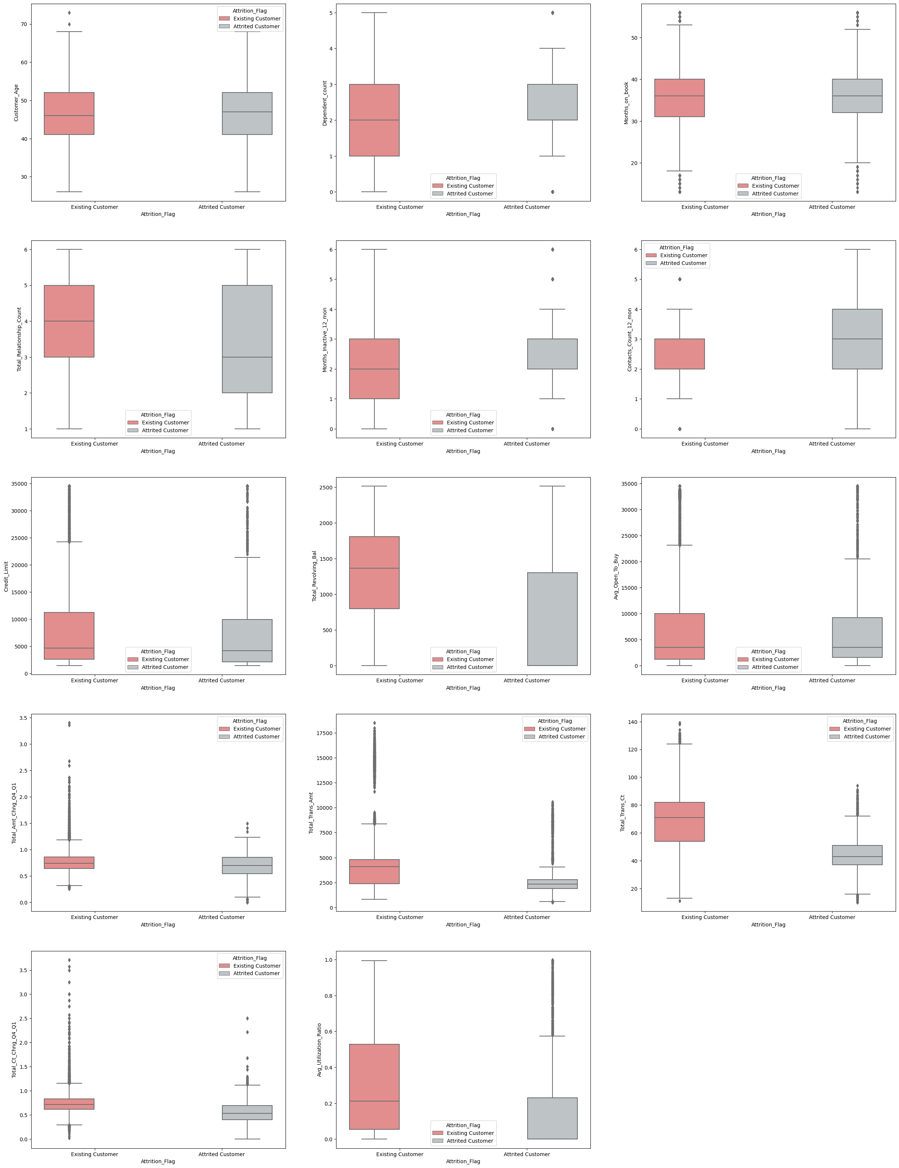
Distributions of Numerical Features
Exploratory Data Analysis
Customers with fewer bank products, low transfer frequency, low credit card utilization and long periods of inactivity are more likely to churn.
Customers who have churned have contacted the bank more often in the past year than those who have retained.

Slide 8
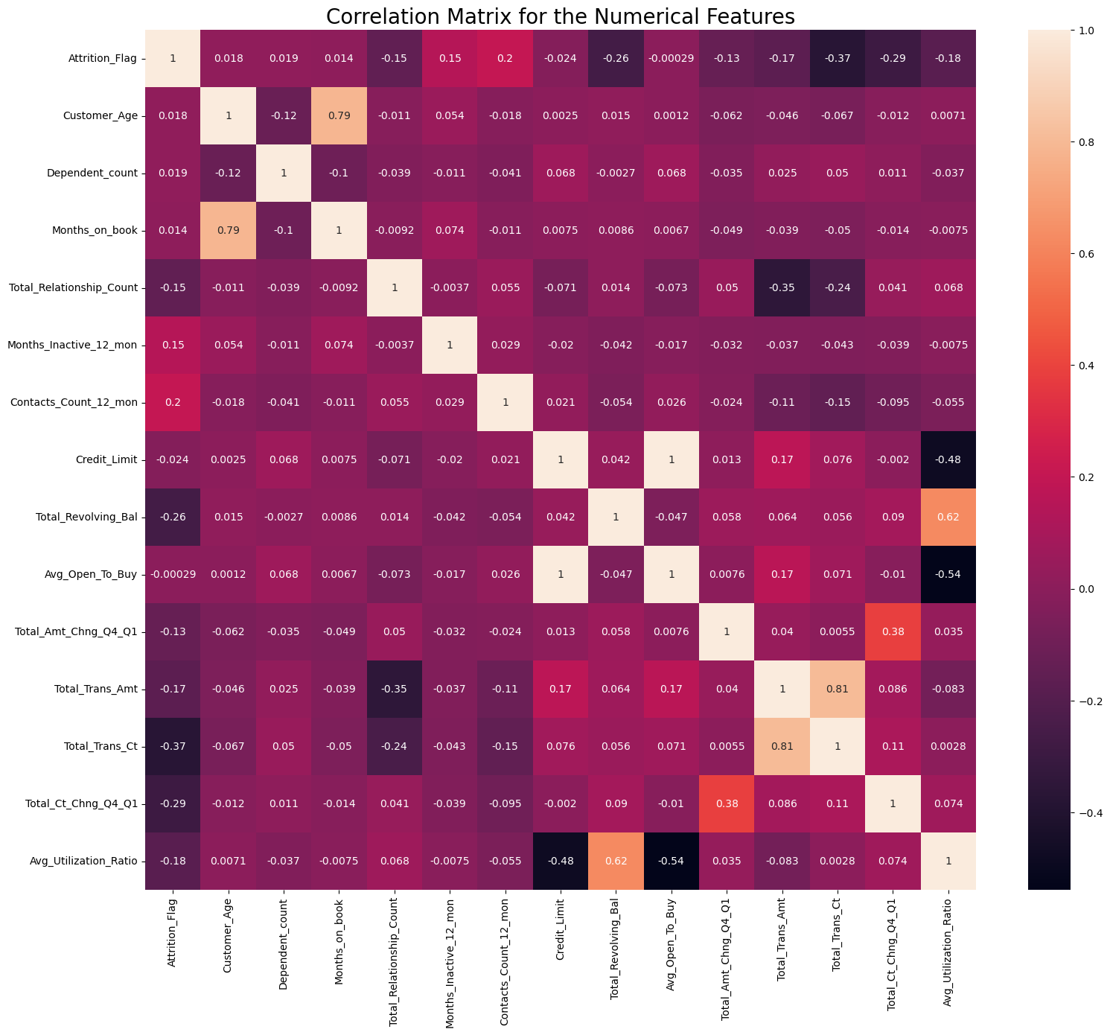
Exploratory Data Analysis
Avg_Open_To_Buy and Credit_Limite are perfect positive correlated..
Total_Revolving_Bal and Avg_Utilization_Ratio are highly positive correlated
Avg_Open_To_Buy and Avg_Utilization_Ratio are highly negative correlated
Credit_Limite=Total_Revolving_Bal+Avg_Open_To_Buy,
Avg_Utilization_Ratio=Total_Revolving_Bal/Credit_Limite
Customer_Age and Months_on_book,
Total_Trans_Amt and Total_Trans_Ct are higly positive correlated.

Slide 9
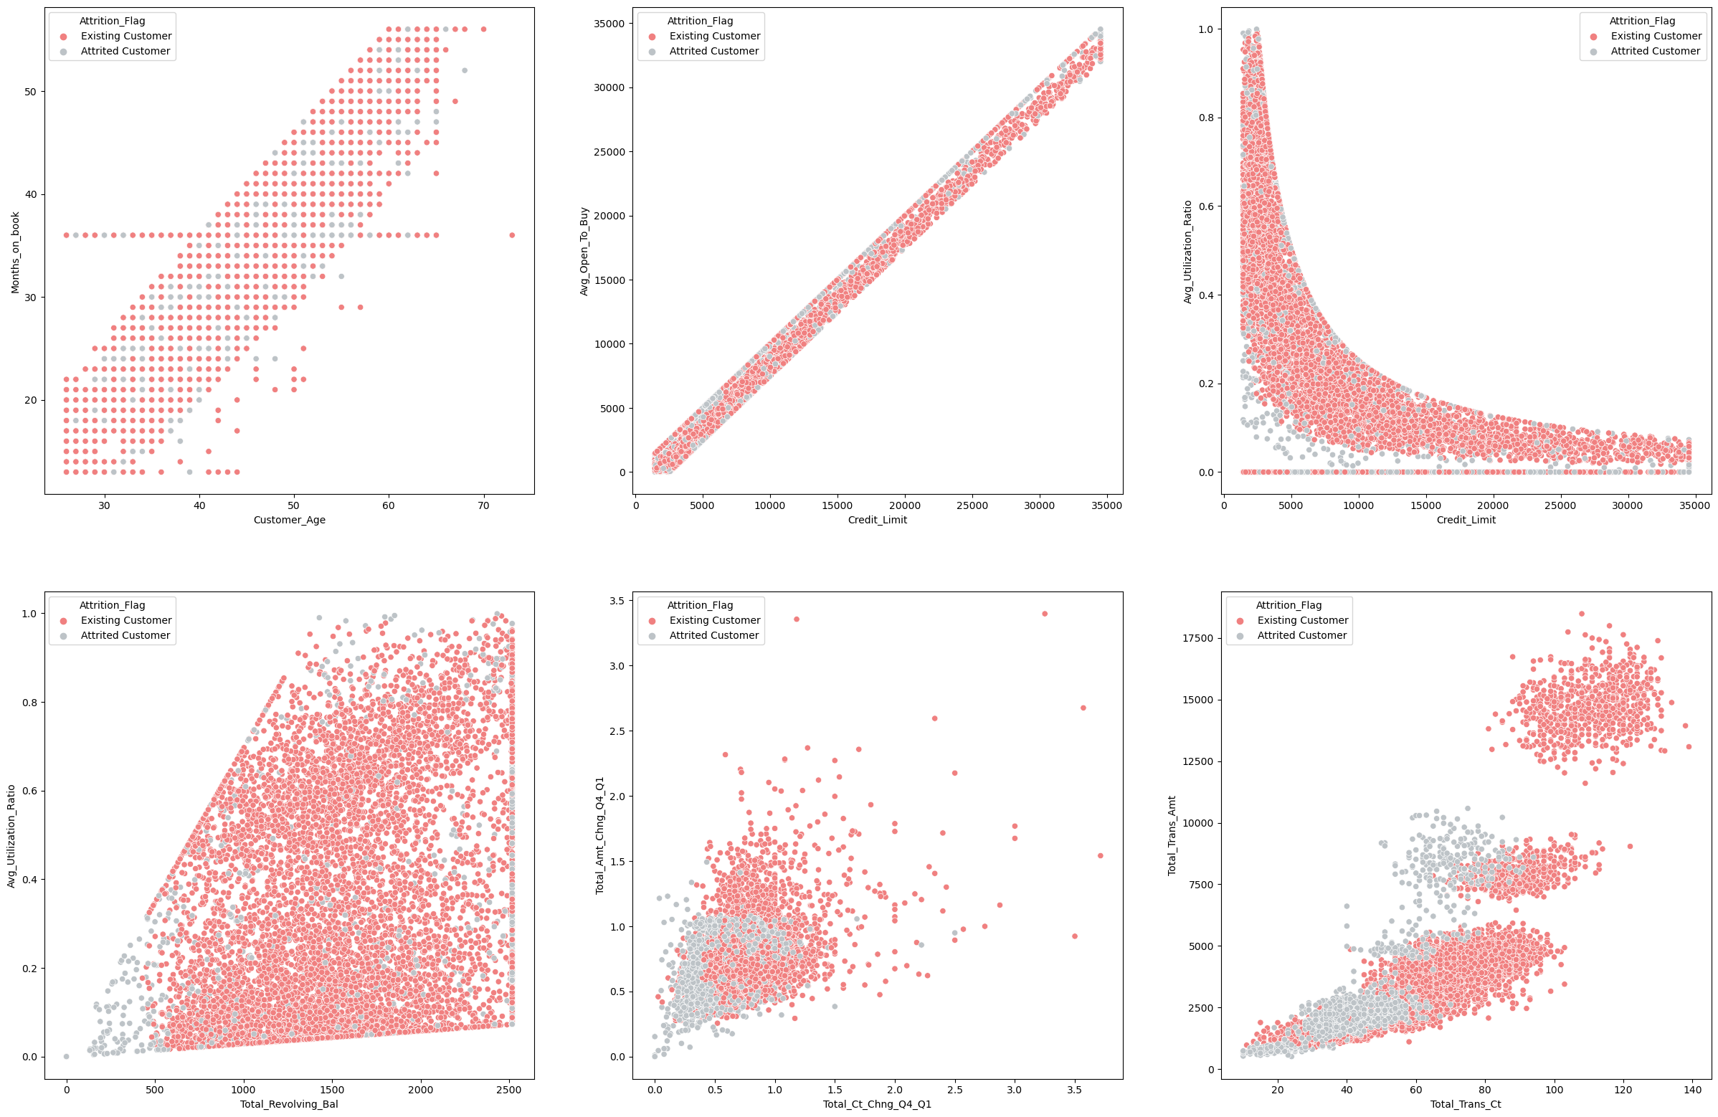
Churned customers tend to have lower credit limit, lower utilization rate, less transaction activities and lower transaction amount.

Slide 10
Modeling
sklearn pipeline
Logistic Regression
Random Forest
XGBoost
SVM Linear
SVM RBF
Categorical
features
OneHotEncoder
Numerical
features
StandardScaler
classification metrics
train_test_split
test_size=0.25
stratify=y
class_weight='balanced’
Cross Validation
Preprocessing
Classifier

Slide 11
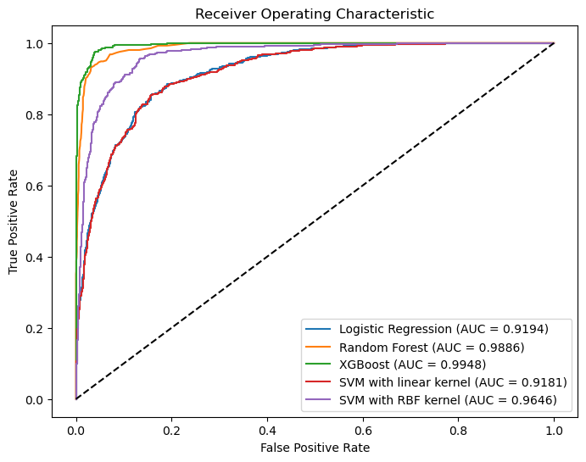
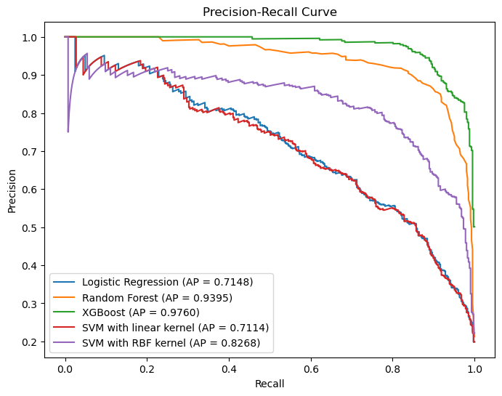
Performance comparison of different algorithms
Modeling
Algorithms | roc_auc | f1 | precision | recall | accuracy
Logistic Regression | 0.9266 | 0.6357 | 0.5102 | 0.8434 | 0.8447
Random Forest | 0.9852 | 0.8208 | 0.9262 | 0.7319 | 0.9469
XGBoost | 0.9909 | 0.9062 | 0.9346 | 0.8795 | 0.9707
SVM Linear | 0.9261 | 0.635 | 0.509 | 0.8442 | 0.8441
SVM RBF | 0.966 | 0.7701 | 0.6789 | 0.8901 | 0.9145
On training set
On test set
Choose XGBoost as our model

Slide 12
Model Tuning
Modeling
Search space
Best params
XGBoost
gamma: (0,5)
learning_rate: (0.01,1)
max_depth: (3,10)
min_child_weight: (0.5,1)
n_estimators:(100,500)
gamma: 0
learning_rate: 0.2632
max_depth: 4
min_child_weight: 0.5731
n_estimators: 289
BayesSearchCV
n_iter = 10
n_jobs=-1
cv=5
scoring='f1'

Slide 13
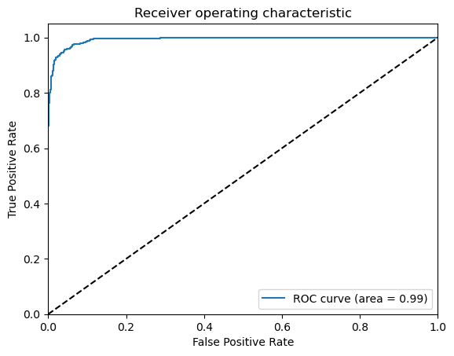
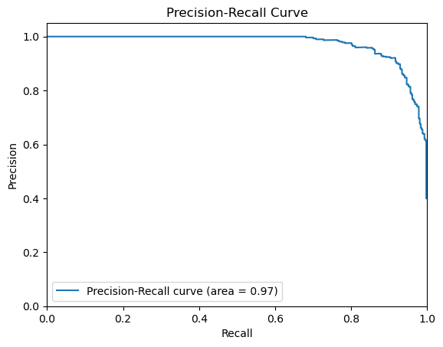
Classification Report
Tuned XGBoost Model Performance on Test Data
Modeling
 | precision | recall | f1-score | support
0 | 0.98 | 0.99 | 0.98 | 2125
1 | 0.94 | 0.89 | 0.92 | 407
accuracy |  |  | 0.97 | 2532
macro avg | 0.96 | 0.94 | 0.95 | 2532
weighted avg | 0.97 | 0.97 | 0.97 | 2532

Slide 14
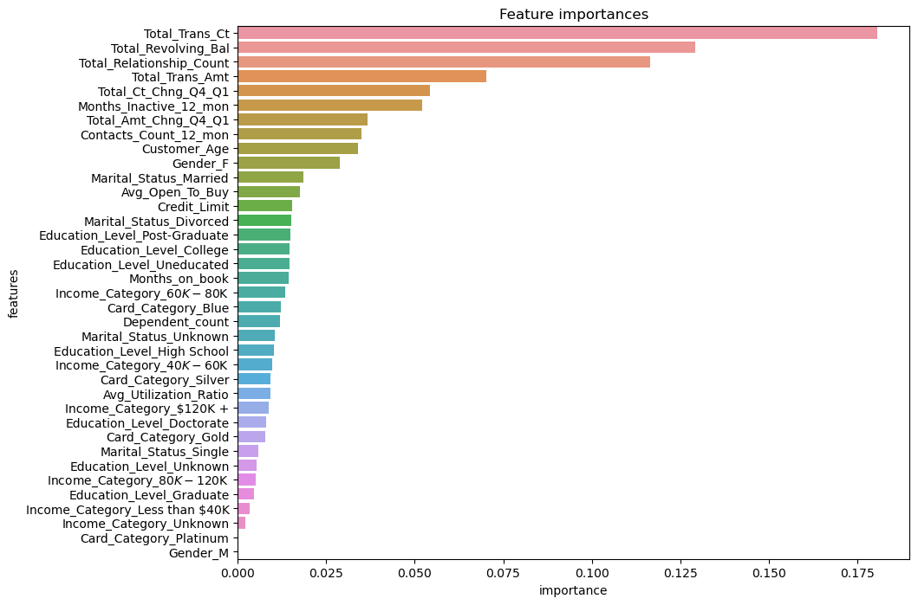
Feature Importance
Modeling

Slide 15
Future Work
Try more algorithms
Try imbalanced data techniques
Try feature selections

Slide 16
Conclusion
Built a model to predict client churn with accuracy 0.97 and f1 score 0.97.
01
According to the model, when a client's account transaction activity is not very active, we should take action to prevent churn.
02
03
The future work for this model will focus on algorithms, imbalanced data techniques and feature selections.

Slide 17
Tank you！
Han Xiong
Springboard DSC capstone project

