Slide 1
AI Coach Gym

Slide 2
Team ID : 17

Slide 3
Team members :-
Asmaa AbdElnasser Amen Mahmoud 162021057
Asmaa Mostafa Tawfik 162021058
Hanaa Mahmoud AbdelAleem 162020718

Slide 4
Description :-
During the days of the ban during the spread of Covid-19, we noticed the great need to perform exercises at home and the danger of going to the gym, which inspired us to build an application to help perform some exercises correctly at home without sustaining any harm.
Our project predicts whether a person is performing the exercise of lat pull down or deadlift correctly or incorrectly using MediaPipe , OpenCV and Tensorflow with Dataset.

Slide 5
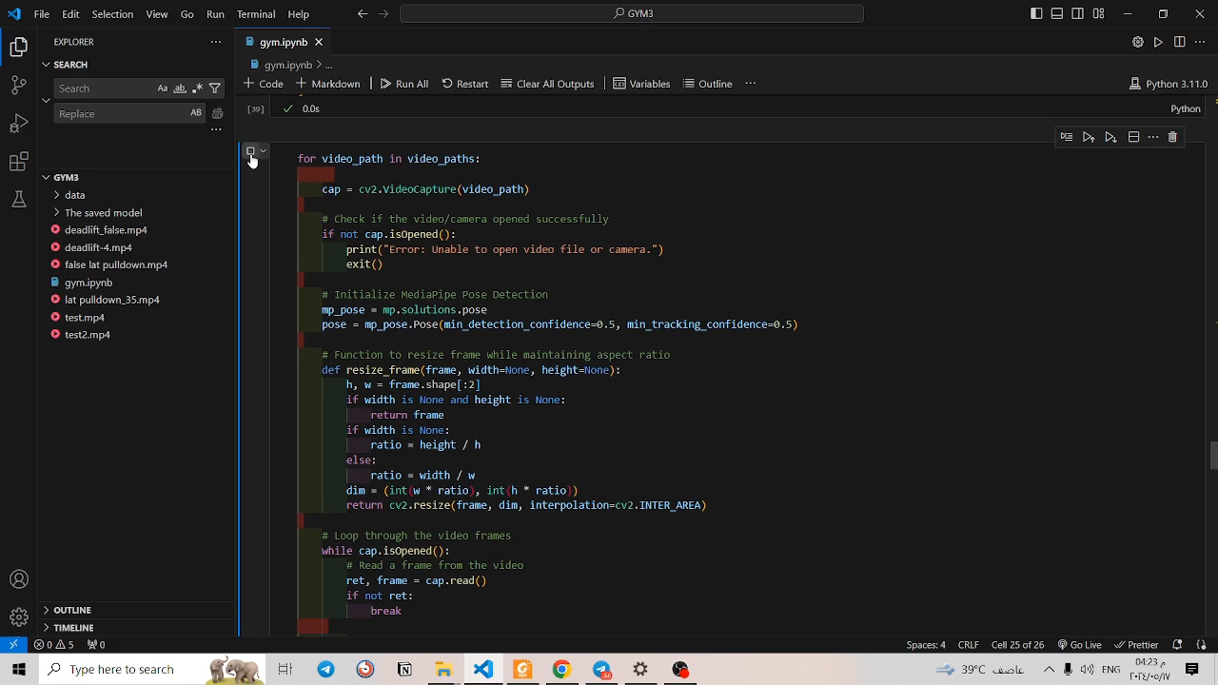
Demo :-

Slide 6
Contribution :-
We downloaded Dataset from Kaggle web site for true exercises.
We collected videos form YouTube and cut them for false exercises.
we add padding to Conv1D layers.
We applied dropout regularization to dense layer.
We add Batch normalization layer after dense layer.
we used ModelCheckpoint and EarlyStopping.
We did error and result analysis.
We used Confusion Matrix.

Slide 7
Data :-
We downloaded Dataset from Kaggle web site for true exercises.
We collected videos form YouTube and cut them for false exercises.
We created 4 folders , 1 for deadlift_False ,1 for deadlift_True,1 for lat_pulldown_False and 1 for lat_pulldown_True.
We used 12 – 50 videos in each folder .

Slide 8
Project architecture :-
import Necessary packages
load dataset
Convert labels to numerical values
ensure the type of data is float32
build the model
Model Checkpoint and EarlyStopping
compile and train the model
confusion matrix , Test and Train accuracy
testing

Slide 9
Methods :-
import Necessary packages
load dataset :-
the code loads data from a specified directory, processes them
using MediaPipe Pose Detection ,and extracts pose landmarks.
Convert labels to numerical values :-
We convert them, to enable the model to train the data that require
numerical inputs.

Slide 10
Methods :-
ensure the type of data is float32 :-
the code checks if the type of data is float32 , If the original data
type of x and y is larger, converting them to np.float32 can help
reduce memory usage ,ensures that they will be compatible with
these functions , improve performance.
build the model :-
- defines a sequential model using the Keras API in TensorFlow.
- The convolutional layers extract features from the input data using
filters.

Slide 11
Methods :-
- The max pooling layers reduce the spatial dimensions of the
extracted features.
- The flatten layer transforms the output from the convolutional layers
into a 1D array.
- The dense layers perform classification tasks.
- The dropout layer helps prevent overfitting.
- The output layer uses softmax activation to generate class
probabilities .

Slide 12
Methods :-
Model Checkpoint and EarlyStopping : -
two callbacks are defined: ModelCheckpoint saves the weights of the
model during training, and EarlyStopping stops training if there is no
improvement in performance.
compile and train the model : -
The Adam optimizer is chosen for training the model It is used for
optimizing deep learning models due to its efficiency and effectiveness.
loss function calculates the cross-entropy loss between the predicted
probabilities and true class labels.
Testing

Slide 13
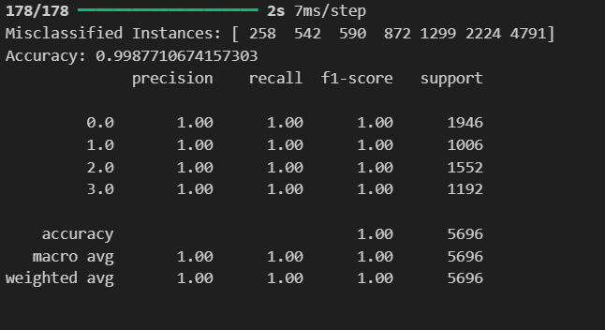
Results :-
Training Accuracy : 99% .
Testing Accuracy : 99% .
Error Analysis : -
Result Analysis : -

Slide 14
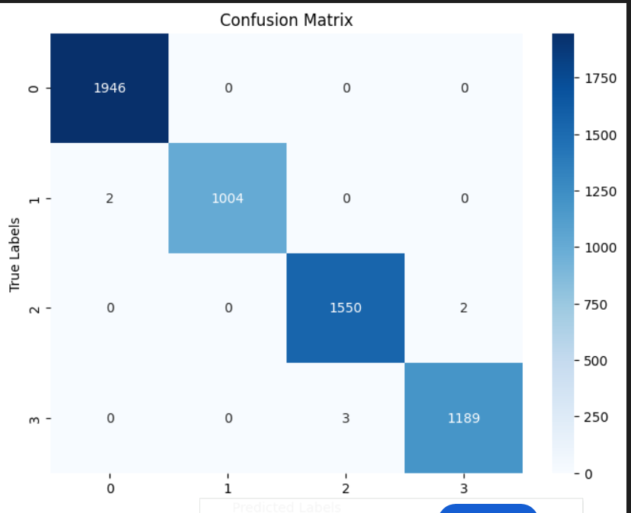
Results :-
Confusion Matrix : -

Slide 15
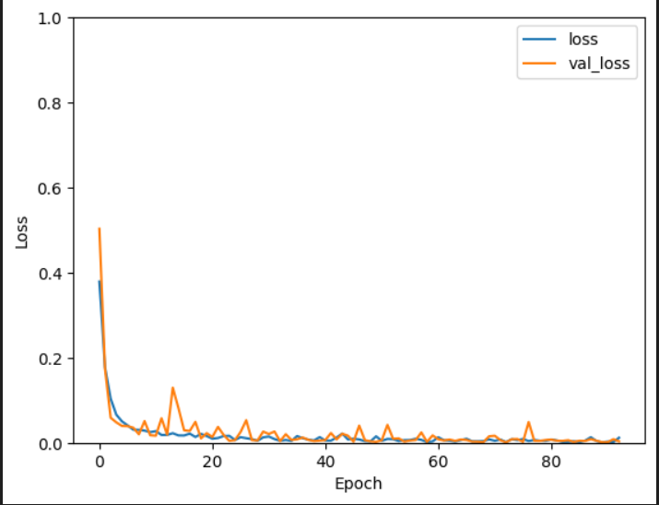
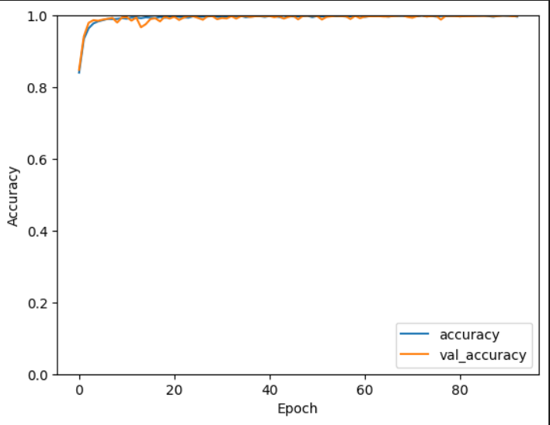
Results :-
Visualization for Test and Train

Slide 16
GitHub :-
https://github.com/hanaa-mahmuod/AI-Coutch-Gym.git

Slide 17


