Slide 1
REPORT 1
GIT, GITHUB & MARKDOWN
Reported by : Ho Dinh Phuc

Slide 2
Contents
Git & GitHub
Commits
Merge conflicts
Branching
More git features
Markdown

Slide 3

I. About Git & Github

Slide 4
Git & Why Git ?
Git is a command line tool that will help us with version control in several different ways :
Allowing us to keep track of changes we make to our code.
Synchronizes code between different people working on the same project.
Make changes and test our code on a different branch without removing access to the original.
Revert back to old versions of our code if we realize we’ve made a mistake.

Slide 5

Github
GitHub is a website that stores Git repositories remotely on the web which can be considered as a folder that holds a whole bunch of codes and files related to our code.

Slide 6
Github
Some git commands :
git clone<respository url> : This will download the repository to your computer.
ls : listing all files and folders in your current directory.
cd <repository name> : to change directory into that folder.
touch <new file name> : to create a new file in that folder.
git add <filename> : to track that specific file, or git add . to track all files within that directory.

Slide 7
Commits
After making some changes to a file, we can commit those changes, taking a snapshot of the current state of our code.
git commit –m “messages” : we can commit those changes.
git commit –am “messages” : we can do both git add and git commit –m.
git push : publish our local commits to GitHub.
git pull : pull any remote changes to our local repository.
git status : see how our code compares to the code on the remote repository.

Slide 8
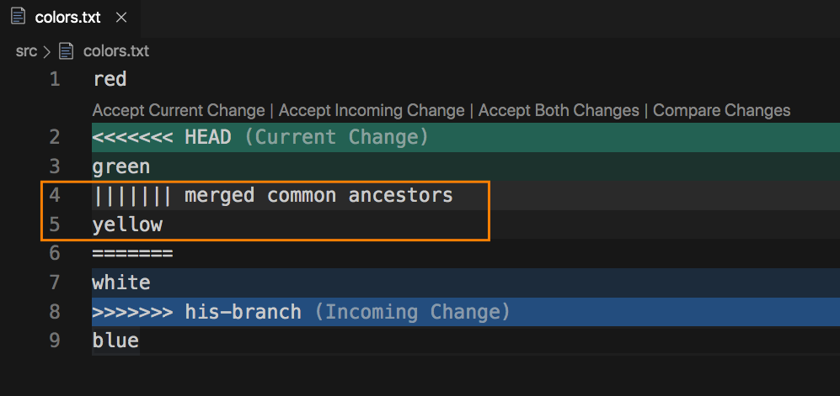
Merge Conflict
One problem that can emerge when working with Git, especially when you’re collaborating with other people, is something called a merge conflict.
This will typically occur when you either git push and git pull.

Slide 9
Merge Conflict
Another potentially usefull git command is git log, which gives you a history of all of your commits on that repository.
git reset --hard <commit> : everts your code to exactly how it was after the specified commit. To spectify the commit, use the commit has associated with a commit which can be found using git log as shown.
git reset --hard origin/master : reverts your code to the version currently stored online on Github.

Slide 10
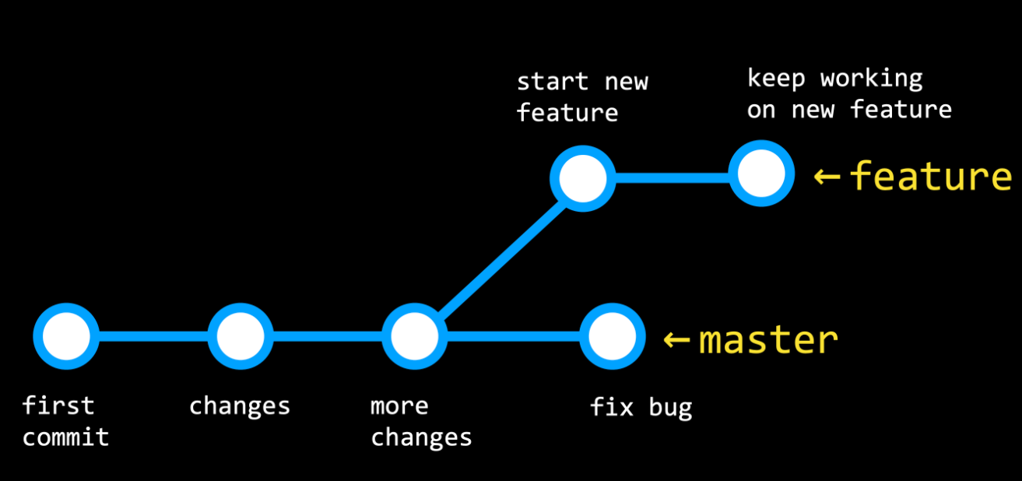
Branching
After you’ve been working on a project for some time, you may decide that you want to add an additional feature.
Branching is a method of moving into a new direction when creating a new feature, and only combining this new feature with the main part of your code, or the main branch.

Slide 11
Branching
Git branch commands :
git branch : see which branch you’re currently working on, which will have an asterisk to the left of its name.
git checkout –b <newbranchname> : make a new branch.
git checkout : Switch between branches using the command and commit any changes to each branch.
git merge <branchname> : merge one branch with master branch.

Slide 12
More Github features
Forking : creates a copy of the repository that you are the owner of.
Pull requests : Once you’ve forked a repository and made some changes to your version, you may want to request that those changes be added to the main version of the repository. This process of people making a few edits and then requesting that they be merged into a main repository,
Github pages : a simple way to publish a static site to the web.

Slide 13

II. Mark Down

Slide 14
Mark Down
Markdown is a way to style text on the web. You control the display of the document; formatting words as bold or italic, adding images, and creating lists are just a few of the things we can do with Markdown. Mostly, Markdown is just regular text with a few non-alphabetic characters thrown in, like # or *
You can use markdown around github :
Git
Comments in Issues and Pull Requests
Files with the .md or .markdown extension.

Slide 15
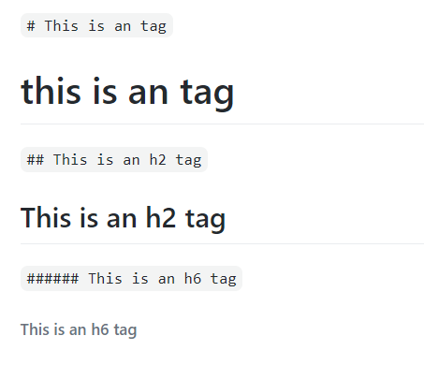
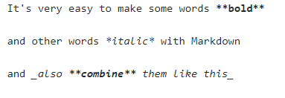
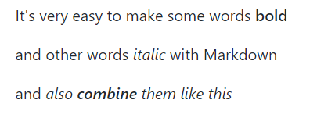
Syntax Guide
Headers :
Emphasis :

Slide 16
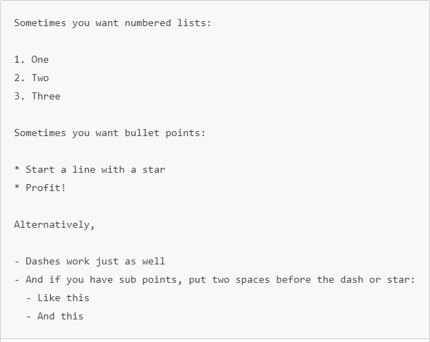
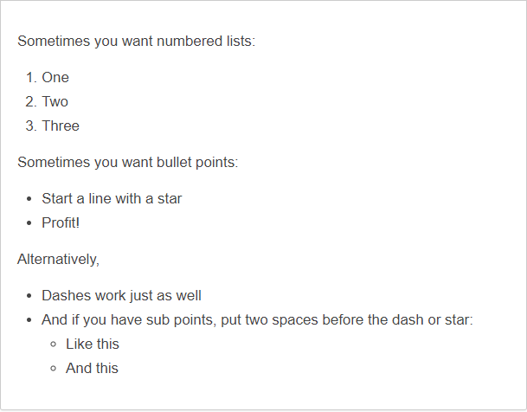
Lists

Slide 17
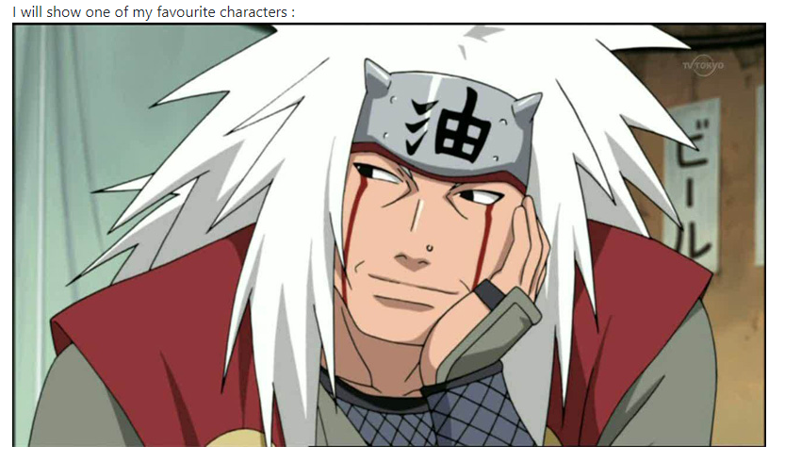
Image
Syntax format : ![Alt Text](url)
EX :
I will show you one of my favourite characters : ![jiraiya](https://sieuimba.com/wpcontent/uploads/2015/09/Jiraiya.jpg)

Slide 18
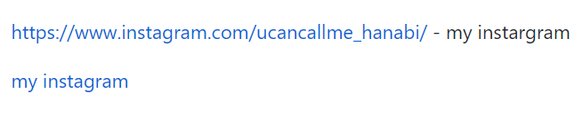
Links
Syntax format :
[Alt text](url) or links – Alt text .
EX :
https://www.instagram.com/ucancallme_hanabi/ - my instagram [myinstagram](https://www.instagram.com/ucancallme_hanabi/)
Would become :

Slide 19
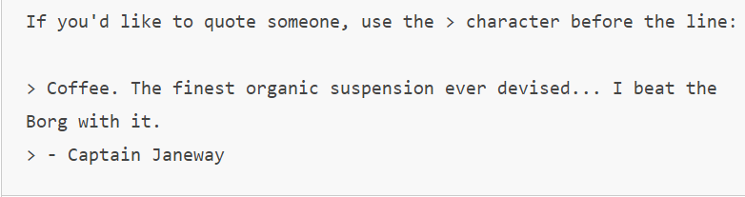
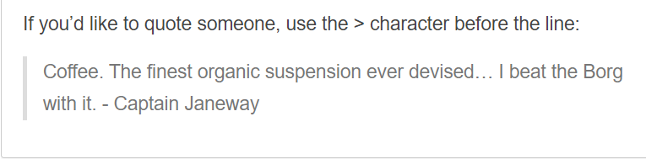
Block Quotes
If you’d like to quote someone, use the > character before the line :
EX :
Result :

Slide 20
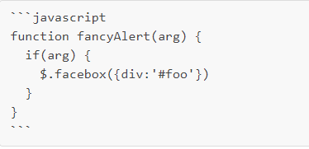
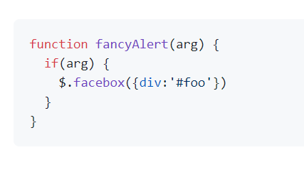
Syntax Highlighting
Here’s an example of how you can use syntax highlighting with Github flavored Markdown
Result :

Slide 21
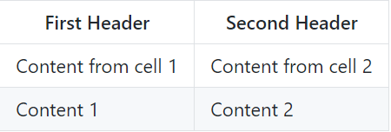
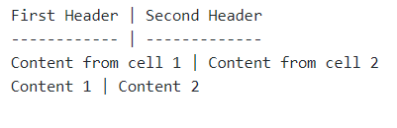
Tables
You can create tables by assembling a list of words and dividing them with hyphens – for the fist row, and then separating each column with a pipe |
Would become :

Slide 22
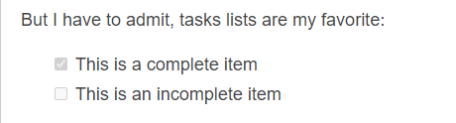
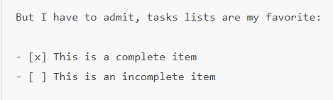
Task Lists
Syntax format :
- [x] completed.
- [ ] incompleted.
EX :
Result :

Slide 23
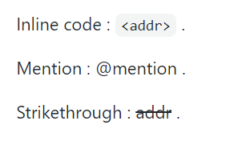
Extras
Inline code : `<addr>` .
Mention : @mention .
Strikethrough : ~~addr~~ .
Emoji.
EX :

Slide 24


