Slide 1
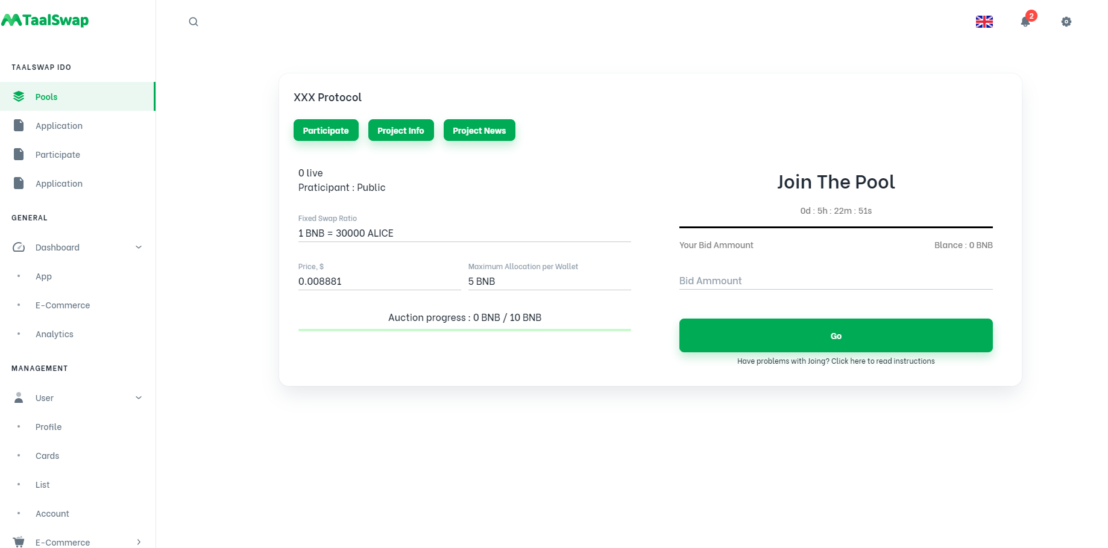
http://localhost:3000/app/taalswap/swap
경로
Src/views/taalswap/SwapView
Index.js
participage.js

Slide 2
빈페이지 생성 Src/views/taalswap/ApplicationPage.js

