Slide 1

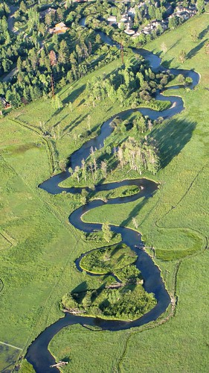
A review on:
Afforestation and its carbon sequestration potential
D. Farhana Kamasela
April 6th , 2023

Slide 2
Introduction
Tree planting has been suggested as a way of capturing carbon dioxide because trees absorb carbon dioxide through photosynthesis, releasing oxygen back into the atmosphere and withholding the carbon.
Forest ecosystems account for around 45% of all the carbon stored on land. Re-growing and expanding existing forests (reforestation), and growing new forests (afforestation), have been proposed as ways to capture and store additional carbon dioxide from the atmosphere (Neumann et al., 2020).

Slide 3
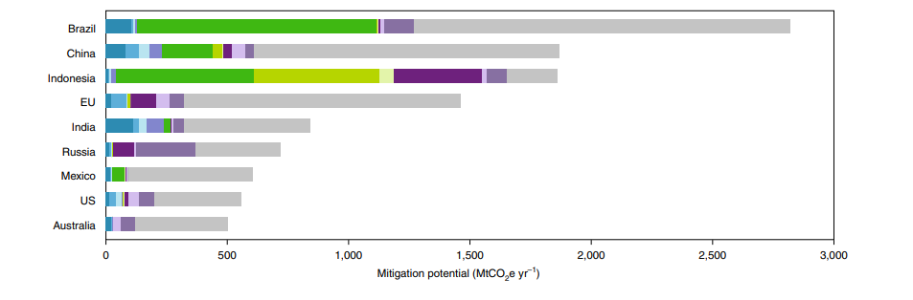
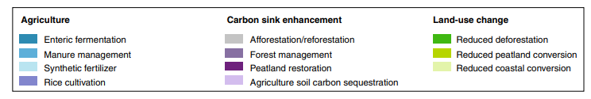
Afforestation/reforestation is the 1st from the top 25 countries with highest land-base mitigation potential
Fig 1. Top 9 out 25 region with highest land-base mitigation potential 2020–2050 ( >500 MtCO2e yr–1) (Roe et al., 2020)

Slide 4
Site selection
Planting preparation
Maintenance
Planting
Afforestation Procedure
Pre planting
Post planting
Notes:
The process of afforestation begins with site selection. Several environmental factors of the site must be analyzed, including climate, soil, vegetation, and human activity.^{[2]} These factors will determine the quality of the site, what species of trees should be planted, and what planting method should be used.^{[2]}
After the forest site has been assessed, the area must be prepared for planting. Preparation can involve a variety of mechanical or chemical methods, such as chopping, mounding, bedding, herbicides, and prescribed burning.^{[3]}
Once the site is prepared, planting can take place. One method for planting is direct seeding, which involves sowing seeds directly into the forest floor.^{[4]} Another is seedling planting, which is similar to direct seeding except that seedlings already have an established root system.^{[5]} Afforestation by cutting is an option for tree species that can reproduce asexually, where a piece of a tree stem, branch, root, or leaves can be planted onto the forest floor and sprout successfully.^{[6]} Sometimes special tools, such as a tree planting bar, are used to make planting of trees easier and faster.^{[7]}

Slide 5
1. What role can forests play in tackling climate change? (Neumann et al., 2020)
Notes:
how afforestation program it self will be successful?
Remembering our target for doing afforestation will to absorb the carbon

Slide 6
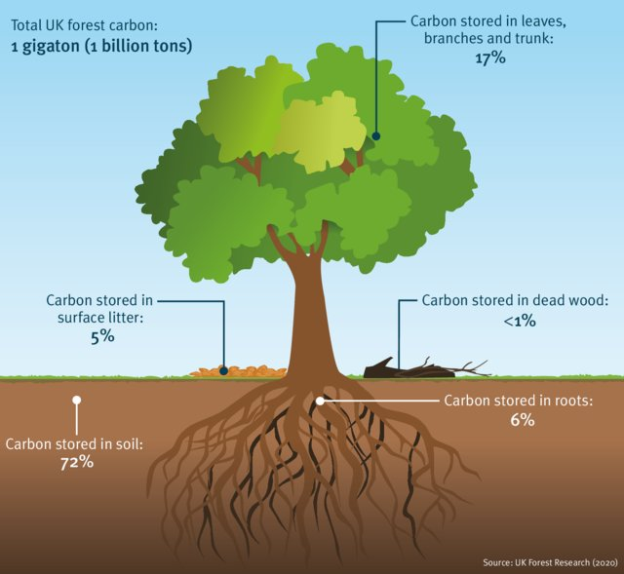
A. How much can trees help to combat global warming
World-wide tree planting capture 40-100 gigatons of C from the Atmosphere equals to 1 decade’s worth of emission at current rates.
(FAO, 2020)
Fig 2. Areas where carbon is stored in a typical temperate forest in the United Kingdom
Notes:
The way of forest sequester carbon/ Changes carbon pool : above ground biomass, underground biomass, deadwood, litter, soil/soil organic matter

Slide 7
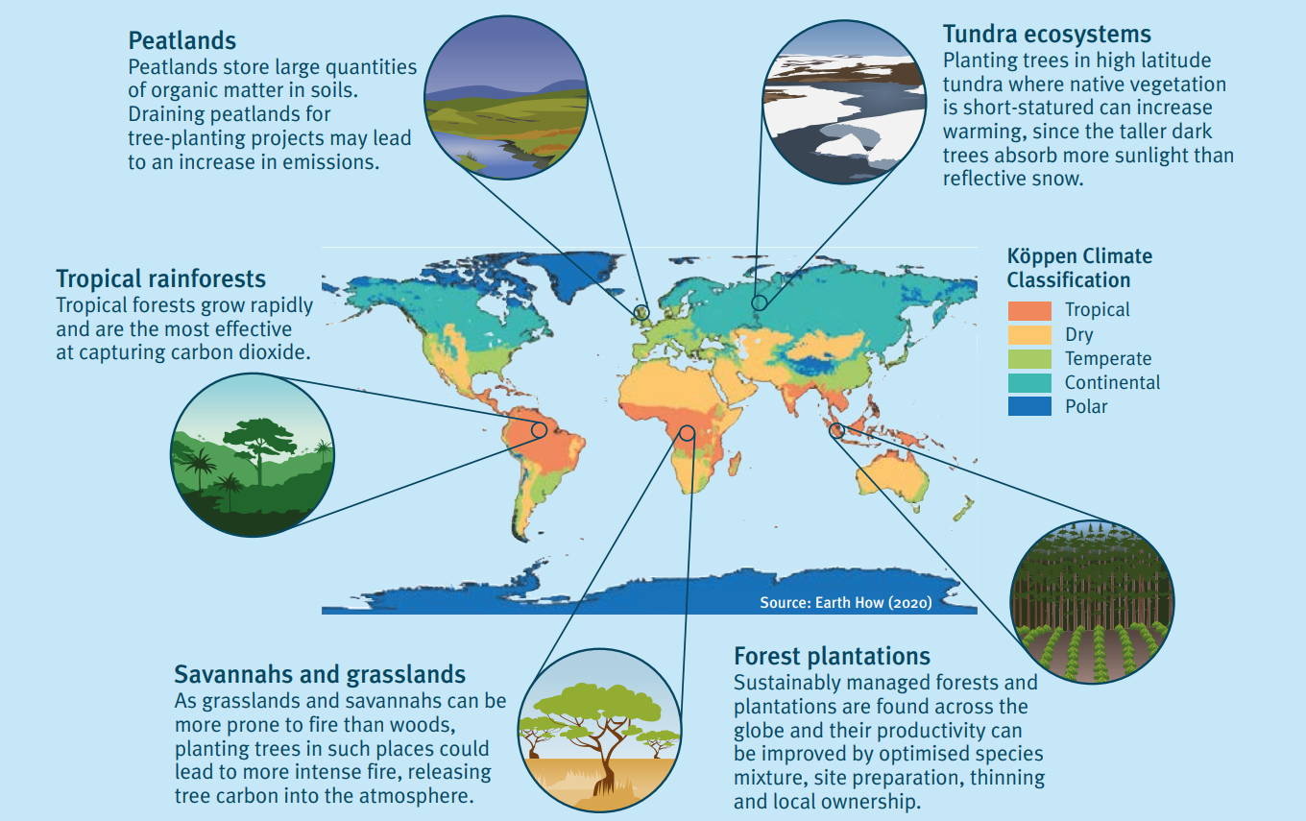
Location of trees Afforestation in places where forests would not naturally grow can also lead to carbon dioxide being released into the atmosphere instead of removed!
B. How to maximize the amount of CO2 captured by trees
Amazon, Brazil
Choice and management of tree species Planting a diversity of native tree species is more effective in storing carbon
Fig 3. Implications of large-scale tree planting in various climatic zones and ecosystems based on seasonal precipitation and temperature patterns
Notes:
In comparison, native forests at high latitudes in the northern hemisphere, such as the boreal forests in North America, Russia and Scandinavia store large amounts of carbon in their soils but, they take longer to grow than trees at lower latitudes, meaning they take longer to accumulate carbon.
Mixed-tree plantations and managed native forests can help remove carbon dioxide from the atmosphere if they are correctly located, planned and implemented.

Slide 8
C. How to deciding the “Mean Average Carbon Flow” in AIM/PLUM
Biomass or MACF (Mean Average Carbon Flow) (MgC ha-1 year-1) is estimated based on biomass growth area forest (ha), vegetation type, climatic zone, ecological zone etc.
Location
Humidity
Forest type
Tropical, Temperate, Boreal
Arid, Dryarid, Moistarid, Subhumid, Humid, Humidry
Tropical rainforest, Tropical moistdecidous forest, Tropical dryforest, Tropical shrubland, Tropial mountainsystems, Subtropical humidforest, Subtropical dryforest, Subtropical steppe, Subtropical mountainsystems, Temperate oceanicforest etc ..
Biomass growth
Above-ground biomas in forest plantation which decided based on forest type (IPCC, 2006) (tonnes d.m ha-1)
Notes:
Conversion of C stock changes to CO2 emissions: C stock x – 44/12 (Molecular weights) (NGHGI, 2006 and Dabas and Bhatia. 1996. )

Slide 9
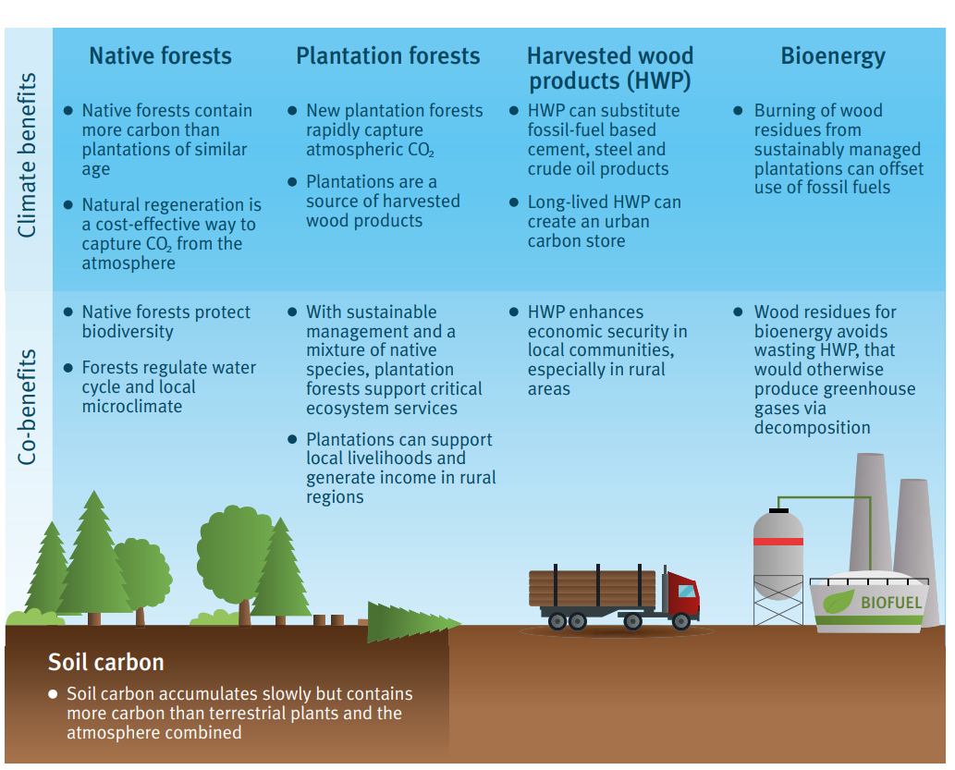
D. What happens to the carbon after it becomes a tree?
Carbon is stored within plant biomass on timescales of seasons to decades
Notes:
Carbon is stored within plant biomass on timescales of seasons to decades. When a tree dies or is harvested, that carbon can be stored in wooden products, or in soils and sediments for much longer periods, and this helps to limit global warming.
Effective forest management can ensure that some of the carbon is transferred to stable soil stores.
Controlled burning of land can lead to formation of carbon- and nutrient-rich soils
Factor that control the soil: location of the tree (type of forest and organisms which can breakdown plant biomass to soil matters)
Burned to Bioenergy from waste matter or residues that would
otherwise emit carbon when decomposing

Slide 10
Key policy decisions for climate-smart tree planting
a) Maximising carbon dioxide captured from the atmosphere and storing it over the long term
b) Protecting biodiversity; assisting protection against natural hazards
c) Enhancing local economies
Notes:
Diversify land-use to balance environmental and economic objectives
Emphasise reforestation and the protection of existing forests
Develop careful management strategies for afforestation projects

Slide 11
2. Assessing the carbon capture potential of a reforestation project (Lefebvre et al., 2021)

Slide 12
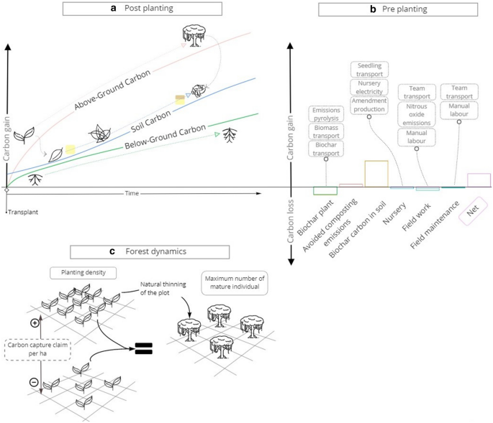
A prediction on the Increase in Carbon stocks after planting (reforestation)
Case study: Peruvian Amazon
Receipt of the seed by the nursery
Development into seedlings
Transport to reforestation plot
Fig 4. Processes and stocks considered . (a) Vegetation and soil C stocks. (b) Processes included in the LCA and their relative impact. (c) effect of the planting density.
Notes:
A prediction on the Increase in Carbon stocks after planting (reforestation)
Location: Peruvian Amazon
Biochar may be useful for restoring or revitalizing degraded forest soils and help with carbon sequestration, nutrient leaching losses, and reducing greenhouse gas emissions.
Case study: Peruvian Amazon
Method:
LCA to quantify carbon footprint and setting up reforestation plot
Soil carbon model with an above- and below-ground plant carbon model to predict increase carbon after planting
Compare with a reforestation platform

Slide 13
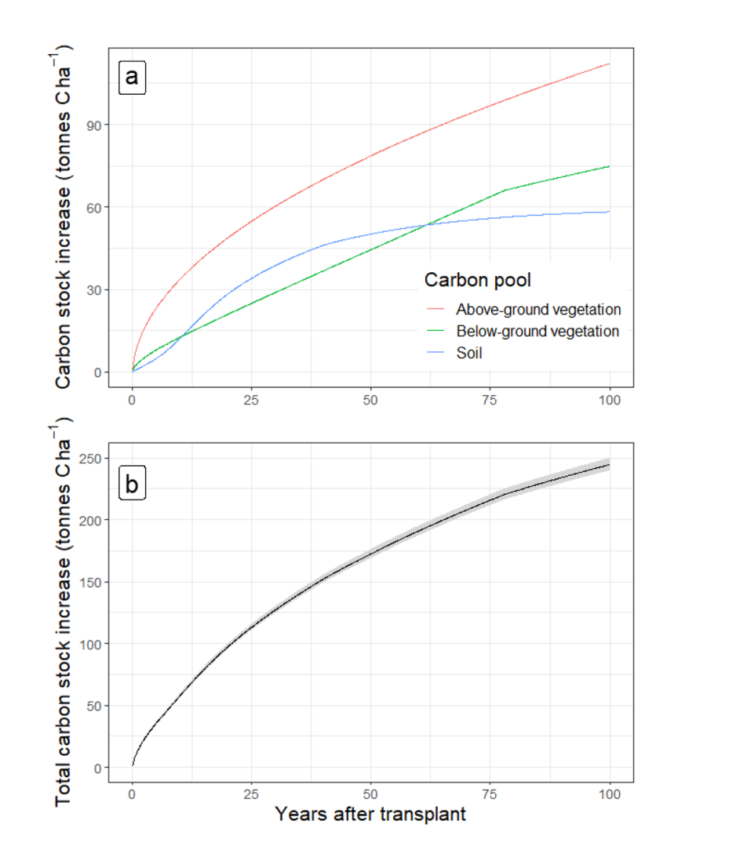
Result:
A. Modelling soil and biomass pools.
Soil took 50 years to reach steady state, both above- and below-ground vegetation pools increased over 100 years at a declining rate over time. The model simulation and evolution of total carbon stocks after transplant is consistent with previous assessments.
With ± 220 tonnes C ha-1
Fig 5. Changes in carbon stocks following transplanting. (a) Vegetation and soil. (b) Total, with ±1 SD indicated by the ribbon.
Notes:
Simulations of the below-ground biomass model matched a previous assessment45 and the evolution of total carbon stocks afer transplant (Fig. 5b) is consistent with previous assessments32,46.

Slide 14
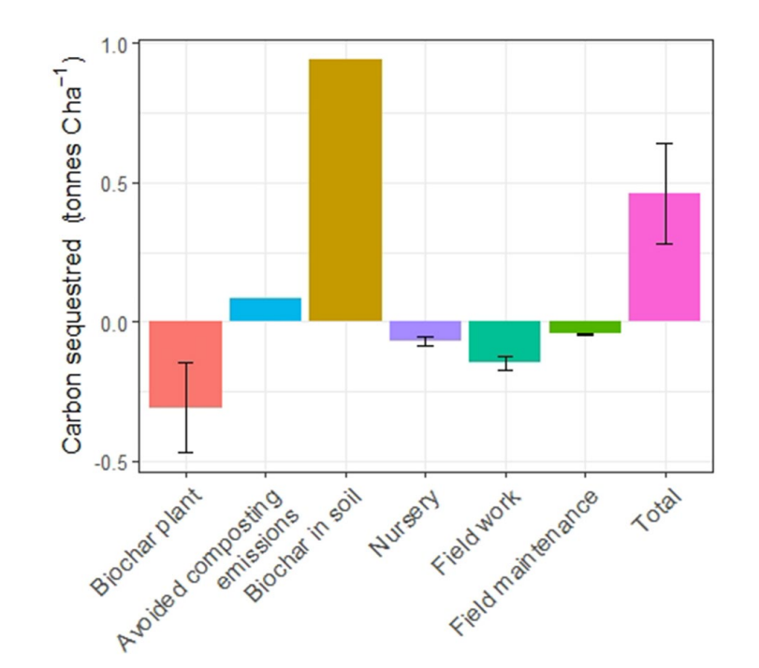
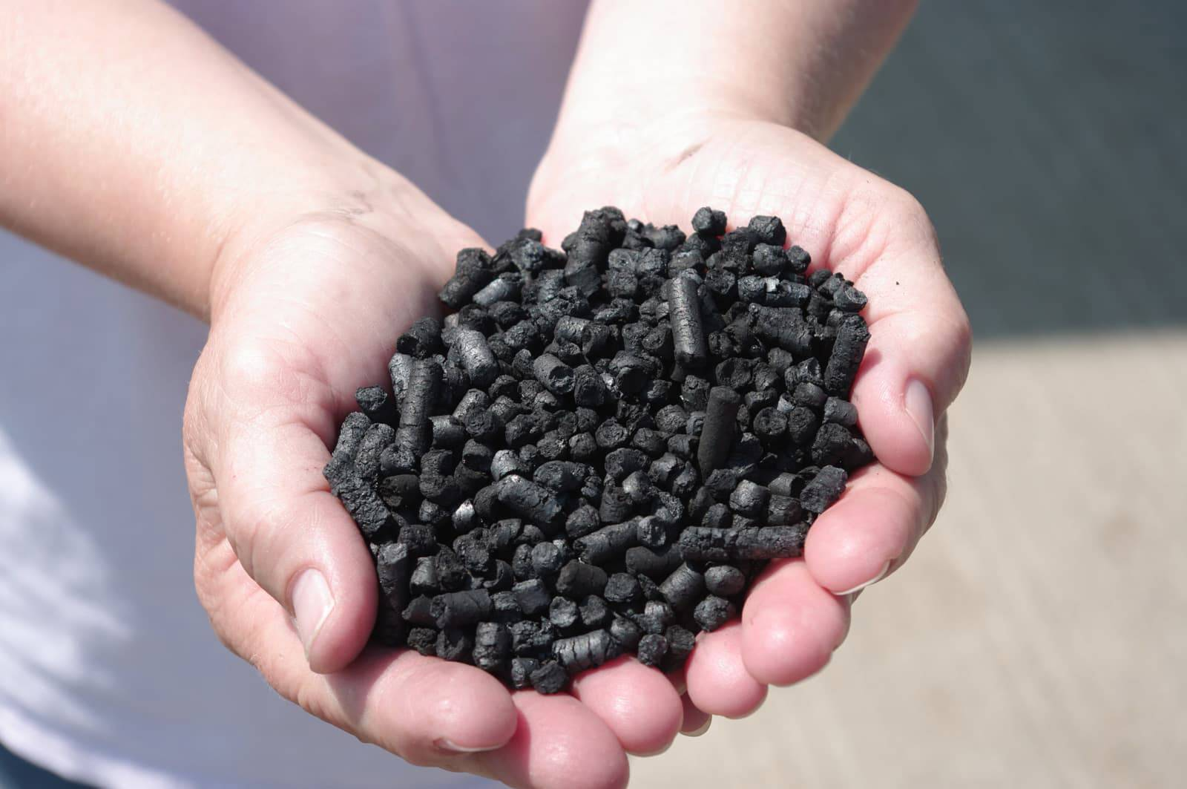
Result:
B. Life cycle assessment of the case study plot.
Most of the establishment emissions arise from pyrolysis, fertilizer manufacture and use, and associated N2O emissions,90% of the sequestration comes from the 1.11 t biochar ha−1 application (capturing 3.45 t CO2e ha−1, i.e. 0.94 t C ha−1).
Excluding biochar production and use, establishing the case study plot emits the C (0.35 t C ha-1).
Fig 6. Grouped contribution analysis of the emission and emission reduction associated with reforesting one hectare from the case study plot including one year maintenance. The error bars represent ±1 SD
Notes:
Te LCA shows that using biochar as a reforestation amendment delivered a net capture of 1.87±0.66 t CO2e ha−1 (0.51±0.18 t C ha−1) within the frst year afer planting (Fig. 6), but the biochar opportunity was site specifc. Most of the establishment emissions arise from pyrolysis, fertilizer manufacture and use, and associated N2O emissions, and 90% of the sequestration comes from the 1.11 t biochar ha−1 application (capturing 3.45 t CO2e ha−1, i.e. 0.94 t C ha−1). Excluding biochar production and use, establishing the case study plot emits 1.27±0.10 t CO2e ha−1 (0.35 t C ha−1).

Slide 15
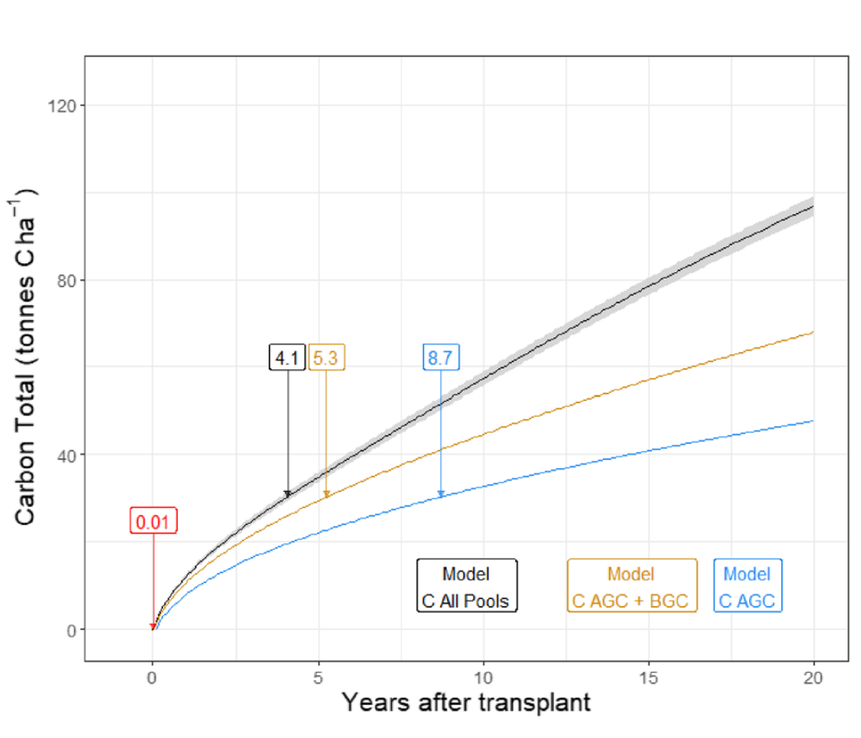
Result:
C. Comparison with a hypothetical reforestation
4.1 years after transplanting to capture 100 kg CO2 per tree planted, which is a typical reforestation platform target.
Fig 7. Time needed in years (labels) to reach estimated claim of 100 kg CO2 captured per tree. The red label represents the time in years necessary to offset the emissions associated to set up the
plot. The ribbon around the model carbon capture rate is ±1 SD
Notes:
4.1 years afer transplanting to capture 100 kg CO2 per tree planted (a typical reforestation platform target) → 111,100 kg CO2 (i.e., 30,300 kg of C) captured / ha.

Slide 16
3. A global analysis of the cost-efficiency of forest carbon sequestration (Grafton et al., 2021)
Notes:
how afforestation program it self will be successful?
Remembering our target for doing afforestation will to absorb the carbon , then What happens to the carbon after it becomes a tree? Is important to understand.

Slide 17
Assessment of countries where forest carbon sequestration would be the most cost-efficient
Afforestation
Reforestation
Forest conservation
Net costs for forest carbon sequestration
Private and non private co-benefits
Opportunity cost of land
Transaction cost
Cost of labour
Forest productivity
Avoided agricultural GHGs
Wildfire risk
Income from sale of harvested timber
The monetary value of ecosystem services other than carbon sequestration
Net amount of sequestered carbon
Data Source: World Bank (WDI database), Normalised Difference Vegetation Index (NDVI) from the Moderate Resolution Imaging Spectroradiometer database of NASA, (Busch et al., 2019), FAO, Global Fire Emissions Database (Randerson et al., 2018).

Slide 18
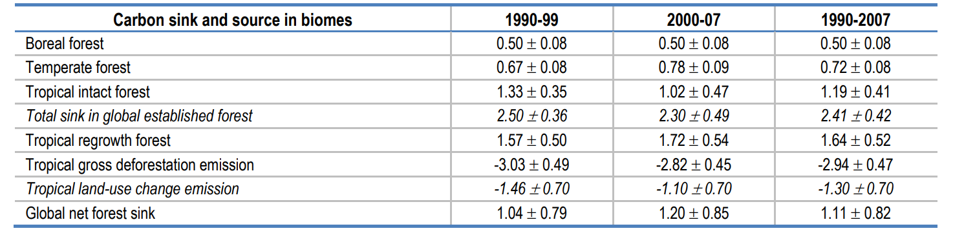
Table 1. Carbon sequestration by forest type (GtC/year)
Source. Pan et al., 2011.
Between 1990 and 2007, tropical deforestation wiped out more than half of the world's forest carbon sequestration

Slide 19
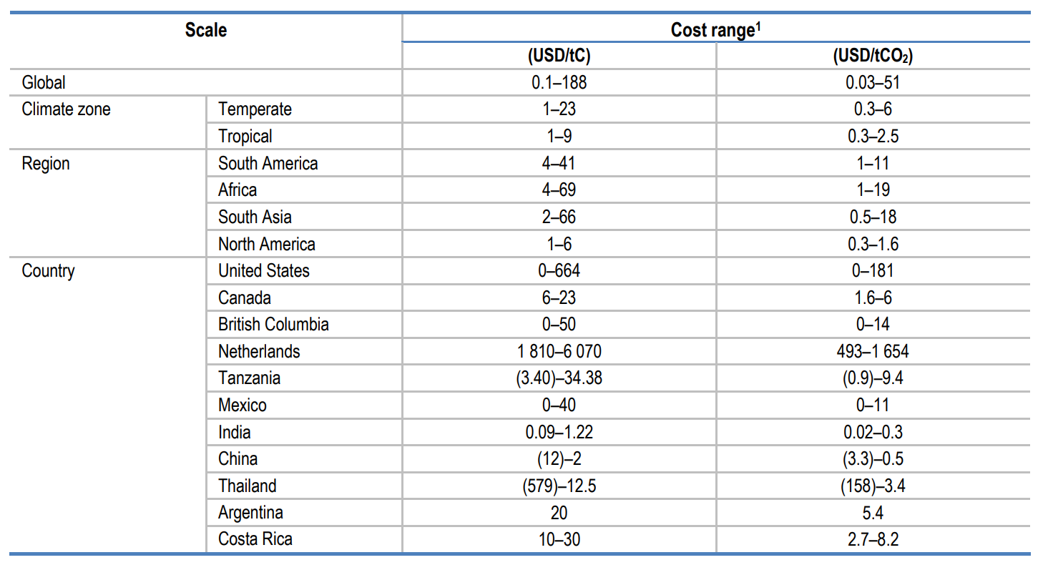
Table 2. Average cost of carbon sequestration in forest-based projects
The global average carbon cost through afforestation projects is estimated to be between USD 34-57/tCO2, depending on the co-benefits from the sale of timber.
At the country level the range is USD 12-169/tCO2 in the low co-benefits scenario and USD 9-108/tCO2 in the high co-benefits scenario.
Note: 1. Considering cost of carbon sequestration in forest plantation, forest management and agroforestry; Figs in parentheses indicate negative costs. Source: Extracted from Richards & Stokes, 2004.

Slide 20
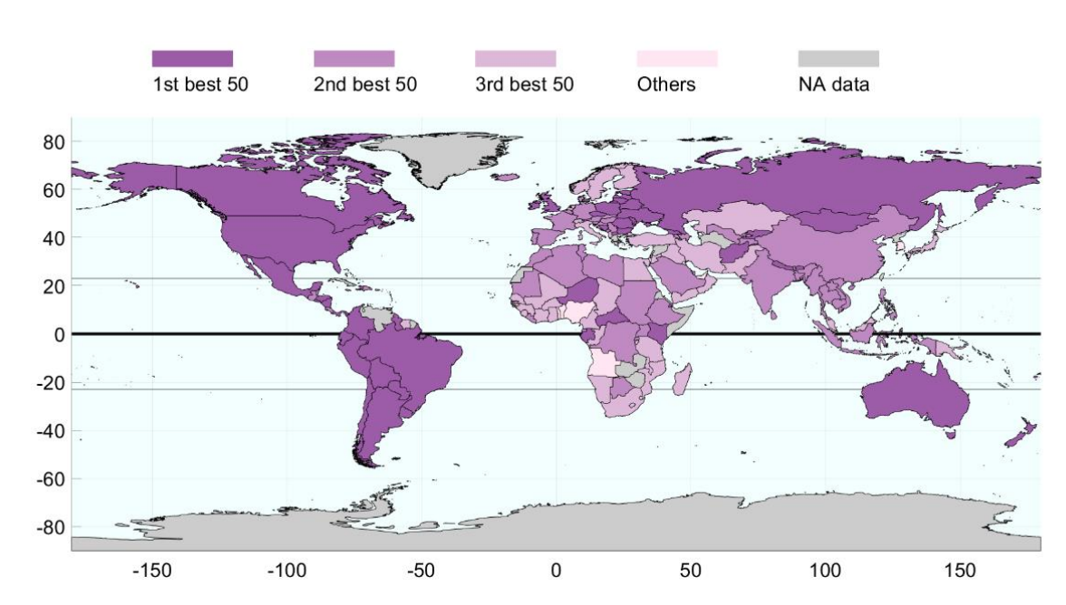
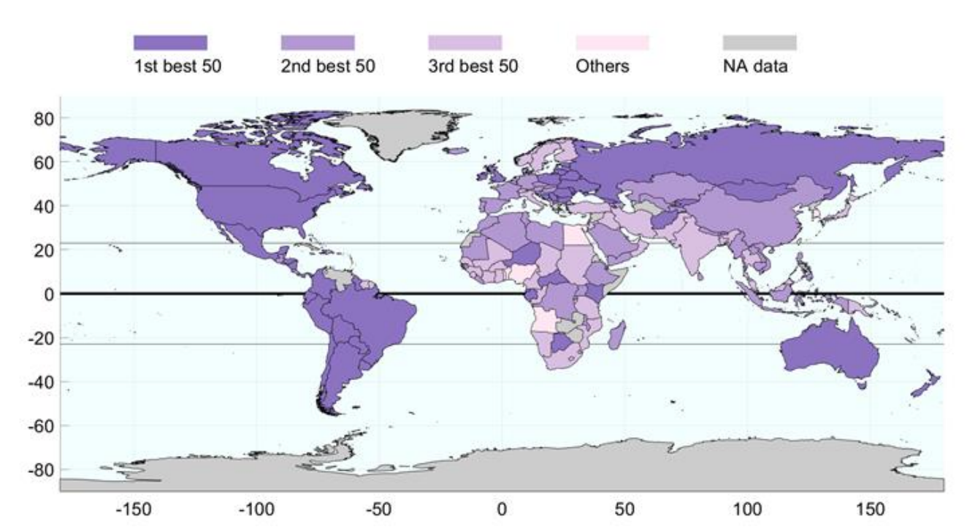
Interestingly, the global distribution of cost-efficiency of carbon sequestration with non-private co-benefits strongly resembles that with private co-benefits.
4 of the 5 most forested countries - Brazil, Canada, Russia and the United States - are in the top 50; only China is not included.
Cost-efficiency differs between countries in Europe, Africa and Asia, although it should be noted that despite climatic conditions conducive to high forest productivity, Southeast Asian countries are not among the most cost-efficient countries to sequester forest carbon due to the high cost of land use and the relatively low quality of the business environment.
A.
B.
Fig 8. Global distribution of the economically viable cost of carbon sequestered through afforestation; A. with private co-benefits, B. with non-private benefits
Notes:
Thanks to the low opportunity cost of land and, for Brazil, also because of high forest productivity. China is not in the top 50 for any of the 6 factors of cost and quantity of forest carbon sequestration.
Further, the global average cost of forest carbon can turn negative when non-private co-benefits are taken into account. A negative value implies that the non-private co-benefits exceed the production and transaction costs of implementing the forest carbon project. In other words, if a forest carbon project has a negative cost, it can both sequester carbon cost-efficiently and provide ecological and social services. The much lower cost of carbon credits with non-private co-benefits emphasises the role of climate policy in promoting biodiversity and other public benefits related to forests.

Slide 21
Research Overview
“Global Afforestation carbon sequestration potential under climate mitigation scenario:
Objective :
To projecting the global area-biomass curve under each scenario (tonne/year)
To projecting the global afforestation carbon sequestration supply curve ($/C)
To presenting regional afforestation carbon sequestration potential map

Slide 22
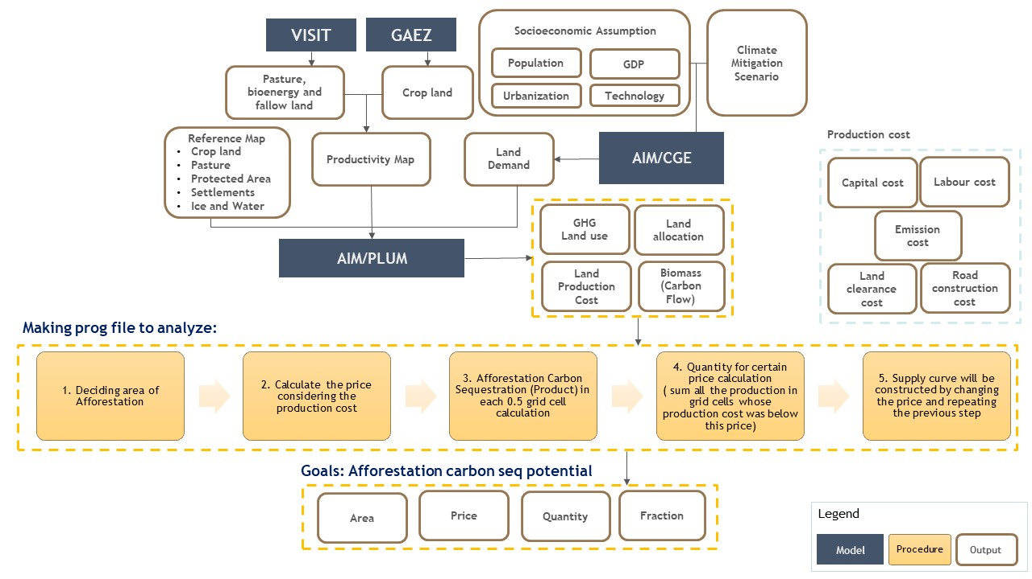
Research Framework
Current task

Slide 23
Thank You
Notes:
Afforestation is the conversion of other land uses to forests, whereas reforestation is the restoration of degraded forests or deforested lands to forest

Slide 24
References
Neumann et al., 2020. What role can forests play in tackling climate change?
Lefebvre et al., 2021. Assessing the carbon capture potential of a reforestation project
Roe et al., 2020. Contribution of the land sector to a 1.5 °C world
Grafton et al., 2021. A Global Analysis of the Cost-Efficiency of Forest Carbon Sequestration

Slide 25
Author Notes

Slide 26
VISIT
GAEZ
Socioeconomic Assumption
Climate Mitigation Scenario
Population
GDP
Pasture, bioenergy and fallow land
Crop land
Urbanization
Technology
Production cost
Reference Map
Crop land
Pasture
Protected Area
Settlements
Ice and Water
Productivity Map
Land Demand
AIM/CGE
Capital cost
Labour cost
GHG
Land use
Land allocation
Emission cost
AIM/PLUM
Land Production Cost
Biomass (Carbon Flow)
Land clearance cost
Road construction cost
Making prog file to analyze:
1. Deciding area of Afforestation
2. Calculate the price considering the production cost
3. Afforestation Carbon Sequestration (Product) in each 0.5 grid cell calculation
4. Quantity for certain price calculation ( sum all the production in grid cells whose production cost was below this price)
5. Supply curve will be constructed by changing the price and repeating the previous step
Goals: Afforestation carbon seq potential
Area
Price
Quantity
Fraction
Legend
Model
Procedure
Output
Notes:
Input cost (intermediate inputs and primary factors such as capital and labour) + land transition cost (labour costs (labor for land clearance), road construction costs and emission costs.
Production costs in this study are composed of input costs and land transition costs. Input costs, including intermediate inputs and primary factors such as capital and labour, were derived using the AIM/CGE model. Land transition costs include labour costs (labor for land clearance), road construction costs, and emission costs. The land transition cost was calculated based on wages (associated with the GDP) and the payback period of the investment cost for agriculture, road construction, and GHG emissions. The payment period of the investment for GHG emissions is grid specific, while the other components of the land transition cost are the same within each region.
The supply curve was constructed via a spatially explicit cost analysis, using a similar approach as to that in Hoogwijk et al. (2009) and van Vuuren et al. (2009). First, sequestration capability (product in C) production in each 0.5° grid cell was calculated. Then, the supply quantity for a certain price was found by summing over all the production in the grid cells whose production cost was below this price. Finally, a supply curve was constructed by changing the prices and repeating the above step.
Making prog file to deciding:
Afforestation land.gms (Potential area for Afforestation, Afforestation carbon seq potential curve
Afforestation carbon seq supply curve

Slide 27
Estimating net carbon Seq for Afforestation program, paper 3
1. Net carbon sequestered by an afforestation project = the amount of carbon sequestered (CS) by planting trees + the avoided carbon emission that would have been generated by land use other than forestry
2. Risk-free Scenario. Carbon stock at age 𝑎, 𝑓(𝑎) represents the relationship between the tree age and the above-ground biomass
3. likelihood of natural disturbances causing carbon emissions
4. The option of end of the project, after the amount of carbon stock is estimated using the age of trees. There is an option specifies that, at time 𝑡, trees could be destroyed with a probability 𝑟t or could continue to grow to a new age with a probability 1 − 𝑟
(Grafton et al., 2021)
Notes:
In afforestation projects, the carbon benefit is the average amount of extra atmospheric carbon that can be sequestrated via planting and managing trees in non-forest land

Slide 28
Estimating net cost carbon Seq for Afforestation program, paper 3
1. The production cost includes the cost of land use, the
cost of labour, the cost of materials and capital depreciation, and other cost items
2. Transaction costs. These costs include: (i) search; (ii) negotiation; (iii) approval; (iv) monitoring; (v) enforcement; and (vi) insurance (Dudek and Wiener, 1996) or (i) design cost; (ii) implementation cost; and (iii) verification or certification cost.
3. The net cost is measured by the production cost + the transaction cost
4.
5. A forest project lifespan
(Grafton et al., 2021)
Notes:
In afforestation projects, the carbon benefit is the average amount of extra atmospheric carbon that can be sequestrated via planting and managing trees in non-forest land

Slide 29
Method in paper 3
The above-ground biomass is approximated by a scale of the square root of age (Busch et al., 2019).
The alternative land use for forests is dominated by agriculture, both subsistence and commercial (UNFCCC, 2007; FAO and UNEP, 2020), Data of the agricultural value added in USD and agricultural land area are extracted from the World Development Indicators of the World Bank (WDI database).
The level of GHG emissions for alternative land-use was approximated by the GHG emissions from agricultural activities, which was also extracted from the WDI database.
To approximate the sequestration capacity per ha of land, we use the Normalised Difference Vegetation Index (NDVI) from the Moderate Resolution Imaging Spectroradiometer database of NASA (Didan et al., 2015), NDVI has very high correlations with forest biomass, and this index can be used to predict carbon stock across different climate zones of the world (González‐Alonso et al., 2006; Le Maire et al., 2011; Gideon Neba et al., 2014; Bhardwaj et al., 2016; Macedo et al., 2018; Motlagh et al., 2018; Forkuor et al., 2020; Issa et al., 2020).
However, the exact mathematical relationship between NDVI and forest quality and age has not been established. Thus, we used the sigmoid function to better relate NVDI to existing forest quality and age and calibrated the sigmoid function based on the global average 30, ENV/WKP(2021)17 A GLOBAL ANALYSIS OF THE COST-EFFICIENCY OF FOREST CARBON SEQUESTRATION Unclassified carbon stock in one hectare of forest land estimated by FAO (FAO, 2020)
Labour costs are approximated by the value added per employed person (WDI).
The level of wildfire risk is approximated by historical data extracted from the Global Fire Emissions Database (Randerson et al., 2018).
Data for the governance indicator are approximated by the Ease-of-Doing-Business index, extracted from the WDI database.
(Grafton et al., 2021)

