Slide 1

MDF1 ML PROJECT
From zero to current situation
A review of the MDF1 manufacturing ML program,
TRAINING + PREDICTION SERVICES
CURRENTLY SERVED: DENSITY + BENDING
Raw dataset
Clean usable rows
Engineered features
Served model R²
Five-target best RF R²
3,128 × 1,165
486
28
~0.69
0.758
KSoft source data
after validation + cleaning
pressure / temp / thickness
density & bending RF bundles
surface soundness baseline
Reviewed source base: MDF1 system one-pager, density one-pager, deployment recommendation, comparison workbook, and training / repo logs.
April 2026 review check
01
Notes:
[Sources] - Reviewed project file: MDF1_ML_System_One_Page_Report.docx (build summary, served bundles, API proof) - Reviewed project file: MLSummary_with_comparison.xlsx (dataset size, 5-target baseline ranking) - Reviewed project file: MDF1_Deployment_Recommendation.docx (deployment phasing) - Generated decorative asset in this session: brain_crop2.png, cropped from an AI-generated image

Slide 2
Executive snapshot
02
What the project is solving, what exists now, and what the current position really is.
Business objective
What is built as 1st phase of ML Training
Current proven status
Predict MDF1 quality targets from KSoft production signals so the organization can move from reactive inspection to earlier, data-driven quality decisions.
• Offline training pipeline
• Governed artifact bundles
• FastAPI prediction service
• /health, /models and /predict endpoints
• Feature-order alignment at inference
PredictionService loads approved bundles, health checks pass, and /predict has already returned HTTP 200 with real prediction responses.
MANUFACTURING ML
VERIFIED
Current strongest story
Most important caveats
Served density RF
Served bending RF
• Project has moved beyond experimentation into an end-to-end ML system with separated training and serving services.
• For the currently served MDF1 bundles, Random Forest remains the strongest practical choice for density and bending (~0.69 test R²).
• Across the broader five-target baseline set, surface soundness and density are the most deployment-ready candidates.
• Dataset is still relatively small after cleaning (486 usable rows).
• Some metrics differ between project-wide summaries and currently served bundles, so reporting needs one agreed reference view.
• API hardening, packaging, monitoring, and release hygiene are still open before calling the system production-ready.
R² 0.6905
R² 0.6923
labDensityAverage_rf_v1
labBendingAvg_rf_v1
Best 5-target RF
Time range
R² 0.7578
Aug 2025 – Mar 2026
labSurfaceSoundnessAvg
baseProductionDate
Notes:
[Sources] - MDF1_ML_System_One_Page_Report.docx: end-to-end system, API endpoints, verified /predict, served density and bending RF bundles - MDF1_Deployment_Recommendation.docx: project-wide deployment readiness and phasing - MLSummary_with_comparison.xlsx: five-target RF ranking and deployment focus

Slide 3
From zero to now: project journey
03
The project matured through several concrete engineering steps, not a single model-training event.
Early friction was real: schema mismatches, unusable fields, and unstable prototype outputs had to be solved before reliable baseline reporting was possible.
The big shift was moving from “can a model train?” to “can the whole system train, save, load, and predict safely?”
By the latest reviewed state, the project supports governed artifacts, model listing, and live API inference—clear evidence of an operational ML product direction.
EARLY START
DATA FOUNDATION
SIGNAL DESIGN
PIPELINE FIXES
CURRENT STATE
1. Schema reality check
2. Clean MDF1 base
3. Engineer process signals
4. Stabilize modeling
5. Systemize serving
Initial runs exposed schema mismatch issues and missing required columns.
Raw KSoft data was validated and reduced to 486 usable rows.
28 aggregated features were added for pressure, temperature and thickness behavior.
Bad feature selections and feature-importance errors were filtered out; time-based training became repeatable.
TrainingService artifacts now feed a separate PredictionService with live REST predictions.
Narrative for stakeholders: the MDF1 work should be presented as a staged engineering journey—schema fixing → data governance → feature design →
baseline benchmarking → artifact governance → live prediction service.
Notes:
[Sources] - Training log excerpts reviewed: early schema mismatch and missing required columns (Pasted text logs from Mar 31 / Apr 1) - Training log excerpts reviewed: clean dataset, engineered features, repeated baseline training, and Apr 10 multi-algorithm runs - MDF1_ML_System_One_Page_Report.docx: current separated TrainingService + PredictionService state

Slide 4
Data foundation and preparation
04
The core signal base comes from KSoft production data and becomes much smaller—but much more usable—after cleaning.
Raw source
After cleaning
Time coverage
Engineered features
Candidate model set
3,128 rows
486 rows
Aug 2025 – Mar 2026
26 added
28 features
1,165 columns from KSoft
1,164 columns
baseProductionDate
pressure / temp / thickness
usable numeric features in latest runs
Data reduction story
What this means analytically
Raw KSoft extract — 3,128 rows / 1,165 cols
• Data volume is not large, so split strategy and leakage control matter more than brute-force model complexity.
• Cleaning removed at least one high-missing feature (operFibresDensity), improving reliability of the modeling base.
• The remaining dataset still spans several months of operations, which supports time-based validation rather than random shuffling.
• Final presentation should emphasize that model quality comes from disciplined data curation, not only from algorithm choice.
Validation + schema checks
Cleaning + high-missing removal
Usable MDF1 training base — 486 rows
TIME-BASED SPLIT
SMALL BUT GOVERNED DATASET
MANUFACTURING SIGNALS
Notes:
[Sources] - MDF1_Density_OnePager.docx: raw dataset 3,128x1,165, cleaned 486 usable rows, time range Aug 2025–Mar 2026 - Training logs reviewed: cleaned data shape 486x1164, dropped high-missing feature operFibresDensity, candidate feature count 28 in latest runs - MDF1_ML_System_One_Page_Report.docx: time-based split in system description

Slide 5
Feature engineering: turning press behavior into learnable signals
05
The most important improvement was converting many raw plant readings into stable, interpretable process summaries.
Pressure group
Temperature group
Thickness group
• L / C / R means and stds
• Global min / max / range
• Front / mid / end means
• Front-end difference
• Global mean and std
• Min / max / range
• Thermal state summarization
• Closed-thickness mean
• Std / min / max
• Range as board stability signal
Why these engineered features matter
They reduce noisy point-level readings into process-shape indicators that are easier to generalize: distribution across the press, thermal regime, thickness stability, and cross-zone balance.
26 ENGINEERED FEATURES
The signal pattern already seen in results
Across targets, the most stable driver families are raw/thickness variables, aggregated press-pressure variables, and temperature / process-state variables.
Example top drivers include rawThickness, pressPressureGlobal_mean, pressPressureC_mean, thicknessClosed_mean, pressPressureMid_mean, and pressPressureFrontEnd_diff.
DRIVER FAMILIES ARE CONSISTENT
Notes:
[Sources] - Training logs reviewed: explicit list of 26 engineered features added (pressure, temperature, thickness aggregations) - MLSummary_with_comparison.xlsx: stable driver families across targets are raw/thickness, press-pressure, and temperature/process-state - MDF1_Density_OnePager.docx and deployment recommendation: top-driver examples and process-learning interpretation

Slide 6
Modeling evolution and lessons learned
06
The final story is stronger when it shows how unstable experiments were converted into a governed baseline.
What went wrong early
What changed in the mature pipeline
• Some first prototype runs selected unusable fields such as abs24h / vkstockProxy variables and produced warnings about features with no observed values.
• One early density run failed during feature-importance export because arrays did not match in length.
• Another run failed because XGBoost saw a training / feature-name mismatch.
• Usable-feature filters were tightened to exclude nonnumeric, all-null, target, leakage-prone, and irrelevant fields.
• Time-based splitting and repeatable artifact naming were standardized.
• Training now saves governed bundles and the serving layer reads the exact saved feature order.
Key lesson for the presentation
Reporting guidance
Show that the team learned to trust the system only after data filters, split logic, and artifact governance were stabilized. This makes the final ~0.69 served performance more credible than flashy but fragile early numbers.
Use three layers of results in the deck:
1) early prototype findings (for learning only),
2) project-wide five-target baseline comparison,
3) current served bundles and API-verified system state.
EARLY RUNS ≠ CURRENT STATE
GOVERNED BASELINE
Notes:
[Sources] - Early prototype logs reviewed: warnings on abs24h features, feature-importance export failure, and schema / feature mismatch issues - Training/code snippets reviewed: _is_usable_feature logic excludes nonnumeric, all-null, target-like, vkstockProxy, and later abs24h fields - MDF1_ML_System_One_Page_Report.docx: governed bundle concept and serving-time feature alignment

Slide 7
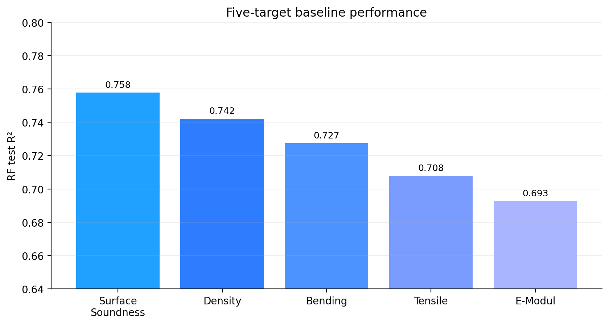
Project-wide baseline comparison: five quality targets
07
The broader MDF1 baseline view shows that multiple targets are learnable, but not equally ready for rollout.
Interpretation
• Best current five-target baseline: labSurfaceSoundnessAvg (RF R² = 0.7578).
• Strong and consistent performers: labDensityAverage (0.7421) and labBendingAvg (0.7274).
• labTensileAvg is still respectable at 0.7079.
• labEModulAvg is the weakest of the five at 0.6928 and should be refined later.
Recommended deployment order
Phase 1 Surface soundness + Density
Phase 2 Bending + Tensile
Phase 3 E-Modul after more refinement
PHASE 1
PHASE 2
PHASE 3
Stakeholder message: MDF1 is not a one-model story. It is a portfolio of learnable quality targets, with density and surface soundness leading the deployment conversation.
Notes:
[Sources] - MLSummary_with_comparison.xlsx: five-target RF R² values, driver families, and deployment notes - MDF1_Deployment_Recommendation.docx: phased rollout recommendation and risk framing

Slide 8
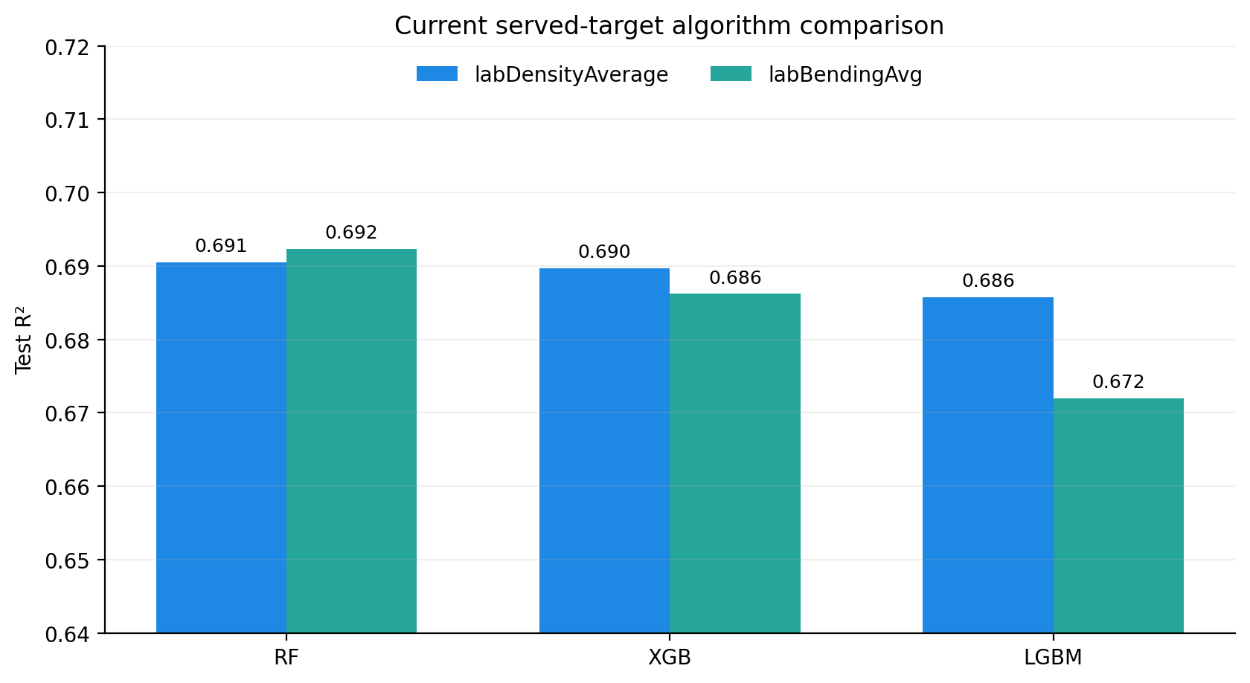
Current served focus: density and bending
08
These are the two targets already reflected in the reviewed PredictionService state and current artifact bundles.
labDensityAverage
labBendingAvg
RF R² 0.6905
RF R² 0.6923
best current served bundle: labDensityAverage_rf_v1
best current served bundle: labBendingAvg_rf_v1
Density signal story
Top drivers repeatedly point to board geometry plus aggregated press-pressure behavior: rawThickness, pressPressureGlobal_mean, pressPressureC_mean.
Bending signal story
Bending performance is strongly linked to thickness stability and mid-press conditions: rawThickness, thicknessClosed_mean, pressPressureMid_mean.
Decision point: RF still edges out XGB and LGBM for both currently served targets, so it remains the strongest practical default for the live bundles reviewed here.
Notes:
[Sources] - MDF1_ML_System_One_Page_Report.docx: served RF bundles and current test R² for density and bending - Apr 10 training logs reviewed: density RF/XGB/LGBM comparison and bending RF/XGB/LGBM comparison - MDF1_Density_OnePager.docx and MLSummary_with_comparison.xlsx: driver interpretation for density and bending

Slide 9
System architecture today
09
The key advance is separation of offline training from online prediction, with artifact governance in the middle.
TrainingService
Artifact bundles
PredictionService
KSoft data
validation
cleaning
engineered features
time-based split
model training
model.joblib
features.json
metrics.json
metadata.json
RF feature importance
loads approved models
serves REST predictions
raw production signals
+ quality targets
REST interface
/health /models /predict
Most important architecture point for stakeholders: inference is governed by the exact saved feature list, so serving does not depend on ad-hoc request column order.
Notes:
[Sources] - MDF1_ML_System_One_Page_Report.docx: TrainingService + PredictionService separation, artifact contents, endpoints, and feature governance at inference - Repo / log snippets reviewed: artifact_sync and sync_artifacts utilities, best_models_registry.json, API route and model loader changes

Slide 10
Current maturity: what is proven, and what still needs hardening
10
This is the right frame to avoid overselling while still showing clear progress.
Already proven
Still open before production confidence
• Repeatable data preparation and engineered-feature generation exist for MDF1.
• At least five quality targets have been benchmarked with consistent Random Forest baselines.
• Artifact bundles are structured and readable by a separate PredictionService.
• Reviewed logs show /health success and /predict returning HTTP 200 with live predictions.
• Density and bending currently have named RF bundles already treated as the active served state.
• Unify reporting so one official metric view is used across one-pagers, comparison sheets, and served bundles.
• Harden API behavior further: default model handling, packaging / Docker, and operational monitoring.
• Improve repo / release hygiene around unstaged changes, artifact version control, and promotion flow.
• Expand post-deployment monitoring: predicted vs actual drift, retraining cadence, and quality feedback loops.
• Collect more data to strengthen generalization, especially for lower-ranked targets.
PROVEN VALUE
NOT YET FULL PRODUCTION
Recommended positioning in the presentation: “operational ML system with verified live inference, not yet a fully hardened production platform.”
Notes:
[Sources] - MDF1_ML_System_One_Page_Report.docx: verified live inference, governed artifacts, next recommended API stabilization steps - MDF1_Deployment_Recommendation.docx: risk considerations, monitoring requirement, phased rollout - Repo / git-status logs reviewed: open Dockerfile, artifact registry, route, service, and sync utility changes plus working-tree hygiene issues

Slide 11
Recommended roadmap from current state
11
A strong closing slide should connect the technical status to a pragmatic rollout path.
Phase 1 — validate in operations
Phase 2 — extend the portfolio
Phase 3 — industrialize
• Deploy / validate the strongest candidate models first
• Use surface soundness and density as initial proof cases
• Track prediction vs actual and operator trust
• Roll bending and tensile after Phase 1 learning
• Keep the same governed artifact pattern
• Standardize dashboard and monitoring outputs
• Refine lower-ranked targets such as E-Modul
• Add packaging, release flow, and monitoring automation
• Set retraining cadence and model promotion rules
Recommended
closing message
MDF1 ML has already crossed the most important threshold: it is no longer just a modeling exercise. It is now an end-to-end ML system with credible baselines, governed artifacts, and verified live inference—ready for disciplined rollout.
Notes:
[Sources] - MDF1_Deployment_Recommendation.docx: phased deployment concept and monitoring / retraining steps - MDF1_ML_System_One_Page_Report.docx: next recommended API stabilization and packaging steps - MLSummary_with_comparison.xlsx: freeze baselines, deploy strongest candidates first, continue refinement in parallel

Slide 12
2026 Revision Highlights
Major improvements integrated across TrainingService, PredictionService, GUIService, and PostgreSQL architecture.
TrainingService now includes modular orchestration, centralized settings, explainability, ensemble evaluation, and production-aware validation.
PredictionService supports registry-driven serving, SHAP explanations, feature governance, ensemble prediction, and PostgreSQL traceability.
GUIService evolved into an operator cockpit with simulation workflows, recommendation rendering, and live monitoring.
PostgreSQL logging expanded into a production diagnostic and traceability layer.

Slide 13
Updated End-to-End Architecture
TrainingService → Artifact Governance → PredictionService → GUIService → PostgreSQL Traceability
TrainingService publishes governed artifact bundles and best_models_registry.json.
PredictionService synchronizes artifacts and exposes prediction APIs.
GUIService provides manual prediction, simulation, monitoring, and explainability workflows.
Prediction logs persist operational diagnostics and prediction history.

Slide 14
Current Industrial ML Position
The MDF1 ML platform has evolved into a production-oriented industrial AI architecture.
Time-based validation reduces leakage and better simulates real production deployment.
Explainability combines correlation, ML importance, and SHAP scoring.
PredictionService enforces exact feature-order governance during runtime.
Current focus areas include monitoring, drift tracking, operational rollout, and governance.

