Slide 1
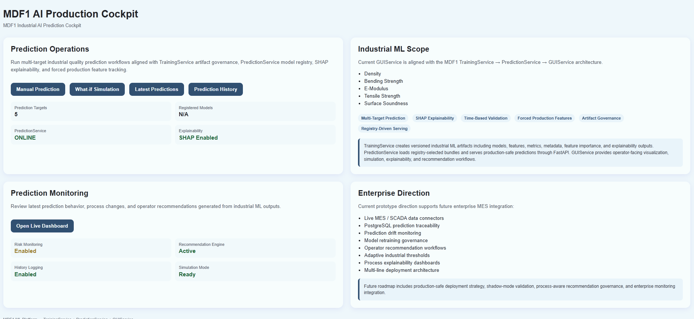
MDF1 Industrial AI Platform
MDF1 Industrial AI Platform

Slide 2
Executive Summary
Executive Summary
The MDF1 platform goes beyond prediction. It combines machine learning, explainable AI, risk assessment, and recommendation generation to support production decisions.
TrainingService → PredictionService → GUIService → PostgreSQL
A production-oriented architecture for industrial AI deployment.
Prediction layer:
For now, Predicts Density, Bending, E-Modulus, Tensile Strength, and Surface Soundness using best registered models.
Explainability layer(SHAP):
- SHAP quantifies how each process variable contributed to an individual prediction.
- Provides transparent and auditable AI decisions.

Slide 3
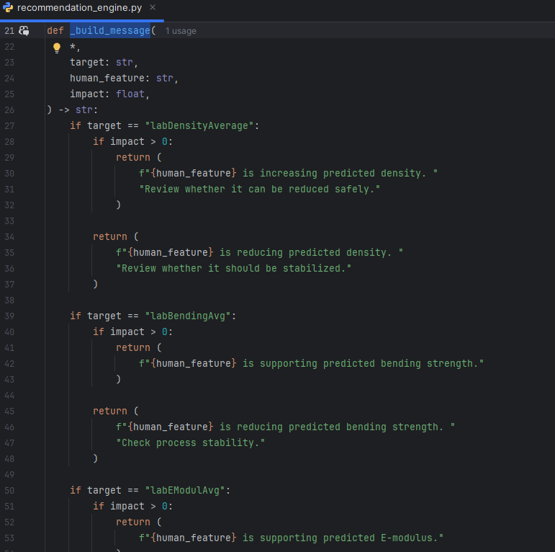
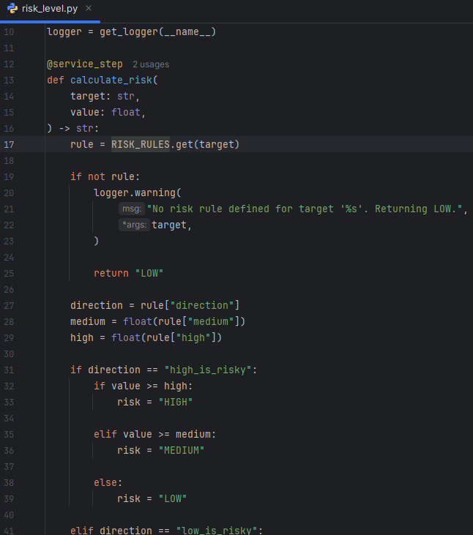
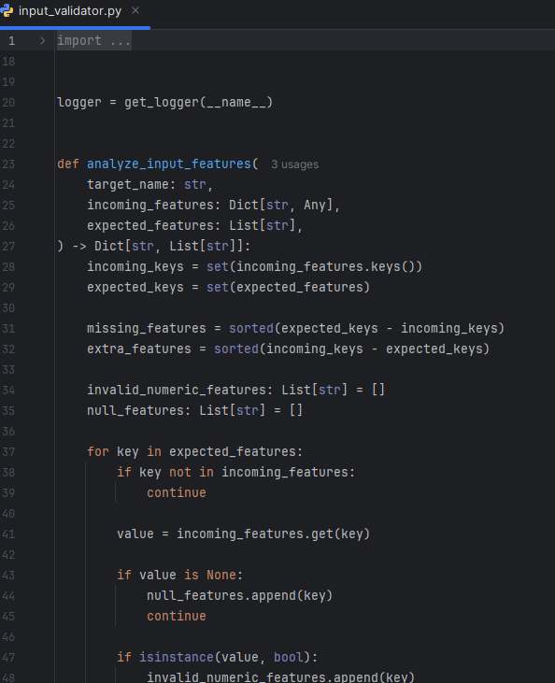
Executive Summary
Feature Impact Analysis
- Top contributing variables are ranked by absolute impact.
- Allows engineers to focus on the most influential process conditions.
Risk Assessment Engine
- Transforms raw predictions into operational LOW, MEDIUM, HIGH risk categories.
Recommendation Engine
- Converts technical SHAP outputs into actionable engineering recommendations aligned with production operations.

Slide 4
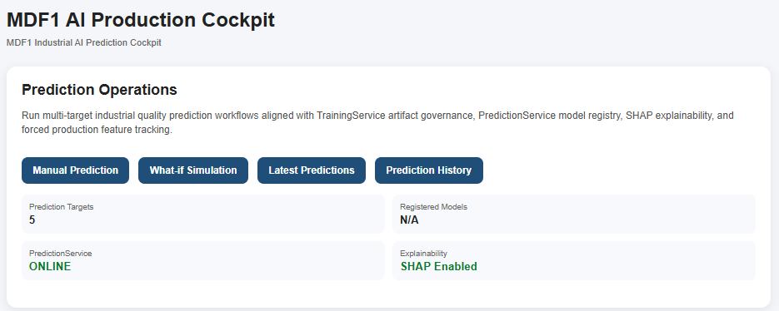
GUI Advisor
GUI Advisor
Displays prediction results, risk levels, top drivers, recommendations, and decision-support guidance in operator-friendly format.
- Data Flow Raw Process Data → Engineered Features → ML Prediction → SHAP Analysis → Risk Assessment → Recommendations → GUI

Slide 5
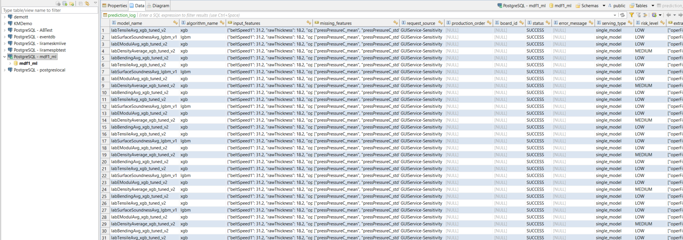
PostgreSQL Integration
PostgreSQL Integration
Stores prediction history, model metadata, risk information, diagnostics, and traceability records.

Slide 6
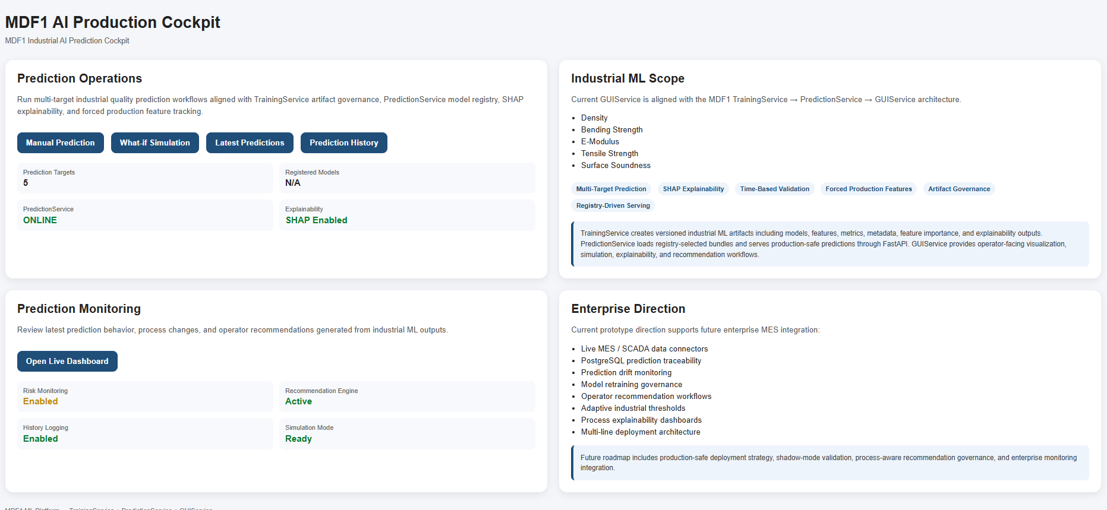
Industrial Benefits
Industrial Benefits
Explainable AI
Reduced troubleshooting time
Improved process control
Higher trust in AI recommendations
Knowledge retention

Slide 7
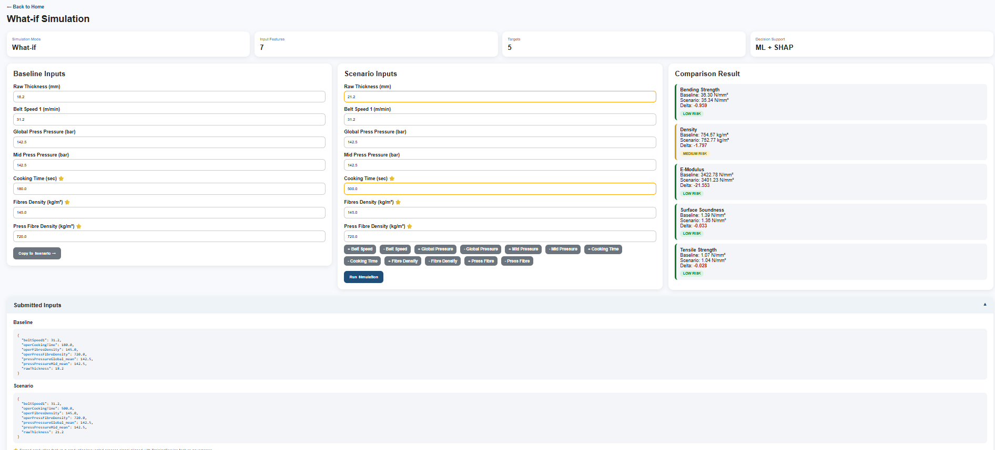
Current Technical Maturity
Current Technical Maturity
Registry-driven model serving
Artifact synchronization
SHAP explainability
Risk scoring
Recommendation generation
Prediction logging

Slide 8
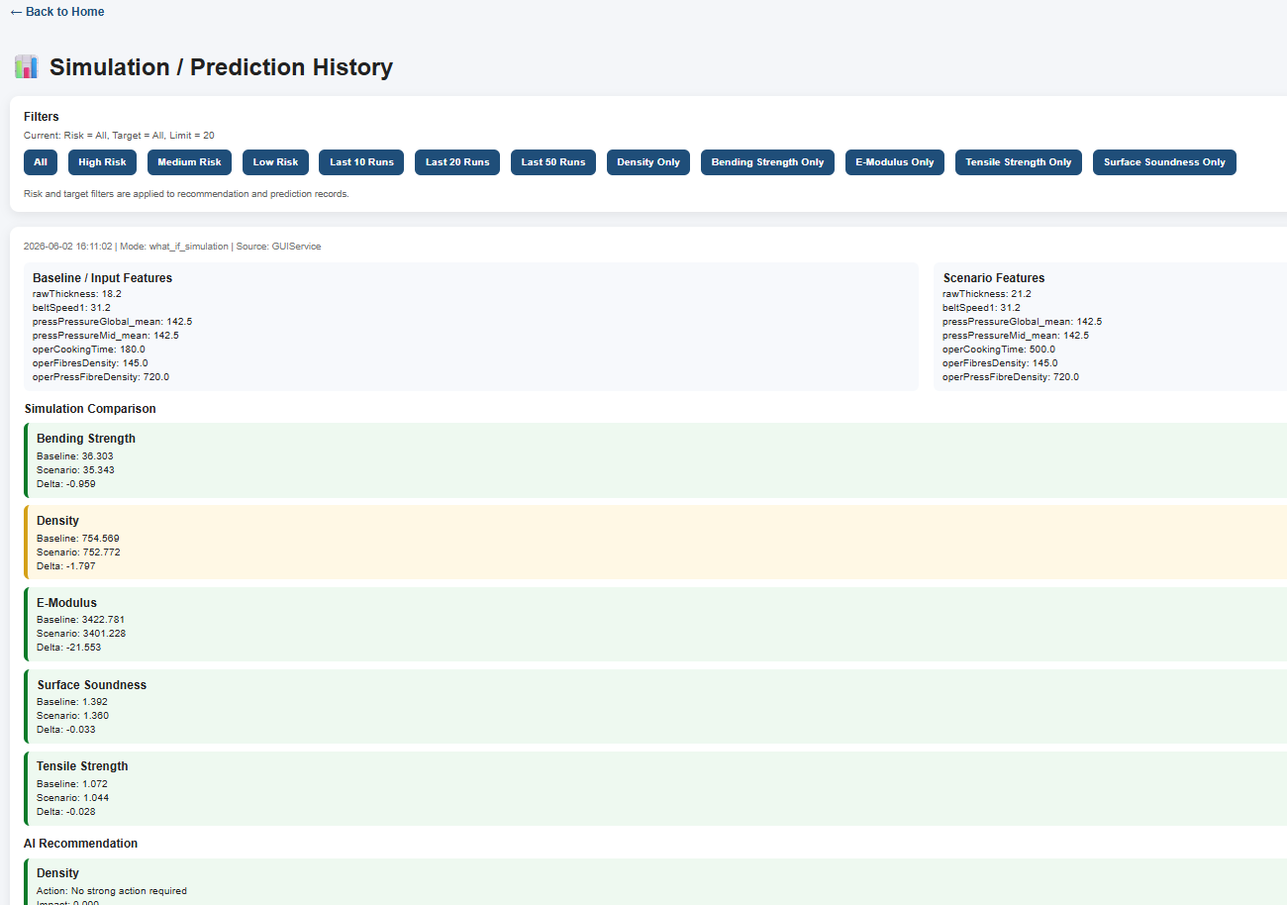
Future Roadmap
Future Roadmap
Advanced advisor logic
Trend monitoring
What-if simulation
Process optimization recommendations
Operator feedback loop

Slide 9
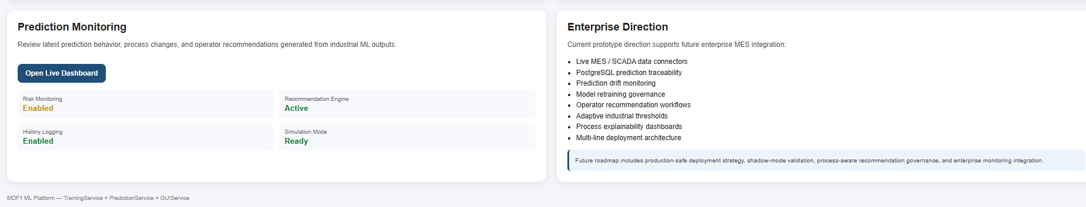
Conclusion
Conclusion
The MDF1 GUI Advisor transforms machine learning outputs into transparent, explainable, and actionable production intelligence.

