Slide 1
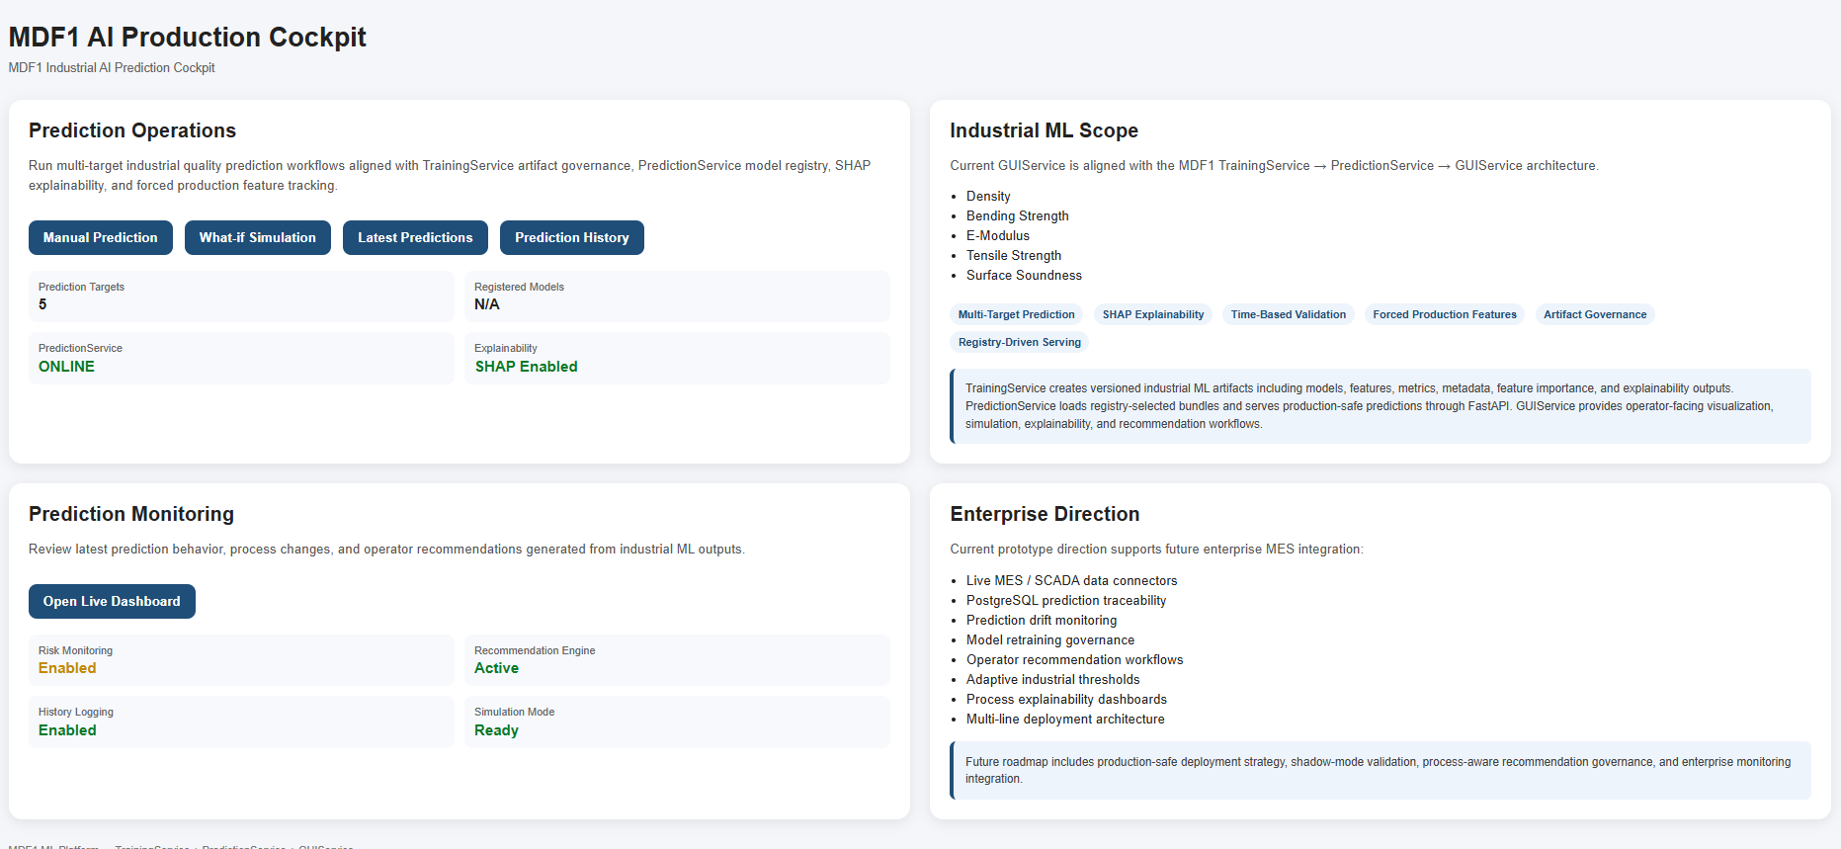
MDF1 Industrial AI Platform
Executive overview of GUI Advisor, SHAP explainability, risk assessment and recommendation engine.

Slide 2
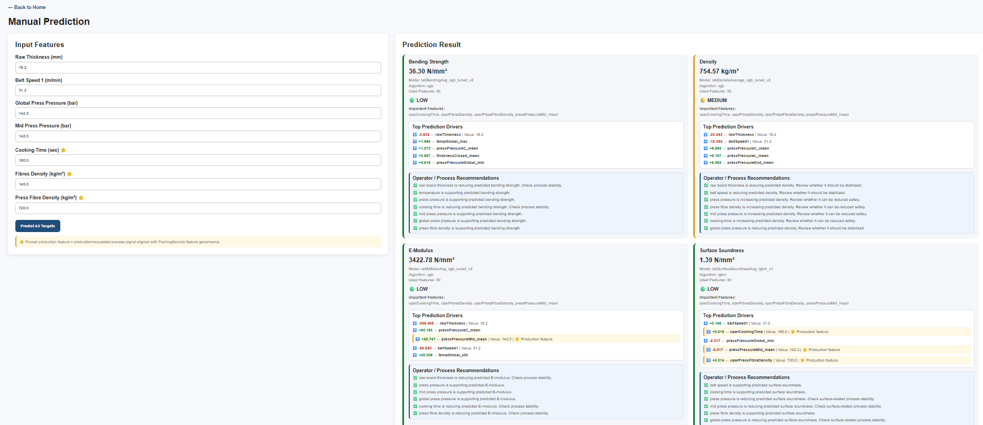
GUI Advisor
Transforms ML predictions into operator-facing recommendations and decision support.

Slide 3
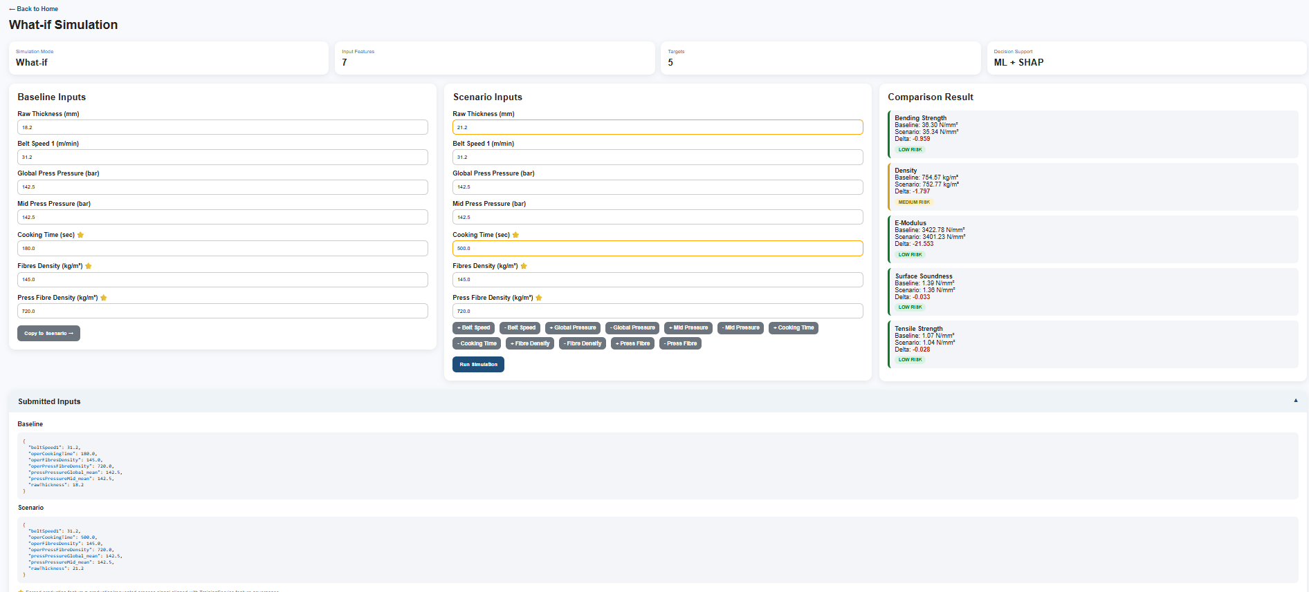
What-If Simulation
Scenario analysis for process optimization and production planning.

Slide 4
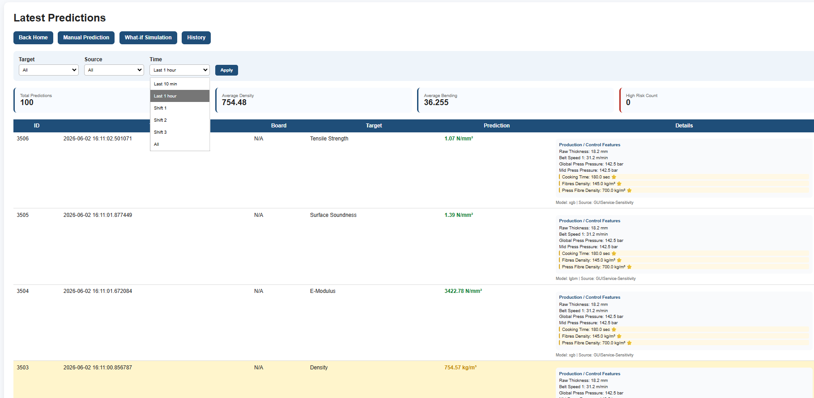
Prediction Monitoring
Traceability, monitoring, KPIs and prediction history.

Slide 5
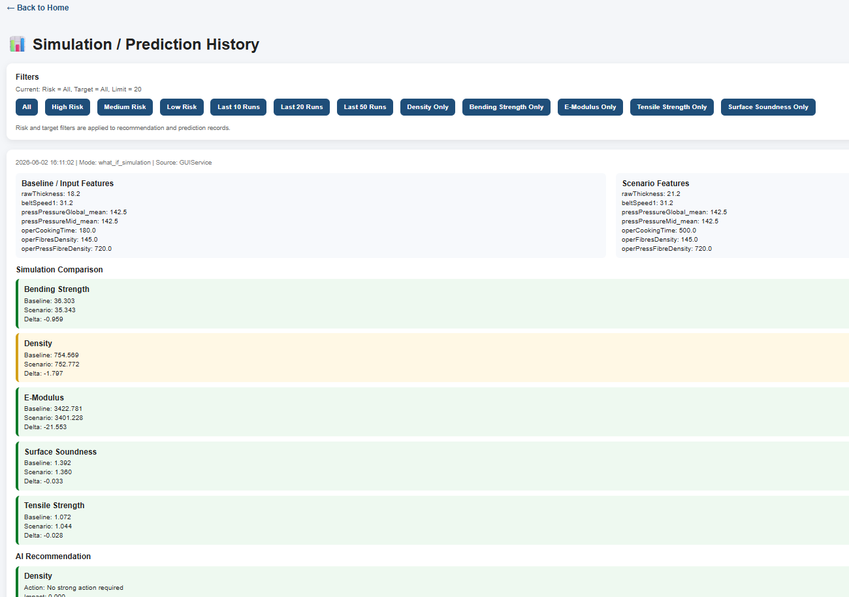
Decision Support & History
Historical comparison, recommendation tracking and continuous improvement.

