Slide 1


Slide 2
Problem Statement
AtliQ Grands owns multiple five-star hotels across India. They have been in the hospitality industry for the past 20 years.
Due to strategic moves from other competitors and ineffective decision-making in management, AtliQ Grands are losing
its market share and revenue in the luxury/business hotels category. As a strategic move, the managing director of AtliQ
Grands wanted to incorporate “Business and Data Intelligence” to regain their market share and revenue.
However, they do not have an in-house data analytics team to provide them with these insights.
Their revenue management team had decided to hire a 3rd party service provider to provide them with insights from
their historical data.

Slide 3
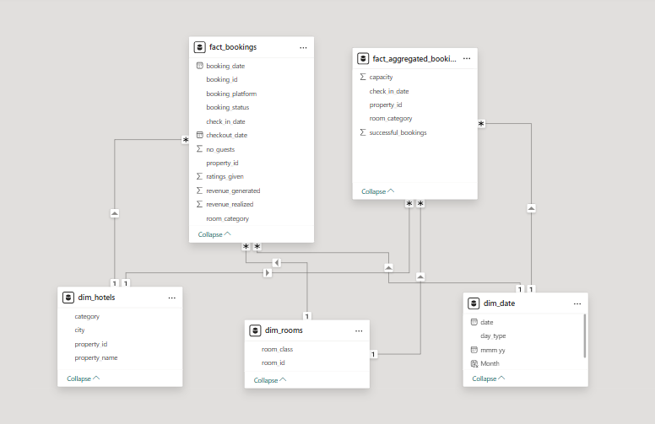
Data Modeling

Slide 4
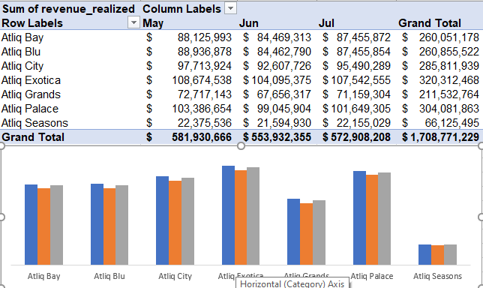
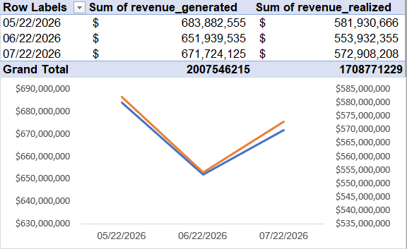
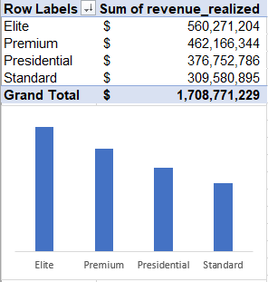
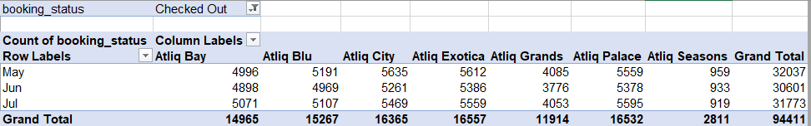
EDA

Slide 5
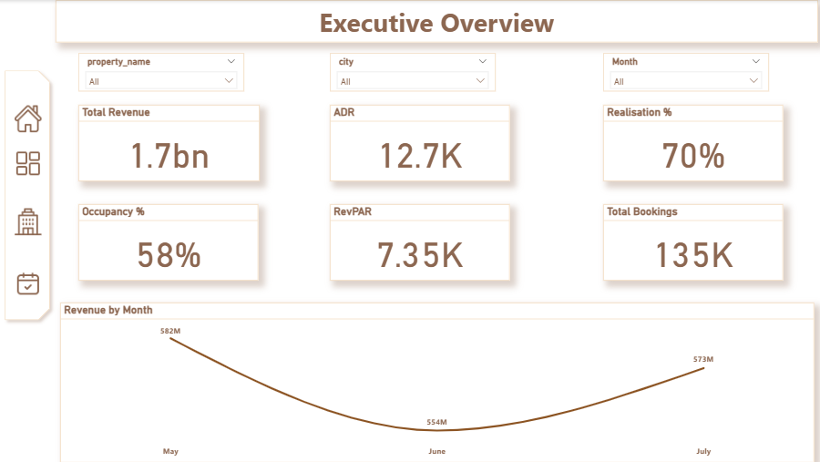

Slide 6
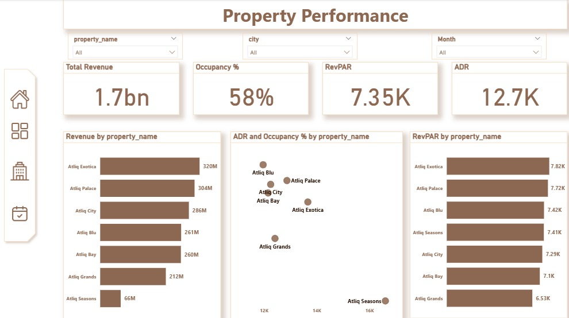

Slide 7
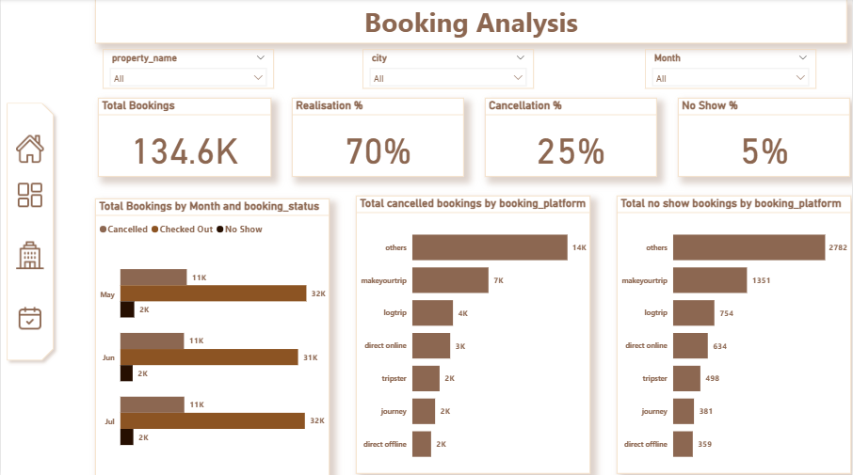

Slide 8
1. Key Insights
Key Insights & Business Recommendations
Revenue Performance
Revenue declined by approximately 4.8% in June compared to May, then recovered by 3.4% in July.
The June decline coincided with fewer checked-out bookings, while cancellations and no-shows also decreased.
This suggests that the decline cannot be explained by an increase in cancellation volume alone.
Property Performance
AtliQ Exotica generated the highest property revenue.
AtliQ Seasons recorded the lowest revenue, alongside the highest ADR and lowest occupancy.
Seasons represents a single property, so its lower total revenue may partly reflect its limited presence. Its pricing and demand patterns deserve further investigation.
Weekday vs. Weekend
Weekdays generated approximately 1.07B in realized revenue, compared to 639M on weekends.
However, weekdays occur more frequently, so average revenue per day is needed for a fair performance comparison.
ADR & Occupancy
The analysis showed an approximately -86% correlation between ADR and occupancy across properties.
This indicates a negative relationship in the observed data, but does not establish that higher prices cause lower occupancy.
City Performance
Mumbai recorded the highest revenue contribution, followed by Bangalore, Hyderabad, and Delhi.
This highlights where revenue is concentrated, but does not necessarily indicate which city is the most profitable or efficient.
Booking Platforms
The "Others" category recorded the highest revenue, as well as the highest cancellation and no-show counts.
Booking counts alone are insufficient to determine platform performance; rates and acquisition costs should also be considered.

Slide 9
Key Insights & Business Recommendations
2. Business Recommendations
1. Review Pricing & Demand
Investigate AtliQ Seasons' pricing strategy and demand patterns.
Evaluate ADR, occupancy, and RevPAR together before making pricing decisions.
2. Investigate the June Revenue Decline
Analyze the decline at property, city, room-category, and booking-platform levels.
Identify which segments contributed most to the decrease in completed bookings.
3. Optimize Booking Channels
Compare cancellation and no-show rates across platforms, not just absolute counts.
Consider booking value and acquisition costs when evaluating channel effectiveness.
4. Explore Expansion Opportunities
Assess opportunities to expand the hotel's presence in promising markets.
Use market demand, competitor performance, capacity, and expansion costs before making investment decisions.
5. Improve Performance Monitoring
Track revenue, ADR, occupancy, and RevPAR together.
Use consistent performance comparisons across properties and time periods.

