Slide 1

Data Pipeline
Week 3 Lab 2
MSDS610
Hana Mengistu

Slide 2
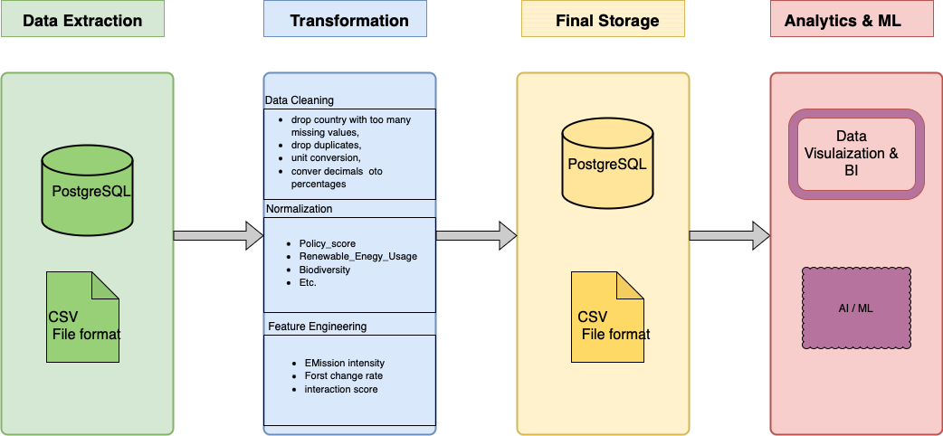
Diagram
Pipeline Type
Batch Processing
My data set has historical data
My dataset I not continually collecting data Data Format
Data Format
CSV
Notes:
Pipeline Type
Batch Processing
My data set has historical data, so processing it in chunks is more efficient than stream processing in real-time. My data is yearly.
My dataset I not continually collecting data but yearly which is a better reason for batch processing
Data Format
CSV
CSV will be the data format for storing the processed data since I will be working with PostgreSQL, and if in the future the data is extracted to be analyzed, a CSV file type will be ideal for a lot of data visualization software

Slide 3
Data Quality
Duplicates
Since months and days are not provided in the dataset, it is necessary to remove duplicates.
Identify duplicate rows where Country and Year are the same and flag them.
If two records have the same Country and Year but different values in other columns, compute the mean to obtain a single output for that country and year.
Outliers
Use Z-score detection to identify outliers that deviate significantly from the mean.
Missing Values
Since all columns are necessary for machine learning, we will not use median, average, or imputation techniques. Instead, we will drop rows with missing values to maintain data integrity.
Notes:
Duplicates
Duplicates can occur when multiple records are recorded in the same year.
Since months and days are not provided in the dataset, it is necessary to remove duplicates.
Identify duplicate rows where Country and Year are the same and flag them.
If two records have the same Country and Year but different values in other columns, compute the mean to obtain a single output for that country and year.
Outliers
Some values may be extreme or unrealistic, such as a negative GDP or unusually high CO₂ emissions.
Use Z-score detection to identify outliers that deviate significantly from the mean.
Missing Values
Missing values in columns can occur due to incomplete data recording.
Since all columns are necessary for machine learning, we will not use median, average, or imputation techniques. Instead, we will drop rows with missing values to maintain data integrity.

Slide 4
Data Drift
Monitor Key Features
Track shifts in important features like CO2 emissions and others.
Thresholds & Alerts
Set acceptable deviation thresholds for key features.
Trigger an alert if the deviation exceeds the threshold for further examination.
Monitor Incoming Schema
Compare the new data schema with the previous schema.
Have someone review and approve or decline the new schema.
Notes:
Monitor Key Features
Track shifts in important features like CO2 emissions and others.
Thresholds & Alerts
Set acceptable deviation thresholds for key features.
Trigger an alert if the deviation exceeds the threshold for further examination.
Monitor Incoming Schema
Compare the new data schema with the previous schema.
Have someone review and approve or decline the new schema.
*The main point is that we set alerts or triggers for approval of data drift or changing the schema, following that the data can be manually reviewed if necessary

Slide 5
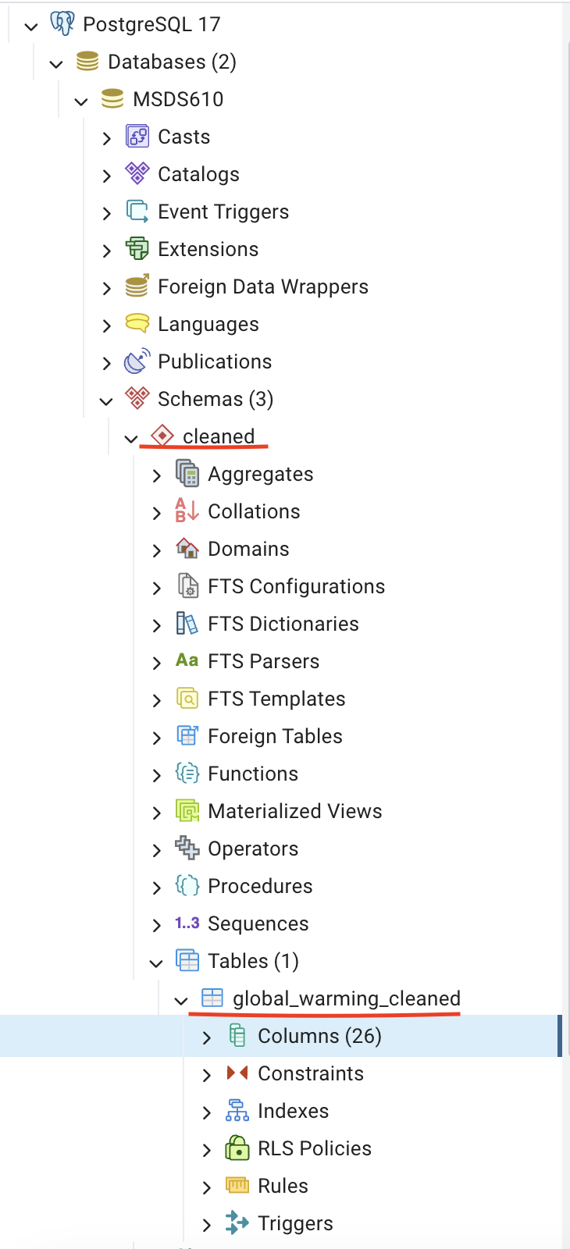
Transformed data
Cleaned data in pgAdmin
Notes:
Check github for code

