Slide 1

Data Set Exploration
Lab 1

Slide 2
Dataset Background
The dataset I'm using focuses on global warming and climate change trends across 95 countries.
The timeline is from 1900 to 2023.
The dataset contains information capturing environmental, economic, and societal factors impacting global warming.
Size: 1,000,000 rows X 26 Columns
Kaggle: https://www.kaggle.com/datasets/ankushpanday1/global-warming-dataset-195-countries-1900-2023

Slide 3
Column name | description | Data Type | Relevance to Problem Defined
Country | Unique id for countries. Country names not provided | Nominal | Help identify and categorize data by country for risk classification
Year | Year data sample taken | Discrete | Tracking changes over time, which can influence risk assessment
Temperature_Anomaly | Deviation from the average temperature baseline | continuous | Directly impacts the risk of global warming, higher anomalies means higher risk
Co2_Emissions | Total carbon dioxide emissions in metric tons | continuous | Higher co2 emission factor in global warming risk
Population | Total population of country | continuous | Large population contributes to higher emissions
Forest_Area | Percentage or area covered by forest in country | continuous | Less forest area over time more likely for global waring risk
GDP | Gross domestic Product of the country | continuous | Higher GDP possible greater industrial activity
Renewal_Energy_Usage | Percentage of energy consumed form renewable sources | continuous | More renewal energy lower global warming risk
Methane_Emissions | Total methane emission (metric tons) | continuous | Higher emissions used for classification
Sea_Level_Rise | Rise in sea level (inches, millimetter or meters NOT SPECIFIED NEED FURTHER RESERCH) | continuous | Tied to risk of costal flooding which shows global warming impact
Arctic_Ice_Extent | Area of Arctic ice coverage | continuous | Melted ice = sea level rise and global warming impact/ severity
Urbanization | Percentage of the population living in urban area | continuous | Higher urbanization, higher emissions in correlation
Deforestation_Rate | Rate of forest loss | continuous | Higher deforestation = higher risk of global warming
Measurements in dataset are not specified. Guessing in description

Slide 4
Column name | description | Data Type | Relevance to Problem Defined
Extreme_Weather_Events | Count of extreme weather events | Discrete | Extreme weather events signal higher risk of global warming
Average_Rainfall | Annual average rainfall | continuous | Indicates global warming effect of water availability
Solar_Energy_Potential | Measure of the countries potential for solar energy generation | continuous | High solar energy = reduces fossil fuels and mitigates climate change risk
Waste_Managment | Percentage of waste effectively managed | continuous | Effective waste management reduce emission & pollution
Per_Capita_Emissions | Carbon emission per person | continuous | Increase in per cap emission = higher chance of climate change
Industrial_Activity | Level of industrial activity | continuous | Higher industrial activity = greater emission = increase in climate change
Air_Pollution_Index | Measurement of air quality ( value of index possibly) | continuous | Higher air pollution index over time = higher global warming risk
Biodiversity_Index | how many of a particular species are distributed in a specific area | continuous | Low bio diversity = environmental degradation and is linked to global warming
Ocean_Acidification | Level of ocean acidity (pH units) | continuous | Rise in ocean acidification = rising co2 level consequence
Fossil_Fuel_Usage | Percentage of energy consumption derived from fossil fuels. | continuous | Higher fossil fuel = increase in co2 emission = higher global warming risk
Energy_Consumption_Per_Capita | Energy usage per individual | continuous | Higher energy consumption leads to higher emission
Policy_Score | Effectiveness of policy percentage | continuous | Higher policy rates = lower risk of global warming risk for the country
Average_Temperature | Average temperature for country | Continuous | Higher average temp shows global warming risk/impact
Measurements in dataset are not specified. Guessing in description

Slide 5
MLS well defined problem
Classify countries as “high risk,”” medium risk,” or “low risk” for global warming impact based on factors such as ice extent, sea level rise, and GDP
After MLS: countries with higher risk can be focused on to decrease climate change / global warming

Slide 6
Sketch of MLS
MLS process
Data Storage:
PostgreSQL
1. Preprocess data: clean, normalize, etc.
2. Model training: Classification between low & high risk
Metric to measure ML model:
Accuracy
Confusion matrix
F1-score
precision and recall
3. Select relevant feature for model accuracy
Output:
Low-risk
Medium risk
High risk

Slide 7
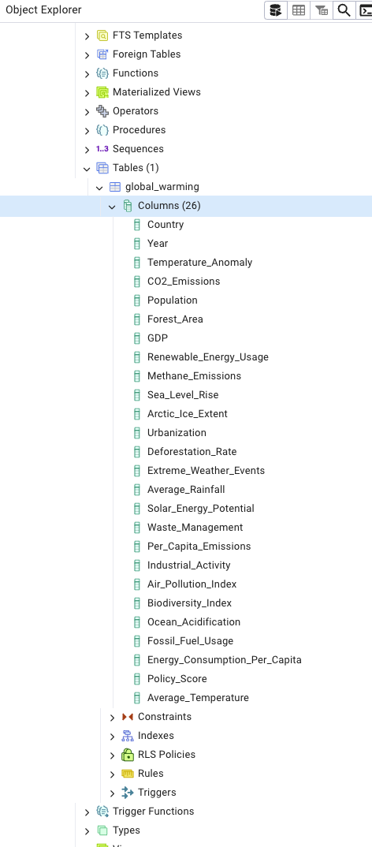
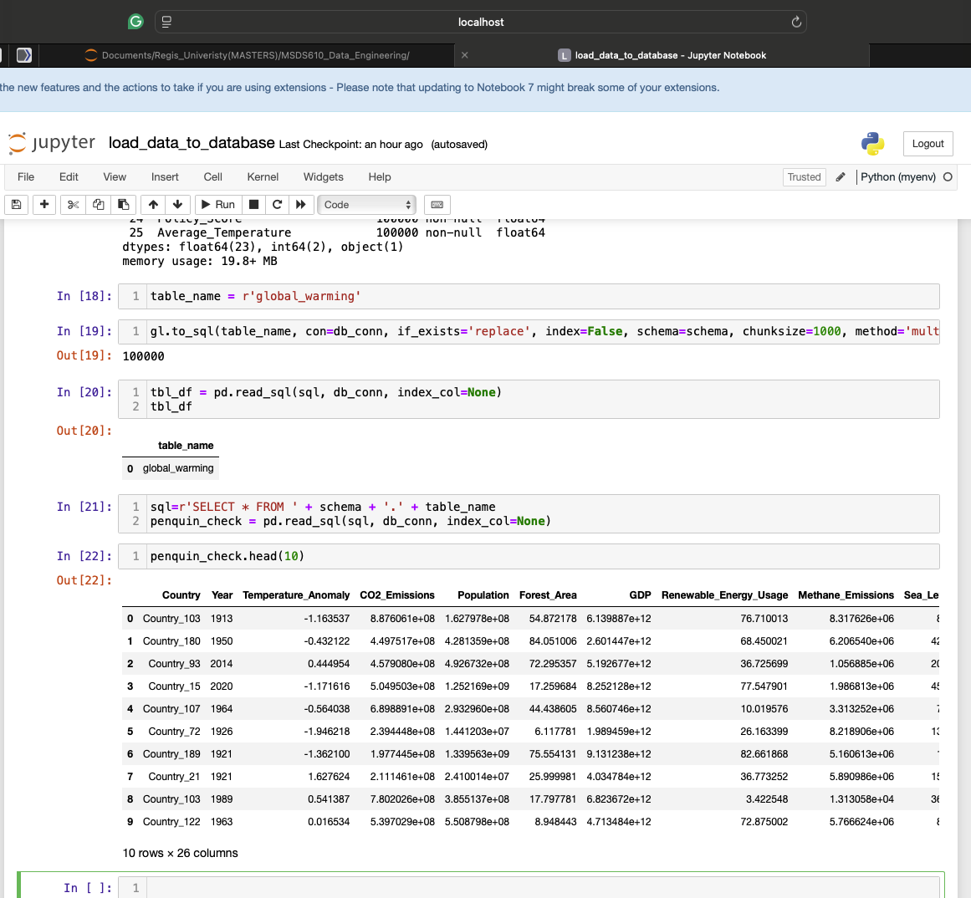
Screenshot of loaded data on PgAdmin

