Slide 1
GUI Graphical User Interface
Seminar
Program of Programming languages :
Made by: Hanan Ben Shabat 315873257
Lecturer: Dr. Yitzhak Aviv
1

Slide 2
Goal:
Developing a GUI(Graphical User Interface) system in Python.
The system displays output of 20 prepared SQL queries from the DB (Data Base).
The DB(Data Base) – Chinook.
The technology – SQLite.
2

Slide 3
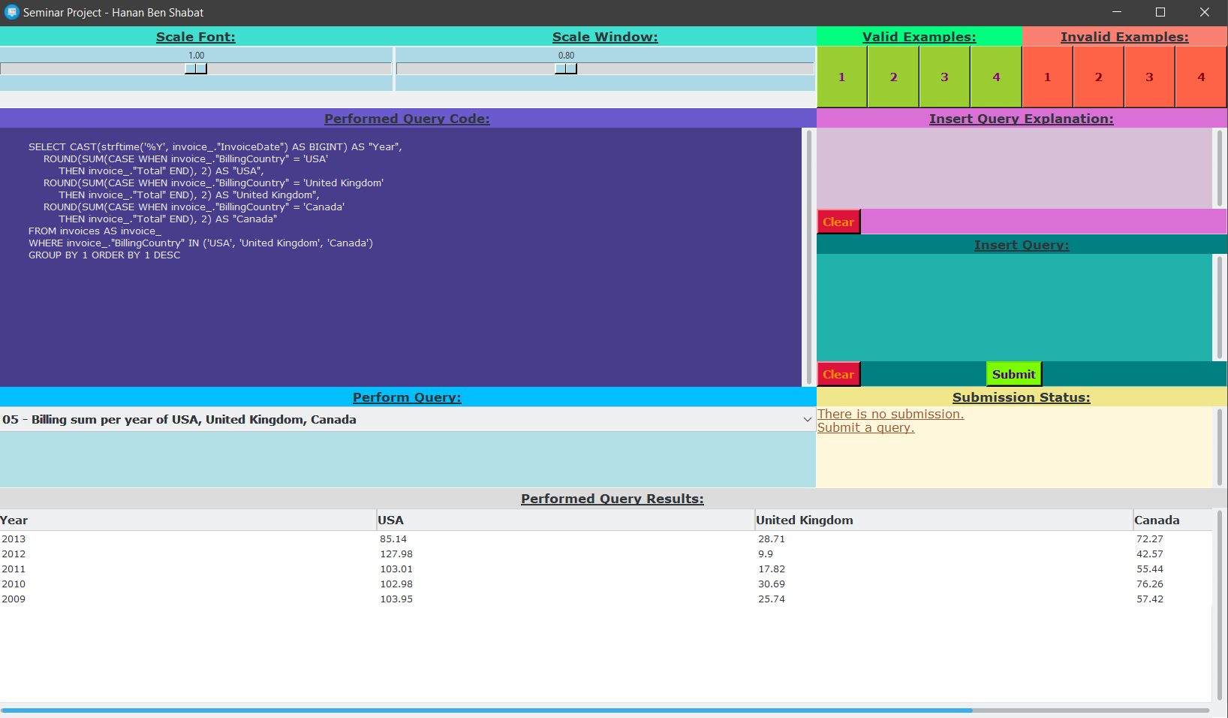
Query sample:
The GUI displays a selectable drop-down box for selecting
a query with a brief note on each query explaining them and upon selecting a query its SQL code and results are displayed.
3

Slide 4
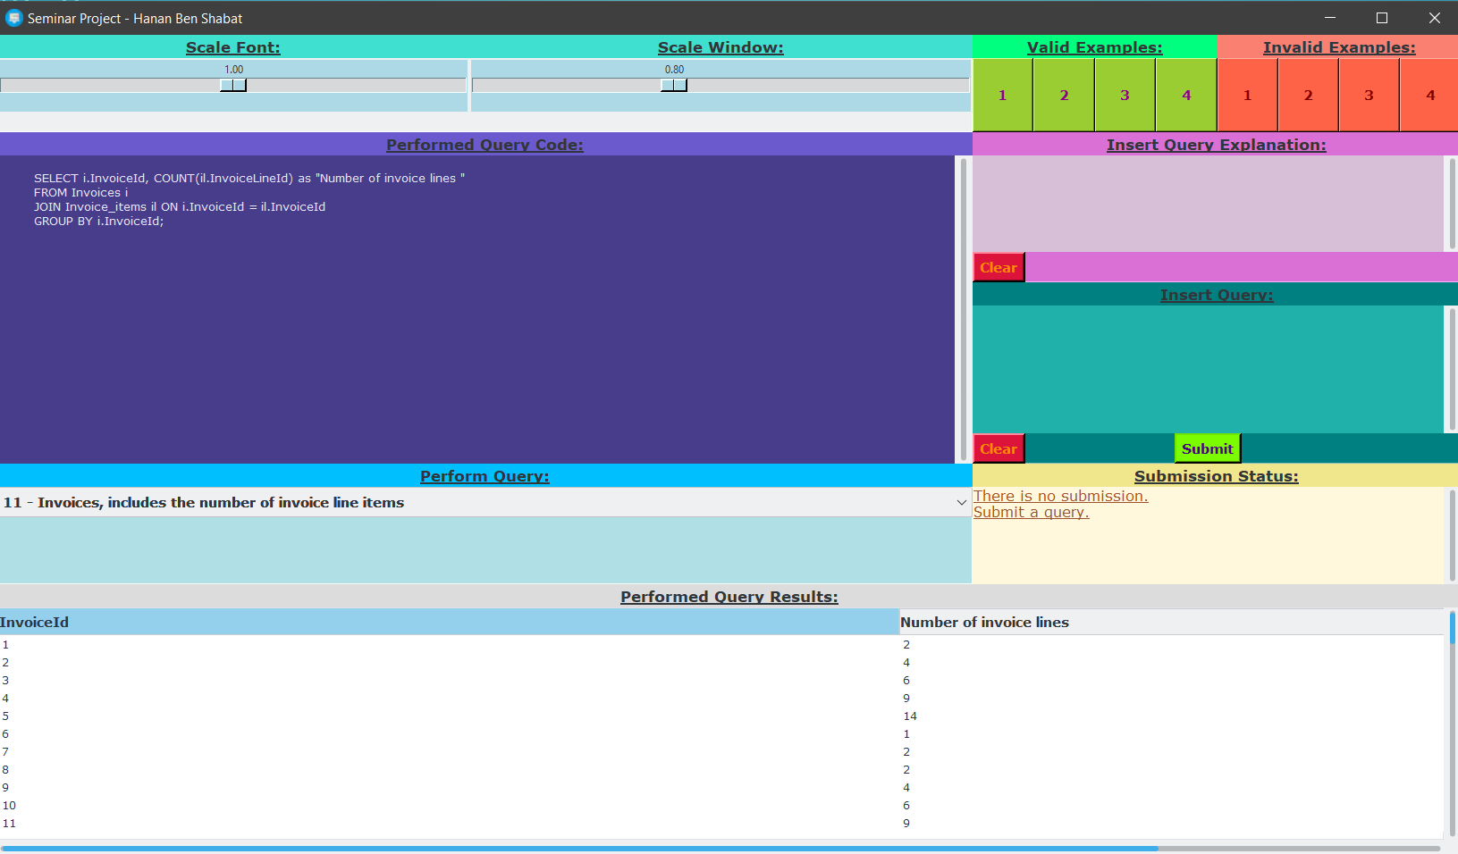

Query sample:
In this example I showed that if the column title is clicked the results get sorted.
If it is clicked again, it get sorted again, in reversed order.
4

Slide 5
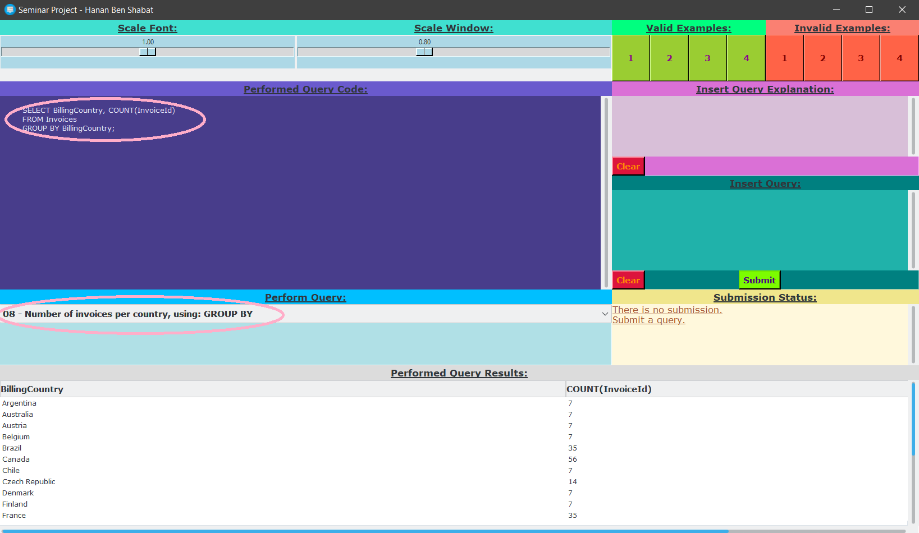
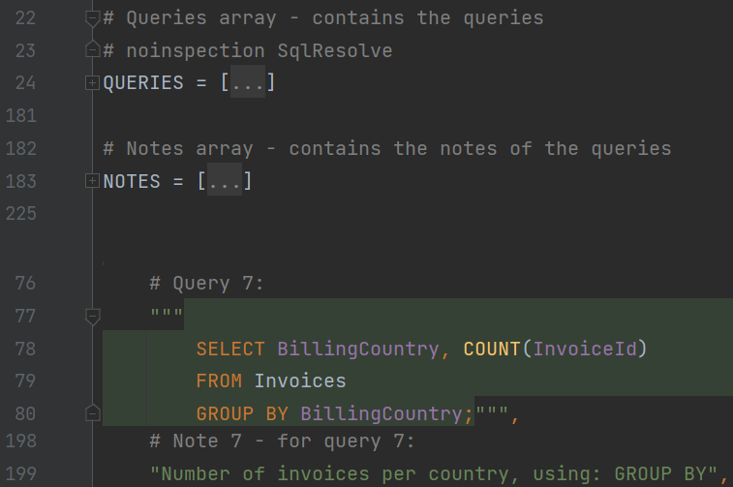
Query sample:
In this example I highlighted the selected query, and the code to show how they look like behind the code and over the GUI.
5

Slide 6
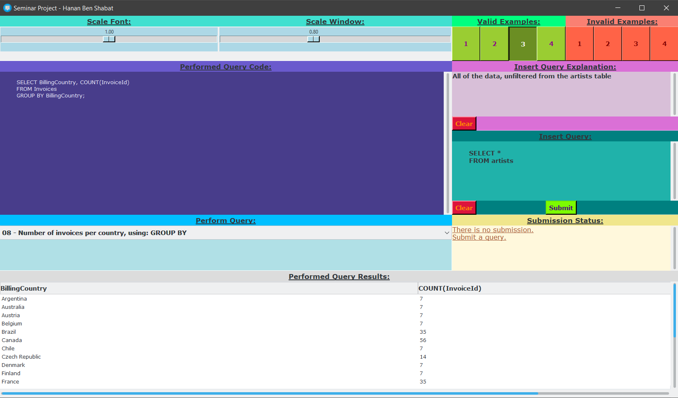
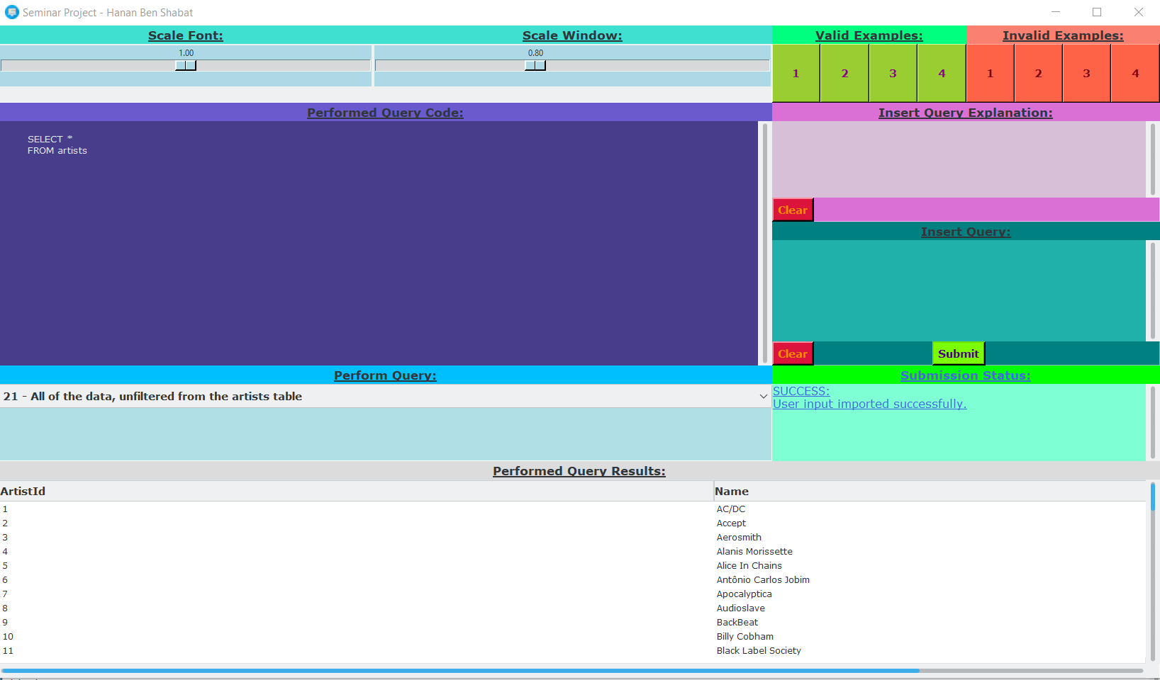
Query sample:
In this example I displayed adding a query with the third(3) valid example button, it is possible to edit the query and explanation areas and after clicking submit it is added if it doesn’t have any errors, the explanation is limited to 60 letters.
6

Slide 7
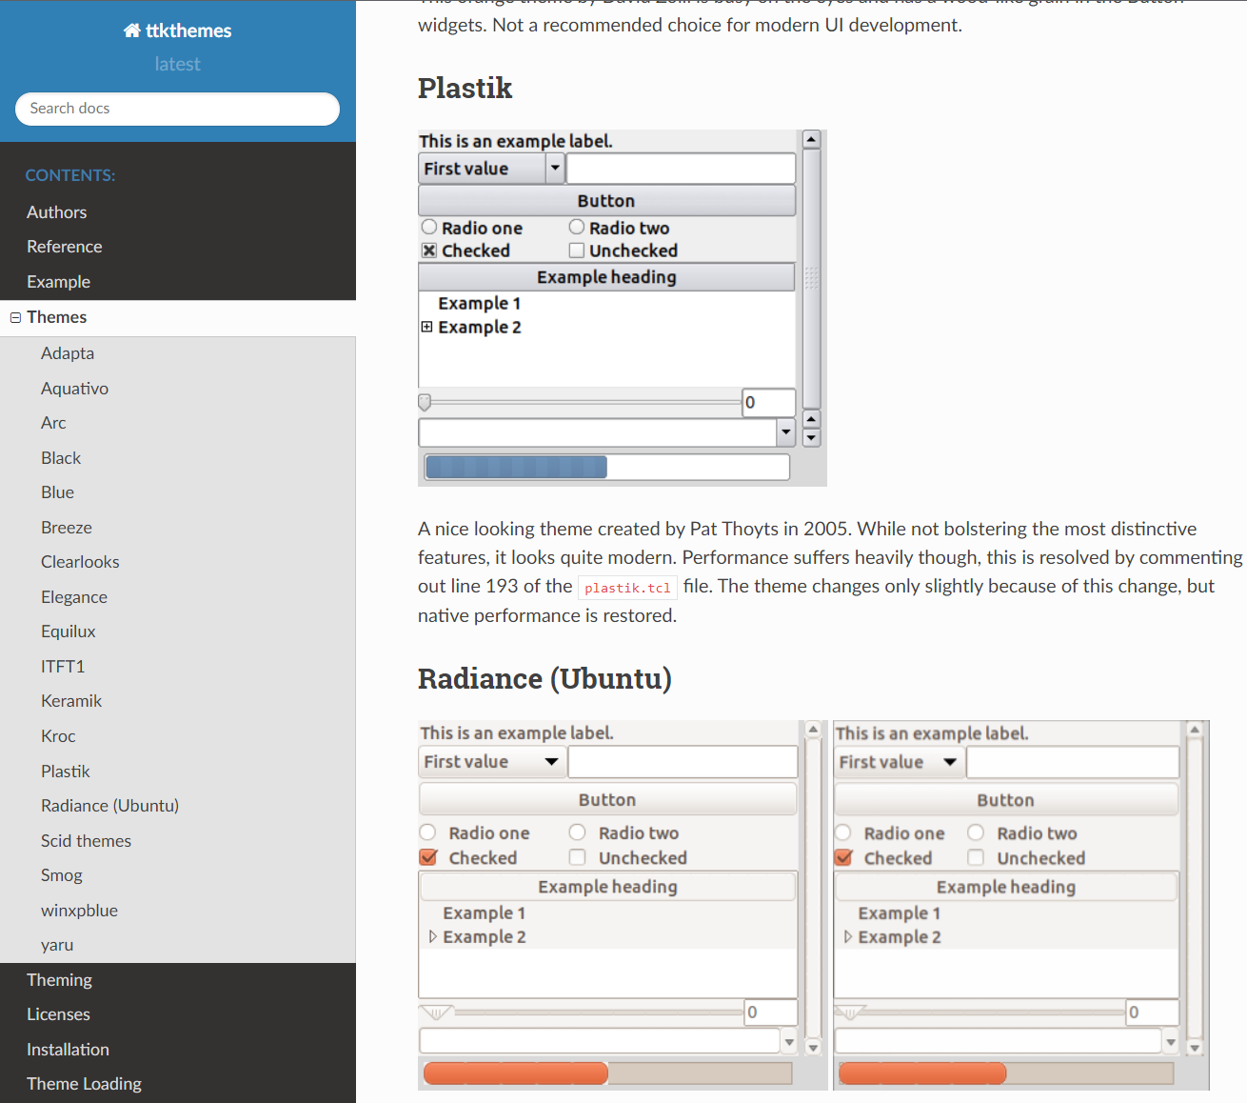
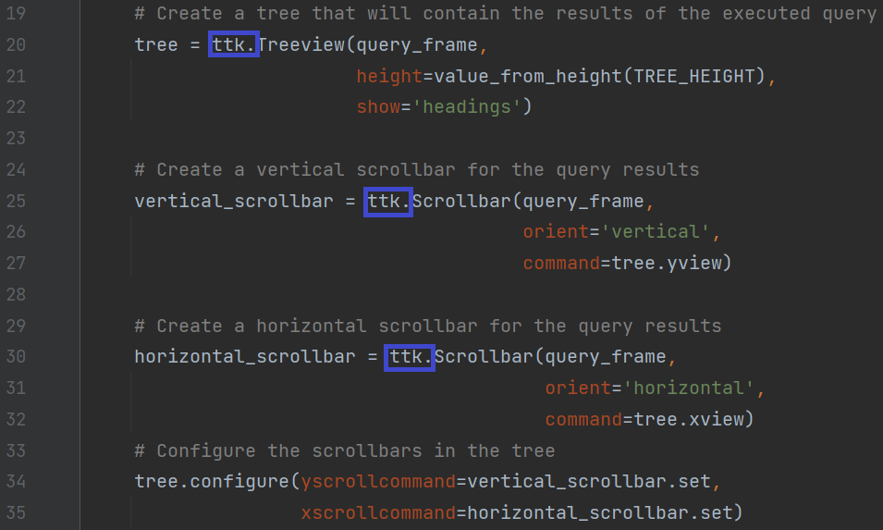
Library samples:
tkinter – used to make the widgets.
ttkthemes – used to improve the GUI style so it looks better.
7

Slide 8
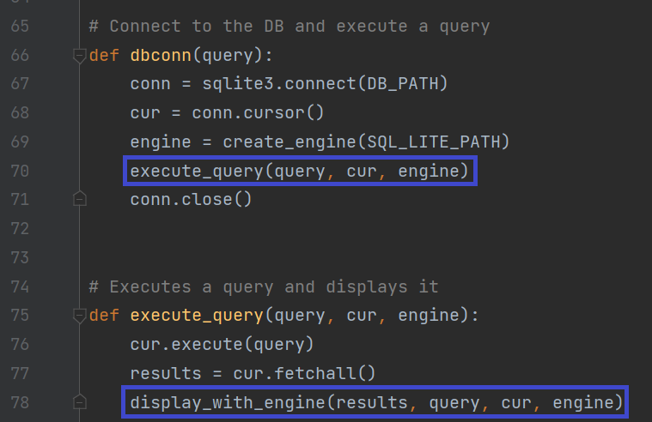
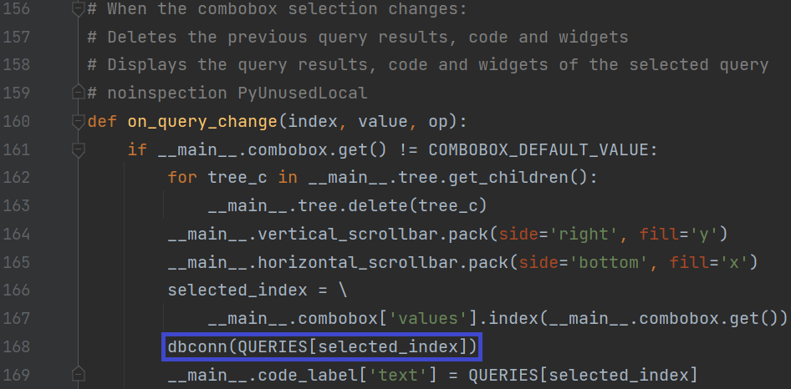
How it works:
dbconn executes when a query is first selected, or when another query is selected instead, connecting to the db and executing a query.
execute_query fetches the results of the SQL query from the DB.
8

Slide 9
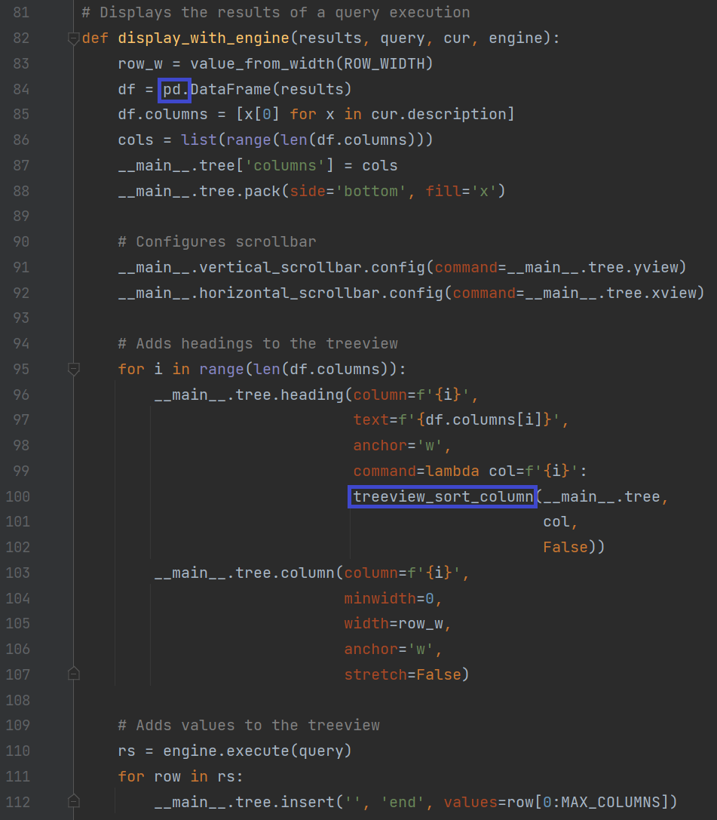
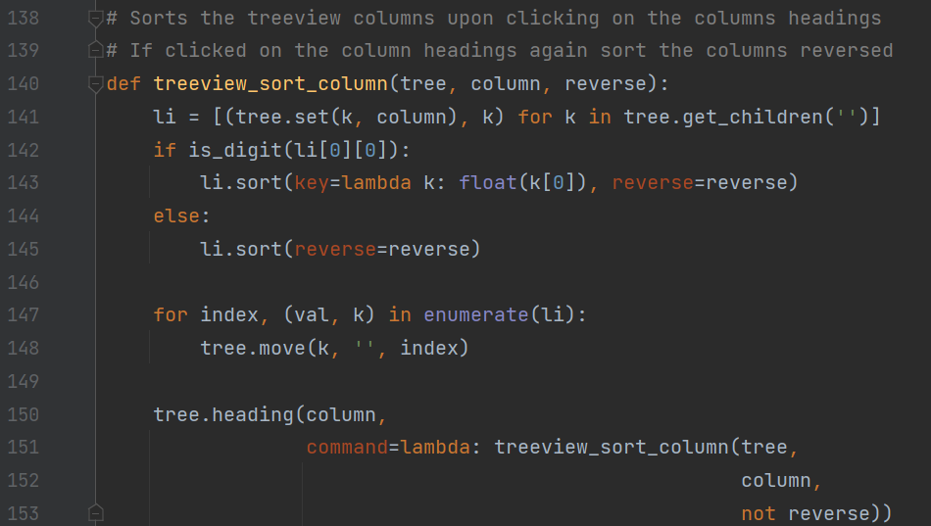
How it works:
display_with_engine uses the library pandas to store the results in its dataframe and with tkinter to display the results of the executed query in its treeview widget.
The treeview headings have a command that sorts by the column when clicked.
9

