Slide 1
Robot Design for Stair
Climbing
Lisa-Sophie Baier
Hanane Lotf
Svetlana Shevchenko

Slide 2
Given Requirements
Maximum mass: mass = 2000g = 2.0kg
Nominal speed: v = 350mm/s = 0.35m/s
Footprint: circular, diameter D = 50cm
Stair height: h = 2.5cm = 0.025m
Minimum runtime: t = 15min = 0.25h
PCB reserved volume: 150 × 150 × 100mm^3
Visual feedback: ≥ 300 lumen
Circular footprint: 50–60 cm
Must climb 5 stairs

Slide 3
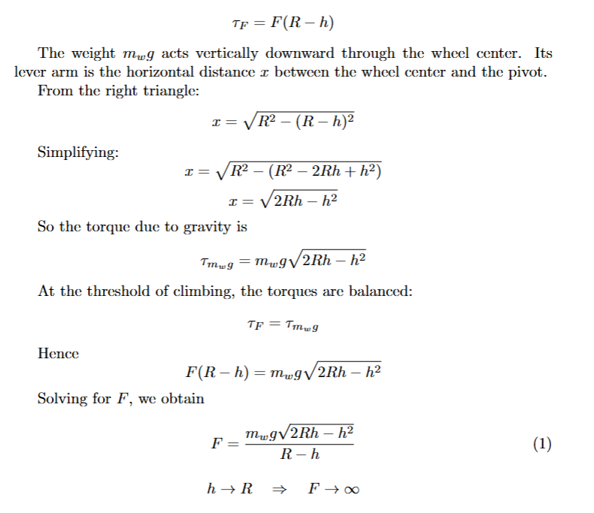
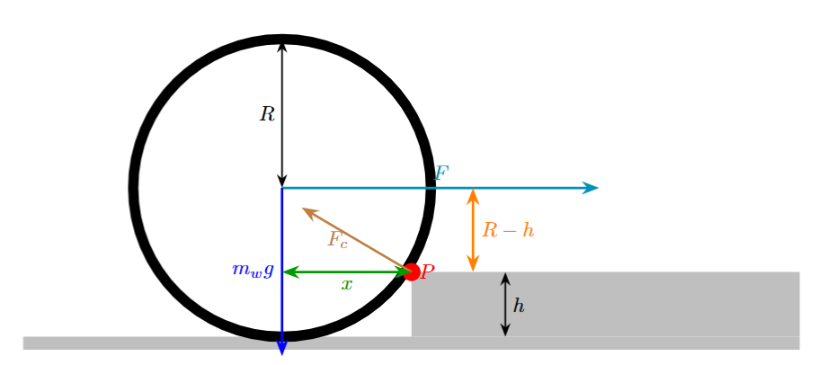
Climbing Force Derivation
The wheel rotates about the corner of the step
The contact force Fc at the pivot does not create any torque
The applied horizontal force F acts at the wheel center

Slide 4
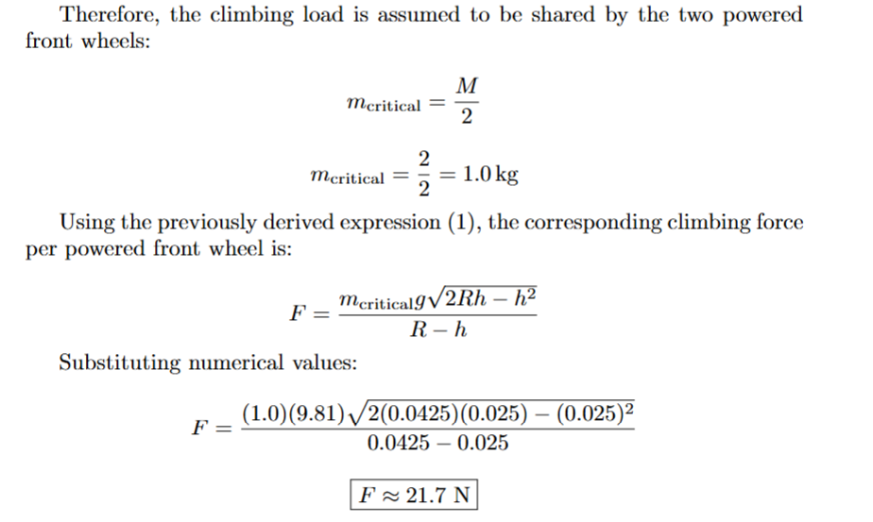
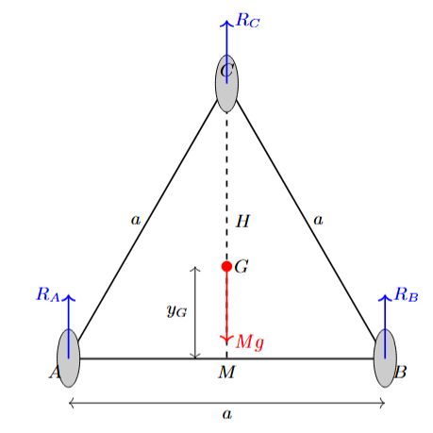
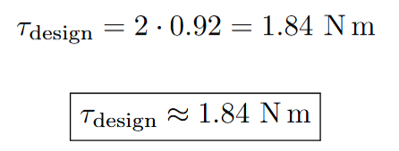


Required Wheel Torque

Slide 5
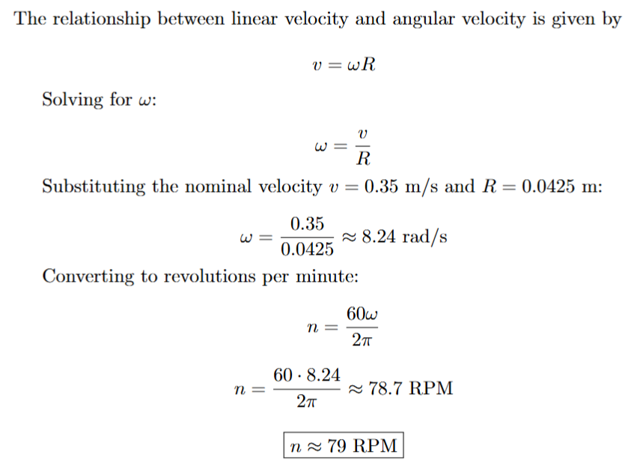
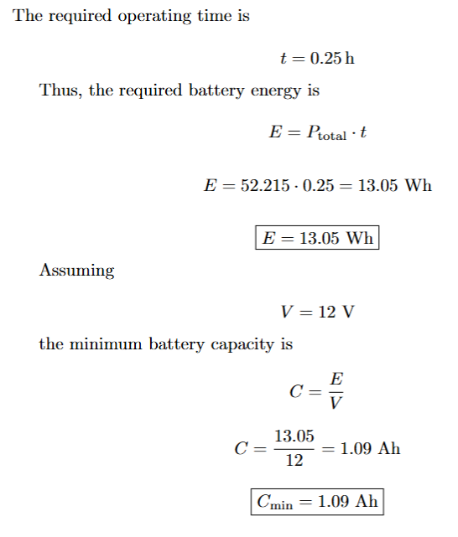
Wheel Angular Velocity, Battery Sizing

Slide 6
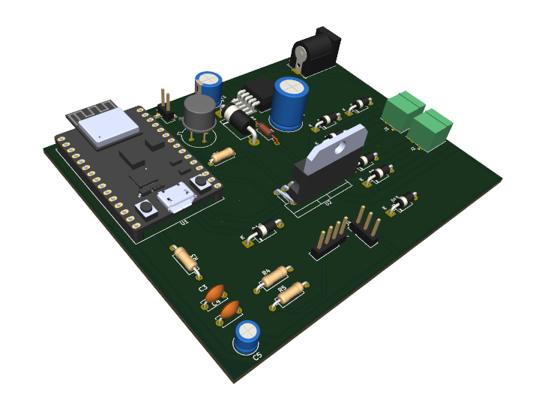
PCB Design
Stair-Climbing Robot: Electronics and PCB

Slide 7
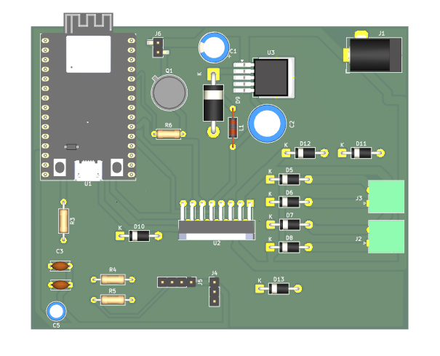
PCB Overview: 4-Block Architecture
Board: 100 x 80 mm
Block 1 — Power Supply: LM2596, 12V→5V
Block 2 — Motor Driver: L298N, dual H-bridge
Block 3 — Microcontroller: ESP32-C3
Block 4 — LED Lighting: separate sub-PCB, 400lm
Fig. 1 — Main PCB layout, 100 x 80 mm, KiCad

Slide 8
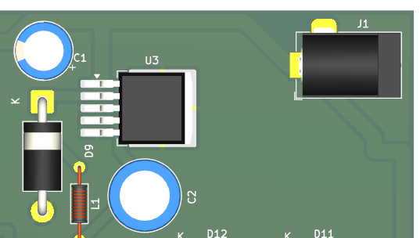
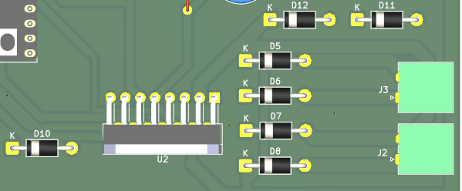
Block 1 & 2 : Power Supply and Motor Driver
Power Supply:
Motor Driver:
L298N (U2): Controls direction and speed of both drive motors using signals from the ESP32.
Motor connectors (J2,J3): Left and right motor outputs
Flyback diodes (D5-D13): they catch voltage spikes from motor back-EMF
Fig. 2 — Block 1: LM2596 power supply
Buck converter (U3):steps down 12V to 5V
Schottky Diode (D9): prevents voltage spikes
Inductor (L1): For energy storage
Screw terminal (J1): 12V battery input connector
Capacitors (C1,C2): Input and output filters
Fig. 3 — Block 2: L298N motor driver

Slide 9
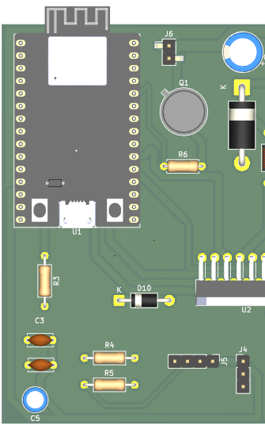
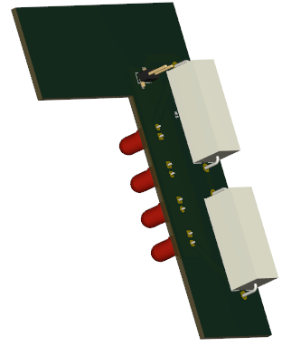
Block 3 & 4: Microcontroller, Sensors and LEDs
Microcontroller and Sensor Interface:
ESP32-C3 (U1): Main microcontroller. Runs navigation firmware, controls motors, reads sensors, and drives LEDs
TCRT5000 (J4):3-pin header for IR sensor for line tracking
HC-SR04 (J5): 4-pin header for ultrasonic sensor for obstacle detection
Transistor 2N2219 (Q1): LED switching transistor. Controlled by ESP32 IO9
LED Lighting:
Connectors (J6,J7): LED_IN & LED_OUT 2-pin connectors to power LEDs with 12V via cable
LEDs (D1-D4): Each LED provides 100 lm/w
Resistors (R1,R2): Limit current to 300 mA per LED
Fig. 4 — Block 3: Sensor interface
Fig. 5 — Block 4: LED sub-PCB

Slide 10
PCB Requirements
PCB fits in chassis: 100x100x80mm within reserved volume
Stair climbing: L298N supports 1.84Nm torque
15 min runtime: 1.09Ah battery
Line tracking + remote control: TCRT5000 + ESP32 Wi-Fi
400lm visual feedback: exceeds 300lm requirement
Remote Control: Blynk app via ESP32 Wi-Fi, no extra hardware needed.

Slide 11
Design Requirements
Circular footprint: 50–60 cm
Maximum weight: 2000 g
Must climb 5 stairs
Step height: 25 mm
Designed in Autodesk Fusion

Slide 12
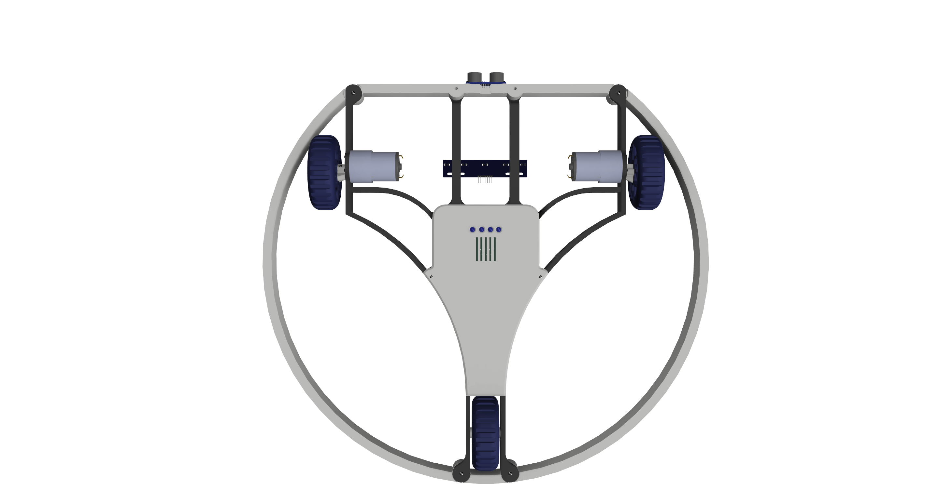
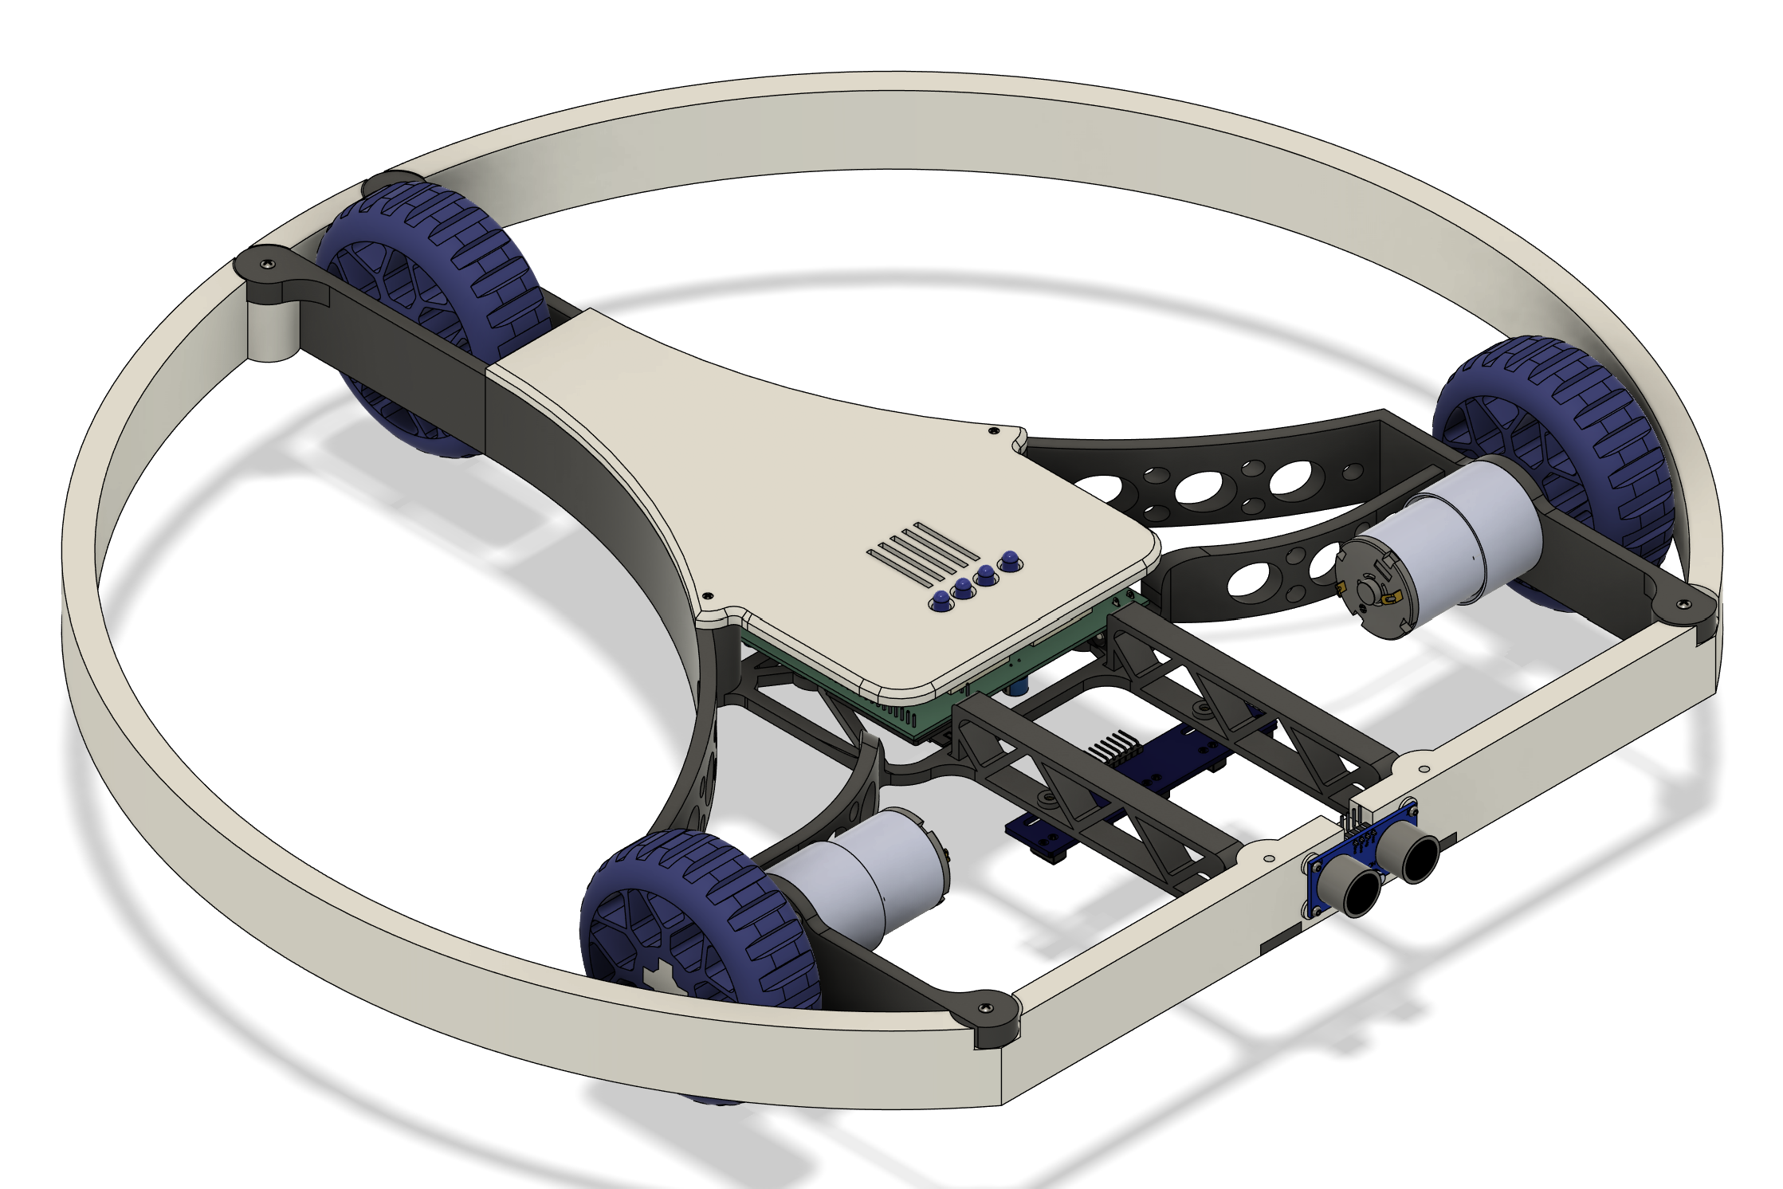
Final CAD Design
Circular ring frame
Central core for electronics and battery
Two driven front wheels
Fixed passive rear wheel
Custom TPU tires

Slide 13
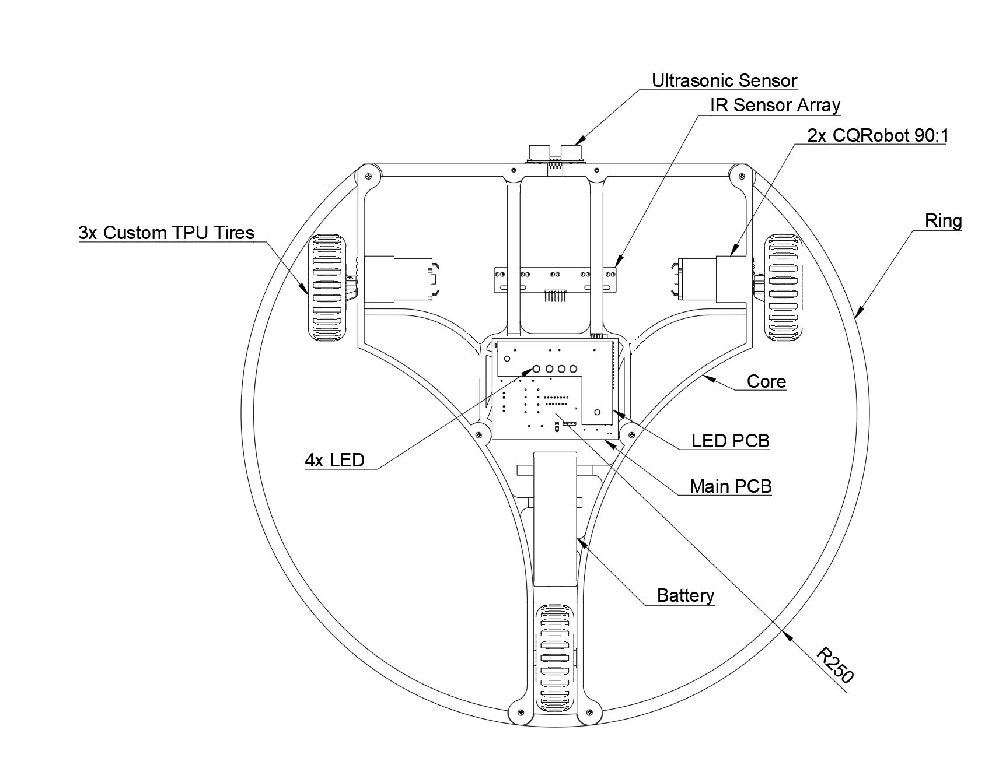
Components
Core
Ring
Lid
Tires+ axis
Main PCB + LED PCB
2x Motors
Ultrasonic sensor
IR sensor Array
Battery
M2 Inserts and Screws

Slide 14
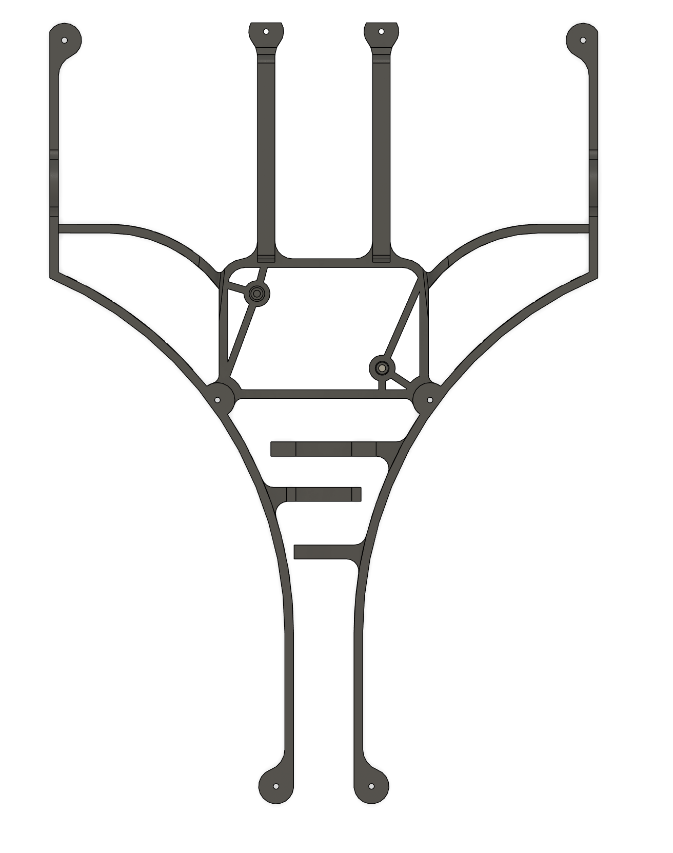
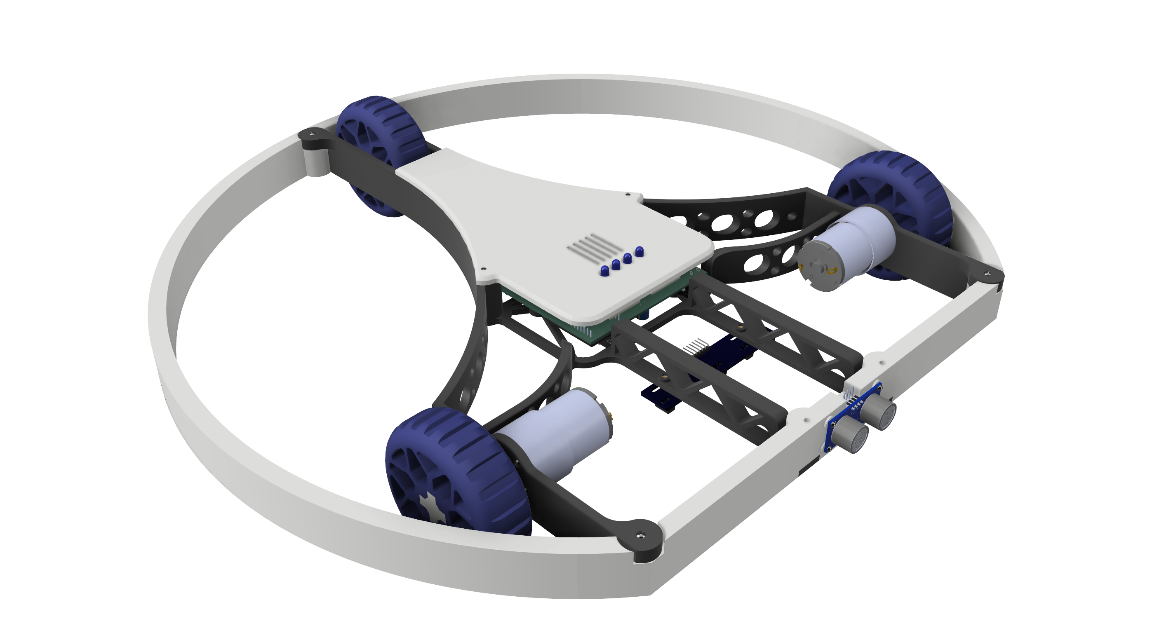
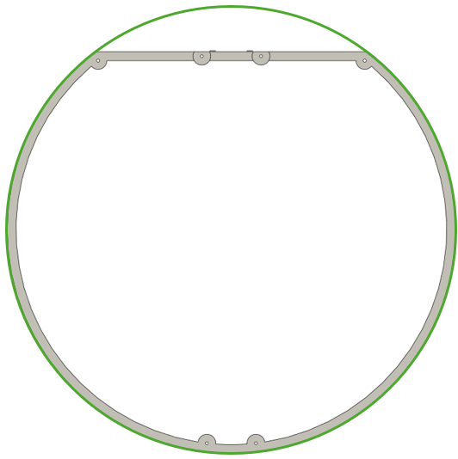
Weight-Saving Design Decisions
Big in size
Ring structure instead of solid circular base
Open core with ribs for stiffness
Fixed rear wheel

Slide 15
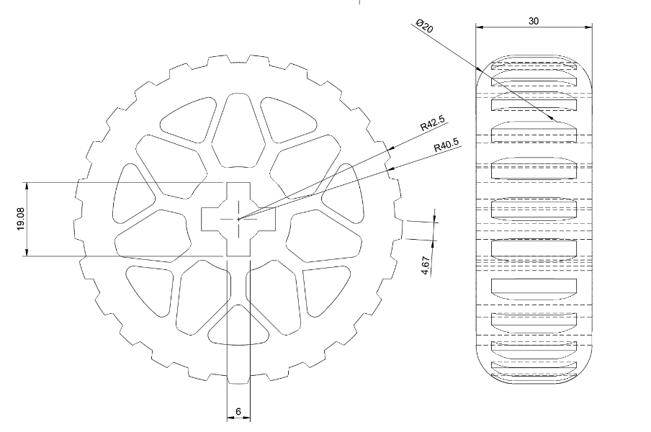
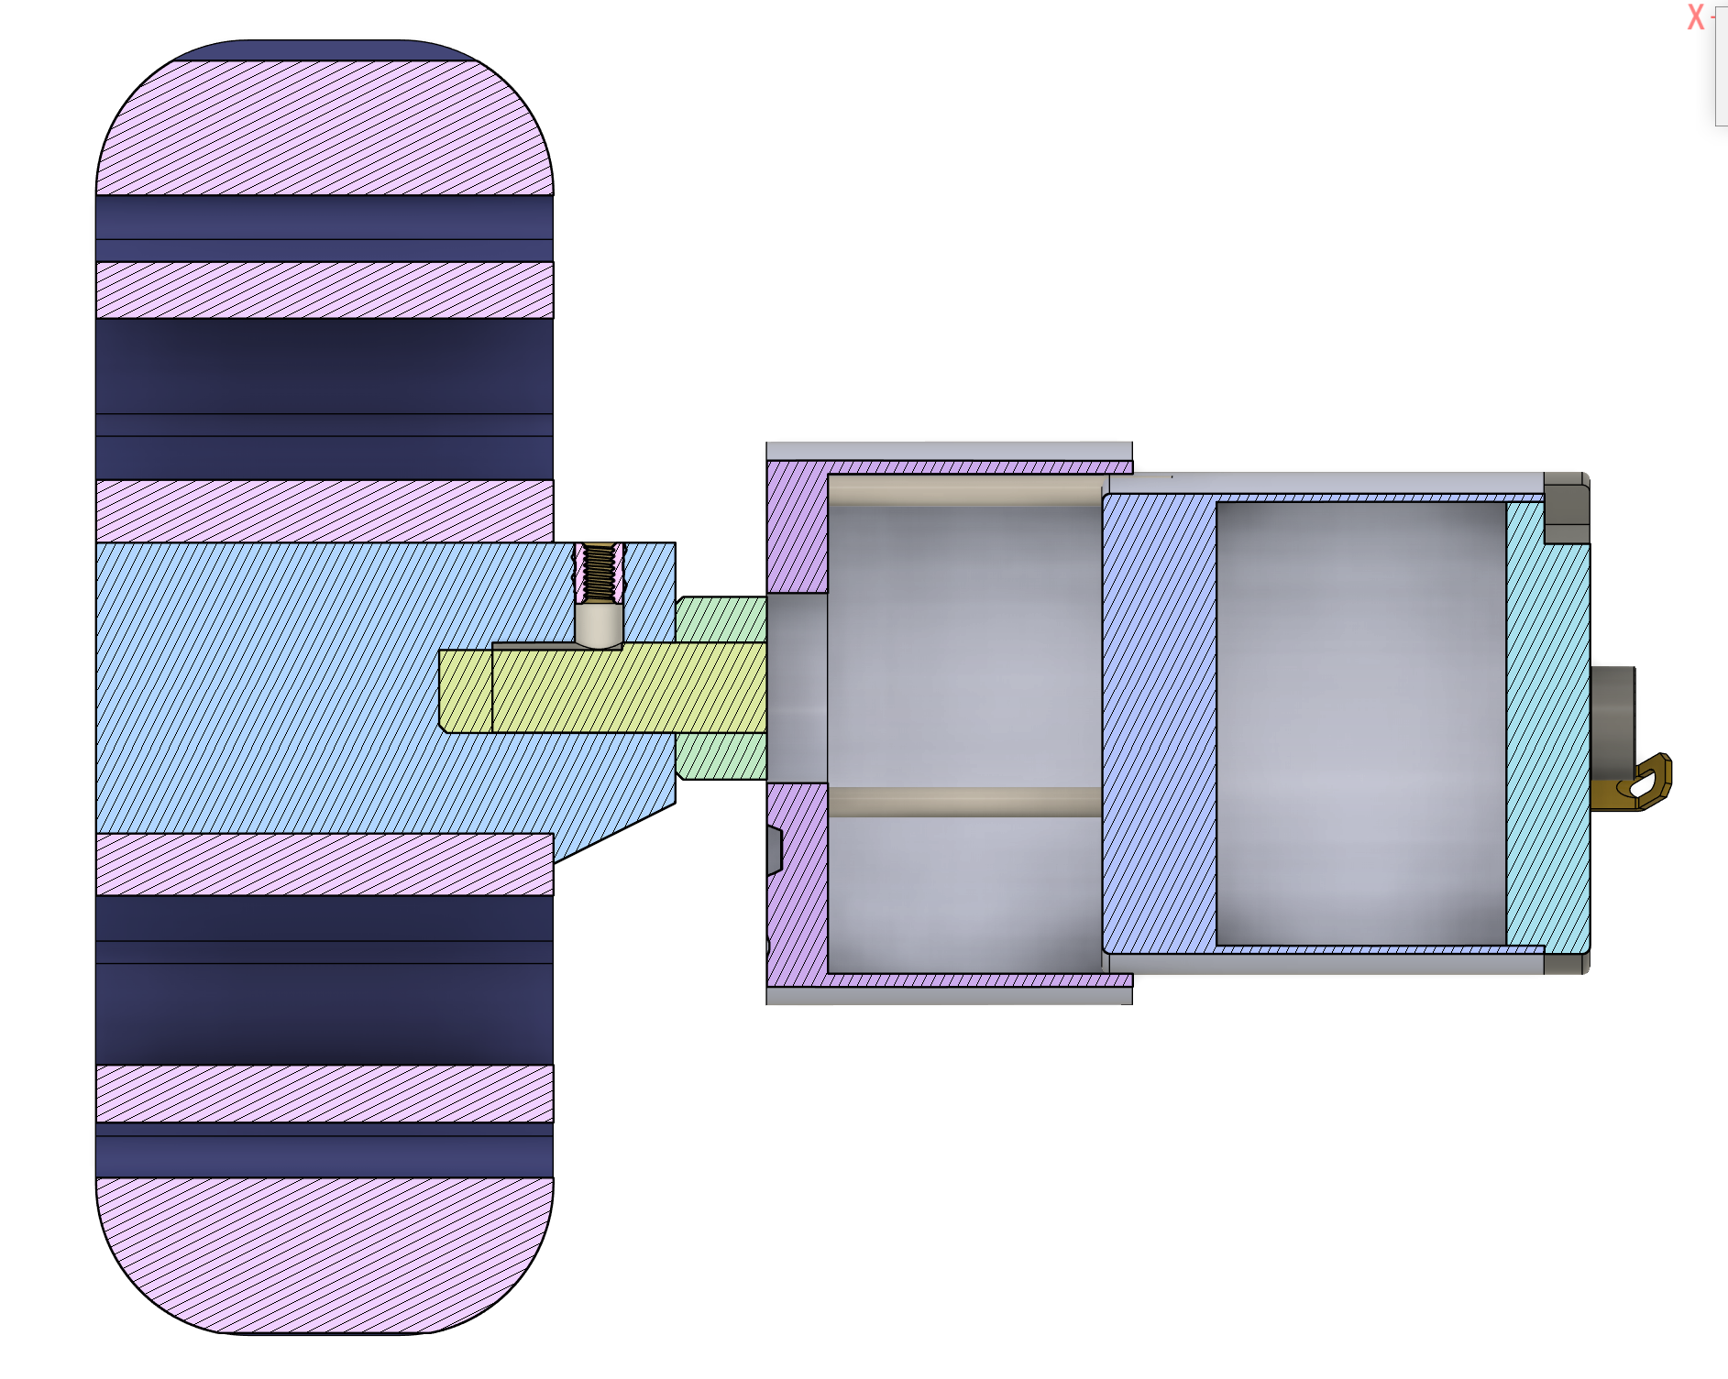
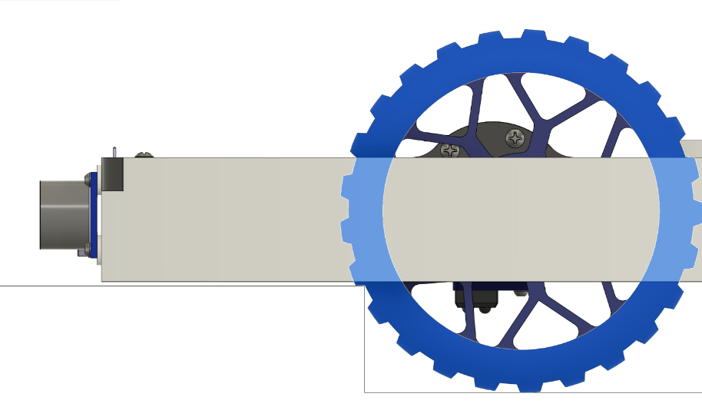
Wheels
custom TPU tires
conneced to motor via 3d-printed axis

Slide 16
Requirement Check / Conclusion
✓ Footprint: 500 mm diameter
✓ Weight: 1405 g → below 2000 g
✓ Stair climbing: 25 mm step verified
✓ Design priority: low weight + simple mechanics

