Slide 1
StatioPoint
Point-of-Sale System for Retail Stationery
Fundamentals of Software Engineering
Hanan Ishaq (24L-2537) | Mohid Israr (24L-2510)

Slide 2
01
Project Introduction
What is StatioPoint?

Slide 3
Project Introduction
What is StatioPoint?
Tech Stack
StatioPoint is a web-based Point-of-Sale system for retail stationery shops in Pakistan. It allows shop owners and cashiers to manage sales, inventory, employees, and analytics from a single platform — replacing manual paper-based operations.
Frontend: HTML, CSS, JavaScript Backend: Node.js + Express.js Database: Microsoft SQL Server
Sprint 1
Sprint 2
Sprint 3
Login, Dashboard, RBAC, Profile
Inventory, Sales, Checkout
Signup, Analytics, Restock

Slide 4
02
Advantages & Constraints
What works well and what are the limitations?

Slide 5
Advantages & Constraints
✓ Advantages
⚠ Constraints
✓ Role-based access keeps admin and cashier data separate and secure
⚠ Currently runs on localhost only — not deployed to cloud
✓ Real-time stock updates after every sale prevent overselling
⚠ Single currency (PKR) — no multi-currency support
✓ Revenue analytics dashboard gives instant business insights
⚠ No offline mode — requires active internet/server connection
✓ Smart restock report automates procurement planning
✓ JWT authentication is stateless — fast and scalable

Slide 6
03
Non-Functional Requirements
Quality attributes of StatioPoint

Slide 7
Non-Functional Requirements
NFR: Security
NFR: Performance
Bcrypt password hashing — passwords never stored as plain text
Async/await prevents server blocking during DB operations
JWT tokens protect all API routes from unauthorized access
Fetch API avoids full page reloads — faster user experience
Role-based middleware blocks cashiers from admin endpoints
Optimized JOIN queries reduce multiple round trips to database
.env file keeps database credentials out of source code
Stateless JWT auth — no session storage needed on server

Slide 8
04
Design
UML Diagrams & System Design

Slide 9
Design — UML Diagrams
Use Case Diagram
Activity Diagrams
Actors: Admin & Cashier
All system interactions mapped
3 diagrams: Add Product,
Create Sale, Sales History
Sequence Diagrams
Class Diagram
3 diagrams showing frontend
→ backend → DB flow
4 classes: User, Product,
Sale, SaleItem with relationships

Slide 10
05
Architecture
Layered Architecture Pattern

Slide 11
Architecture — Layered Pattern
Presentation Layer
login.html | signup.html | admin.html | cashier.html
▼
UI Management & Authentication Layer
JWT Middleware | Role-Based Access Control | Input Validation
▼
Business Logic Layer
Auth Routes | Product Routes | Sales Routes | Analytics Routes | Inventory Routes
▼
Database Layer
Users Table | Products Table | Sales Table | SaleItems Table (Microsoft SQL Server)
✓ Advantages: Easy to maintain, layers are independent, security enforced at middleware
⚠ Limitation: Slight overhead as all requests pass through every layer

Slide 12
06
Implementation
Key features across all 3 sprints

Slide 13
Implementation — Key Features
Login & Signup
Admin Dashboard
Inventory Management
Sprint 1 & 3
Sprint 1
Sprint 2
JWT auth, bcrypt hashing, BVA-tested signup validation
KPI cards, revenue chart, role-based access control
Add/Edit/Delete products, low stock alerts in red
Cashier Checkout
Revenue Analytics
Smart Restock Report
Sprint 2
Sprint 3
Sprint 3
Product search, cart, payment selection, auto stock update
Weekly chart, category pie, top 5 products, Chart.js
Auto-calculated restock, cost estimate, CSV export

Slide 14
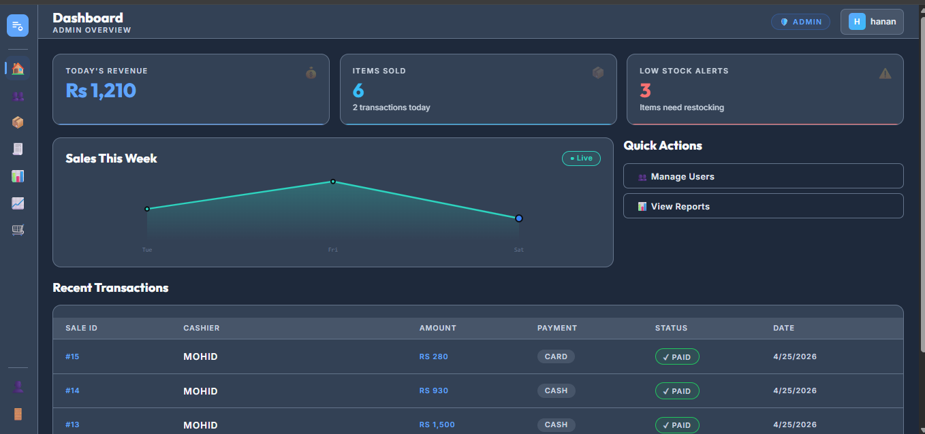
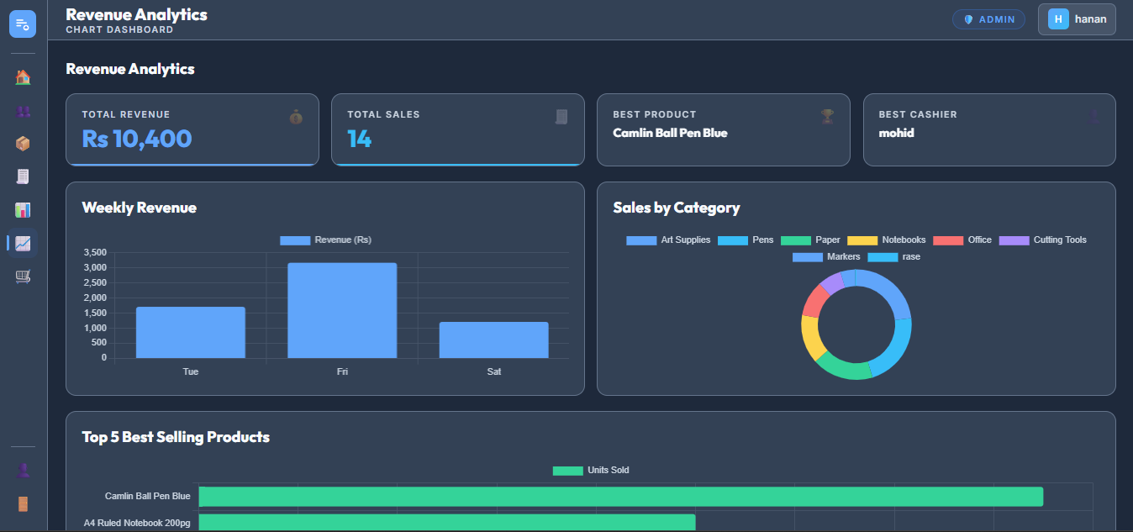
Implementation Screenshots
[ INSERT SCREENSHOT 1 ]
Admin Dashboard / Inventory
[ INSERT SCREENSHOT 2 ]
Analytics / Restock Report

Slide 15
07
Work Division
Team contribution across all sprints

Slide 16
Work Division
Mohid Israr
Hanan Ishaq
24L-2510
24L-2537
Backend API development (all 3 sprints)
Frontend development (all HTML pages)
Database design & SQL Server setup
Signup page UI & validation
JWT authentication & middleware
Analytics dashboard with Chart.js
Analytics & restock API routes
Restock report UI & CSV export
Server configuration & .env setup
Testing, debugging & report writing

Slide 17
08
Lessons Learnt
Key takeaways from the project

Slide 18
Lessons Learnt
🔐 JWT & Security
📊 Data Visualization
🧪 BVA Testing
Stateless authentication with JWT taught us how to protect APIs without server-side sessions
Chart.js made analytics simple — frontend libraries can add huge value with minimal backend changes
Boundary testing revealed edge cases we never considered, like 3-char usernames and +92 phone validation
🗂️ Agile Process
🔧 Git Version Control
📁 Project Structure
Breaking work into sprints with Trello kept both team members aligned and progress visible at all times
Committing regularly saved us when new features broke existing ones — history is invaluable
Organizing backend into routes/, config/, middleware/ from the start made the codebase easy to scale

Slide 19
Thank You!
Questions?
StatioPoint — POS System for Retail Stationery
Hanan Ishaq (24L-2537) | Mohid Israr (24L-2510)

