Slide 1
IT420/CS420: Selected Topics Mobile Application Development
Lecture 0: Course Overview

Slide 2
Lecturer Details
Dr. Walid Khedr
Email: wkhedr@fci.zu.edu.eg
Web: http://www.wikhedr.faculty.zu.edu.eg/
Department of Information Technology
Facebook Messenger: m.me/khedrw

Slide 3

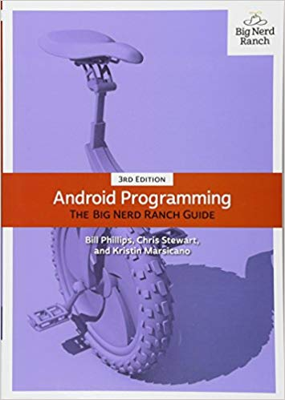
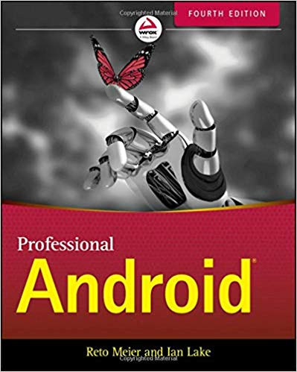
Course Info
Course Name: Selected Topics in IT/CS
Course Number: IT420/CS420
Course Group:
https://www.facebook.com/groups/it420.fci/
Tools: Android Studio
Office Hours: 11 am – 1 pm, Thursday
Prerequisite:
CS250 (OOP)
JAVA
Data Structures
XML
Course Materials:
Text Books
Lectures
http://developer.android.com/index.html

Slide 4
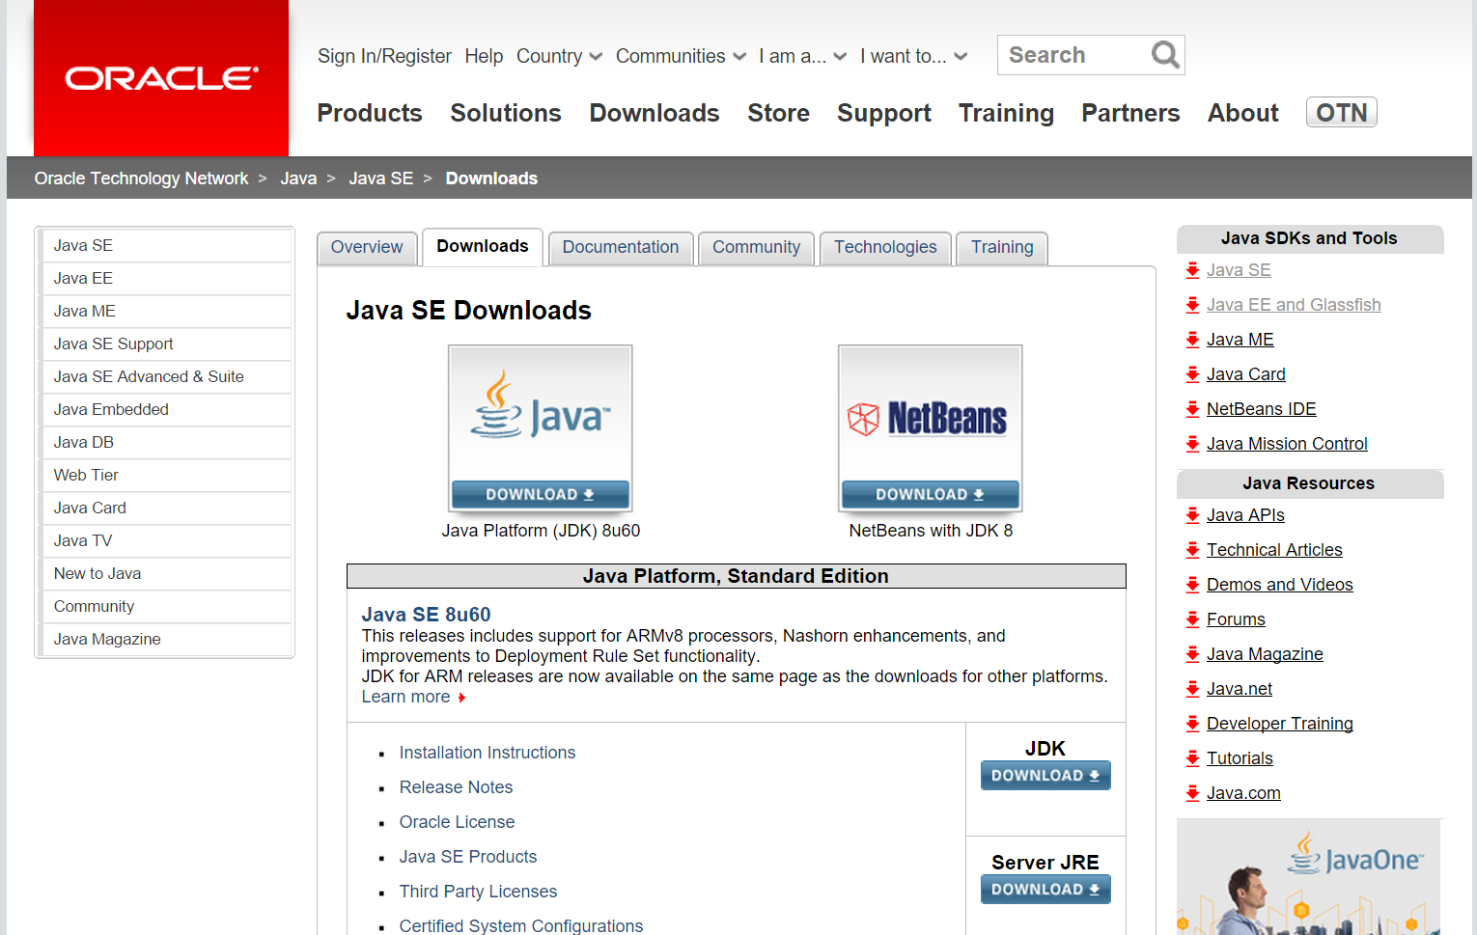
JDK

Slide 5
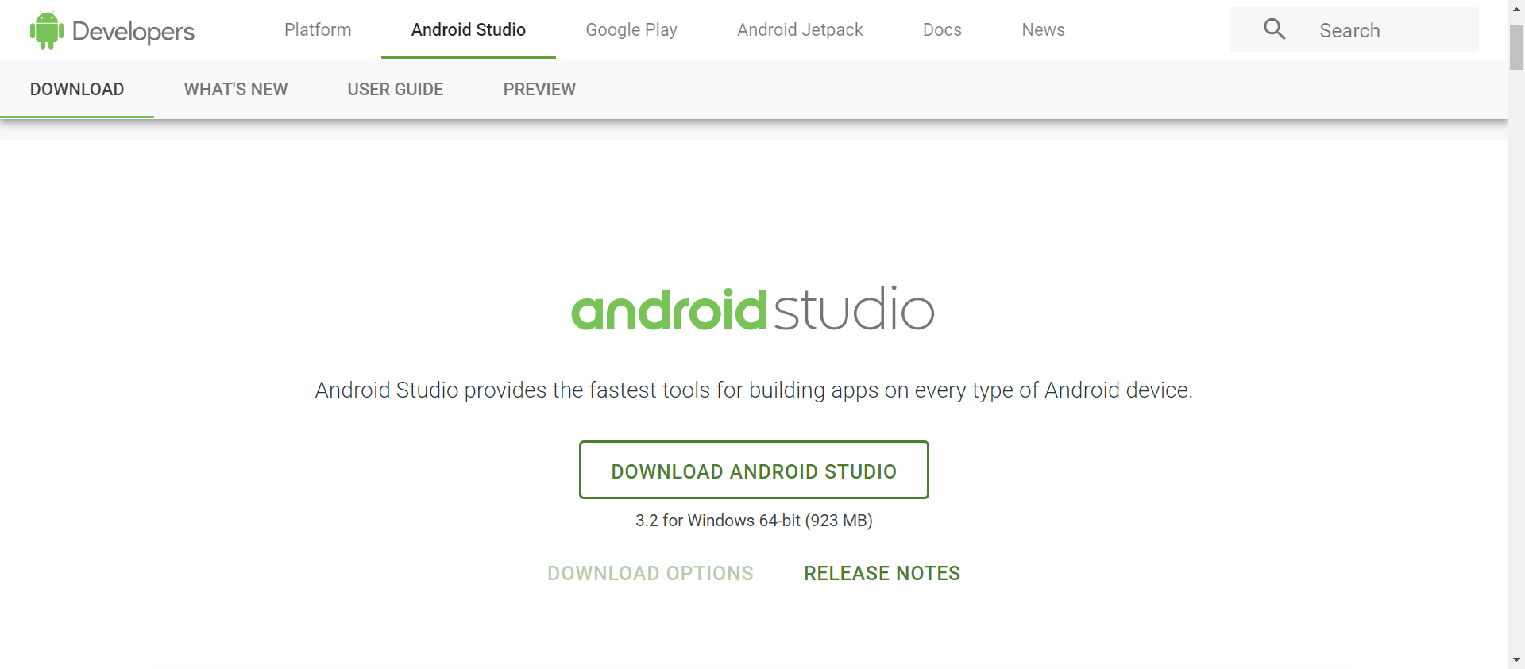
Android Studio IDE https://developer.android.com/studio/

Slide 6
Grading Policy
Your final grade will be calculated as follows:
Term Work: Assignments / Homework / Quizzes / Midterm exam (20 points)
Lab Exam & Project (20 points)
Oral Exam, Attendance and Participation (20 points)
How to participate?
Ask questions
Answer questions
Make comments
Final Exam (90 points)

Slide 7
Grading Rules
Final exam is cancelled if attendance < %75
If final exam grade is less than %30, your final grade will be just your final exam grade.

Slide 8
Term Project
You will discuss project topics in sections.
You are welcomed to suggest creative topics till the midterm.
The project is due one week before the final lab exam.
You should prepare for a demo to show your project and to explain your design.

Slide 9
What is Mobile Application Development?
Mobile application development is the set of processes and procedures involved in writing software for small, wireless computing devices such as smartphones or tablets

Slide 10
Course Objective
This course will teach fundamental programming principles with a focus on the mobile environment and the Android Platform.
You should already have a familiarity with Java, an understanding of basic OOP, studied basic algorithms and data structures and XML
Course projects will be written in Java for the Android platform using the Android Studio and Android SDK.

Slide 11
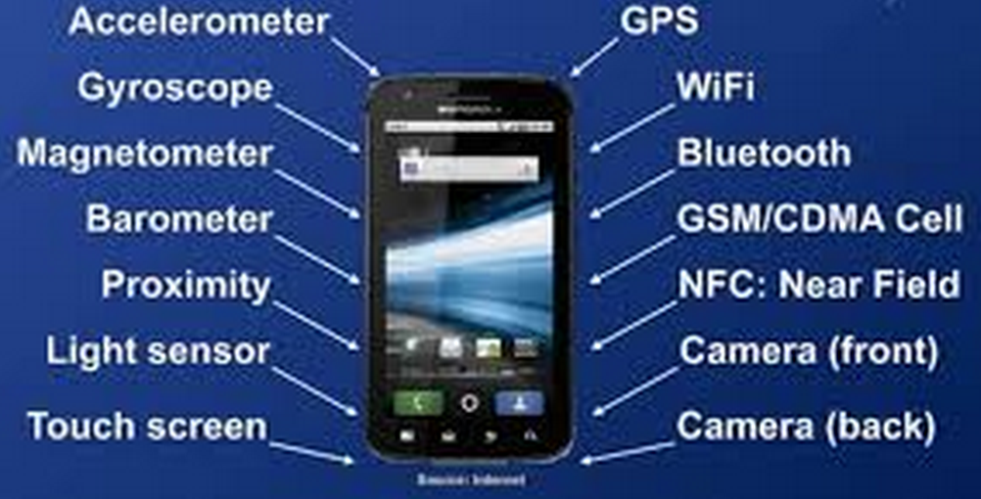
What is Smartphone
A smartphone or smart phone is a mobile phone with an advanced mobile operating system which combines features of a personal computer operating system with other features useful for mobile or handheld use

Slide 12
Mobile Operating System
A mobile operating system, also called a mobile OS, is an operating system that is specifically designed to run on mobile devices such as mobile phones, smartphones, PDAs, tablet computers and other handheld devices.
The mobile operating system is the software platform on top of which other programs, called application programs, can run on mobile devices.

Slide 13
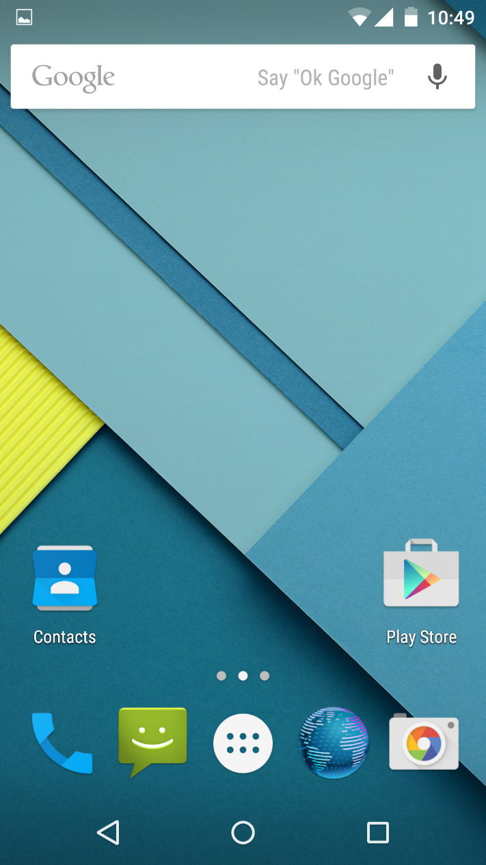
Mobile Operating System
Android: is a mobile operating system (OS) based on the Linux kernel and currently developed by Google.

Slide 14
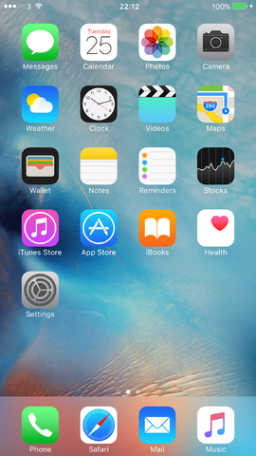
Mobile Operating System
iOS: originally iPhone OS, is a mobile operating system created and developed by Apple Inc. and distributed exclusively for Apple hardware.
It is based on XNU computer operating system kernel developed at Apple.
It is the operating system that presently powers many of the company's mobile devices, including the iPhone, iPad, and iPod touch.

Slide 15
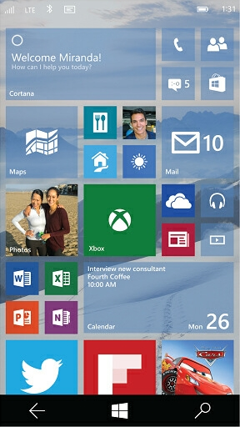
Mobile Operating System
Windows 10 Mobile: is an edition of the Windows 10 operating system being developed by Microsoft.
This edition of Windows 10 is a mobile operating system that succeeds Windows Phone 8.1 and is designed for smartphones running on ARM as well as IA-32 processor architectures.

Slide 16
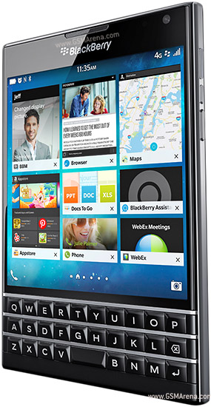
Mobile Operating System
BlackBerry OS: BlackBerry OS is a proprietary mobile operating system developed by BlackBerry Ltd for its BlackBerry line of smartphone handheld devices

Slide 17
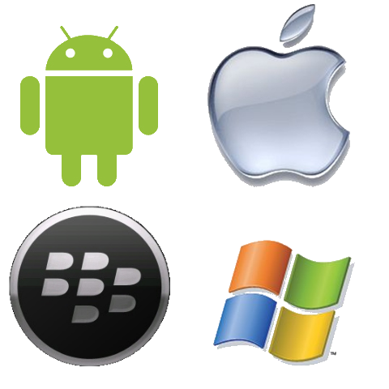
Which Mobile OS ?

Slide 18
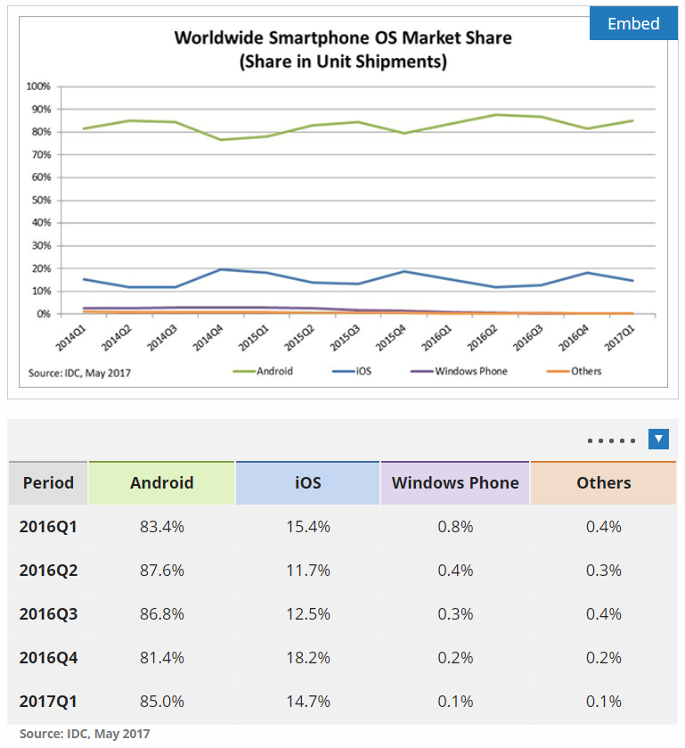
Which Mobile OS ?

Slide 19
Which Mobile OS ?
Feature | iOS | Android | Windows Phone | BlackBerry 10
Company | Apple Inc. | Open Handset Alliance/Google | Microsoft | BlackBerry Ltd.
Market share | 18.3% | 78.0% | 2.7% | 0.3%
Supported CPU architecture | ARM, ARM64 | ARM, x86, MIPS and the 64-bit variants of all three | ARM | ARM
Programmed in | C, C++, Objective-C,Swift | C, C++, Java | 8+: .NET C#, VB.NET, Silverlight, native C/C++, WinRTP (XMLA), DirectX | C/ C++: Native SDK, C++/Qt: Cascades SDK, HTML5/Javascript/CSS: Webworks SDK, ActionScript: Adobe AIR, Java

Slide 20
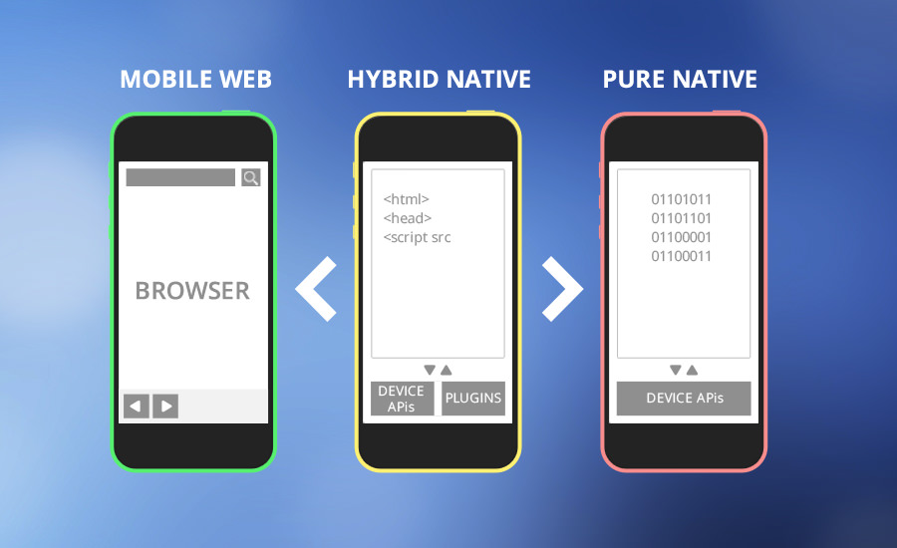
Applications (Apps) on Smart Phone
Notes:
Native apps are written for a specific operating system – most often iOS or Android. Native apps can harness the power of platform-specific features, such as a camera, microphone or GPS. However, a separate release of the app must be coded for each target OS.

Slide 21
Applications (Apps) on Smart Phone
Native apps live on the device and are accessed through icons on the device home screen.
Native apps are installed through an application store (such as Google Play or Apple’s App Store).
They are developed specifically for one platform, and can take full advantage of all the device features.
Notes:
Native apps are written for a specific operating system – most often iOS or Android. Native apps can harness the power of platform-specific features, such as a camera, microphone or GPS. However, a separate release of the app must be coded for each target OS.

Slide 22
Applications (Apps) on Smart Phone
Web apps are not real applications; they are really websites that, in many ways, look and feel like native applications, but are not implemented as such.
They are run by a browser and typically written in HTML5.
Users first access them as they would access any web page
Web apps became really popular when HTML5 came around and people realized that they can obtain native-like functionality in the browser.

Slide 23
Applications (Apps) on Smart Phone
Hybrid apps are part native apps, part web apps.
Like native apps, they live in an app store and can take advantage of the many device features available.
Like web apps, they rely on HTML being rendered in a browser, with the browser is embedded within the app
Tools: PhoneGap
Notes:
A hybrid app is first coded like a website, using industry-standard Web technologies such as HTML, CSS, and JavaScript. This platform-independent code is then "wrapped" inside a native container that allows the app to access platform-specific features and to be distributed and installed like a native app.

Slide 24
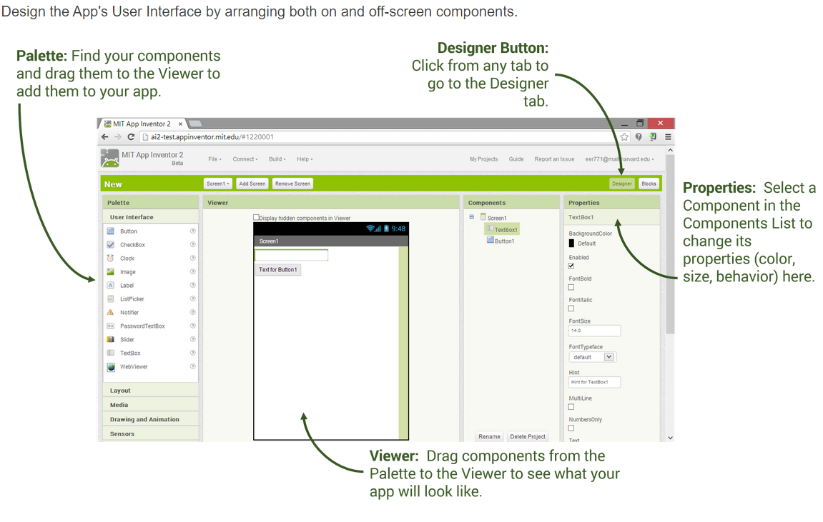
Android Native Apps Development Tools
MIT App Inventor

Slide 25
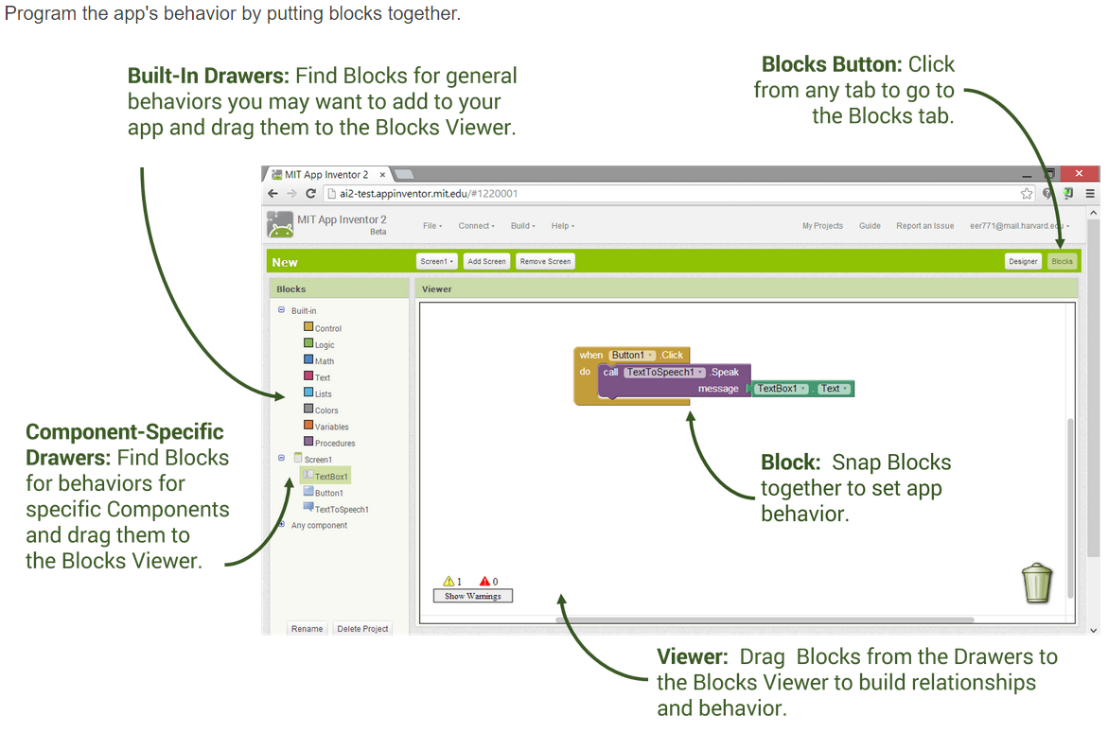
Android Native Apps Development Tools

Slide 26
Android Native Apps Development Tools
Android Studio IDE
Android SDK tools

Slide 27
Things to Know Before Building Your First Android App
Java Experience: Android development is mostly done in Java. Android Java is not exactly standard Java, but learning standard Java will make it much easier for you to pick up Android development.
XML Experience: Knowing XML can be useful in a number of tech-related fields and Android is no exception. In particular, XML files make it easier to declare UI elements in the apps you create. Past experience is a big plus.

Slide 28
Main Topics
Course Overview
Introduction
Building Interactive
Multiple Activities and Intents
The Activity Lifecycle
The User Interface
List Views and Adapters
Fragments
Action Bars & Navigation Drawers
SQLite Databases
Services & Broadcast Receivers
Material Design
Consuming a web services in Android
Google Firebase

Slide 29
Java Background
Multithreading
Exception Handling
GUI
Event Driven Programming

Slide 30
Next Lecture
Chapter 1: Introduction

