Slide 1
IT420: Selected Topics in IT Mobile Application Development
Lecture 2: Building Interactive Apps

Slide 2
Lecturer Details
Dr. Walid Khedr
Email: khedrw@yahoo.com
Web: www.staff.zu.edu.eg/wkhedr
Department of Information Technology

Slide 3
Introduction
Most apps need to respond to the user in some way.
In this lecture, you’ll see how you can make your apps a bit more interactive.
You’ll see how you can get your app to do something in response to the user, and how to get your activity and layout talking to each other
In this lecture, we’re going to create a Book Adviser app.
In the app, users can select the types of book they like, click a button, and get back a list of books to read.

Slide 4
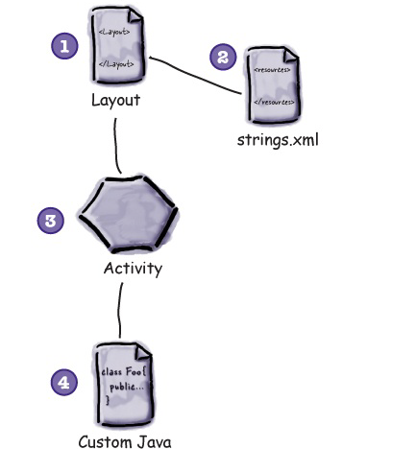
Book Adviser app
The layout specifies what the app will look like.
The file strings.xml includes any string resources needed by the layout—for example, the label of the button specified in the layout
The activity specifies how the app should interact with the user.
The custom Java class contains the application logic for the app

Slide 5
Steps
Create a project
Update the layout
Wire the layout to the activity.
Write the application logic

Slide 6
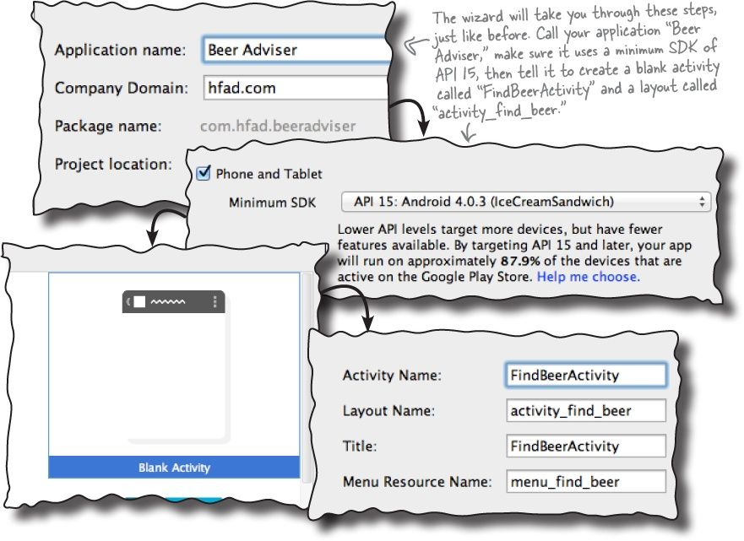
Create a project

Slide 7
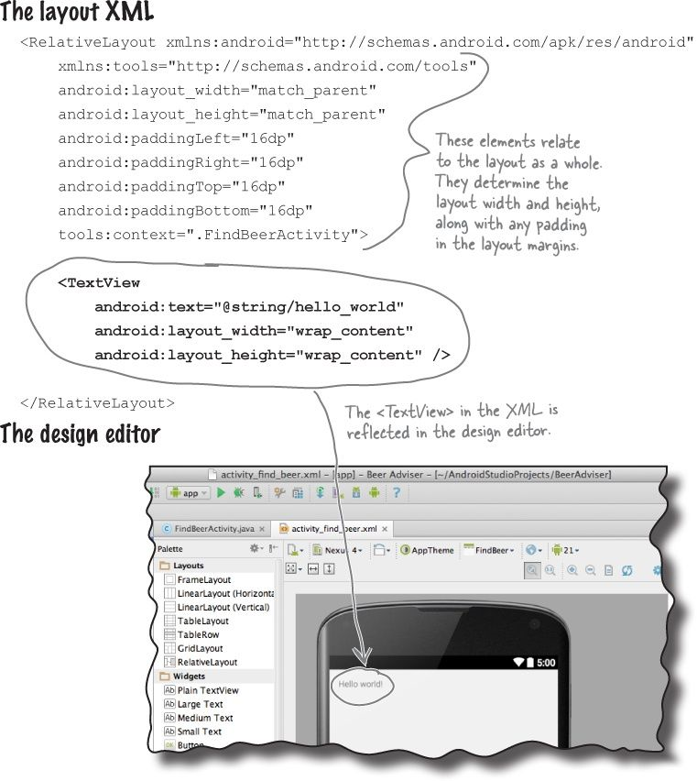
Update the layout

Slide 8
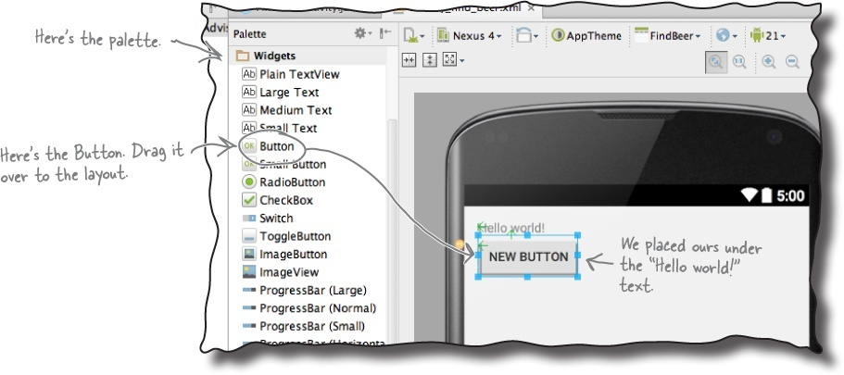
Update the layout – Cont.

Slide 9
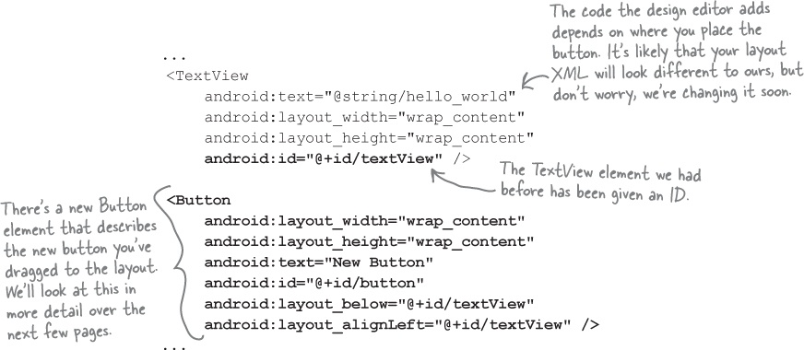
Update the layout – Cont.

Slide 10
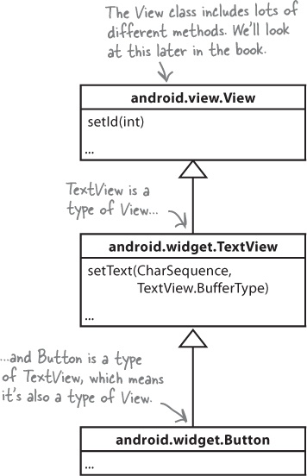
A closer look at the layout code

Slide 11
A closer look at the layout code
Buttons and text views are subclasses of the same Android View class
android:id- This gives the component an identifying name. The ID property enables you to control what components do via activity code, and also allows you to control where components are placed in the layout
android:text- This tells Android what text the component should display
android:layout_width, android:layout_height- These properties specify the basic width and height of the component. "wrap_content" means it should be just big enough for the content

Slide 12
A closer look at the layout code
The RelativeLayout element : tells Android that the different GUI components in the layout should be displayed relative to each other.
As an example, you can use it to say that you want one component to appear to the left of another one, or that you want them to be aligned or lined up in some way.
In this example, the button appears directly underneath the text view, so the button is displayed relative to the text view.

Slide 13
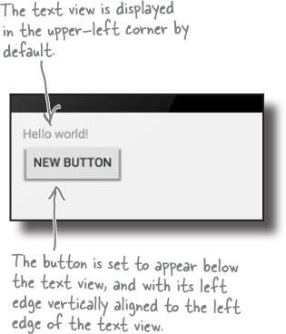
A closer look at the layout code
There are different ways of writing the layout XML in order to produce the same visual effect.
As an example, the XML above specifies that the button is positioned below the text view.
An equivalent statement would be to say that the text view is positioned above the button.

Slide 14
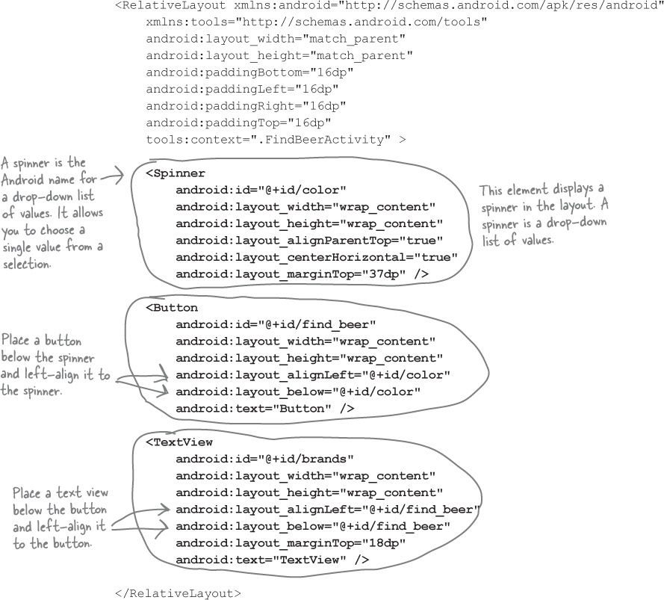
A closer look at the layout code

Slide 15
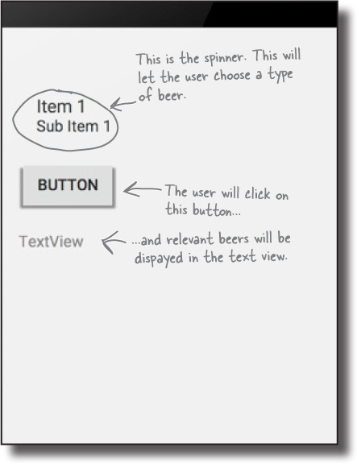
A closer look at the layout code

Slide 16
Use string resources rather than hardcoding the text
It’s a good idea to change hardcoded strings to use the strings resource file strings.xml instead.
Using the strings resource file for static text makes it easier to create international versions of your app, and if you need to tweak the wording in your app, you’ll be able to do it one central place.

Slide 17
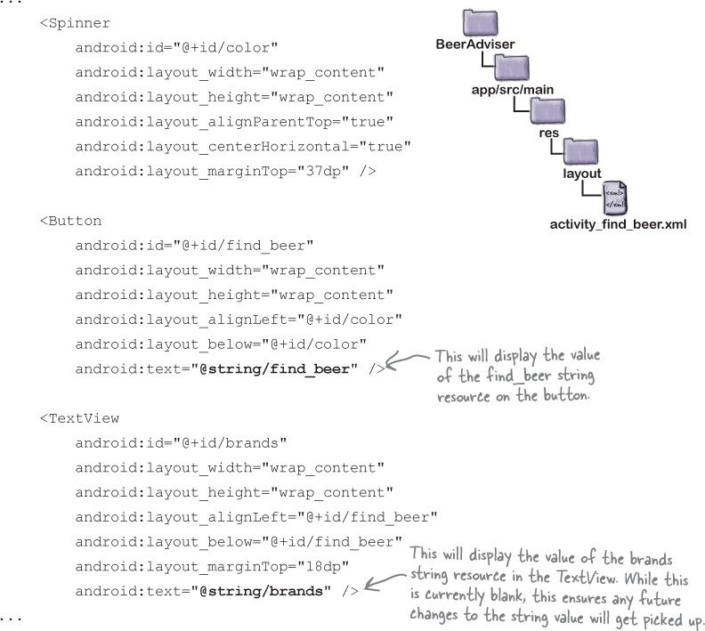
Change the layout to use the string resources

Slide 18
Test Drive the App

Slide 19
Add values to the spinner
We can give the spinner a list of values in pretty much the same way that we set the text on the button
So far, we’ve used strings.xml to specify single String values.
All we need to do is specify an array of String values, and get the spinner to reference it.

Slide 20
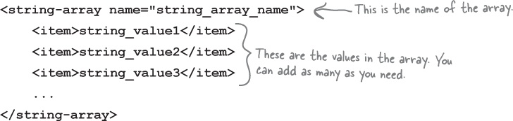
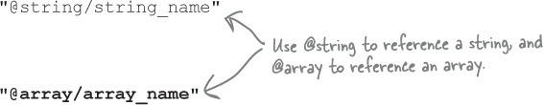
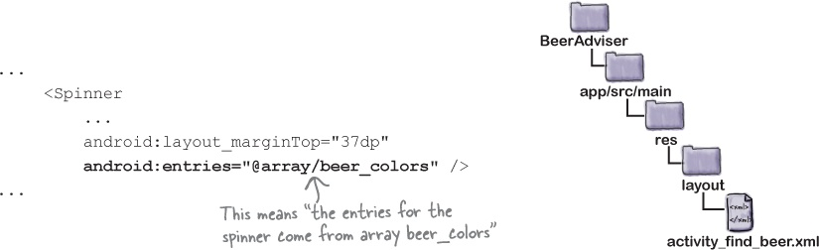
Adding an array resource

Slide 21
Connect Activity
The user chooses a type of book from the spinner.
The user clicks on the button to find matching beers
The layout specifies which method to call in the activity when the button is clicked
The method in the activity retrieves the value of the selected book type in the spinner and passes it to the getBooks() method in a Java custom class called BookTypesClass
BookTypesClass getBooks() method finds matching booksfor the type of book and returns them to the activity as an ArrayList of Strings
The activity gets a reference to the layout text view and sets its text value to the list of matching books.

Slide 22
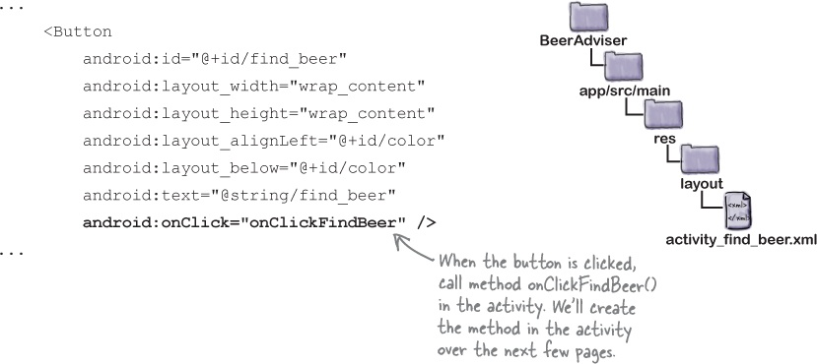
Make the button call a method

Slide 23
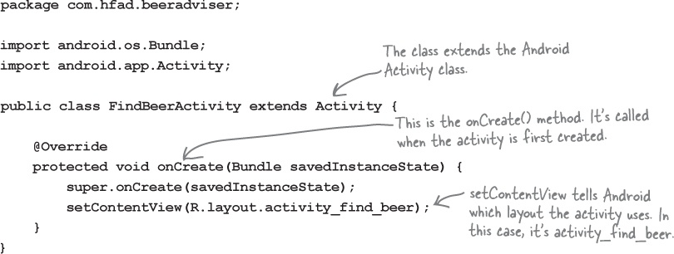
The Activity Class

Slide 24
OnFindBooksListener
public class MainActivity extends AppCompatActivity { @Override protected void onCreate(Bundle savedInstanceState) { super.onCreate(savedInstanceState); setContentView(R.layout.activity_main); } public void OnFindBooksListener(View view) { } }
If you want a method to respond to a button click, it must be public, have a void return type, and take a single View parameter.

Slide 25
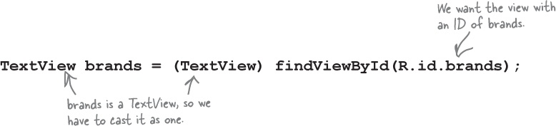
OnFindBooksListener
We can get a handle for our two GUI components using a method called findViewById().
The findViewById() method takes the ID of the GUI component as a parameter, and returns a View object.
You then cast the return value to the correct type of GUI component (for example, a TextView or a Button).

Slide 26
OnFindBooksListener
R is a special Java class that enables you to retrieve references to resources in your app.
R.java is a special Java file that gets generated by the Android tools whenever you create or build your app.
It lives within the app/build/ generated/source/r/debug folder in your project in a package with the same name as the package of your app.
Android uses R to keep track of the resources used within the app, and among other things it enables you to get references to GUI components from within your activity code.

Slide 27
The first version of the activity
public class MainActivity extends AppCompatActivity { private Spinner spin; private TextView txt; @Override protected void onCreate(Bundle savedInstanceState) { super.onCreate(savedInstanceState); setContentView(R.layout.activity_main); spin = (Spinner) findViewById(R.id.spinner); txt = (TextView) findViewById(R.id.textView); } public void OnFindBooksListener(View view) { String s = (String) spin.getSelectedItem(); txt.setText(s); } }

Slide 28
Building the custom Java class
The custom Java class is written in plain old Java
public class BookTypesClass { List<String> getBooks(String bt) { List books = new ArrayList<String>(); if (bt.equals("Networks")) { books.add("Network Book 1"); books.add("Network Book 2"); } else { books.add("Graphics Book 1"); books.add("Graphics Book 2"); } return books; } }

Slide 29
Activity code version 2
public class MainActivity extends AppCompatActivity { private Spinner spin; private TextView txt; private BookTypesClass CBooks; @Override protected void onCreate(Bundle savedInstanceState) { super.onCreate(savedInstanceState); setContentView(R.layout.activity_main); spin = (Spinner) findViewById(R.id.spinner); txt = (TextView) findViewById(R.id.textView); CBooks = new BookTypesClass(); } public void OnFindBooksListener(View view) { String s = (String) spin.getSelectedItem(); List<String> books = CBooks.getBooks(s); StringBuilder sb = new StringBuilder(); for (String str: books) { sb.append(str).append("\n"); } txt.setText(sb); } }

Slide 30
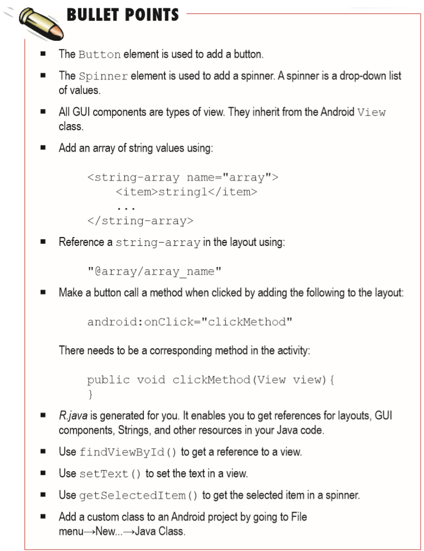

Slide 31
Next Lecture
Chapter 3: Multiple activities and intents

