Slide 1
IT420: Selected Topics in IT Mobile Application Development
Lecture 3: Multiple Activities and Intents

Slide 2
Lecturer Details
Dr. Walid Khedr
Email: khedrw@yahoo.com
Web: www.staff.zu.edu.eg/wkhedr
Department of Information Technology

Slide 3
Introduction
We’re going to show you how to build apps with multiple activities, and how you can get your apps talking to each other using intents.
We’ll also look at how you can use intents to go beyond the boundaries of your app and make activities in other apps on your device perform actions.

Slide 4
The Messenger App
You’re going to build an app containing two activities.
The first activity will allow you to type a message.
When you click on a button in the first activity, it will launch the second activity and pass it the message.
The second activity will then display the message.

Slide 5
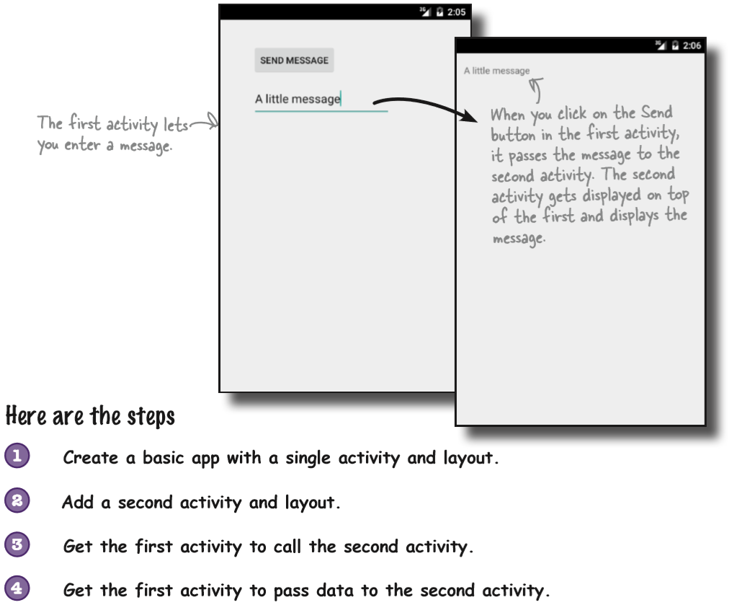
The Messenger App

Slide 6
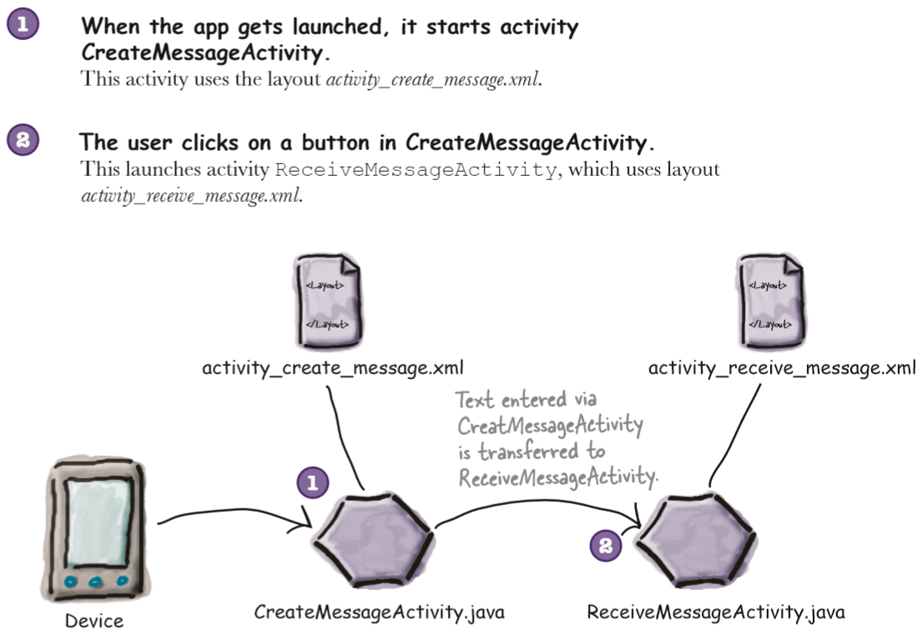
The app structure

Slide 7
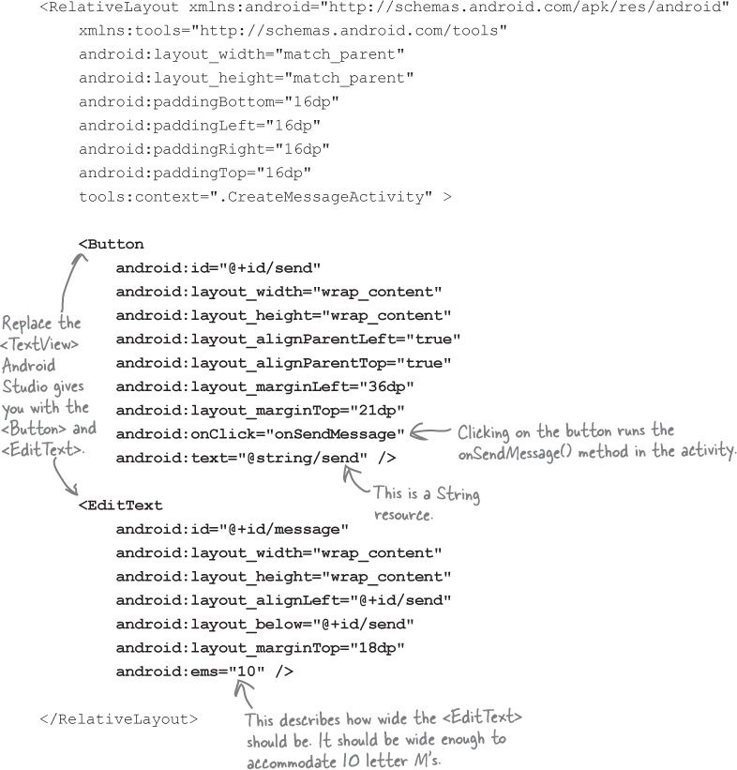
Update the layout

Slide 8
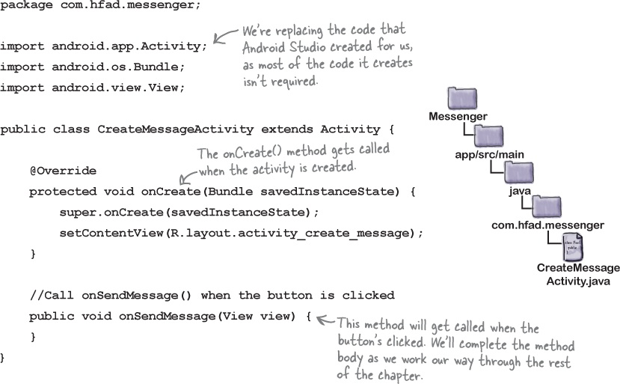
CreateMessageActivity

Slide 9
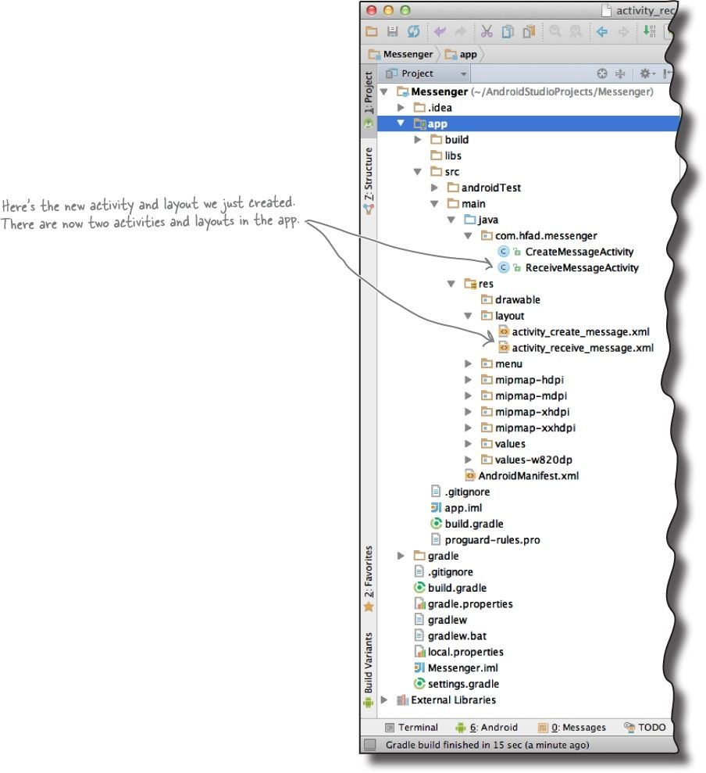
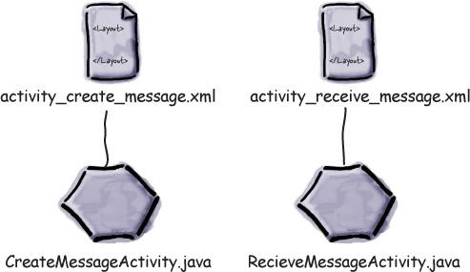
Create the second activity and layout

Slide 10
The Android manifest file
Behind the scenes, Android Studio also made a configuration change to the app in a file called AndroidManifest.xml
Every Android app must include a file called AndroidManifest.xml.
The AndroidManifest.xml file contains essential information about your app, such as what activities it contains, required libraries, and other declarations.
Android creates the file for you when you create the app.

Slide 11
The Android manifest file
<?xml version="1.0" encoding="utf-8"?> <manifest xmlns:android="http://schemas.android.com/apk/res/android" package="com.wik4apps.messanger"> <application android:allowBackup="true" android:icon="@mipmap/ic_launcher" android:label="@string/app_name" android:supportsRtl="true" android:theme="@style/AppTheme"> <activity android:name=".CreateMessageActivity"> <intent-filter> <action android:name="android.intent.action.MAIN" /> <category android:name="android.intent.category.LAUNCHER" /> </intent-filter> </activity> <activity android:name=".RecieveMessageActivity" android:label="Receive Activity" android:parentActivityName=".CreateMessageActivity"> </activity> </application> </manifest>

Slide 12
Intents
What we need to do next is get CreateMessageActivity to call ReceiveMessageActivity when the user clicks the Send Message button
You start an activity by creating an intent and using it in the startActivity() method.
Intent is a type of message that allows you to bind separate objects (such as activities) together at runtime.
If one activity wants to start a second activity, it does it by sending an intent to Android.
Android will start the second activity and pass it the intent.

Slide 13
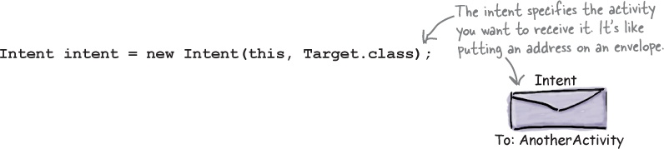

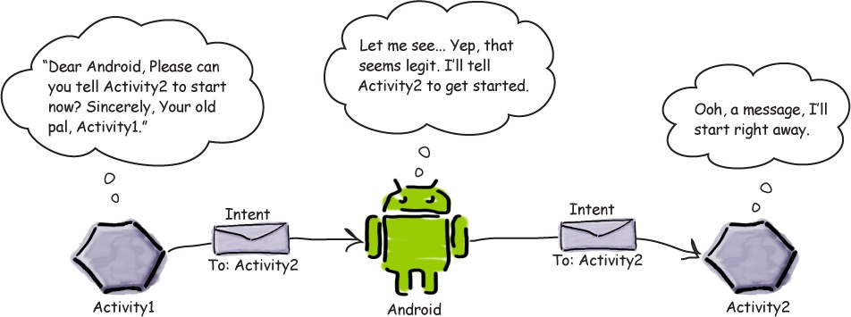
Intents

Slide 14
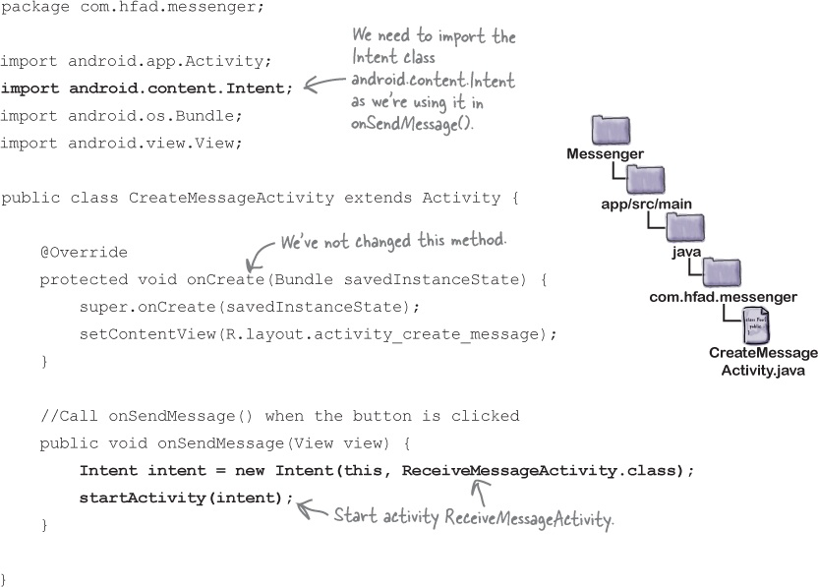
Use an intent to start the second activity

Slide 15
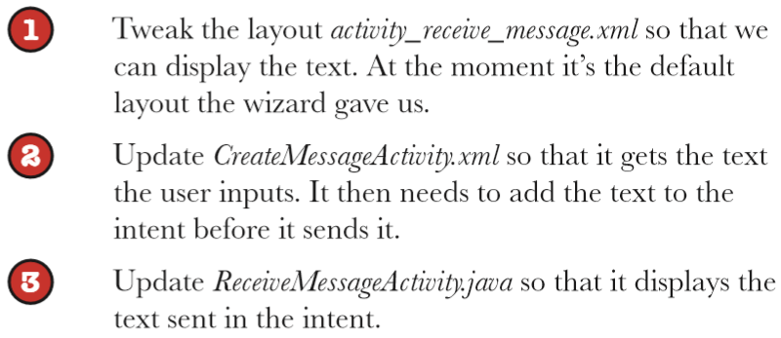
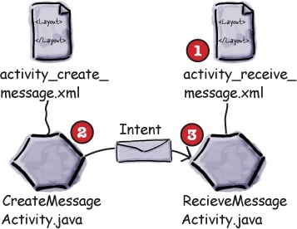
Pass text to a second activity

Slide 16
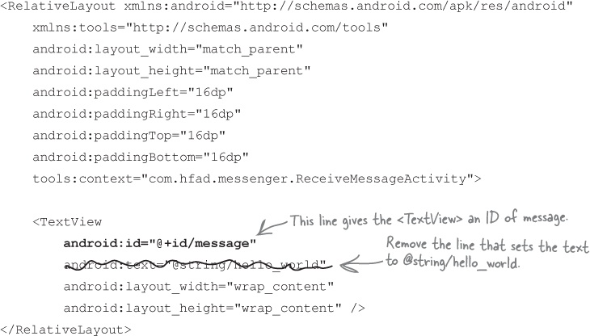

Slide 17
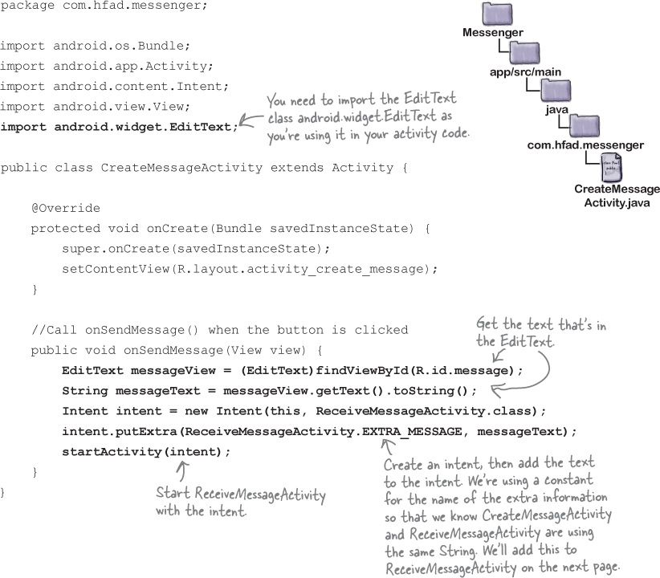

Slide 18
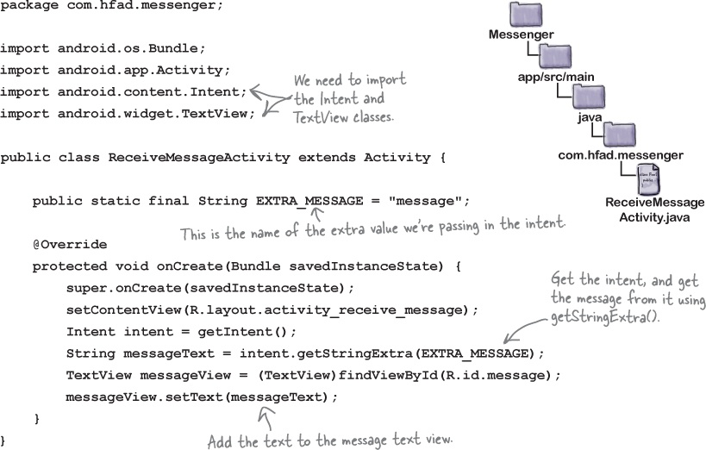

Slide 19
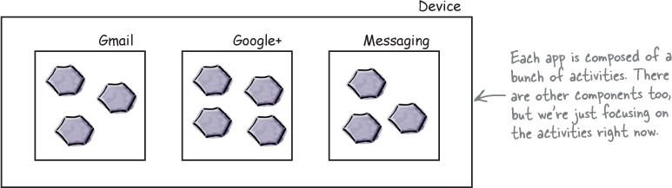
How Android apps work
All Android apps are composed of one or more activities, along with other components such as layouts.
Each activity is a single defined focused thing the user can do.

Slide 20
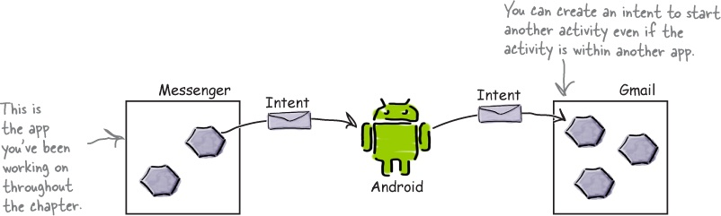
Intents can start activities in other apps
This means that you can build apps that perform far more powerful tasks by chaining together activities across the device.

Slide 21
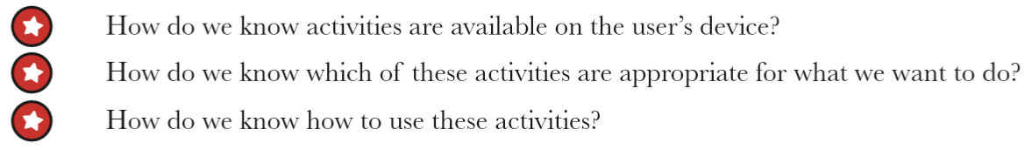
Intents can start activities in other apps
All of these problems can be solved using actions.
Actions are a way of telling Android what standard operations activities can preform.
As an example, Android knows that all activities registered for a send action are capable of sending messages.

Slide 22
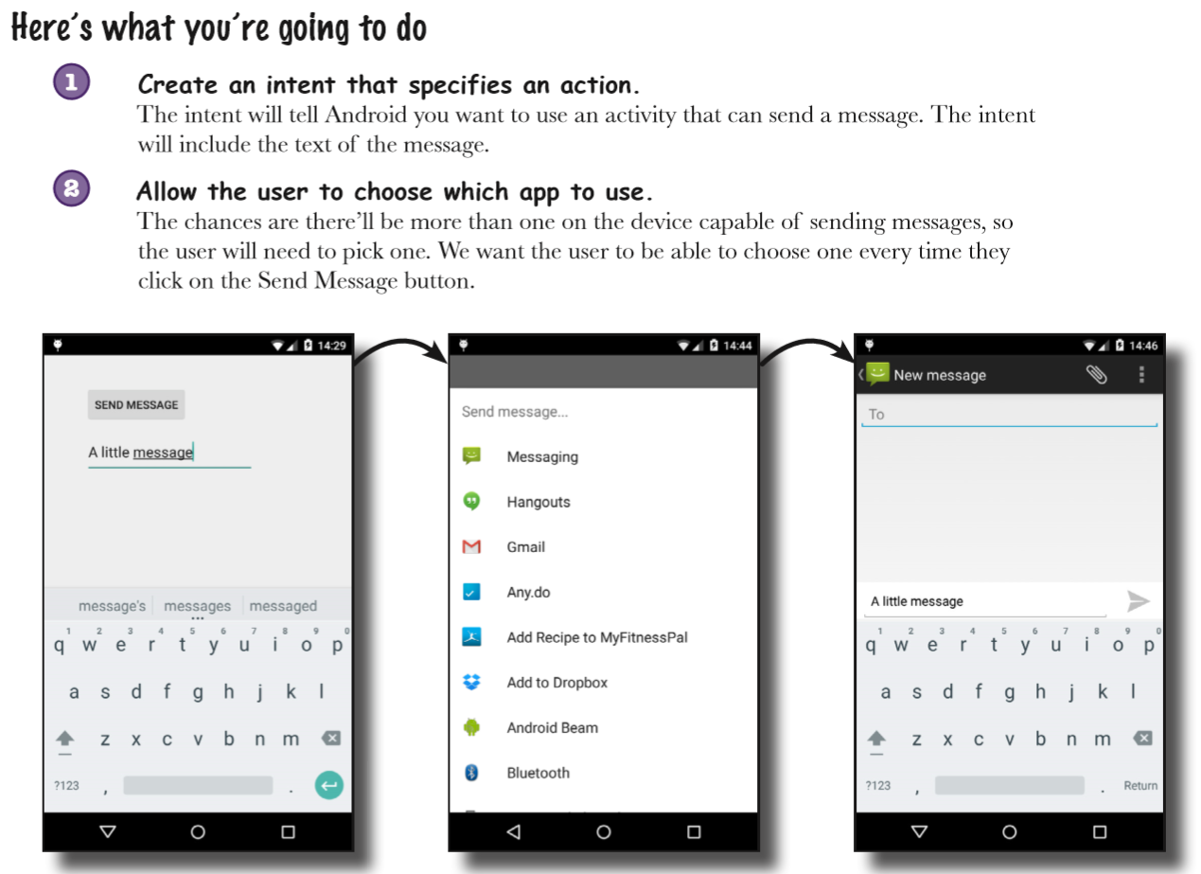

Slide 23
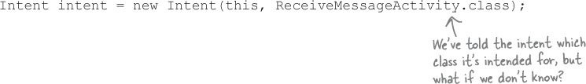
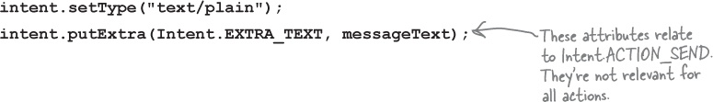
Create an intent that specifies an action
The intent is an explicit intent; you explicitly tell Android which class you want it to run
If there’s an action you want done but you don’t mind which activity does it, you create an implicit intent.

Slide 24
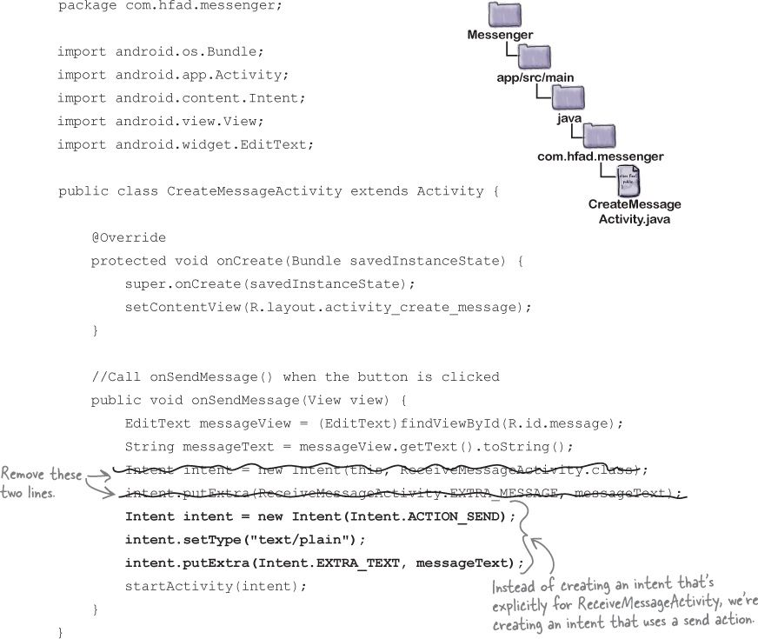

Slide 25
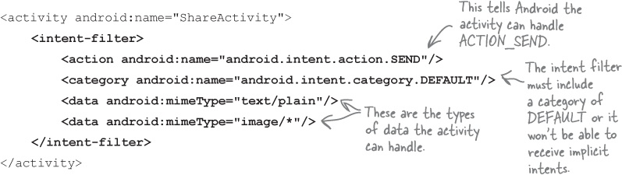
The intent filter
When Android is given an intent, it has to figure out which activity, or activities, are able to handle it.
This process is known as intent resolution
Android uses the information in the intent to figure out which components are able to receive it.
It does this by checking the intent filters in every app’s copy of AndroidManifest.xml

Slide 26
How Android uses the intent filter
When you use an implicit intent, Android compares the information given in the intent with the information given in the intent filters specified in every app’s AndroidManifest.xml file.
Intent filters without this category will be omitted as they can’t receive implicit intents
Android then matches intents to intent filters by comparing the action and MIME type contained in the intent with those of the intent filters.
If Android finds a single match, Android starts the component (in our case, the activity) and passes it the intent. If it finds multiple matches, it asks the user to pick one

Slide 27
Testing Apps on Real Device
In order to test our app properly, we need to run it on a physical device where we know there’ll be more than one app that can support our action
Enable USB debugging on your device
Open “Developer options” (in Android 4.0 onward, this is hidden by default).
To enable it, go to Settings → About Phone and tap the build number seven times.
Plug your device into your computer with a USB cable
Run your app in Android Studio as normal

Slide 28
Chooser Dialog
Android automatically asks you to choose which activity you want to use if there’s more than one activity on your device that’s capable of receiving your intent.
It even asks you whether you want to use this activity all the time or just on this occasion.
What if you want to guarantee that users can choose an activity every time they click on the Send Message button?

Slide 29
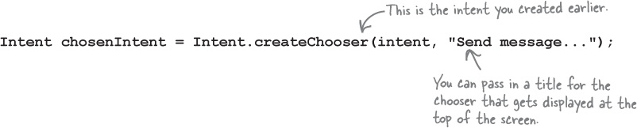
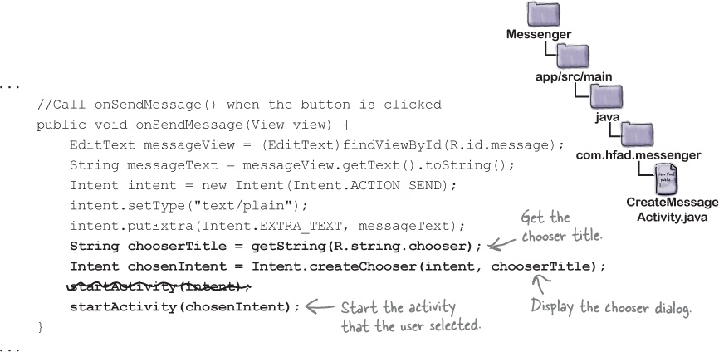
Chooser Dialog
Intent.createChooser() displays a chooser dialog

Slide 30
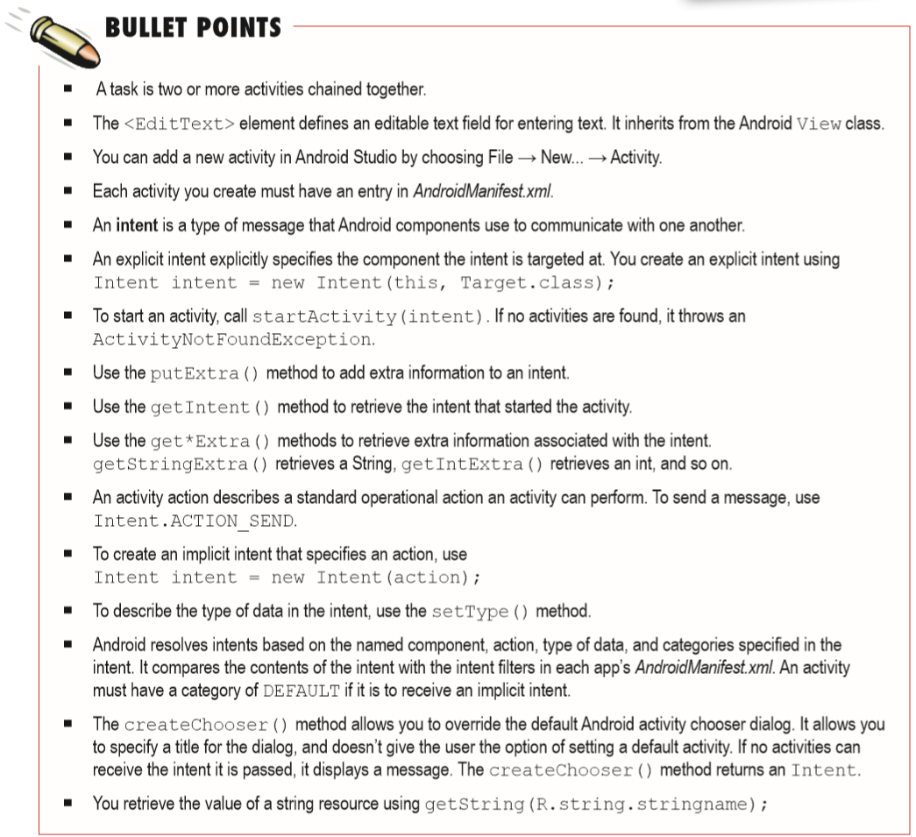

Slide 31
Next Lecture
Chapter 4: The activity lifecycle

