Slide 1
IT420: Selected Topics in IT Mobile Application Development
Lecture 4: The Activity Lifecycle

Slide 2
Lecturer Details
Dr. Walid Khedr
Email: khedrw@yahoo.com
Web: www.staff.zu.edu.eg/wkhedr
Department of Information Technology

Slide 3
Introduction
What happens when an activity is created and destroyed?
Which methods get called when an activity is made visible and appears in the foreground
Which get called when the activity loses the focus and is hidden?
How do you save and restore your activity’s state?

Slide 4
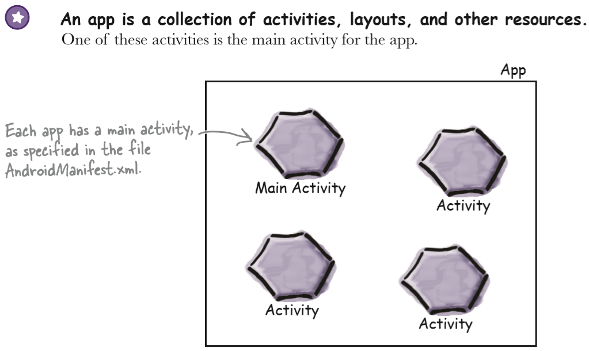
How do activities work?

Slide 5
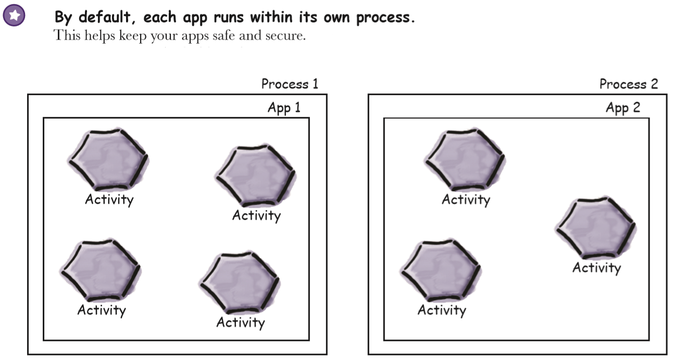
How do activities work?

Slide 6
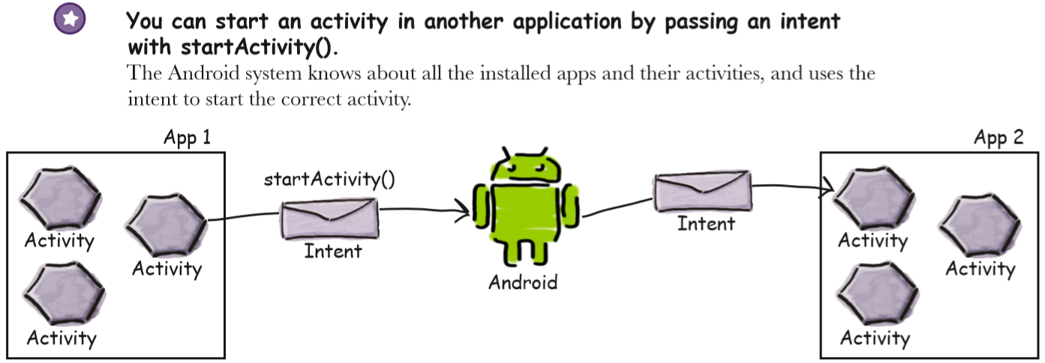
How do activities work?

Slide 7
How do activities work?

Slide 8
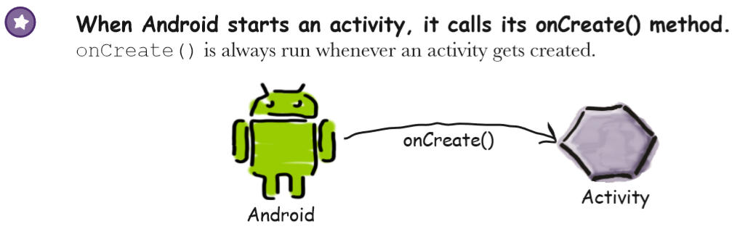
How do activities work?

Slide 9
Questions
How long does the activity live for?
What happens when your activity disappears from the screen? Is it still running? Is it still in memory?
What happens if your app gets interrupted by an incoming phone call?
We want to be able to control the behavior of our activities in a whole range of different circumstances, but how?

Slide 10
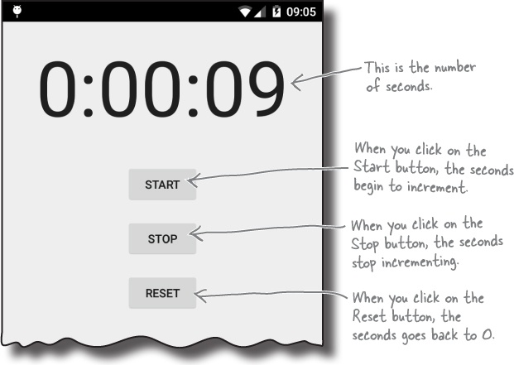
The Stopwatch app

Slide 11
How the activity code will work
We’ll update the stopwatch using a method we’ll create called runTimer().
The runTimer() method will run code every second to check whether the stopwatch is running, increment the number of seconds and display the number of seconds in the text view.
To help us with this, we’ll use two private variables to record the state of the stopwatch. We’ll use an int called seconds to track how many seconds have passed since the stopwatch started running, and a boolean called running to record whether the stopwatch is currently running.

Slide 12
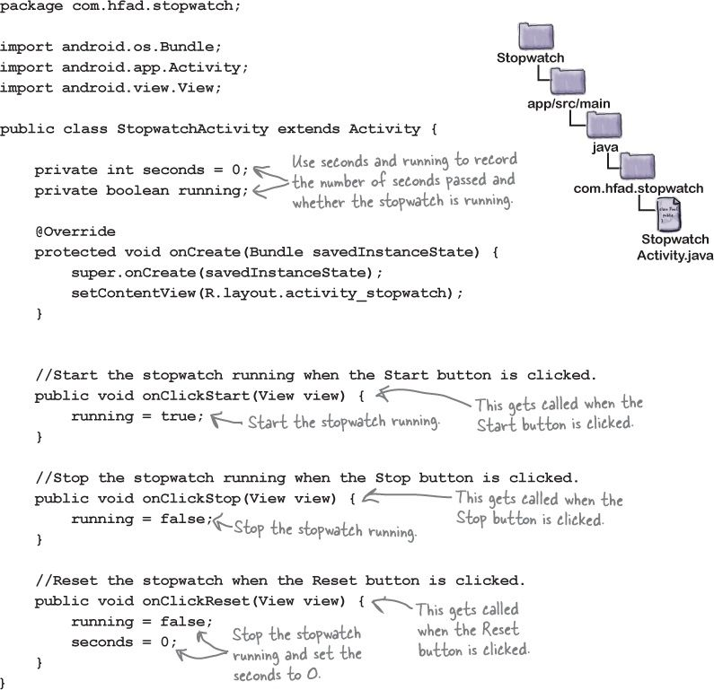

Slide 13
Handlers allow you to schedule code
A Handler is an Android class you can use to schedule code that should be run at some point in the future.
You can also use it to post code that needs to run on a different thread.
In our case, we’re going to use a Handler to schedule the stopwatch code to run every second.

Slide 14

Handlers allow you to schedule code
The post() method
The postDelayed() method

Slide 15
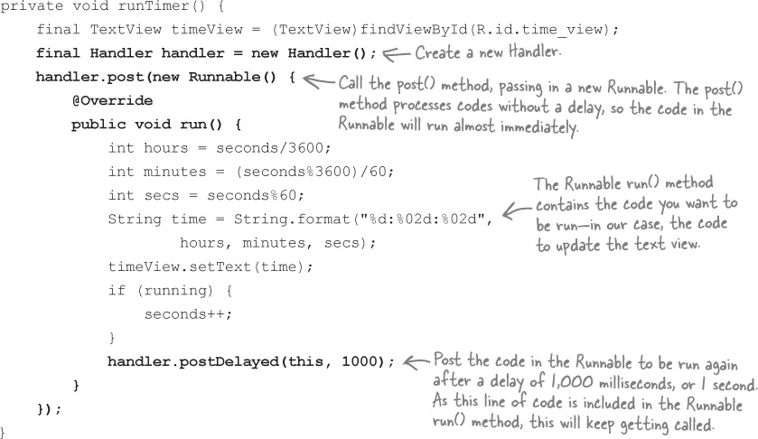
The runTimer() method
Notes:
int hours = seconds / 3600;
int minutes = (seconds % 3600) / 60;
int secs = seconds % 60;
String time = String.format("%02d:%02d:%02d", hours, minutes, secs);

Slide 16
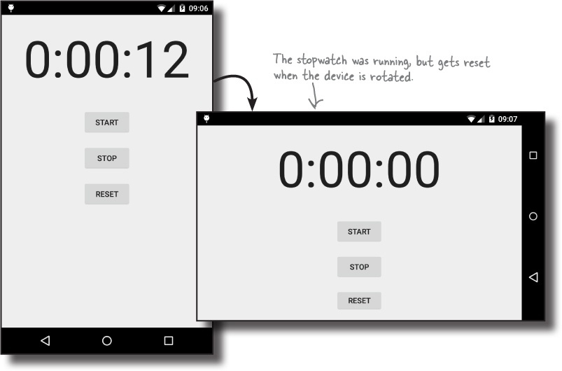
Test Drive the App

Slide 17
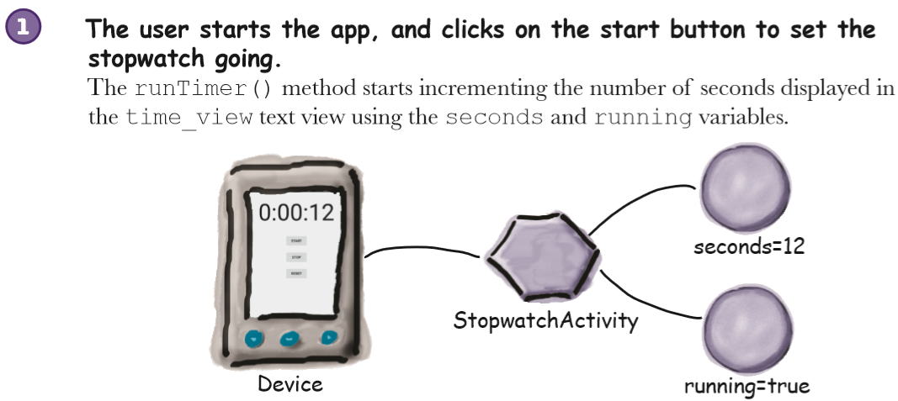
What just happened?

Slide 18
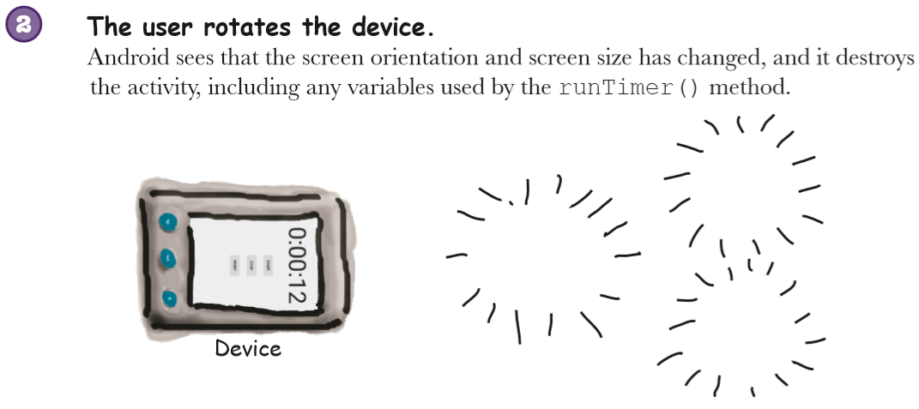
What just happened?

Slide 19
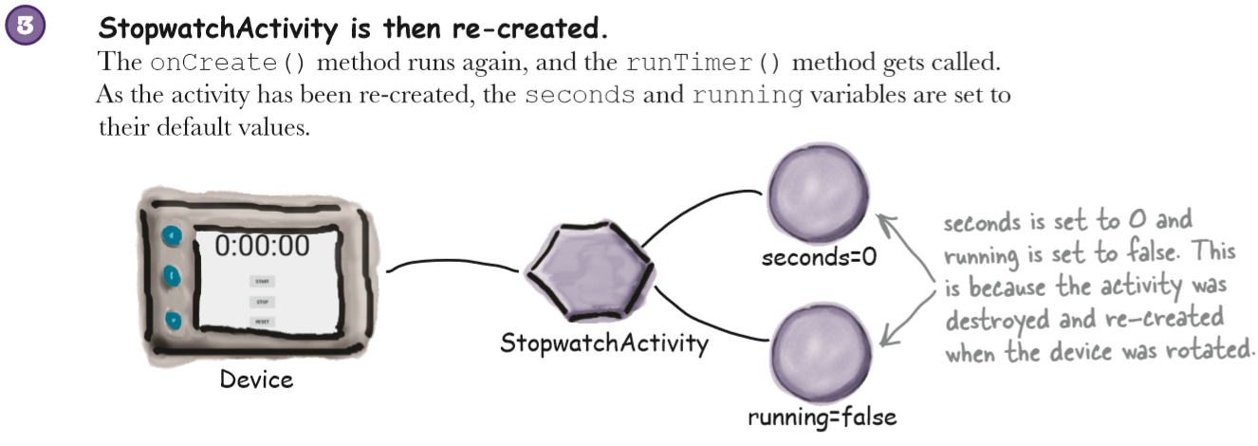
What just happened?

Slide 20
Device Configuration
When Android runs your app and starts an activity, it takes into account the device configuration.
By this we mean the configuration of the physical device (such as the screen size, screen orientation, and whether there’s a keyboard attached)
When the device configuration changes, anything that displays a user interface needs to be updated to match the new configuration.
If you rotate your device, it destroys the current activity, and then re-creates it again so that resources appropriate to the new configuration get picked

Slide 21
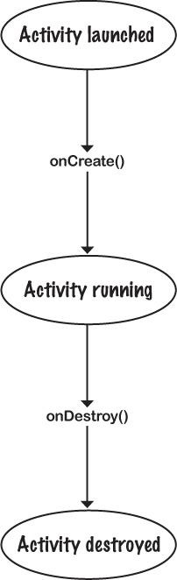
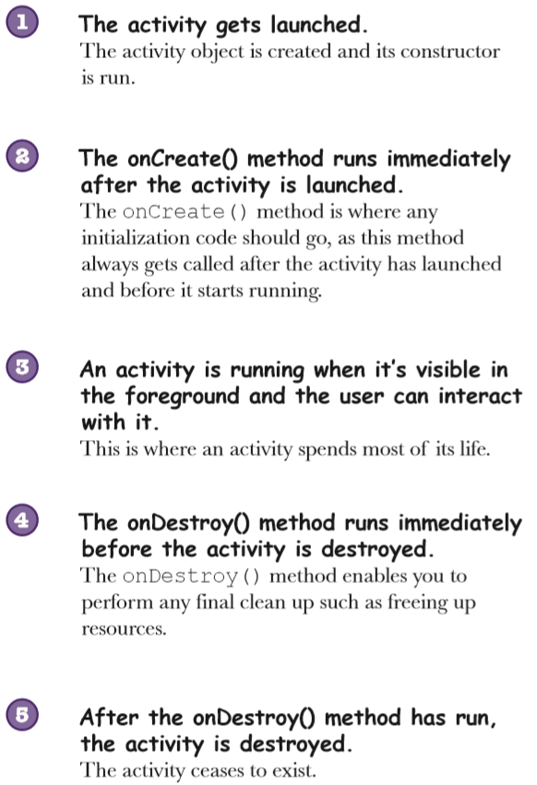
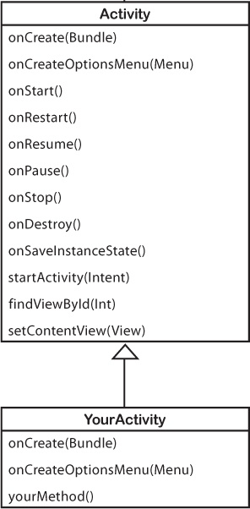
The activity lifecycle: from create to destroy

Slide 22
How do we deal with configuration changes?
There are two options:
we can tell Android to bypass restarting the activity
We can save its current state so that the activity can re-create itself in the same state.

Slide 23
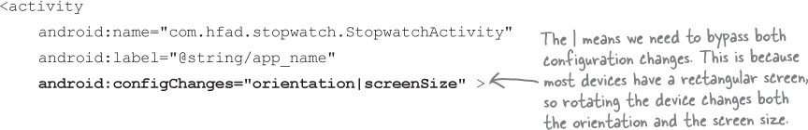
Bypass re-creating the activity
The first option is to tell Android not to restart the activity
It’s usually not the best option.
If you bypass this, you may have to write a bunch of extra code to deal with the new configuration yourself.
If Android encounters this type of configuration change, it makes a call to the onConfigurationChanged(Configuration) method instead of re-creating the activity:

Slide 24
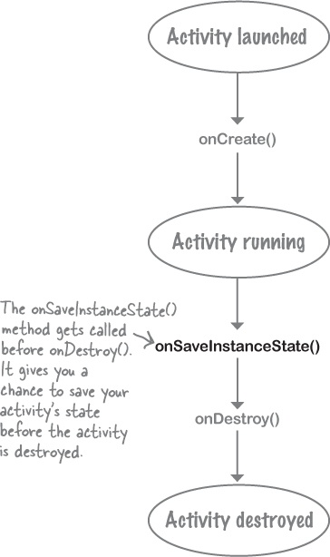
Saving the Activity State
The better way of dealing with configuration changes is to save the current state of the activity, and then reinstate it in the onCreate() method of the activity.
To save the current state of the activity, you need to implement the onSaveInstanceState() method which gets called before the activity gets destroyed,

Slide 25
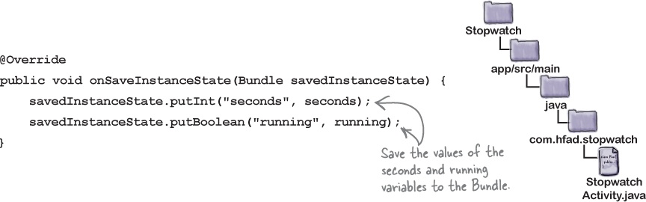
Saving the Activity State
The onSaveInstanceState() method takes one parameter, a Bundle.
A Bundle allows you to gather together different types of data into a single object:
The onCreate() method gets passed the Bundle as a parameter.

Slide 26
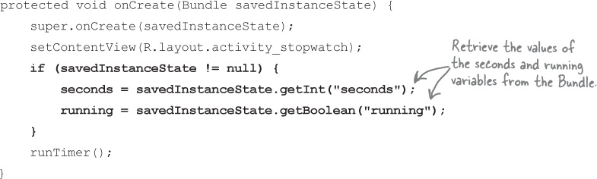
Restore the state in onCreate()

Slide 27
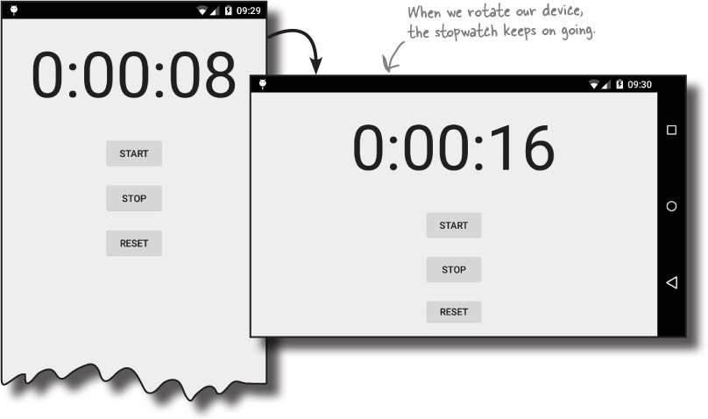
Test drive the app

Slide 28
More Activity States
There are three key lifecycle methods that deal with when an activity becomes visible or invisible to the user.
onStart(): gets called when your activity becomes visible
onStop(): gets called when your activity has stopped being visible
onRestart(): gets called after your activity has been made invisible, before it gets made visible again.
Just as with onCreate() and onDestroy(), your activity inherits them from the Android Activity class.

Slide 29
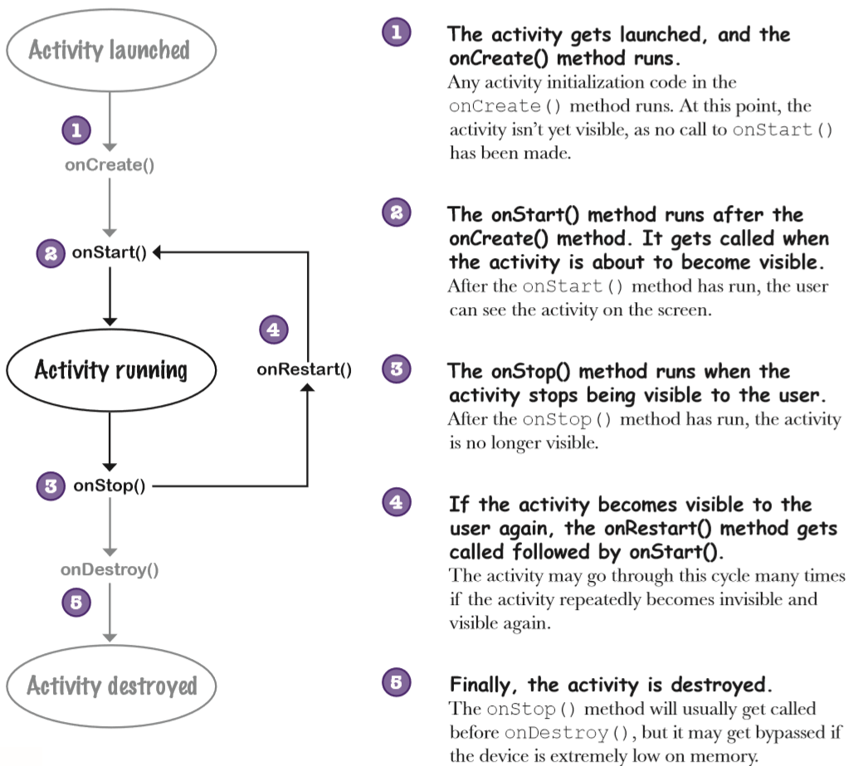

Slide 30
Updating the Stopwatch App
First, we need to implement the activity’s onStop() method so that the stopwatch stops running when the app isn’t visible.
Once we’ve done that, we need to implement the onStart() method so that the stopwatch starts again when the app is visible.

Slide 31
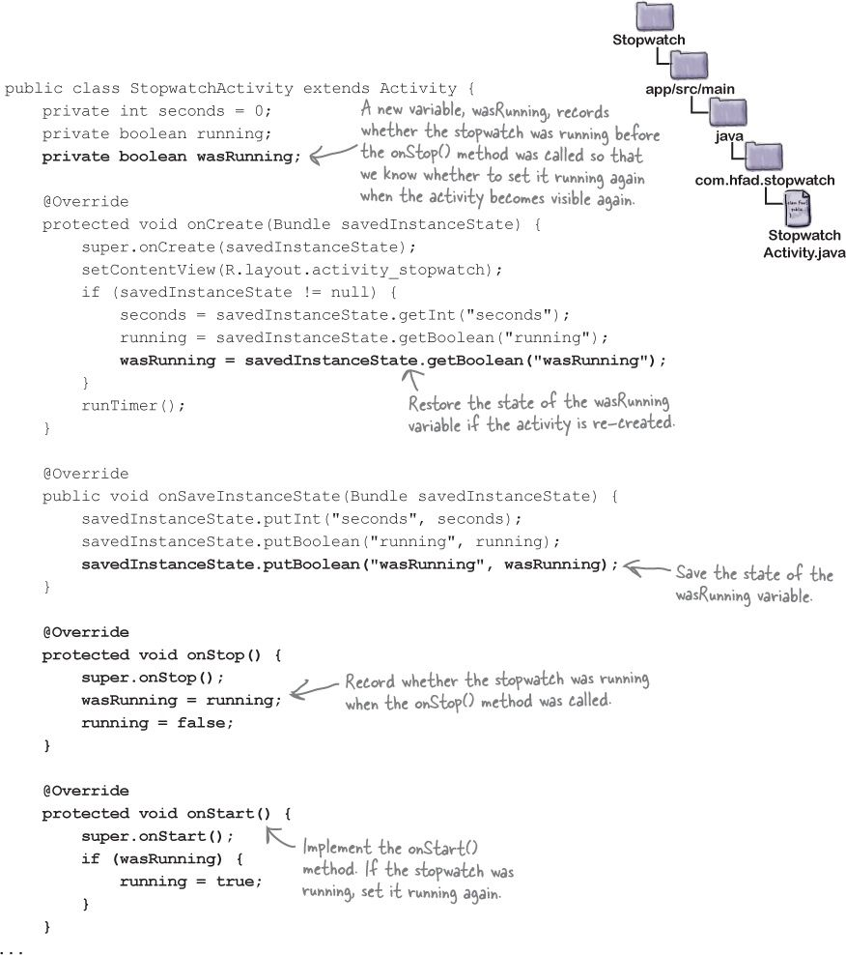

Slide 32
What if an app is only partially visible?
There are two lifecycle methods that deal with when the activity is paused and when it becomes active again:
onPause() gets called when your activity is visible but another activity has the focus.
onResume() is called immediately before your activity is about to start interacting with the user

Slide 33
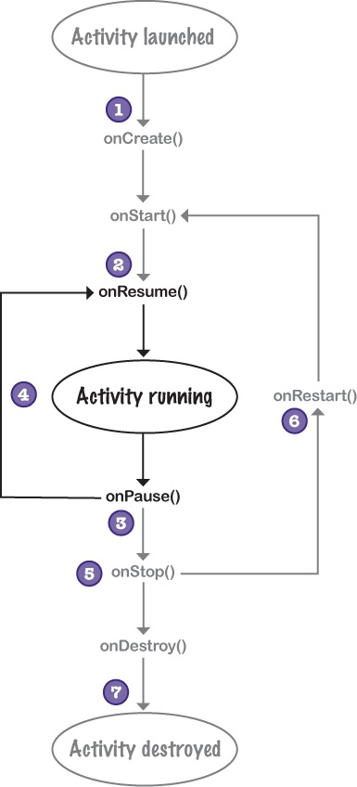

Slide 34
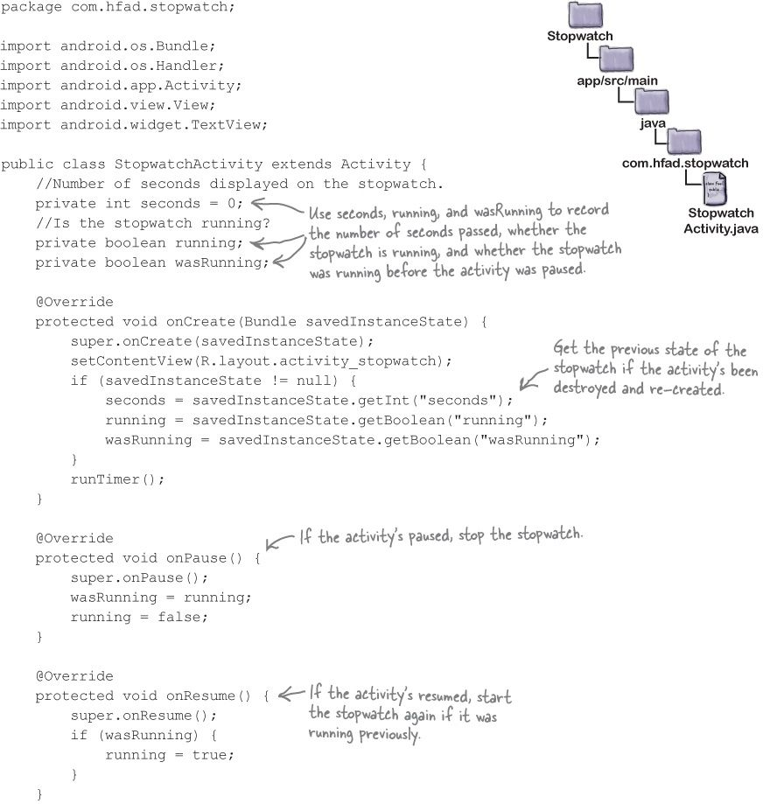

Slide 35
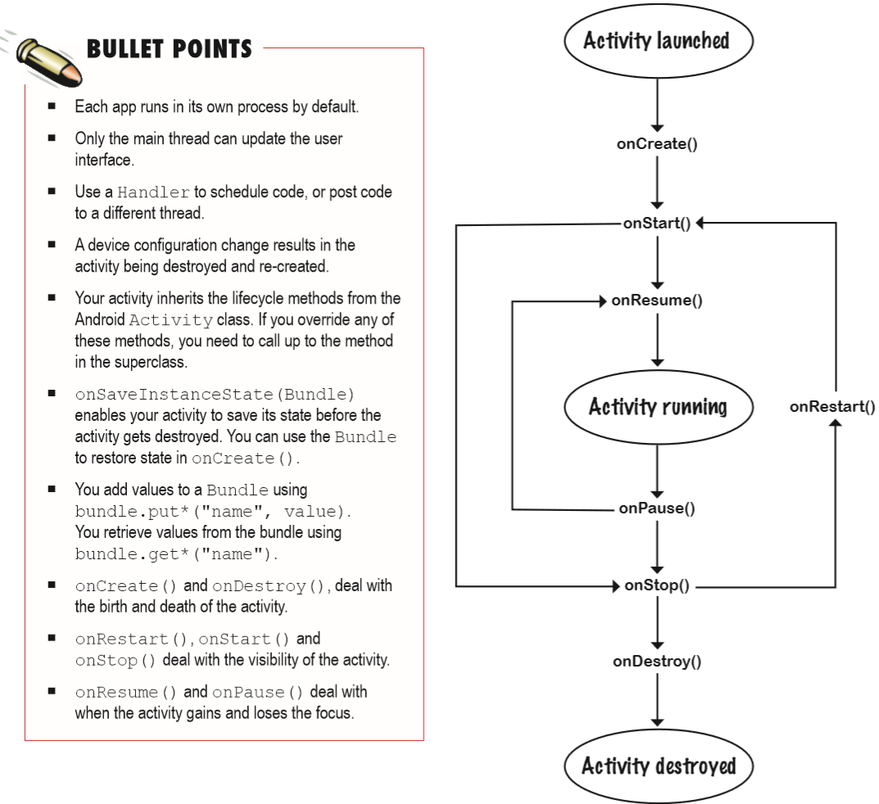

Slide 36
Next Lecture
Chapter 5: The User Interface

