Slide 1
IT420: Selected Topics in IT Mobile Application Development
Lecture 6: List Views and Adapters

Slide 2
Lecturer Details
Dr. Walid Khedr
Email: khedrw@yahoo.com
Web: www.staff.zu.edu.eg/wkhedr
Department of Information Technology

Slide 3
Introduction
We’ll show you how lists of data can form the core part of your app design, and how linking them together can create a powerful and easy-to-use app.
Along the way, you’ll get your first look of using event listeners and adapters to make your app more dynamic.

Slide 4
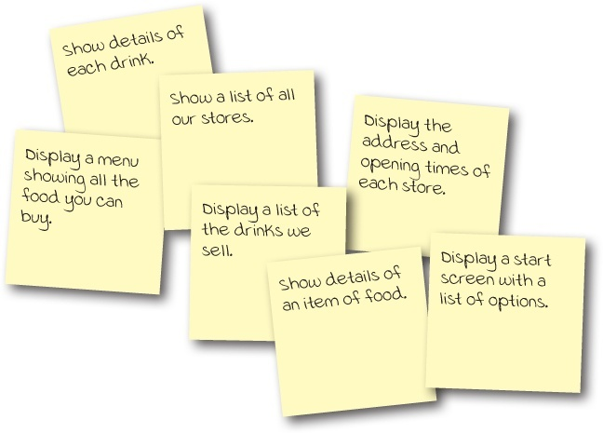
Every app starts with ideas
A restaurant manager wants a new app to entice more customers to their stores.
These are some of the ideas they came up with for what the app should include

Slide 5
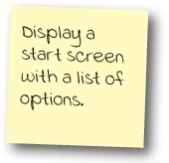
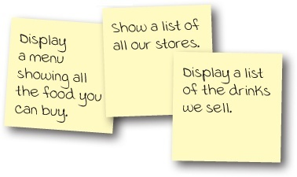
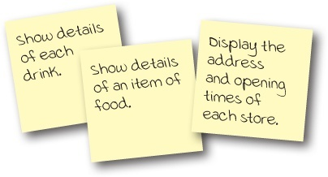
Top-level, category, and detail/edit activities

Slide 6
Top-level, category, and detail/edit activities
Suppose a user wanted to look at details of one of the drinks.
He would launch the app, and be presented with the top-level activity start screen showing her a list of options.
The user would click on the option to display a list of drinks.
To see details of a particular drink, he would then click on her drink of choice from the list

Slide 7
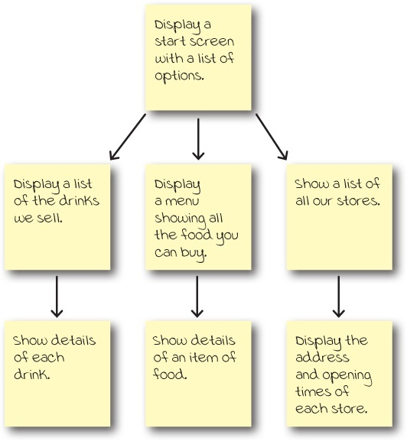

Slide 8
Use ListViews to navigate to data
When you structure your app in this way, you need a way of navigating between your activities.
A common approach used in this situation is to use list views.
A list view allows you to display a list of data that you can then use to navigate through the app.
DEMO

Slide 9
Build the Starbuzz app
We’re going to focus on just the drinks.
We’re going to build a top-level activity that the user will see when they launch the app, a category activity that will display a list of drinks, and a detail/edit activity that will display details of a single drink.
The top-level activity
The drinks category activity
The drink detail activity

Slide 10
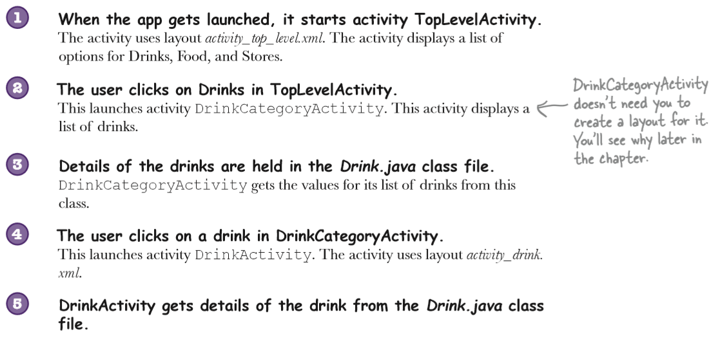
Build the Starbuzz app

Slide 11
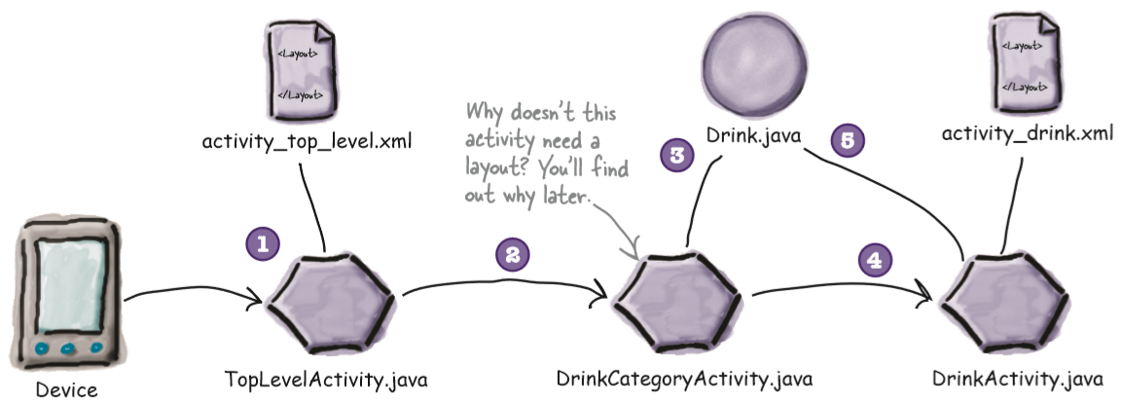
Build the Starbuzz app

Slide 12
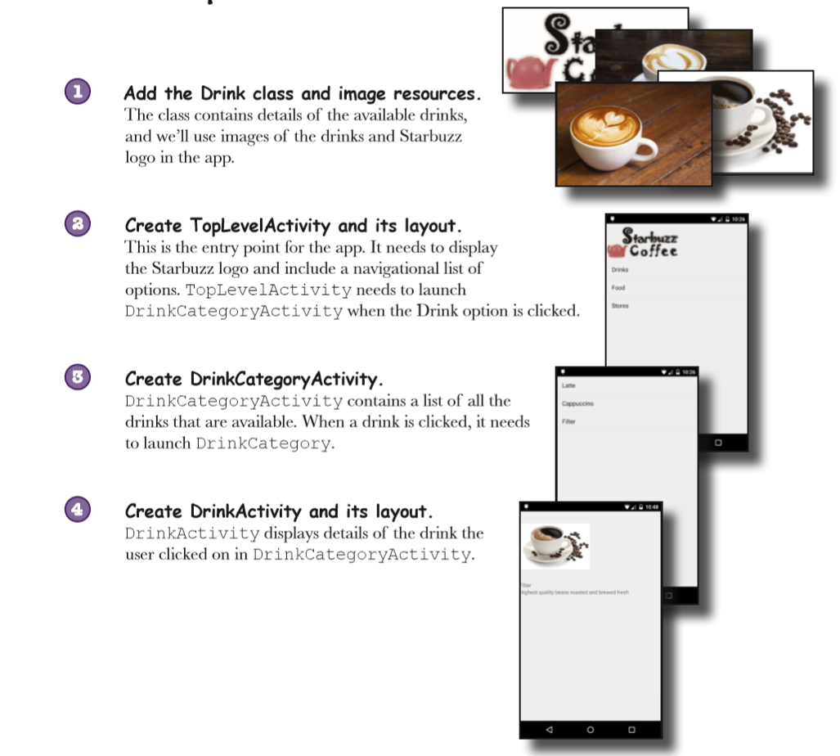

Slide 13
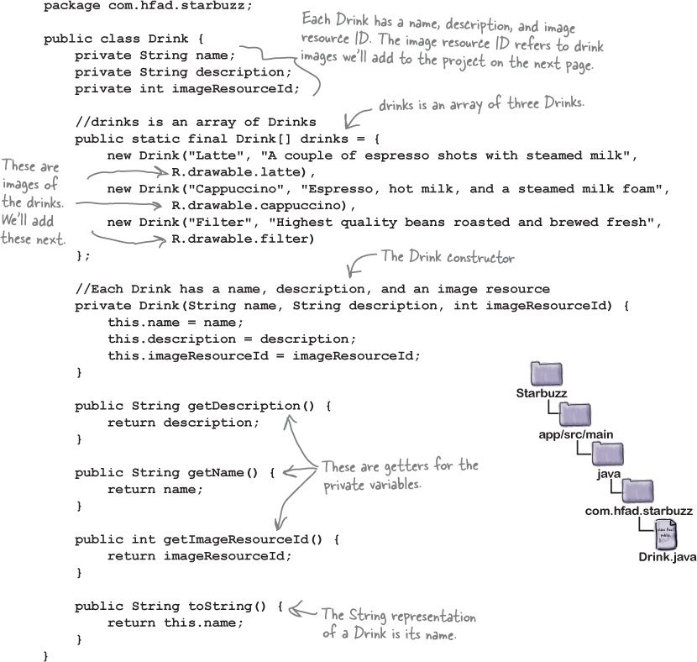

Slide 14
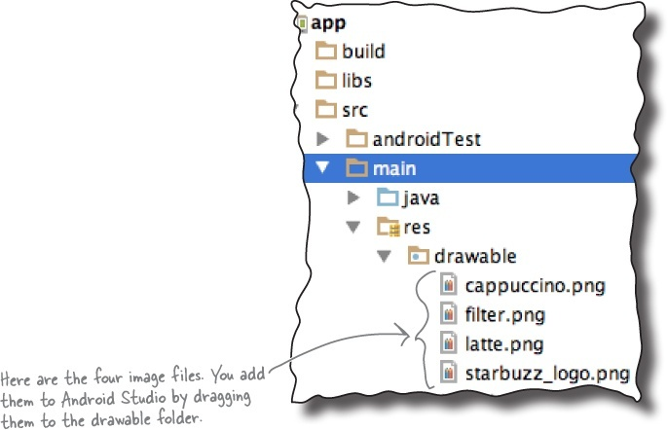
The image files

Slide 15
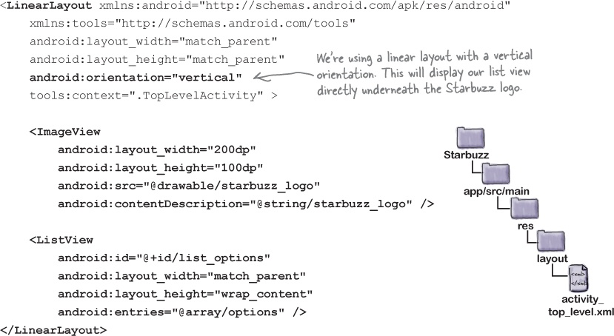
The top-level layout

Slide 16
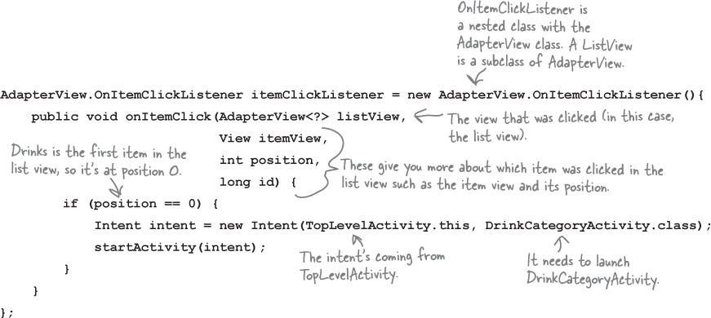
Get ListViews to respond to clicks

Slide 17
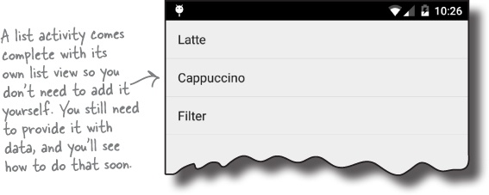
Drink Category Activity
A list activity is type of activity that specializes in working with a list.
It’s automatically bound to a list view, so you don’t need to create one yourself.

Slide 18
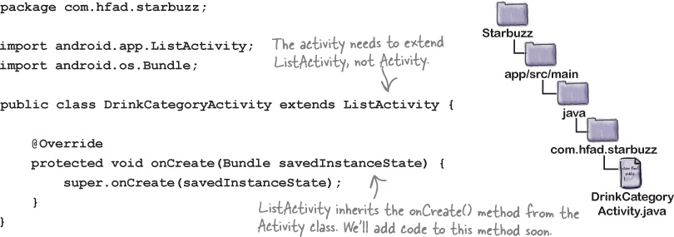
How to create a list activity

Slide 19
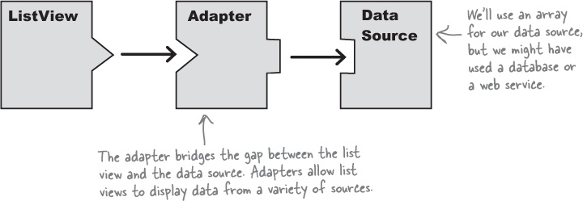
Nonstatic data List
If you need to display data in a list view that comes from a nonstatic source such as a Java array or database, you need to use an adapter.
An adapter acts as a bridge between the data source and the list view

Slide 20
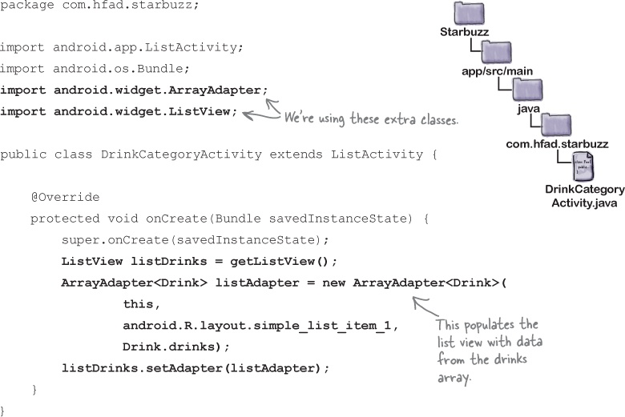
Nonstatic data List

Slide 21
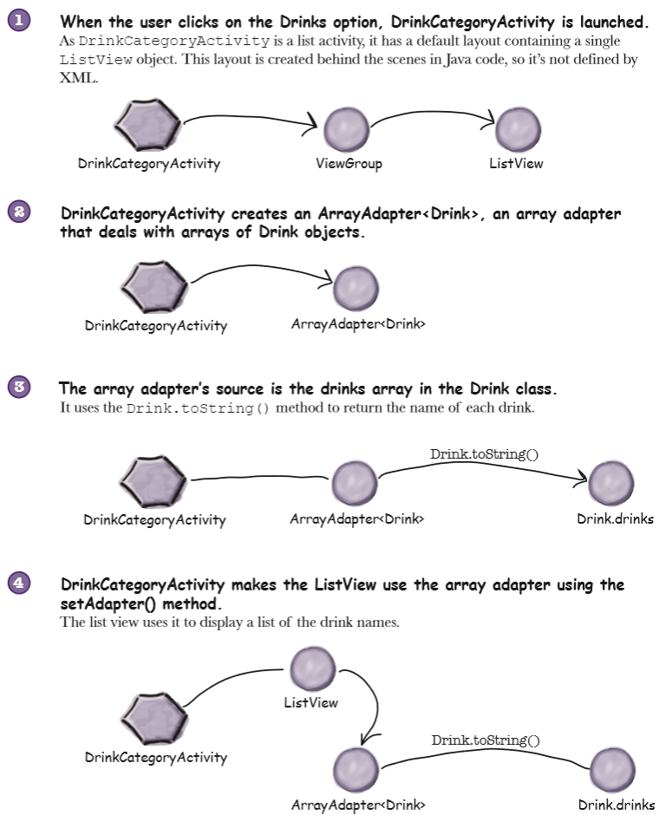

Slide 22
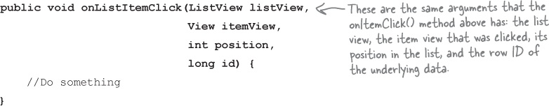
ListActivity implements an item click listener by default

Slide 23
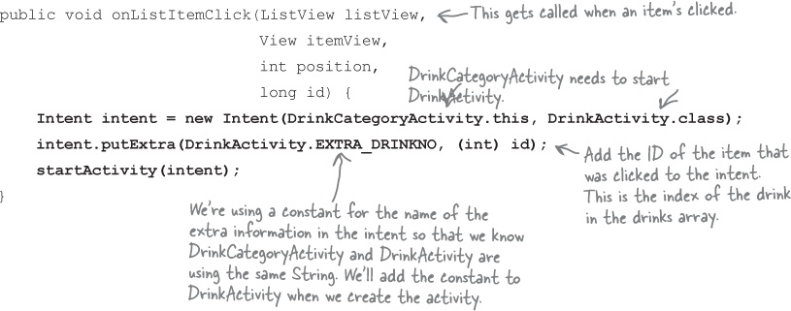
Pass data to an activity using the ListActivity onListItemClick() method

Slide 24
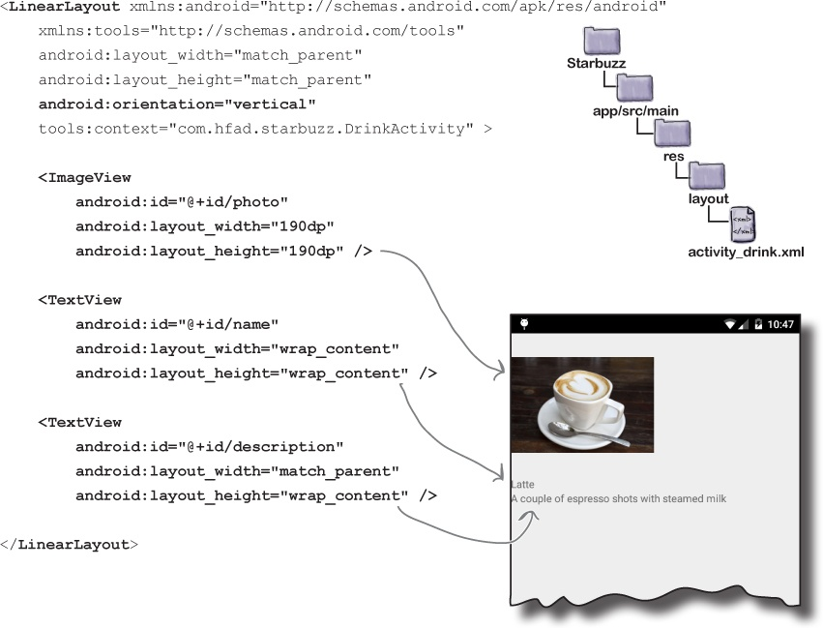
The detail activity

Slide 25
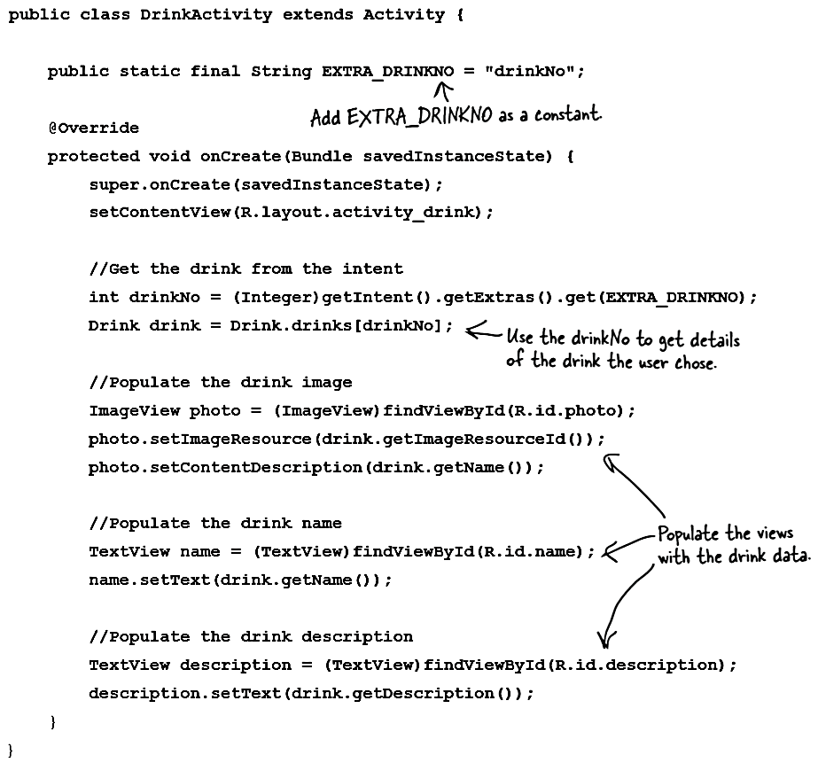
Retrieve data from the intent

Slide 26
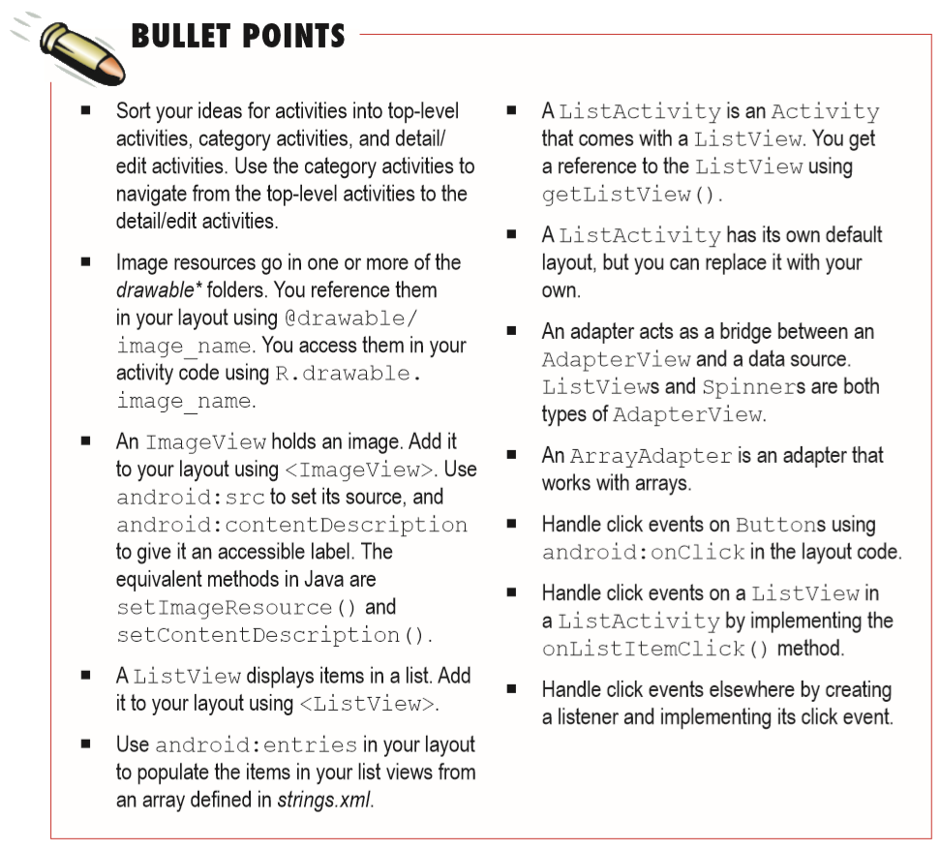

Slide 27
Next Lecture
Chapter 7: Fragments

Slide 28
WEB SERVICES
INTRODUCTION

Slide 29
Web Services
A web service is a web application or component which communicates with other applications using open protocols like HTTP (Hyper Text Transport Protocol), SOAP (Simple Object Access Protocol).
Web services and consumers of Web services (clients) are typically businesses, making Web services business-to-business (B-to-B) transactions.
Web Services will always be accessed by software, never directly by humans even though there might be a human using that software.
In simple words, websites for humans, Web Services for applications.

Slide 30
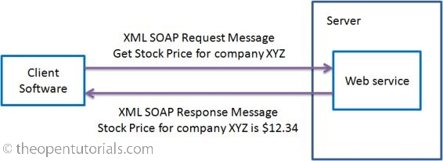
Web Services

Slide 31
SOAP Web Service Architecture
XML along with HTTP forms the basis of web services.
XML provides a language which can be used between different platforms and programming languages.
The HTTP protocol is the most used Internet protocol.
Web services platform consists of the following components:
UDDI (Universal Description, Discovery and Integration)
WSDL (Web Services Description Language)
SOAP (Simple Object Access Protocol)

Slide 32
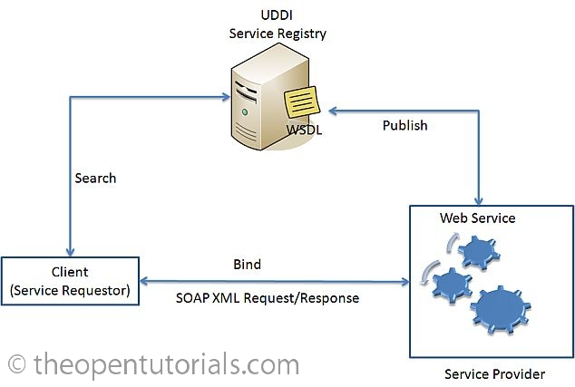
SOAP Web Service Architecture

Slide 33
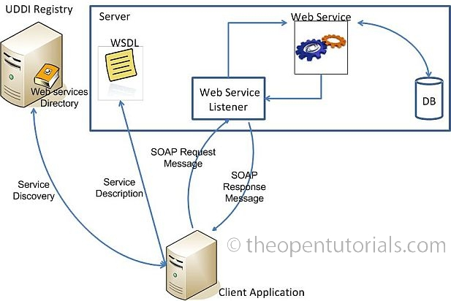
SOAP Web Service Architecture

Slide 34
RESTful Web Services
RESTful web services are based on the way how our web works.
World wide web (www) – the largest distributed application – is based on an architectural style called REST – Representational State Transfer.
REST is neither a standard nor a protocol. It is just an architectural style like say for example client-server architecture (client-server is neither a standard nor a protocol).
Web services following this architectural style are said to be RESTful Web services.

Slide 35
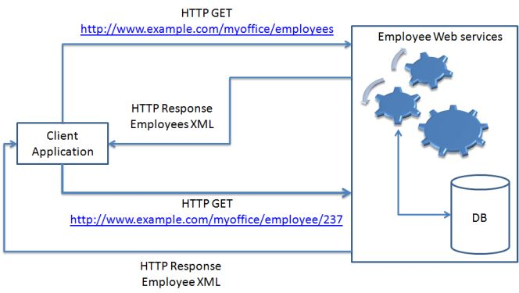
RESTful Web Services

