Slide 1
IT420: Selected Topics in IT Mobile Application Development
Lecture 7: Fragments

Slide 2
Lecturer Details
Dr. Walid Khedr
Email: khedrw@yahoo.com
Web: www.staff.zu.edu.eg/wkhedr
Department of Information Technology

Slide 3
Introduction
You can put the exact same app on devices with completely different screen sizes and processors, and have them run in exactly the same way.
But Does that mean they always have to look exactly the same?

Slide 4
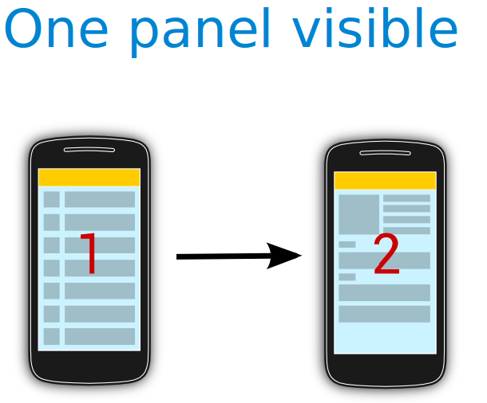

Slide 5
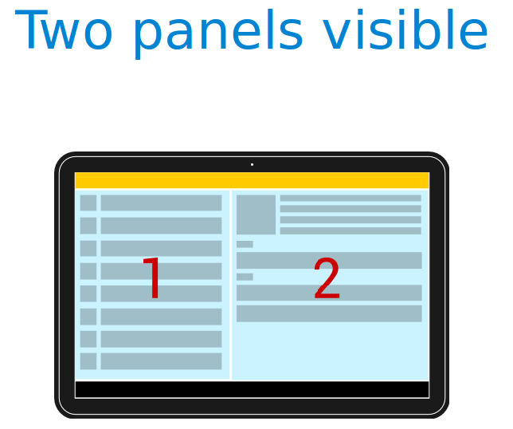

Slide 6
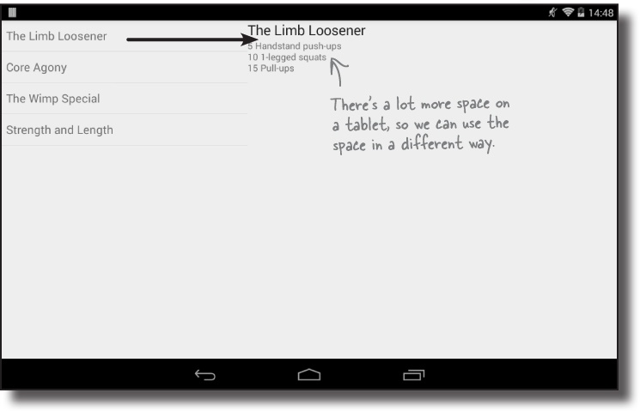
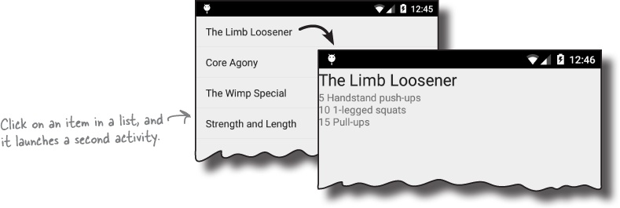

Slide 7
Introduction
To make the phone and tablet user interfaces look different from each other, we can use separate layouts for large devices and small devices
You also need different Java code to run alongside the layouts.
The second activity that runs only on phones will need to insert the details of a workout into the layout.
But that code will also need to be available in the main activity for when the app is running on a tablet.
Rather than duplicate the code in the two activities, we can use fragments

Slide 8
What is fragment?
Fragments are like reusable components or subactivities.
A fragment is used to control part of a screen, and can be reused between screens.
This means we can create a fragment for the list of workouts, and a fragment to display the details of a single workout.
These fragments can then be shared between layouts.
A fragment has an associated layout.
If you design it carefully, the Java code can be used to control everything within the interface.
If the fragment code contains all that you need to control its layout, it greatly increases the chances that you’ll be able to reuse it elsewhere in the app.

Slide 9
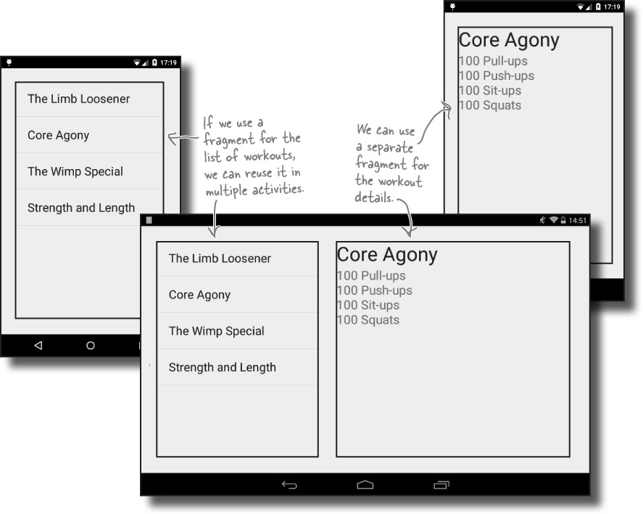

Slide 10
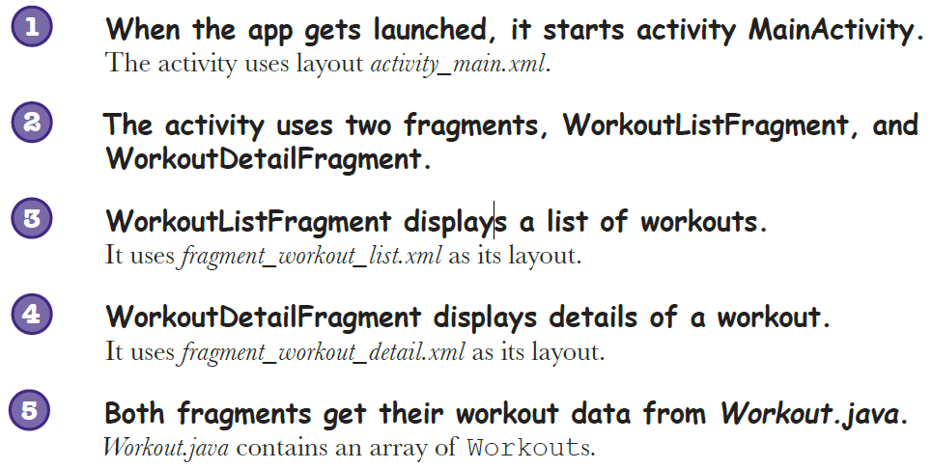
The Workout app structure

Slide 11
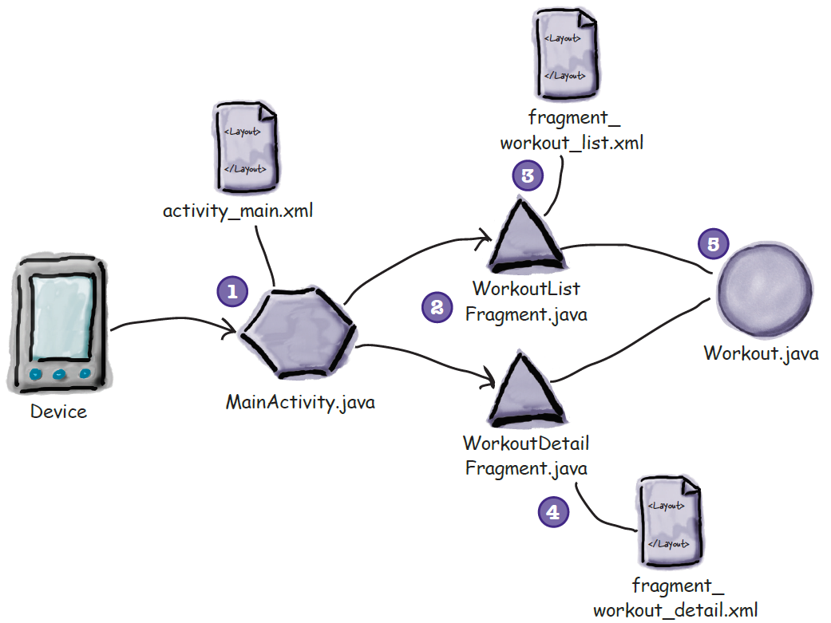
The Workout app structure

Slide 12
Create the project

Slide 13
The Workout class
public class Workout { private String name; private String description; public static final Workout[] workouts = { new Workout("The Limb Loosener", "5 Handstand push-ups\n10 1-legged squats\n15 Pull-ups"), new Workout("Core Agony", "100 Pull-ups\n100 Push-ups\n100 Sit-ups\n100 Squats"), new Workout("The Wimp Special", "5 Pull-ups\n10 Push-ups\n15 Squats"), new Workout("Strength and Length", "500 meter run\n21 x 1.5 pood kettleball swing\n21 x pull-ups") }; private Workout(String name, String description) { this.name = name; this.description = description; } public String getDescription() { return description; } public String getName() { return name; } public String toString() { return this.name; } }

Slide 14
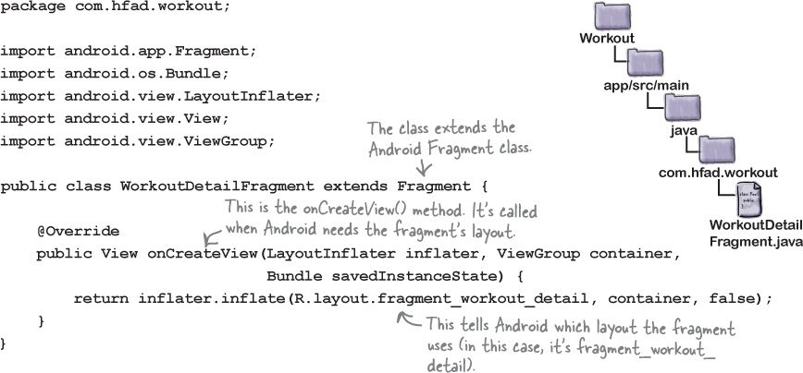
Fragment code

Slide 15
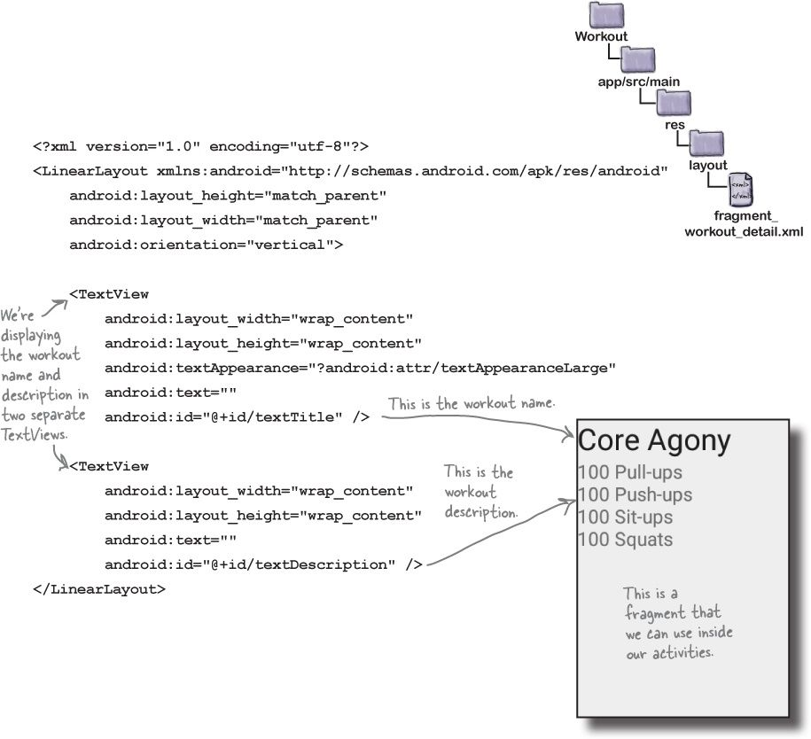
Fragment layout code

Slide 16
Fragment code
The onCreateView() method gets called each time Android needs the fragment’s layout
You specify the fragment’s layout using the code inflater.inflate(R.layout.fragment_workout_detail, container, false);
The container argument is passed by the activity that uses the fragment.
It’s the ViewGroup in the activity that the fragment layout needs to be inserted into.

Slide 17
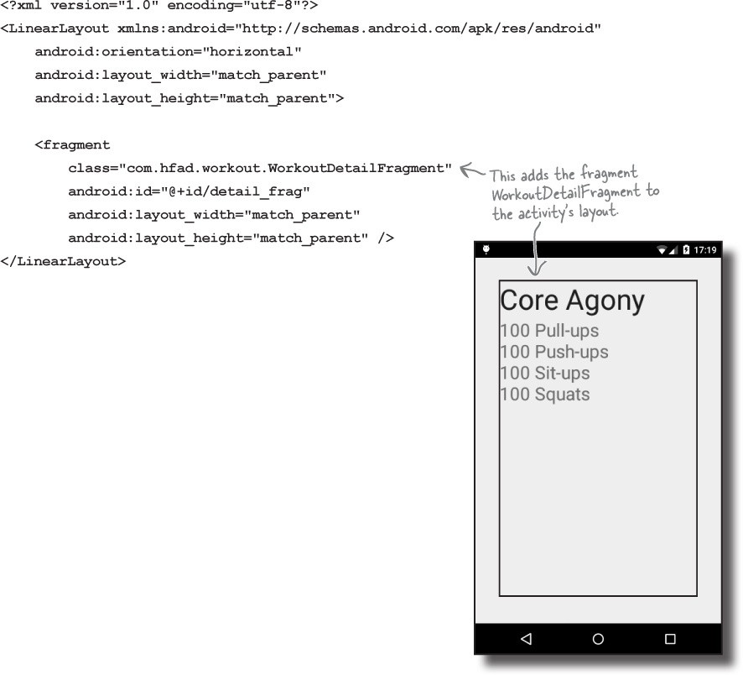
Adding a fragment to an activity’s layout

Slide 18
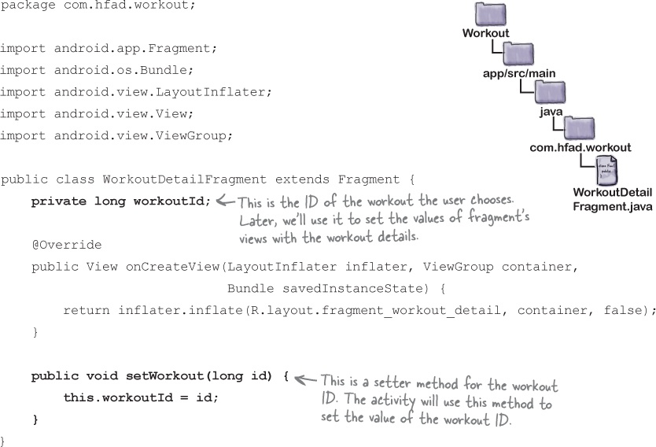
Passing the workout ID to the fragment

Slide 19
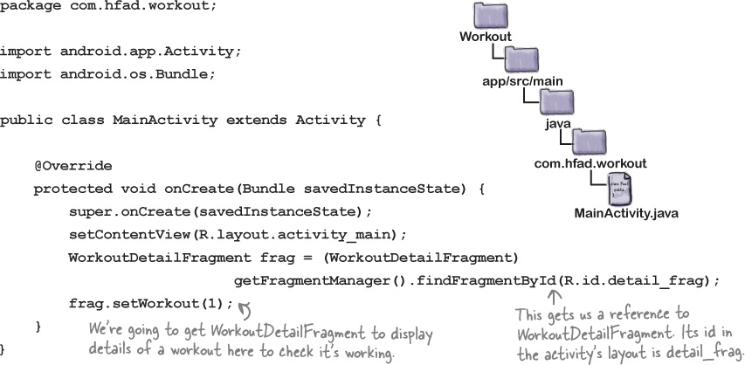
Get the activity to set the workout ID

Slide 20
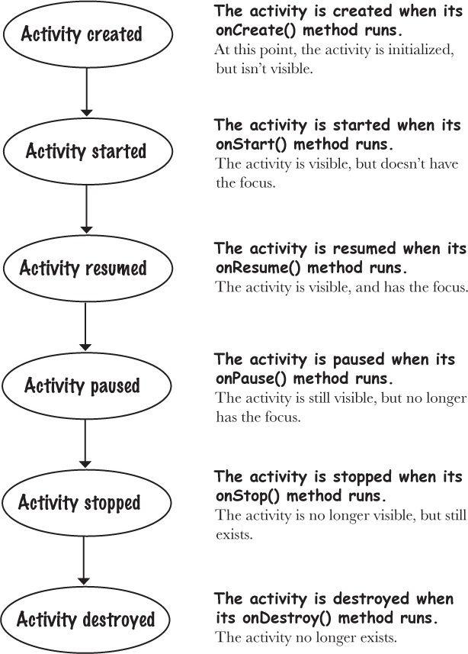
Fragment’s lifecycle

Slide 21
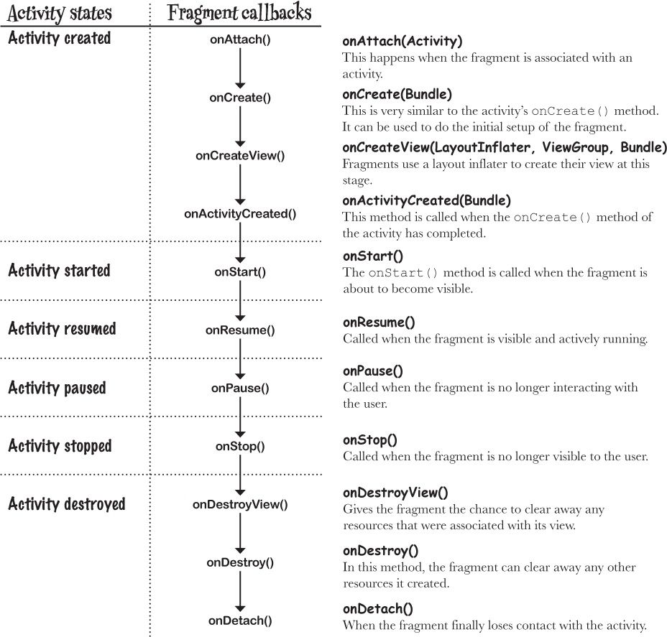
Fragment’s lifecycle

Slide 22
Fragment’s lifecycle
Fragment class doesn’t extend the Activity class
Unlike an activity, a fragment isn’t a type of context and therefore doesn’t have direct access to global information about the application environment.
Instead, fragments must access this information using the context of other objects such as its parent

Slide 23
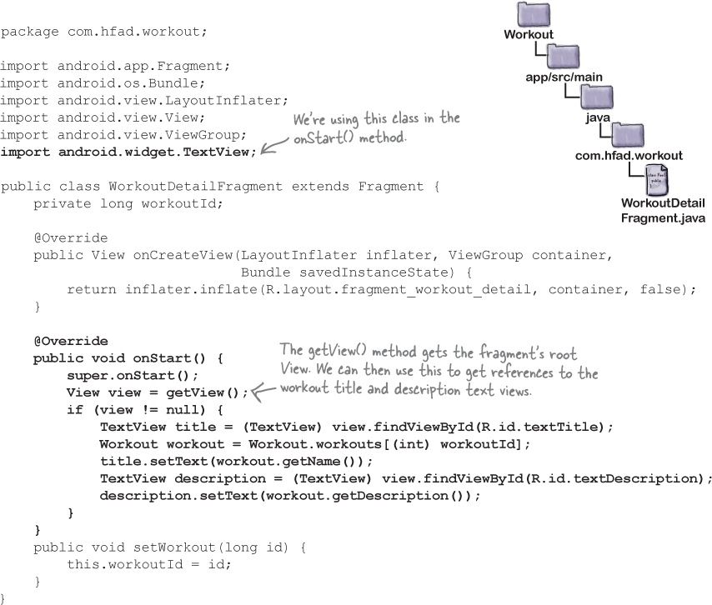
Set the view’s values in the fragment

Slide 24
Create a fragment with a list
We need to create a second fragment that contains a list of the different workouts
We can use a type of fragment called a ListFragment
A list fragment is a type of fragment that specializes in working with a list

Slide 25
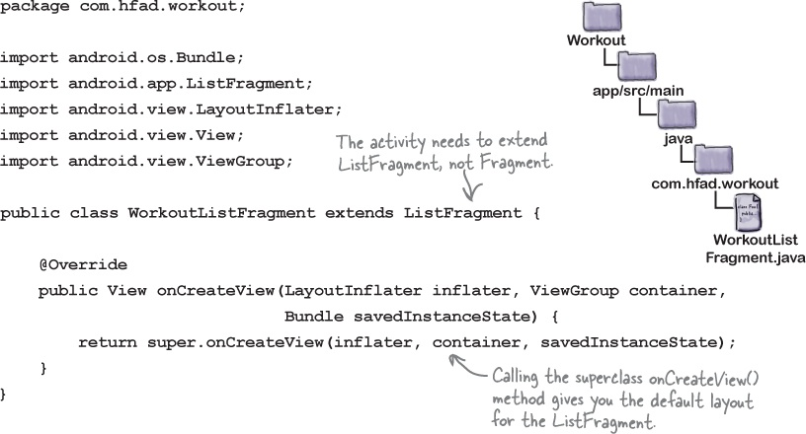
How to create a list fragment

Slide 26
Use ArrayAdapter to set the values in ListView
public class WorkoutListFragment extends ListFragment { public WorkoutListFragment() { // Required empty public constructor } @Override public View onCreateView(LayoutInflater inflater, ViewGroup container, Bundle savedInstanceState) { ArrayAdapter<Workout> adpt = new ArrayAdapter<Workout>(getActivity(), android.R.layout.simple_list_item_1,Workout.workouts); setListAdapter(adpt); return super.onCreateView(inflater,container,savedInstanceState); } }

Slide 27
Display WorkoutListFragment
<LinearLayout xmlns:android="http://schemas.android.com/apk/res/android" xmlns:tools="http://schemas.android.com/tools" android:layout_width="match_parent" android:layout_height="match_parent" android:paddingLeft="@dimen/activity_horizontal_margin" android:paddingRight="@dimen/activity_horizontal_margin" android:paddingTop="@dimen/activity_vertical_margin" android:paddingBottom="@dimen/activity_vertical_margin" tools:context=".MainActivity" android:orientation="horizontal"> <fragment android:layout_width="0dp" android:layout_weight="2" android:layout_height="match_parent" android:name="com.wik4apps.workout.WorkoutListFragment" android:id="@+id/list_fragment" /> <fragment android:layout_width="0dp" android:layout_weight="3" android:layout_height="match_parent" android:name="com.wik4apps.workout.WorkoutDetailFragment" android:id="@+id/detail_fragment" tools:layout="@layout/fragment_workout_detail" /> </LinearLayout>

Slide 28
get WorkoutDetailFragment to respond to clicks in WorkoutListFragment
We don’t want to write code in WorkoutListFragment that talks directly to WorkoutDetailFragment. Can you think why?
We have two objects that need to talk to each other—the fragment and the activity—and we want them to talk without one side knowing too much about the other.
The way we do that in Java is with an interface
It means that we’ll be able to get the fragment to talk to any kind of activity, so long as that activity implements the interface.

Slide 29
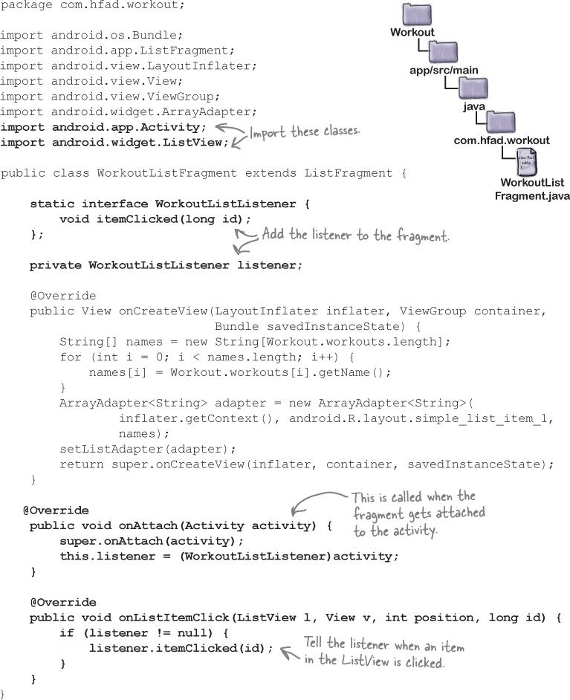

Slide 30
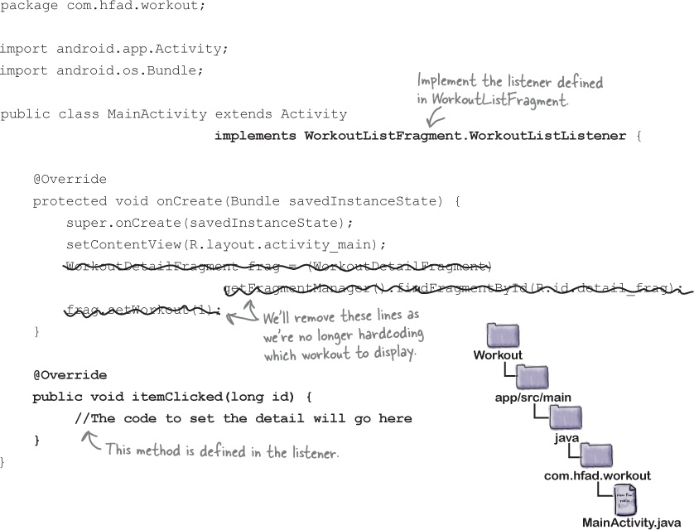
Make the activity implement the interface

Slide 31
How do we update the workout details?
The WorkoutDetailFragment updates its views when the fragment is started.
But once the fragment is displayed on screen, how do we get the fragment to update the details?
We could play with the fragment’s lifecycle so that we get it to update.
Instead, we’ll replace the detail fragment with a brand-new detail fragment, each time we want its text to change.
Fragment changes can be undone with the back button, just like activity changes can.

Slide 32
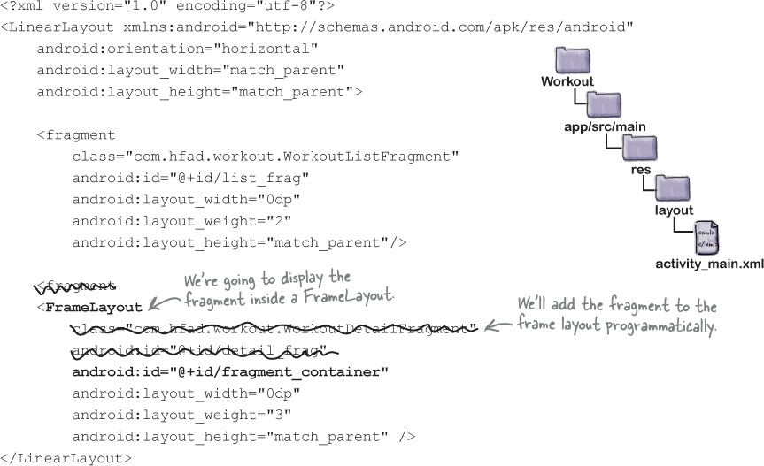
Don’t update—instead, replace
Add a fragment to an activity using <fragment> if you don't need it to respond to changes in the user interface. Otherwise, use a <FrameLayout>.

Slide 33
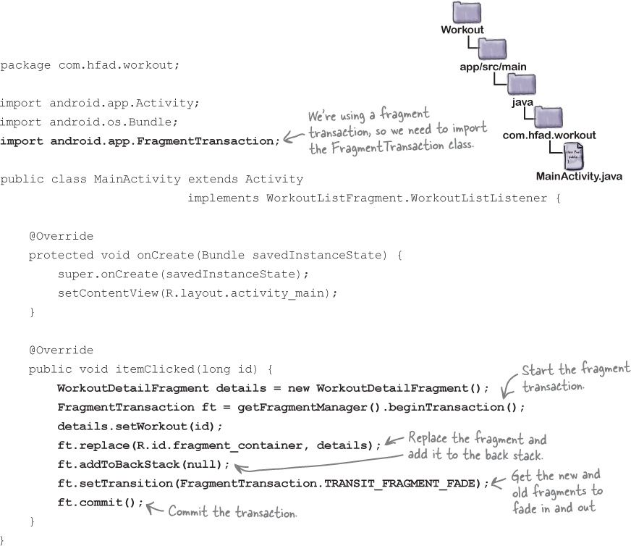

Slide 34
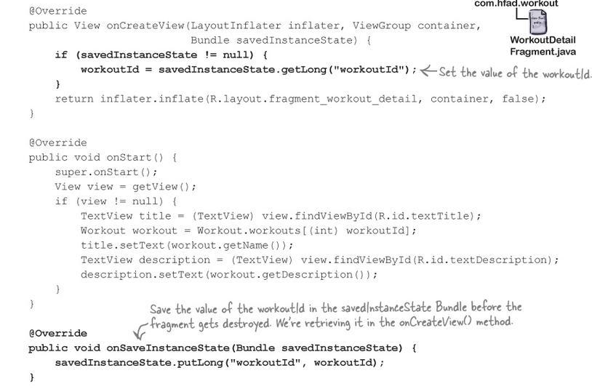
Rotating the device breaks the app

Slide 35
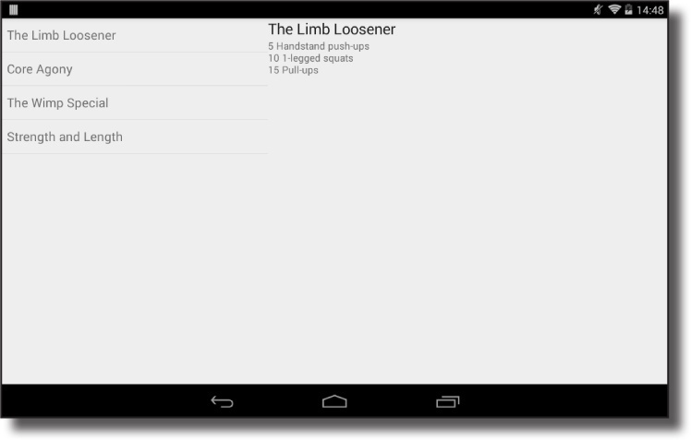
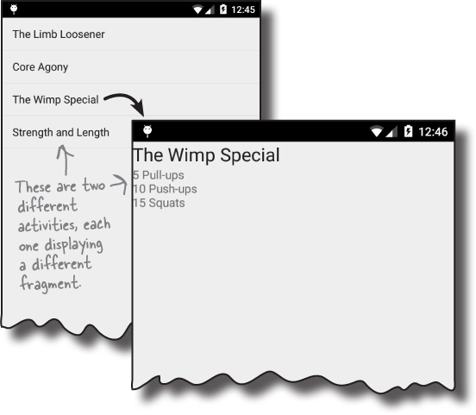
Phone versus tablet

Slide 36
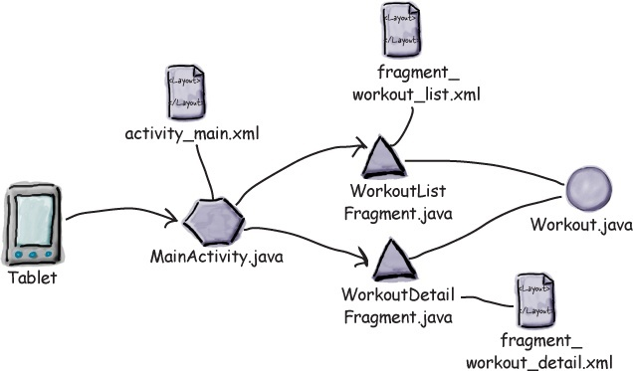
Tablet

Slide 37
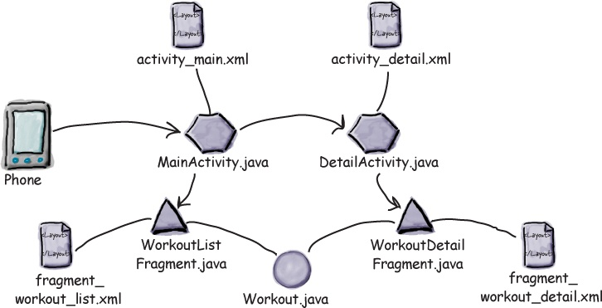
Phone

Slide 38
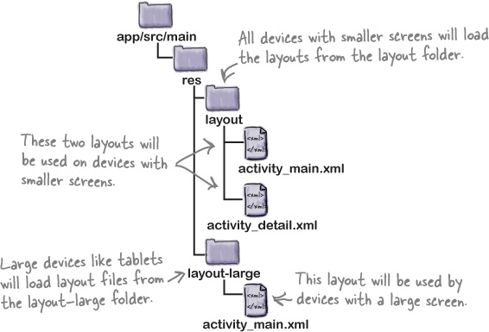
Different resources for different screens

Slide 39
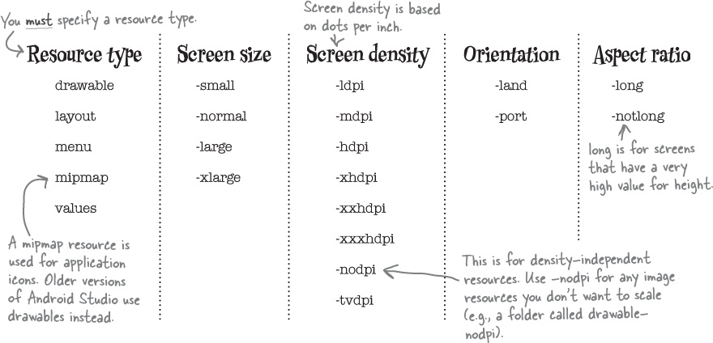
Different resources for different screens

Slide 40
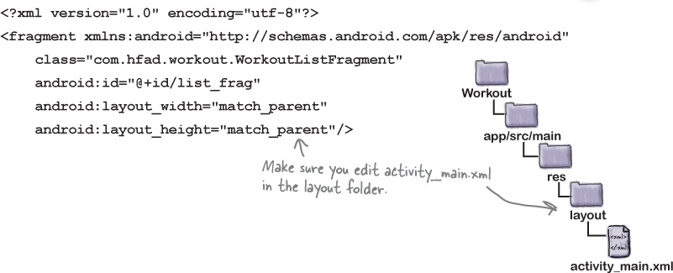
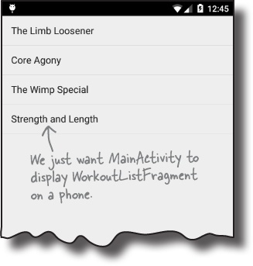
The MainActivity phone layout

Slide 41
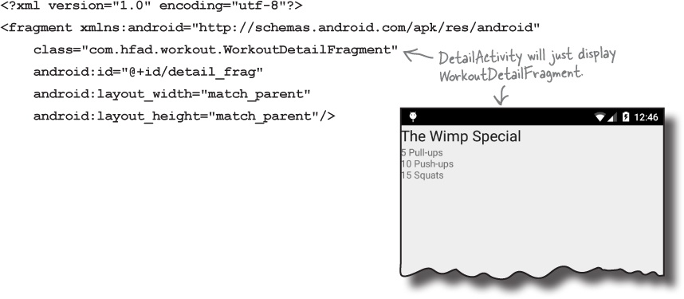
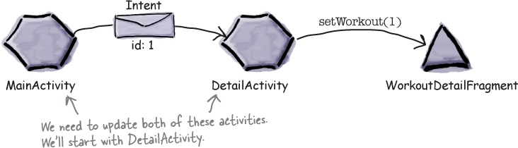
Create DetailActivity

Slide 42
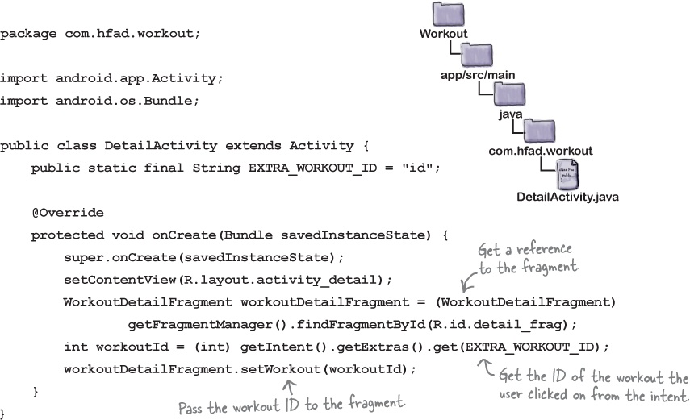
Create DetailActivity

Slide 43
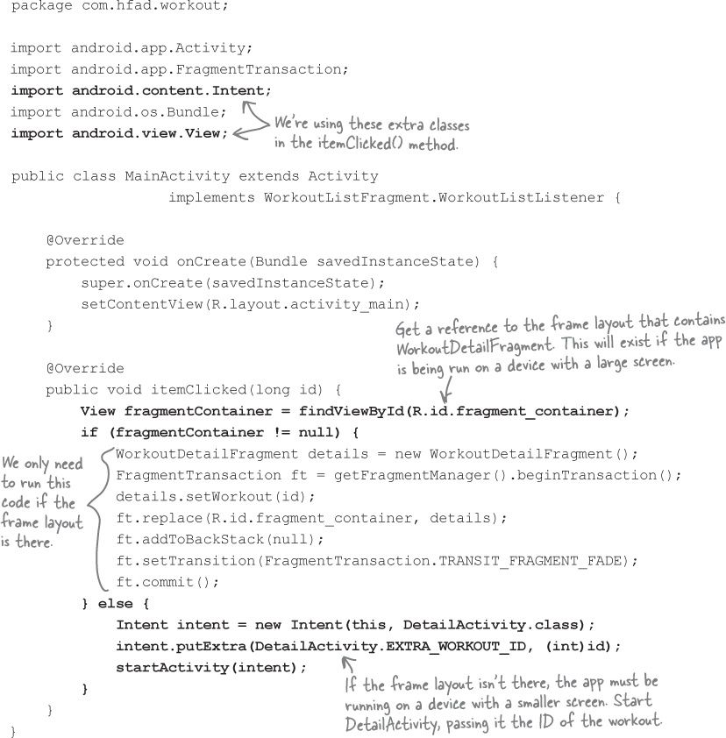
Which layout

Slide 44
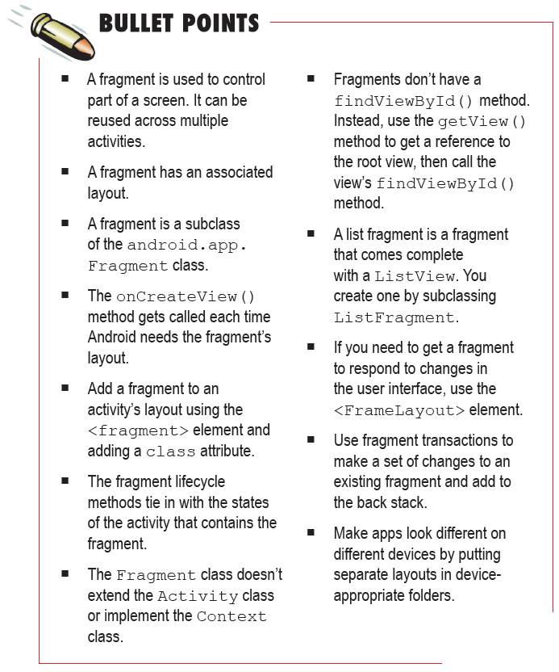

Slide 45
Next Lecture
Chapter 7: Fragments

