Slide 1
IT420: Selected Topics in IT Mobile Application Development
Lecture 11: SQLite databases

Slide 2
Lecturer Details
Dr. Walid Khedr
Email: khedrw@yahoo.com
Web: www.staff.zu.edu.eg/wkhedr
Department of Information Technology

Slide 3
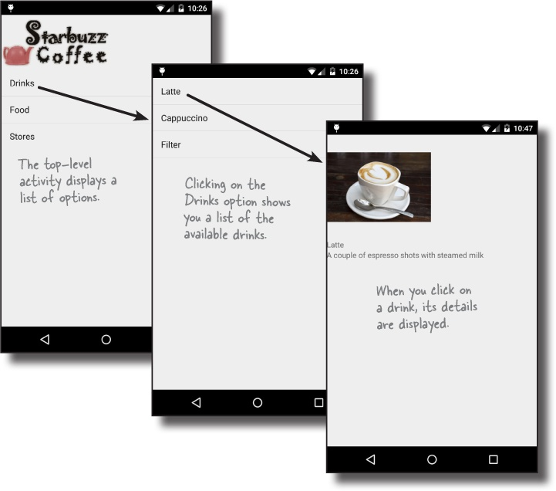
Introduction
We’re going to change the Starbuzz database so that it gets its data from a SQLite database.

Slide 4
Why SQLite?
It’s lightweight: Most database systems need a special database server process in order to work. SQLite doesn’t, a SQLite database is just a file.
It’s optimized for a single user: so we shouldn’t have to identify ourselves with a username and password.
It’s stable and fast: the code that reads and writes the data is written in optimized C code. Not only is it fast, but it also reduces the amount of processor power it needs

Slide 5
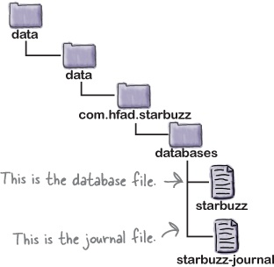
Where’s the database stored?

Slide 6
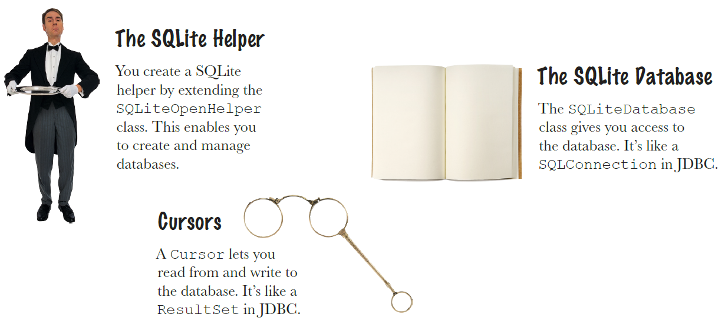
Android comes with SQLite classes

Slide 7
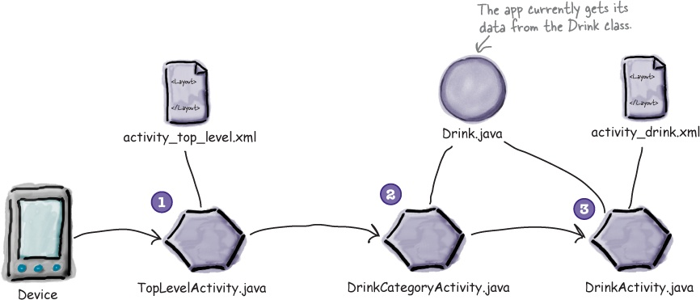
The current Starbuzz app structure

Slide 8
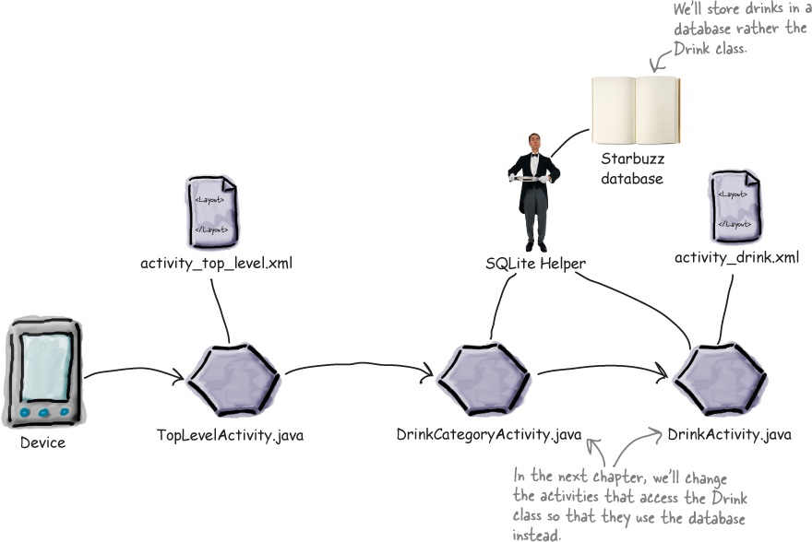
Change the app to use a database

Slide 9
The SQLiteOpenHelper class
You create a SQLite helper by writing a class that extends the SQLiteOpenHelper class.
When you do this, you must override the onCreate() and onUpgrade() methods.
These methods are mandatory.

Slide 10
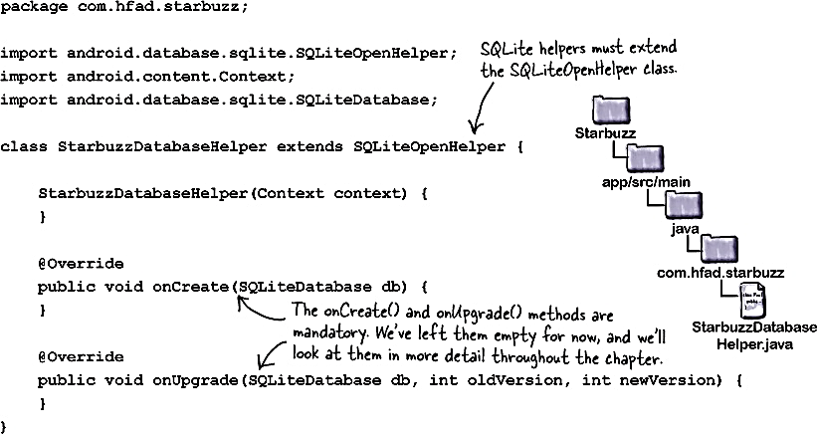
StarbuzzDatabaseHelper Class

Slide 11
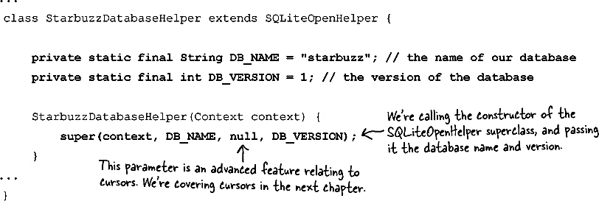
Specify the database

Slide 12
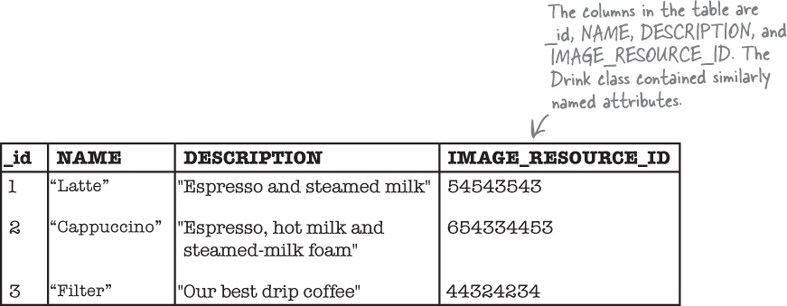
Inside a SQLite database

Slide 13
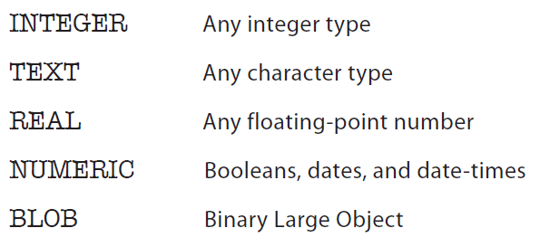
Storage classes and data-types
Notes:
Unlike most database systems, you don’t need to specify the column size in SQLite. Under the hood, the data type is translated into a much broader storage class. This means you can say very generally what kind of data you’re going to store, but you’re not forced to be specific about the size of data.

Slide 14
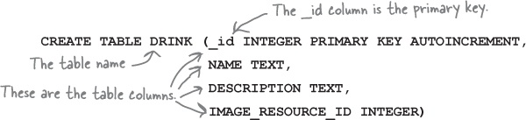
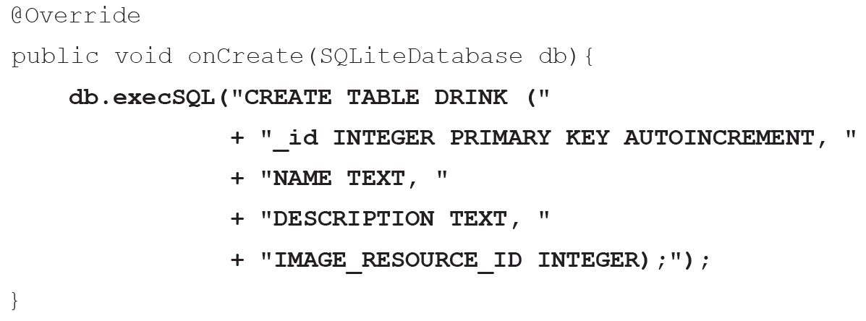
Create tables using SQL
Notes:
"CREATE TABLE STUDENT (_id INTEGER PRIMARY KEY AUTOINCREMENT, " + "NAME TEXT, " + "EMAIL TEXT, " + "IMAGE_RESOURCE_ID INTEGER);"

Slide 15
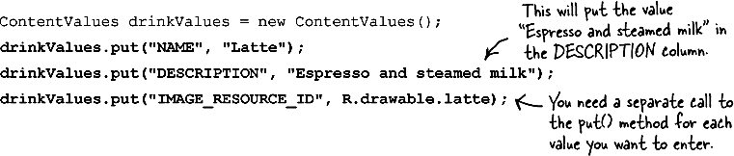
Inserting data
The SQLiteDatabase class contains several methods that enable you to insert, update, and delete data
If you need to prepopulate a SQLite table with data, you can use the SQLiteDatabase insert() method.
To use the insert() method, you need to specify the table you want to insert into, and the values you’re inserting. You say what values you want to insert by creating a ContentValues object

Slide 16
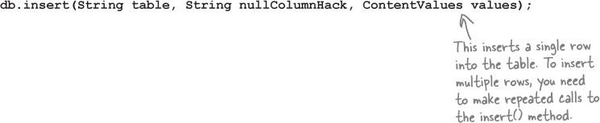
Inserting data

Slide 17
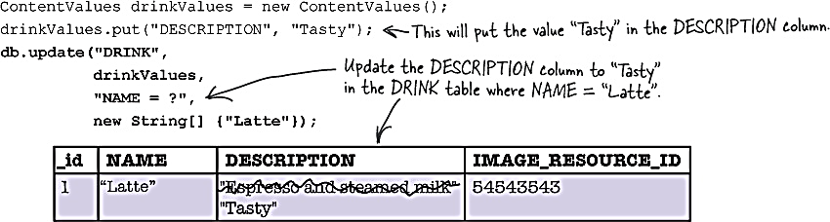

Update data

Slide 18
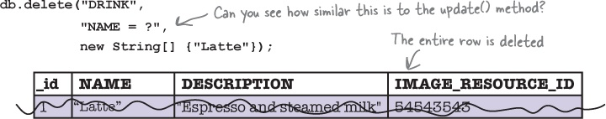
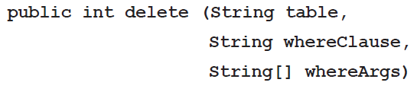
Delete Data

Slide 19
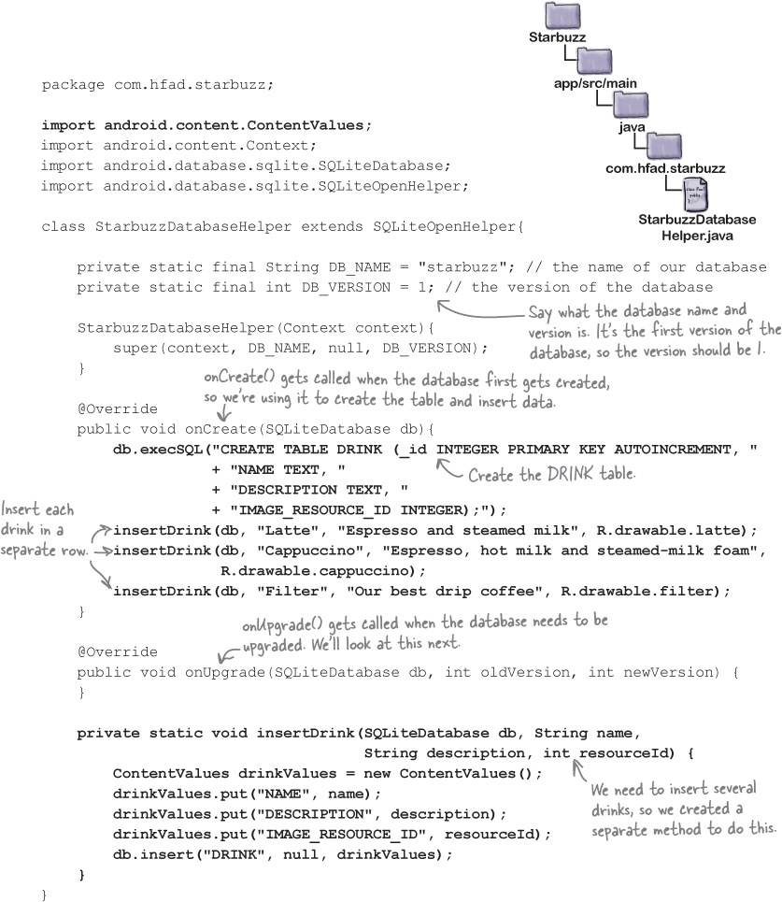

Slide 20
Change the database
The first scenario is that the user has never installed your app before, and doesn’t have the database installed on her device. In this case, the SQLite helper creates the database the first time the database needs to be accessed, and runs its onCreate() method.
The second scenario is where the user installs a new version of your app which includes a different version of the database. If the SQLite helper spots that the database that’s installed is out of date, it will call either the onUpgrade() or onDowngrade() method

Slide 21
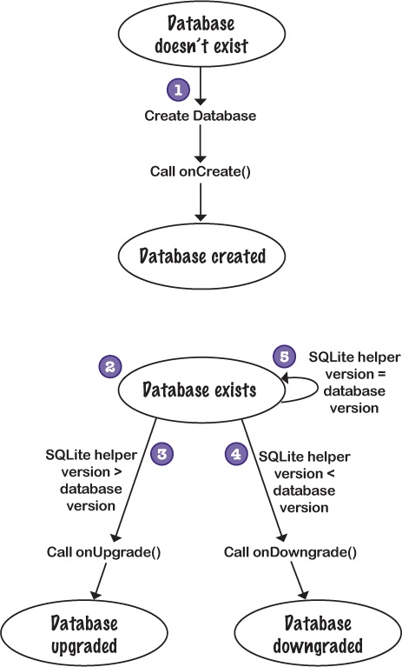

Slide 22
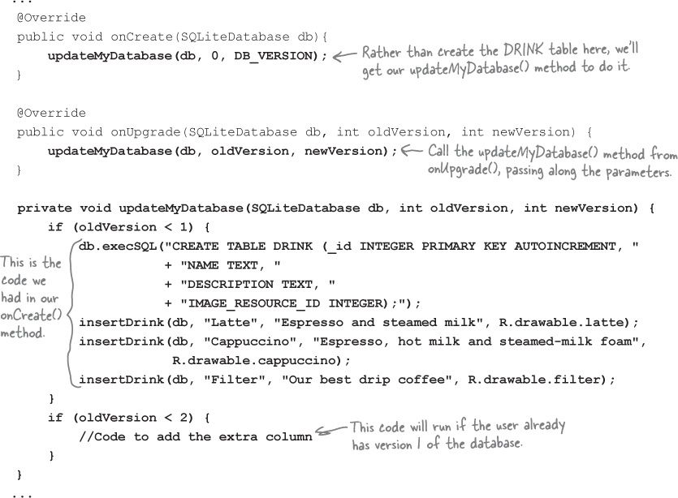

Slide 23
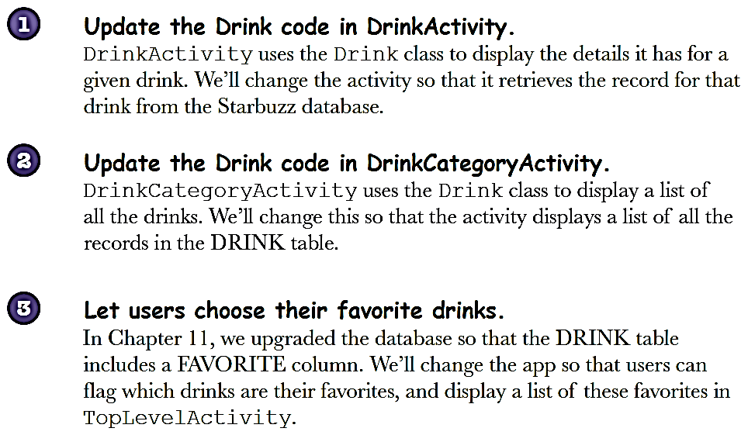
Change the app to use the database

Slide 24
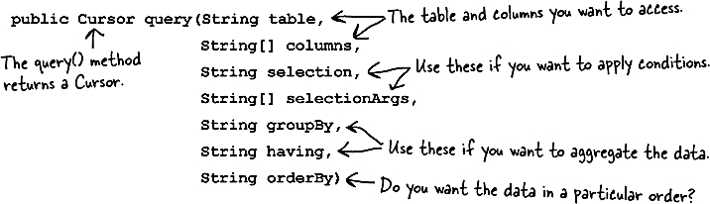
Get data from the database
You can build a query using the SQLiteDatabase query() method.
The query() method returns an object of type Cursor, which your activities can use to access the database.
Behind the scenes, Android uses the query() method to construct an SQL SELECT statement

Slide 25
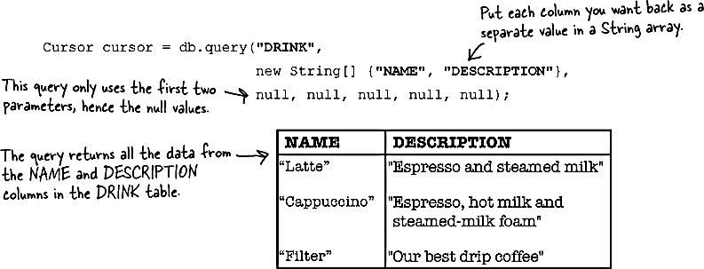
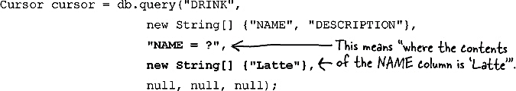
query() method examples

Slide 26
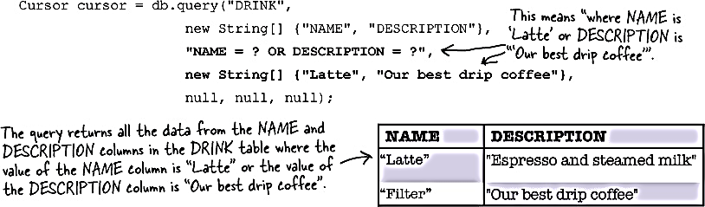
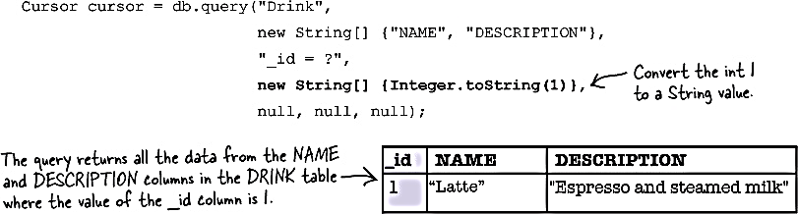
query() method examples

Slide 27
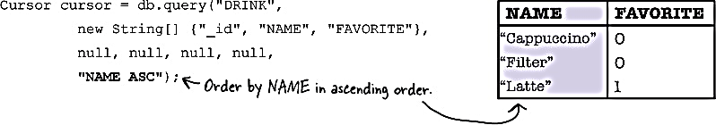
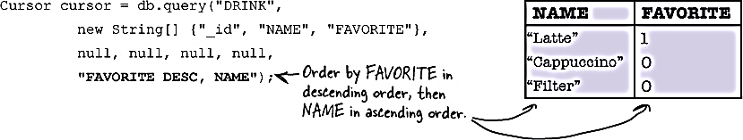
query() method examples

Slide 28
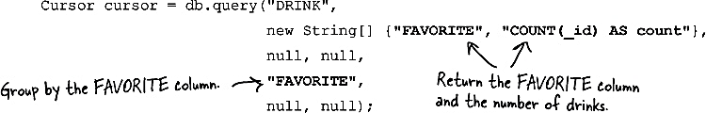
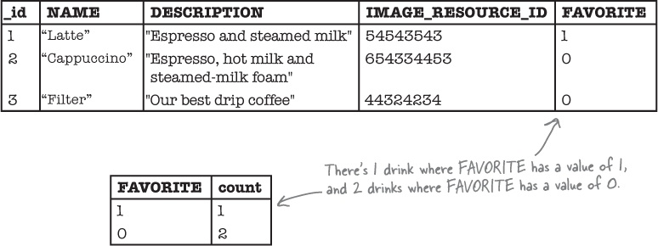
query() method examples

Slide 29
Get a reference to the database
The SQLiteOpenHelper class implements a couple of methods that can help us with this:
getReadableDatabase()
getWritableDatabase().
Each of these methods returns an object of type SQLiteDatabase, which gives us access to the database

Slide 30
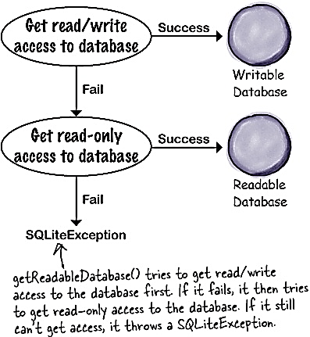
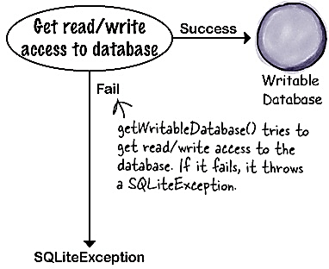
Get a reference to the database

Slide 31
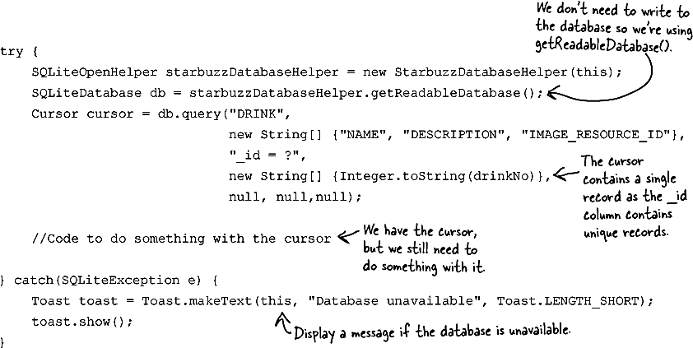
The code for getting a cursor

Slide 32
Navigating cursors
There are four main methods you use to navigate through the records in a cursor. These methods are:
moveToFirst()
moveToLast(),
moveToPrevious()
moveToNext().

Slide 33
Getting cursor values
You retrieve a value from the current record in a cursor using its get*() methods.
The exact method you use for this depends on the type of value you want to retrieve.
As an example, the getString() method returns the value of a column as a String, and the getInt() method returns the value of a column as an int.
Each of the methods takes a single parameter, the column index.

Slide 34
Close the cursor and database
You do this by calling the cursor and database close() methods:
cursor.close();
db.close();

Slide 35
The DrinkActivity code

Slide 36
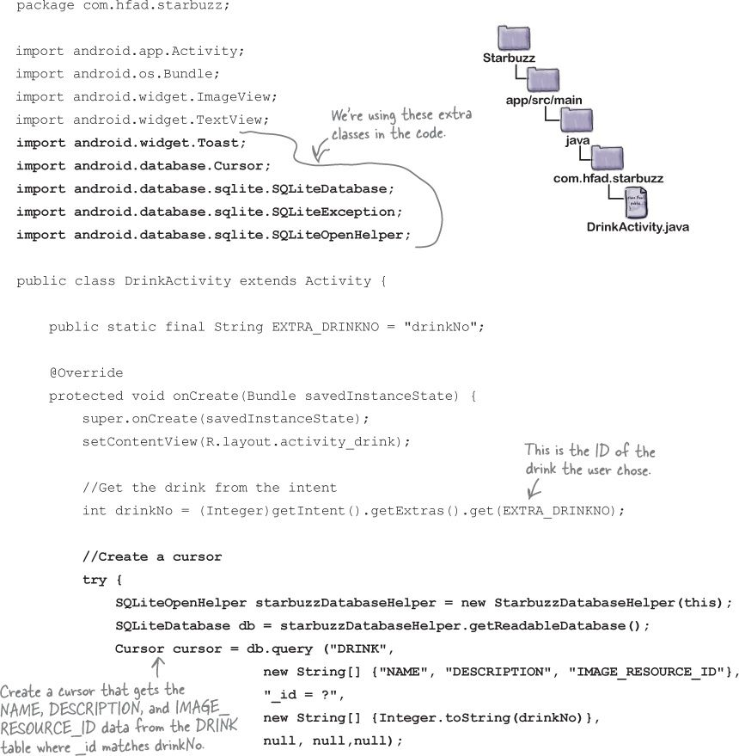

Slide 37
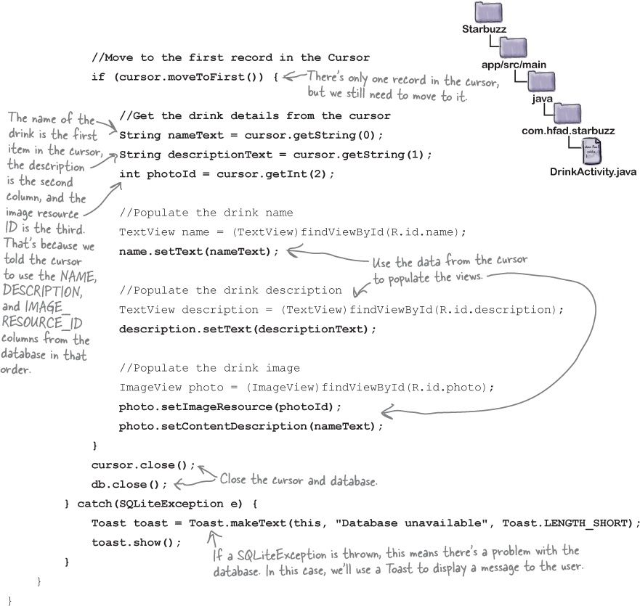

Slide 38
DrinkCategoryActivity

Slide 39
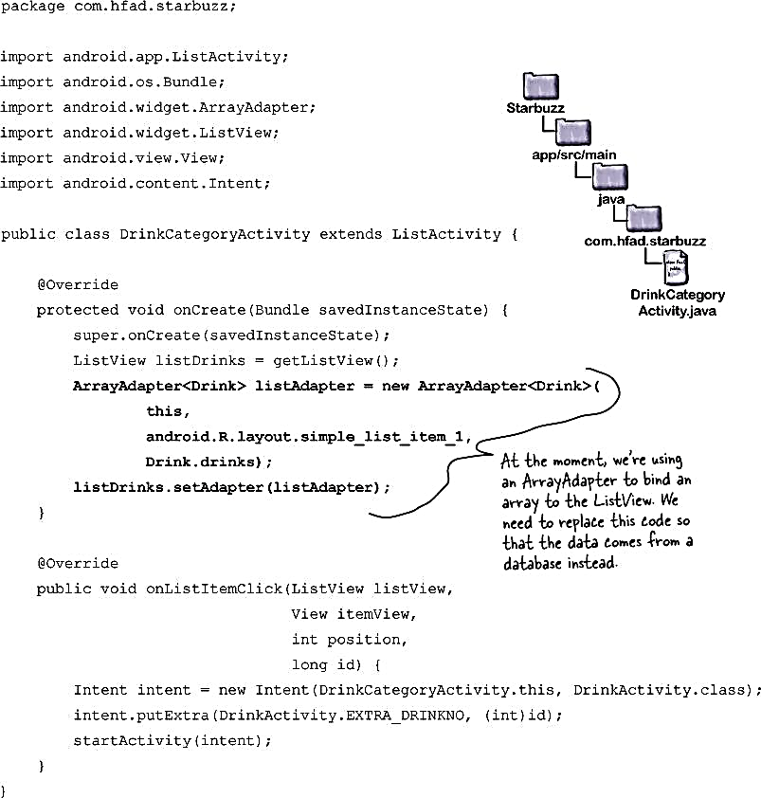

Slide 40
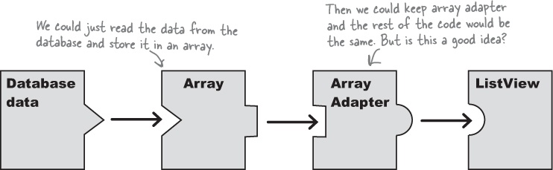
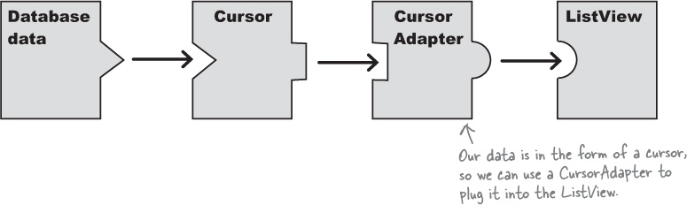
How do we replace the array data in the ListView?

Slide 41
The Cursor Adapter
A CursorAdapter reads just enough data
The ListView can only display a limited number of items at one time.
On a small device, it might only initially show, say, the first 11 coffees.
If we were using an array, we would have to read all 300 coffees from the database into the array before we could display any on the screen.
That’s not how it works with a CursorAdapter.

Slide 42
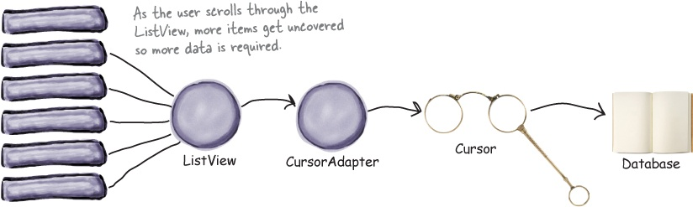

Slide 43
A SimpleCursorAdapter
We’re going to create a simple cursor adapter to use with our app.
A SimpleCursorAdapter is an implementation of CursorAdapter that can be used in most cases where you need to display cursor data in a list view.
It takes columns from a cursor, and maps them to TextViews or ImageViews.

Slide 44
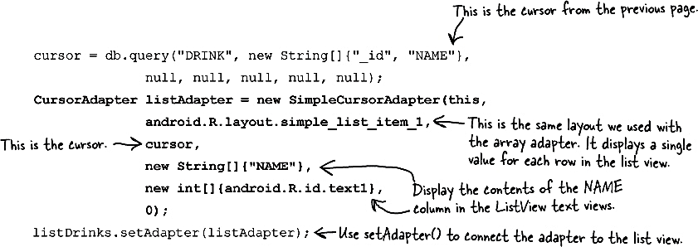
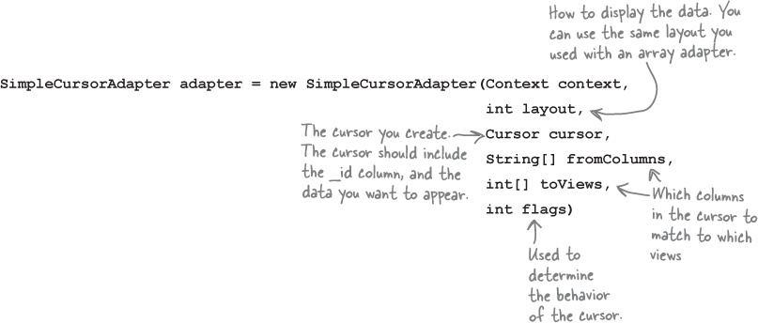

Slide 45
The revised code for DrinkCategoryActivity

Slide 46
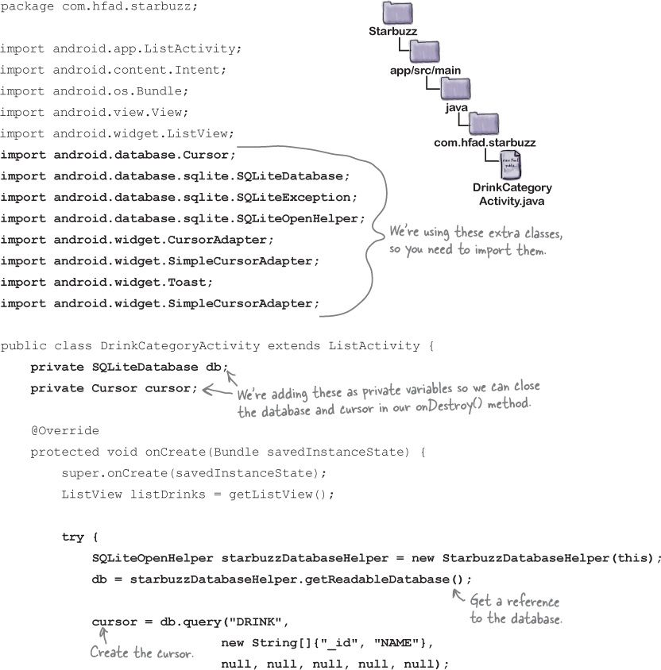

Slide 47
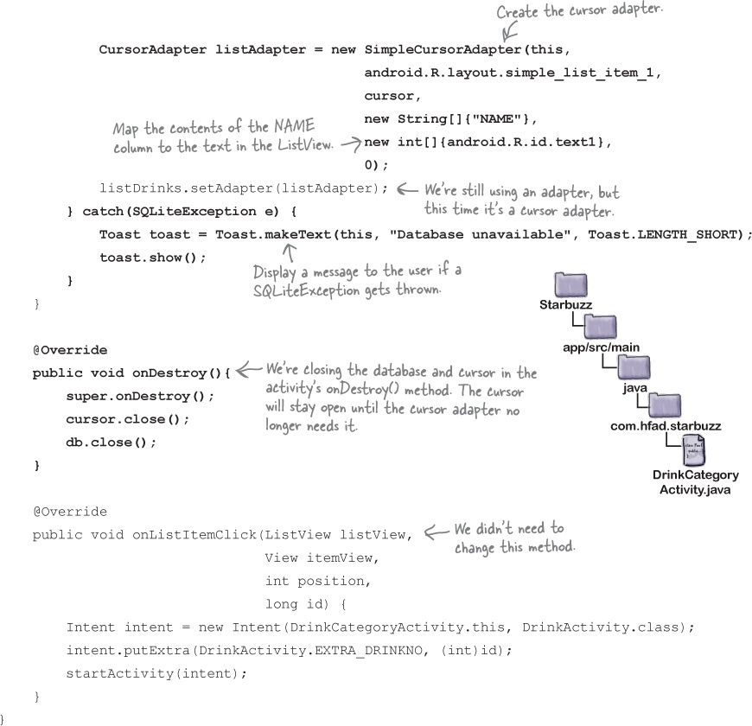

Slide 48
AsyncTask performs asynchronous tasks
The AsyncTask class lets you perform operations in the background.
When they’ve finished running, it then allows you to update views in the main event thread.
You create an AsyncTask by extending the AsyncTask class, and implementing its doInBackground() method.
The code in this method runs in a background thread, so it’s the perfect place for you to put database code.
The AsyncTask class also has an onPreExecute() method that runs before doInBackground(), and an onPostExecute() method that runs afterward.
There’s an onProgressUpdate() method if you need to publish task progress.

Slide 49
private class DownloadFilesTask extends AsyncTask<URL, Integer, Long> { protected Long doInBackground(URL... urls) { int count = urls.length; long totalSize = 0; for (int i = 0; i < count; i++) { totalSize += Downloader.downloadFile(urls[i]); publishProgress((int) ((i / (float) count) * 100)); // Escape early if cancel() is called if (isCancelled()) break; } return totalSize; } protected void onProgressUpdate(Integer... progress) { setProgressPercent(progress[0]); } protected void onPostExecute(Long result) { showDialog("Downloaded " + result + " bytes"); } }
new DownloadFilesTask().execute(url1, url2, url3);

Slide 51
Next Lecture
Chapter 10

