Slide 1
IT420: Selected Topics in IT Mobile Application Development
Lecture 18: started services

Slide 2
Lecturer Details
Dr. Walid Khedr
Email: khedrw@yahoo.com
Web: www.staff.zu.edu.eg/wkhedr
Department of Information Technology

Slide 3
Introduction
There are some operations you want to keep on running,
If you start downloading a file, you don’t want the download to stop when you switch to another app. I
You will learn how to started services
You’ll see how to create a started service using the IntentService class, and find out how its lifecycle fits in with that of an activity
You’ll discover how to log messages, and keep users informed using Android’s built-in notification service.

Slide 4
Services work in the background
A service is an application component like an activity but without a user interface.
They have a simpler lifecycle than activities.
They come with a bunch of features that make it easy to write code that will run in the background while the user is doing something else.

Slide 5
There are three types of service
Started services: can run in the background indefinitely, even when the activity that started it is destroyed
Bound services: is bound to another application component such as an activity. The activity can interact with it, send requests, and get results. A bound service runs as long as components are bound to it.
Scheduled service: is one that’s scheduled to run at a particular time.

Slide 6
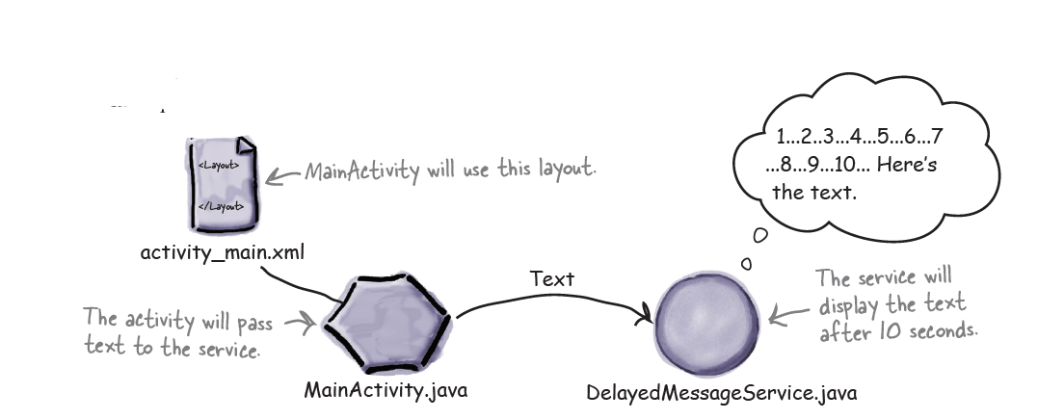
STARTED service
Display the message in Android’s log: We’ll start by displaying the message in Android’s log.
Display the message in a notification: We’ll get DelayedMessageService to use Android’s built-in notification service to display the message in a notification.

Slide 7
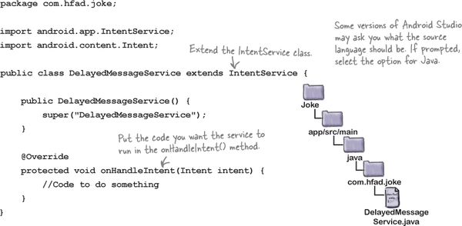
Use the IntentService class to create a basic started service

Slide 8
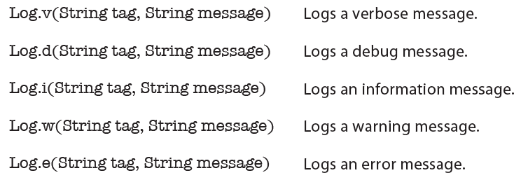
How to log messages
You log messages using one of the following methods in the Android.util.Log class:

Slide 9
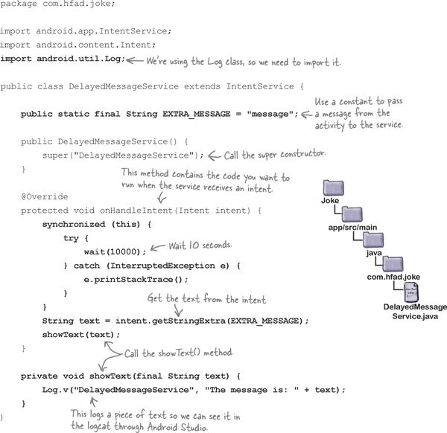
The full DelayedMessageService code

Slide 10
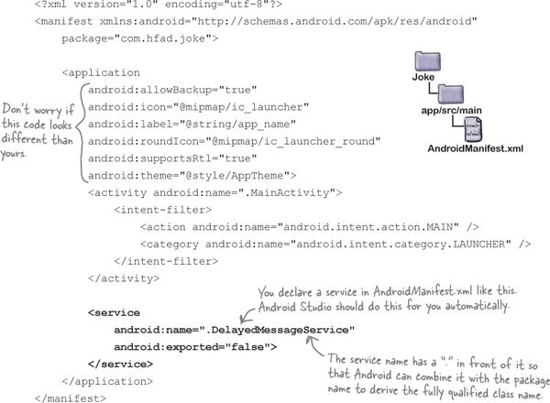
You declare services in AndroidManifest.xml

Slide 11
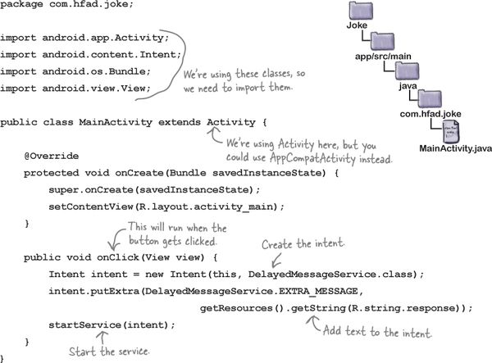
You start a service using startService()

Slide 12
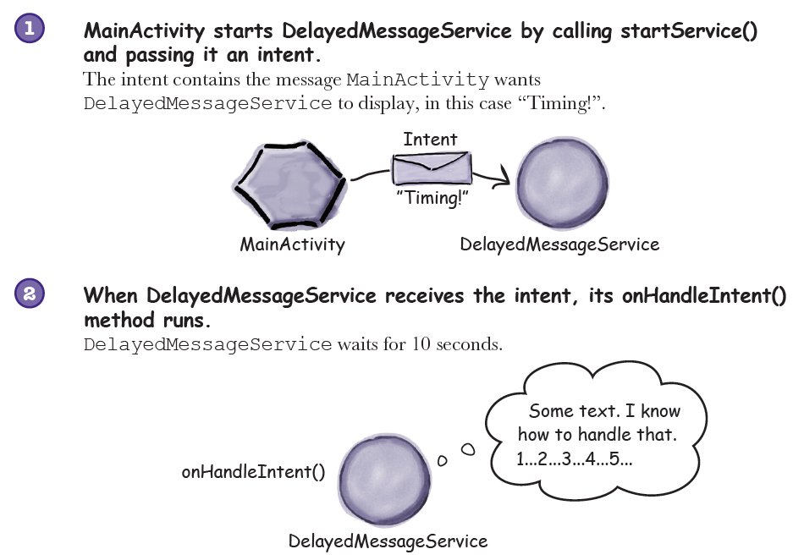
What happens when you run the app

Slide 13
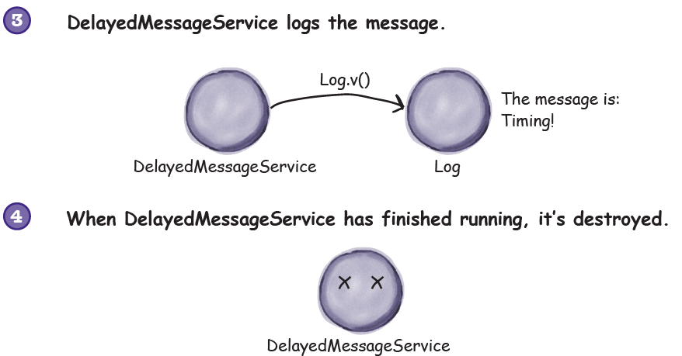
What happens when you run the app

Slide 14
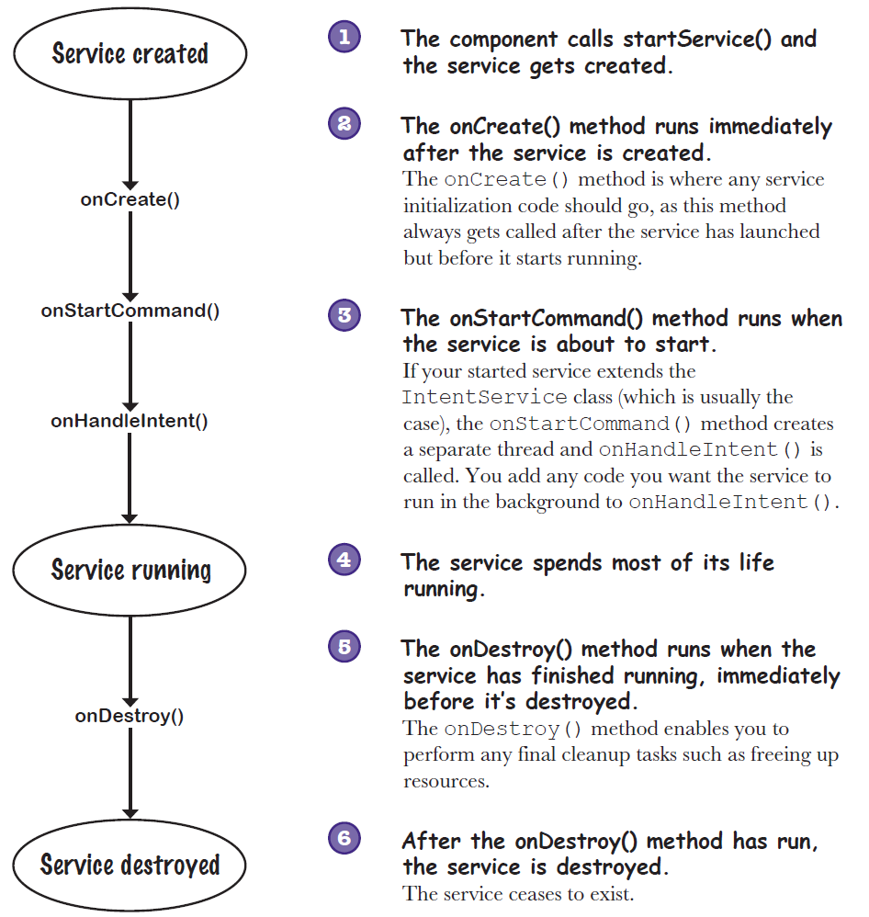
The states of a started service

Slide 15
Android has a built-in notification service
Unlike a toast or snackbar, notifications are available outside the app that issues them, so the user can access them no matter what app they’re currently using (if any).
They’re much more configurable than toasts and snackbars, too.
To display the notification, we’re going to use one of Android’s built-in services, the notification service.

Slide 16
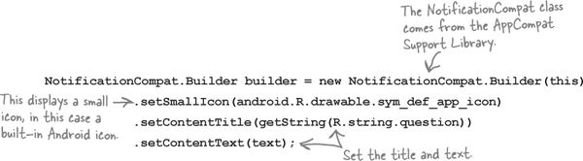
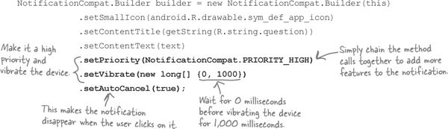
First create a notification builder

Slide 17
Add an action to tell the notification which activity to start when clicked
You add an action by creating a pending intent to start an activity, which you then add to the notification.
A pending intent is an intent that your app can pass to other applications.
The application can then submit the intent on your app’s behalf at a later time.

Slide 18

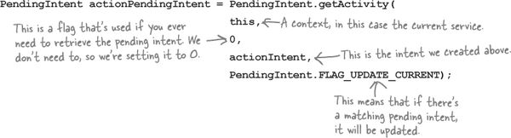
Add an action to tell the notification which activity to start when clicked
.

Slide 19

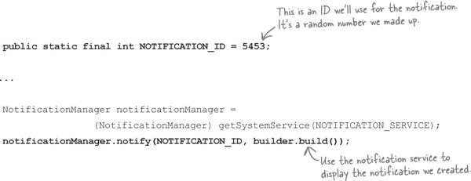
Issue the notification using the built-in notification service

Slide 20
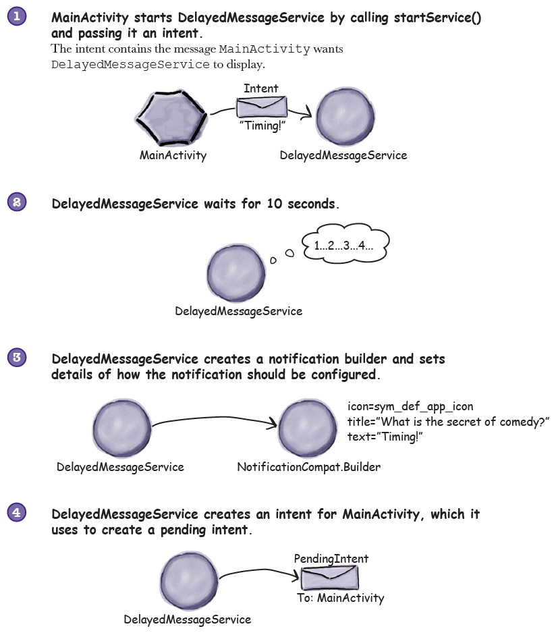
What happens when you run the code

Slide 21
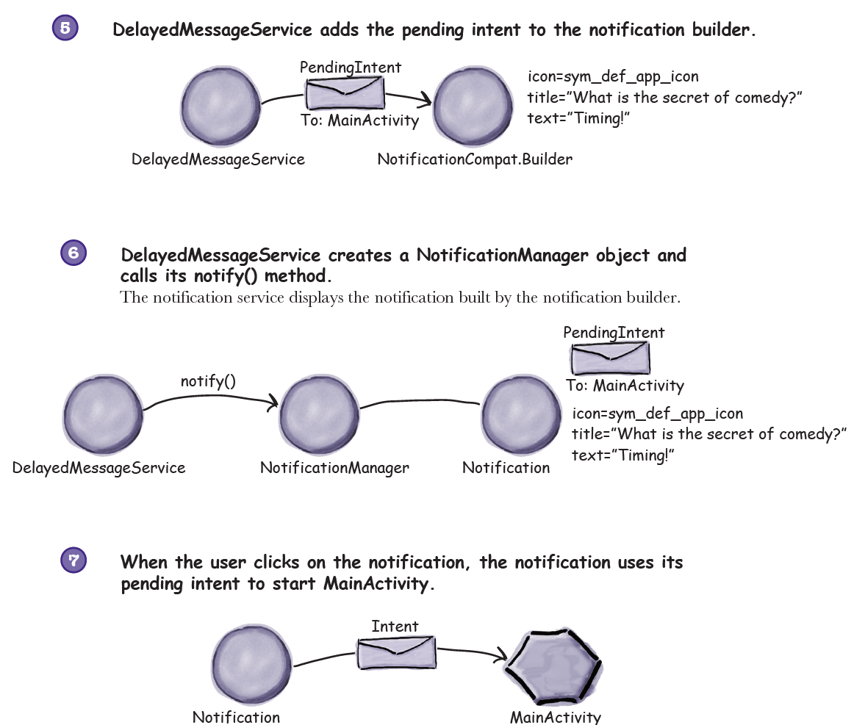
What happens when you run the code

Slide 22
protected void onHandleIntent(Intent intent) {
for (int i=0;i<3;i++) {
synchronized (this) {
try {
wait(5000);
} catch (InterruptedException e) {
e.printStackTrace();
}
}
String str = intent.getStringExtra("SERVICEMSG");
Log.v("SERVICEMSG",str);
Notification.Builder nb = new Notification.Builder(this);
nb = nb.setSmallIcon(android.R.drawable.sym_def_app_icon)
.setContentTitle("Service Notefication")
.setContentText(str);
Intent myintent = new Intent(this,MainActivity.class);
PendingIntent pintent = PendingIntent.getActivity(this,0,
myintent,PendingIntent.FLAG_UPDATE_CURRENT);
nb = nb.setContentIntent(pintent);
Notification notification = nb.build();
NotificationManager nf = (NotificationManager) getSystemService(NOTIFICATION_SERVICE);
nf.notify(123,notification);
Log.v("SERVICEMSG","Finish");
}
}

