Slide 1
IT420: Selected Topics in IT Mobile Application Development
XML Review

Slide 2
Lecturer Details
Dr. Walid Khedr
Email: khedrw@yahoo.com
Web: www.staff.zu.edu.eg/wkhedr
Department of Information Technology

Slide 3
What is XML?
XML stands for EXtensible Markup Language
XML is a markup language much like HTML
XML was designed to describe data, not to display data
XML tags are not predefined. You must define your own tags
XML is designed to be self-descriptive

Slide 4
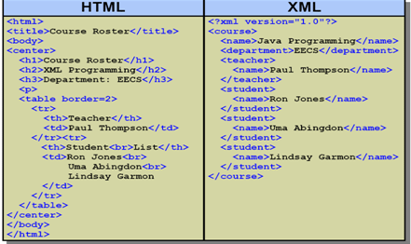
HTML Vs XML

Slide 5
The Difference Between XML and HTML
XML is not a replacement for HTML.
XML and HTML were designed with different goals:
XML was designed to describe data, with focus on what data is
HTML was designed to display data, with focus on how data looks

Slide 6
XML Does Not DO Anything
XML does not DO anything.
The following example is a note to Tove, from Jani, stored as XML:
<note> <to>Tove</to> <from>Jani</from> <heading>Reminder</heading> <body>Don't forget me this weekend!</body> </note>
But still, this XML document does not DO anything.
It is just information wrapped in tags.
Someone must write a piece of software to send, receive or display it.

Slide 7
XML Does Not DO Anything
The tags in the example above (like <to> and <from>) are not defined in any XML standard. These tags are "invented" by the author of the XML document.
That is because the XML language has no predefined tags.
The tags used in HTML are predefined. HTML documents can only use tags defined in the HTML standard (like <p>, <h1>, etc.).
XML allows the author to define his/her own tags and his/her own document structure.

Slide 8
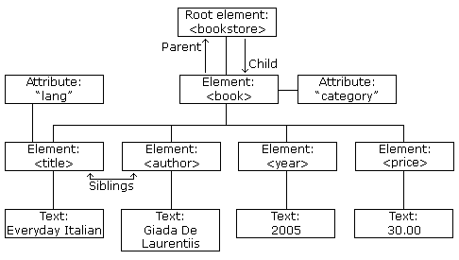
XML Tree
XML documents must contain a root element.
The elements in an XML document form a document tree.
The tree starts at the root and branches to the lowest level of the tree.

Slide 9
XML Tree
<bookstore> <book category="COOKING"> <title lang="en">Everyday Italian</title> <author>Giada De Laurentiis</author> <year>2005</year> <price>30.00</price> </book> <book category="CHILDREN"> <title lang="en">Harry Potter</title> <author>J K. Rowling</author> <year>2005</year> <price>29.99</price> </book> <book category="WEB"> <title lang="en">Learning XML</title> <author>Erik T. Ray</author> <year>2003</year> <price>39.95</price> </book> </bookstore>

Slide 10
XML Syntax Rules
All XML Elements Must Have a Closing Tag
XML Tags are Case Sensitive
XML Elements Must be Properly Nested
XML Documents Must Have a Root Element
XML Attribute Values Must be Quoted
Comments in XML, <!-- This is a comment -->
Entity References
<message>if salary < 1000 then</message> X
<message>if salary &lt; 1000 then</message> √

Slide 11
XML Syntax Rules
&lt; | < | less than
&gt; | > | greater than
&amp; | & | ampersand
&apos; | ' | apostrophe
&quot; | " | quotation mark

Slide 12
XML Elements
An XML element is everything from (including) the element's start tag to (including) the element's end tag.
An element can contain:
other elements
text
attributes
or a mix of all of the above...
<bookstore> <book category="CHILDREN"> <title>Harry Potter</title> <author>J K. Rowling</author> <year>2005</year> <price>29.99</price> </book> <book category="WEB"> <title>Learning XML</title> <author>Erik T. Ray</author> <year>2003</year> <price>39.95</price> </book> </bookstore>

Slide 13
XML Attributes
XML elements can have attributes, just like HTML.
Attributes are designed to contain data related to a specific element.
XML Attributes Must be Quoted
<person gender="female">
XML Elements vs. Attributes
<person gender="female"> <firstname>Anna</firstname> <lastname>Smith</lastname> </person>
<person> <gender>female</gender> <firstname>Anna</firstname> <lastname>Smith</lastname> </person>

Slide 14
XML Attributes for Metadata
<messages> <note id="501"> <to>Tove</to> <from>Jani</from> <heading>Reminder</heading> <body>Don't forget me this weekend!</body> </note> <note id="502"> <to>Jani</to> <from>Tove</from> <heading>Re: Reminder</heading> <body>I will not</body> </note> </messages>

Slide 15
XML Namespaces
Name Conflicts
<table> <tr> <td>Apples</td> <td>Bananas</td> </tr> </table>
<table> <name>African Coffee Table</name> <width>80</width> <length>120</length> </table>

Slide 16
XML Namespaces
Solving the Name Conflict Using a Prefix
<h:table> <h:tr> <h:td>Apples</h:td> <h:td>Bananas</h:td> </h:tr> </h:table>
<f:table> <f:name>African Coffee Table</f:name> <f:width>80</f:width> <f:length>120</f:length> </f:table>

Slide 17
XML Namespaces
When using prefixes in XML, a so-called namespace for the prefix must be defined.
The namespace is defined by the xmlns attribute in the start tag of an element.
The namespace declaration has the following syntax. xmlns:prefix="URI".
<root> <h:table xmlns:h="http://www.w3.org/TR/html4/"> <h:tr> <h:td>Apples</h:td> <h:td>Bananas</h:td> </h:tr> </h:table> <f:table xmlns:f="http://www.w3schools.com/furniture"> <f:name>African Coffee Table</f:name> <f:width>80</f:width> <f:length>120</f:length> </f:table> </root>

Slide 18
XML Namespaces
When using prefixes in XML, a so-called namespace for the prefix must be defined.
The namespace is defined by the xmlns attribute in the start tag of an element.
The namespace declaration has the following syntax. xmlns:prefix="URI".
<root xmlns:h="http://www.w3.org/TR/html4/" xmlns:f="http://www.w3schools.com/furniture"> <h:table> <h:tr> <h:td>Apples</h:td> <h:td>Bananas</h:td> </h:tr> </h:table> <f:table> <f:name>African Coffee Table</f:name> <f:width>80</f:width> <f:length>120</f:length> </f:table> </root>

Slide 19
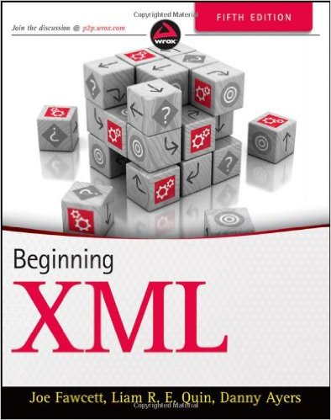
Reading
Beginning XML 5th Edition

