Slide 1
Topic 6:
MSI Components
FLB 20203 DIGITAL SYSTEMS
Combinational Circuits: MSI Components

Slide 2
Combinational Circuits: MSI Components
Adders/Substractors
Half/Full/Ripple Adders
Substractors
Using Adders as Substractors
Comparators
FLB 20203 DIGITAL SYSTEMS
Combinational Circuits: MSI Components

Slide 3
Combinational Circuits: MSI Components
Decoders
Implementing Functions with Decoders
Decoders with Enable
Larger Decoders
Standard MSI Decoders
Implementing Functions with Decoders (2)
Useful MSI circuits
Reducing Decoders
FLB 20203 DIGITAL SYSTEMS
Combinational Circuits: MSI Components

Slide 4
Combinational Circuits: MSI Components
Encoder
Demultiplexer
Multiplexer
Multiplexer IC Package
Larger Multiplexers
Standard MSI Multiplexer
Implementing Functions with Multiplexers
Implementing Functions with Smaller Multiplexers
FLB 20203 DIGITAL SYSTEMS
Combinational Circuits: MSI Components

Slide 5
Adders/Subtractors
Half Adder
Full Adder
Ripple Adder
Full Subtractor
Ripple Subtractor
Adder/Subtractor Circuit
FLB 20203 DIGITAL SYSTEMS
Combinational Circuits: MSI Components

Slide 6


Half Adder: adds two 1-bit operands
Truth table :
X Y HS=(X+Y) CO
0 0 0 0
0 1 1 0
1 0 1 0
1 1 0 1
X
H S
Y
CO
FLB 20203 DIGITAL SYSTEMS
Combinational Circuits: MSI Components

Slide 7
Full Adders: provide for carries between bit positions
Basic building block is “full adder”
  1-bit-wide adder, produces sum and carry outputs
Truth table:
X Y Cin S Cout
0 0 0 0 0
0 0 1 1 0
0 1 0 1 0
0 1 1 0 1
1 0 0 1 0
1 0 1 0 1
1 1 0 0 1
1 1 1 1 1
S is 1 if an odd number of inputs are 1.
COUT is 1 if two or more of the inputs are 1.
Recall: Table 2-3, pp32
FLB 20203 DIGITAL SYSTEMS
Combinational Circuits: MSI Components

Slide 8
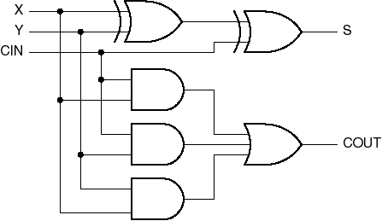
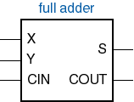
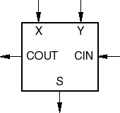
Full-adder circuit
FLB 20203 DIGITAL SYSTEMS
Combinational Circuits: MSI Components

Slide 9
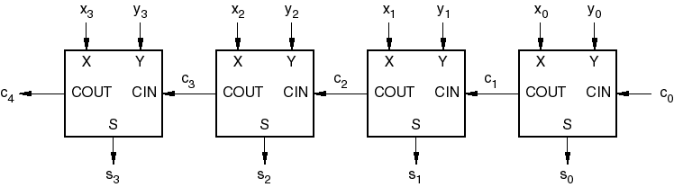
Ripple adder
Speed limited by carry chain
Faster adders eliminate or limit carry chain
  2-level AND-OR logic ==> 2^{n} product terms
  3 or 4 levels of logic, carry lookahead
FLB 20203 DIGITAL SYSTEMS
Combinational Circuits: MSI Components

Slide 10
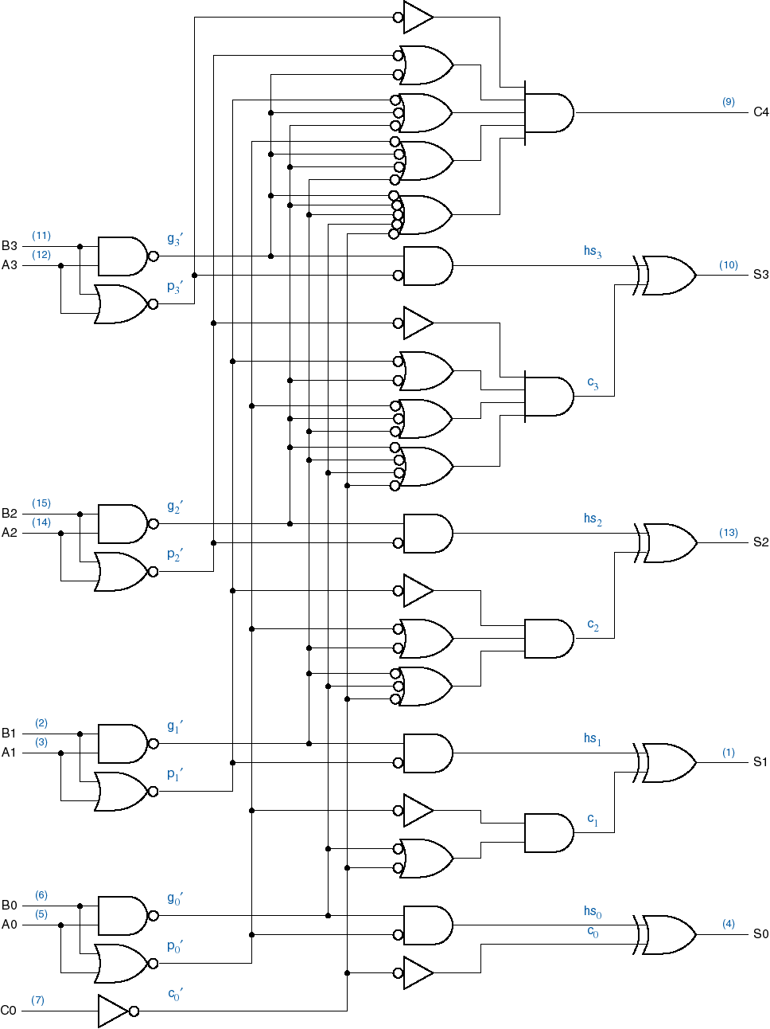
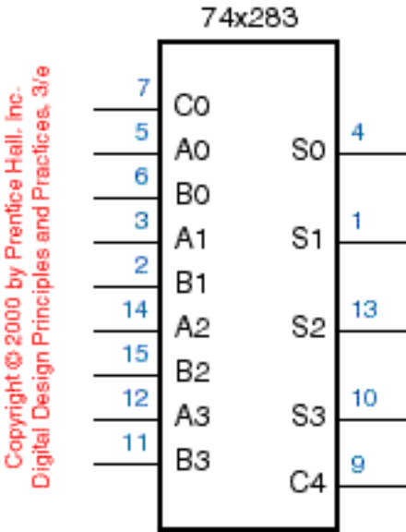
74x283
4-bit adder
Uses carry lookahead internally
FLB 20203 DIGITAL SYSTEMS
Combinational Circuits: MSI Components

Slide 11
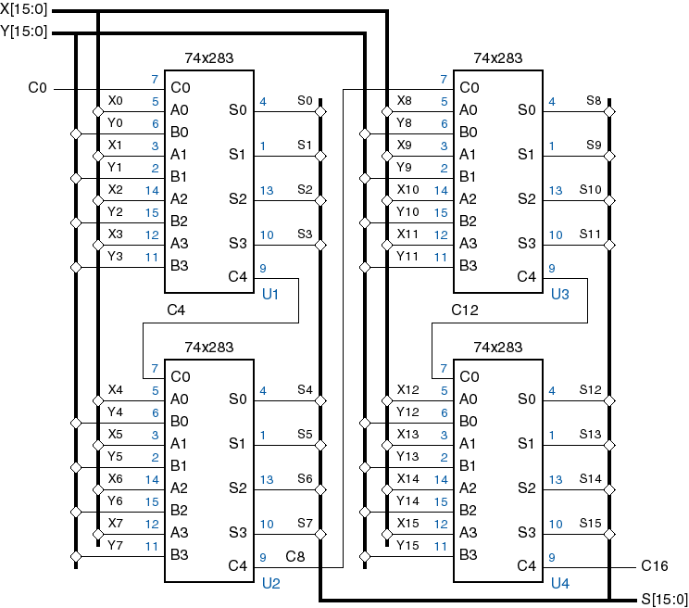
16-bit group-ripple adder
FLB 20203 DIGITAL SYSTEMS
Combinational Circuits: MSI Components

Slide 12
Subtraction
Subtraction is the same as addition of the two’s complement.
The two’s complement is the bit-by-bit complement plus 1.
Therefore, X – Y = X + Y’ + 1
FLB 20203 DIGITAL SYSTEMS
Combinational Circuits: MSI Components

Slide 13
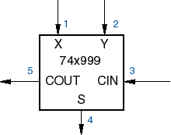
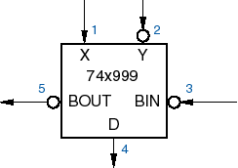
Full subtractor = full adder, almost
X,Y are n-bit unsigned binary numbers
Addition : S = X + Y
Subtraction : D = X - Y = X + (-Y) =
= X+ (Two’s Complement of Y)
= X+ (One’s Complement of Y) + 1
= X+ Y’+ 1
FLB 20203 DIGITAL SYSTEMS
Combinational Circuits: MSI Components

Slide 14

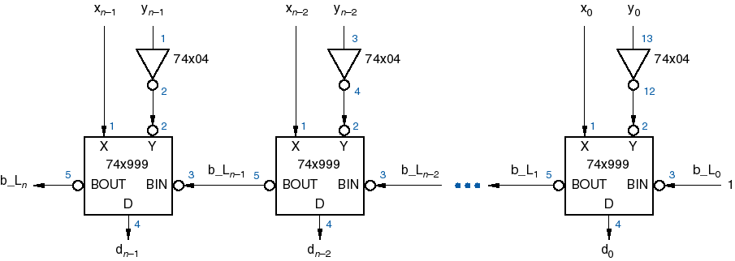
Using Adder as a Subtractor
Ripple Adder can be used as a subtractor by inverting Y and setting the initial carry ( CIN ) to 1
FLB 20203 DIGITAL SYSTEMS
Combinational Circuits: MSI Components

Slide 15
Comparators
Compares Two binary words and indicate if they are equal
Magnitude Comparators :
Comparator
A
OUTPUT
B
A
Comparator
A=B
A>B
B
A<B
FLB 20203 DIGITAL SYSTEMS
Combinational Circuits: MSI Components

Slide 16

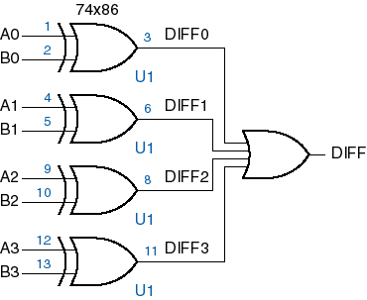
Equality Comparators
1-bit comparator
4-bit comparator
EQ_L
FLB 20203 DIGITAL SYSTEMS
Combinational Circuits: MSI Components

Slide 17
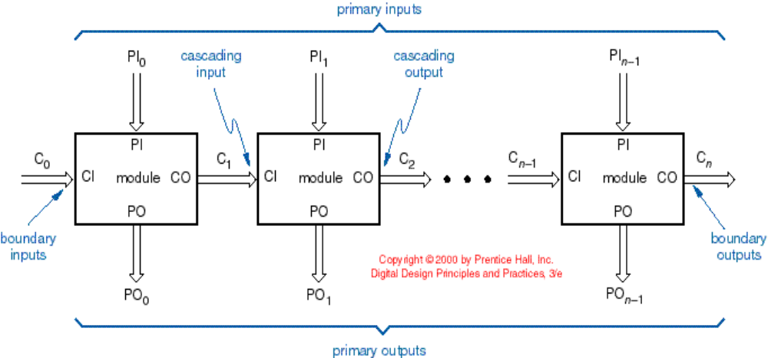
Iterative Comparator
FLB 20203 DIGITAL SYSTEMS
Combinational Circuits: MSI Components

Slide 18
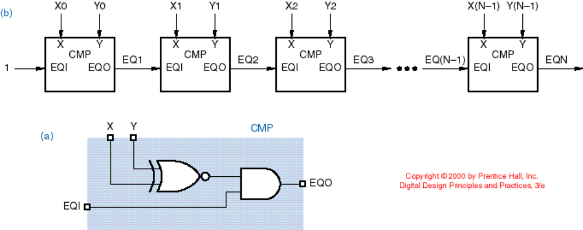
Multibit Iterative Comparator
FLB 20203 DIGITAL SYSTEMS
Combinational Circuits: MSI Components

Slide 19
MSI Comparator : 7485
74x85
A<BIN
A<BOUT
4 bit comparator
3 outputs : A=B, A<B, A>B
3 Cascading inputs
Functional Output equations :
(A>B OUT)= (A>B)+(A=B).(A>B IN)
(A<B OUT)= (A<B)+(A=B).(A<B IN)
(A=B OUT)= (A=B).(A=B IN)
Cascading inputs initial values :
(A=B IN) =1
(A>B IN) =0
(A<B IN) =0
A=BIN
A=B OUT
A>BIN
A>BOUT
A0
B0
A1
B1
A2
B2
A3
B3
FLB 20203 DIGITAL SYSTEMS
Combinational Circuits: MSI Components

Slide 20
8 bit Comparator
+5V
74x85
74x85
A<BIN
A<BOUT
A<BIN
A<BOUT
A<B
A=BIN
A=B OUT
A=BIN
A=B OUT
A=B
A>BIN
A>BOUT
A>BIN
A>BOUT
A>B
A0
A0
A4
A0
B0
B0
B4
B0
A1
A1
A5
A1
B1
B1
B5
B1
A2
A2
A6
A2
B2
B2
B6
B2
A3
A3
A7
A3
B3
B3
B7
B3
Least Significant bits
Most Significant bits
FLB 20203 DIGITAL SYSTEMS
Combinational Circuits: MSI Components

Slide 21
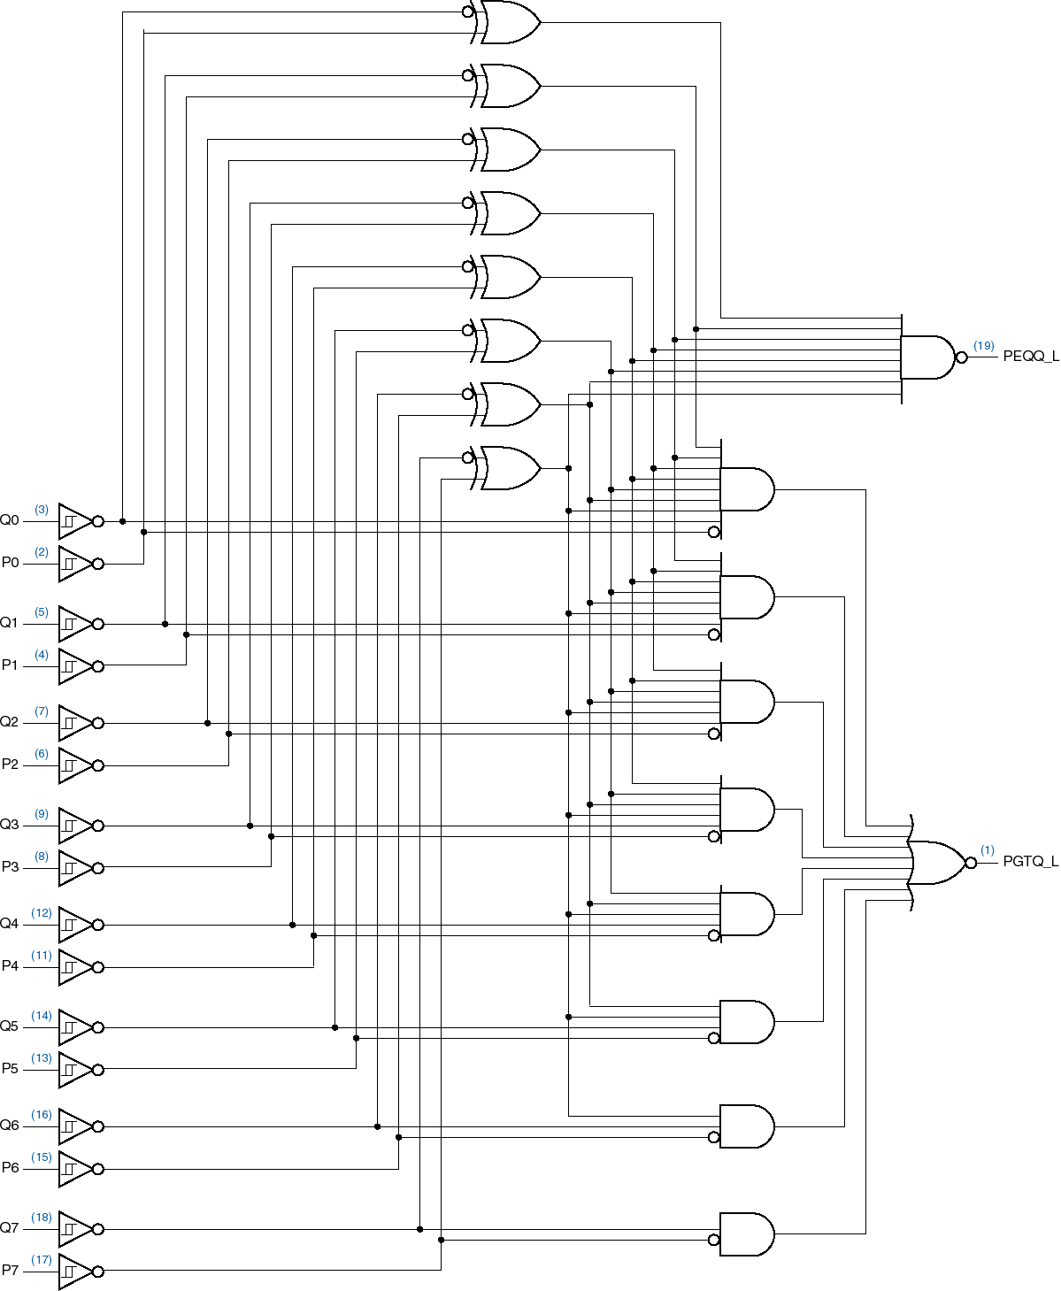
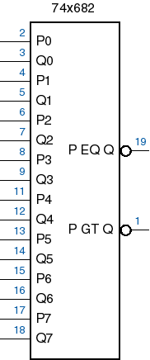
8-bit Magnitude Comparator
FLB 20203 DIGITAL SYSTEMS
Combinational Circuits: MSI Components

Slide 22
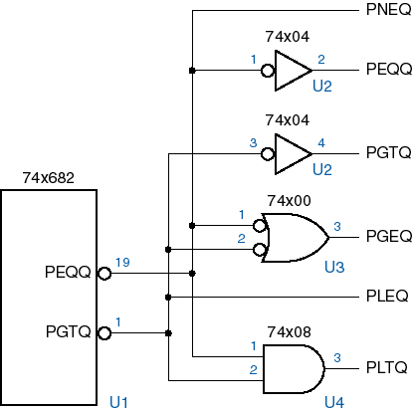
Other conditions
FLB 20203 DIGITAL SYSTEMS
Combinational Circuits: MSI Components

Slide 23
Useful MSI circuits
Four common and useful MSI circuits are:
  Decoder
  Demultiplexer
  Encoder
  Multiplexer
Block-level outlines of MSI circuits:
decoder
encoder
code
entity
entity
code
mux
data
data
demux
output
input
select
select
FLB 20203 DIGITAL SYSTEMS
Combinational Circuits: MSI Components

Slide 24
Decoders
Codes are frequently used to represent entities, e.g. your name is a code to denote yourself (an entity!).
These codes can be identified (or decoded) using a decoder. Given a code, identify the entity.
Convert binary information from n input lines to (max. of) 2^{n} output lines.
Known as n-to-m-line decoder, or simply n:m or n×m decoder (m ≤ 2^{n}).
May be used to generate 2^{n} (or fewer) minterms of n input variables.
FLB 20203 DIGITAL SYSTEMS
Combinational Circuits: MSI Components

Slide 25
Decoders
In general, for an n-bit code, a decoder could select up to 2^{n} lines:
n-bit
code
n to 2^{n}
decoder
up to 2^{n}
output lines
:
:
FLB 20203 DIGITAL SYSTEMS
Combinational Circuits: MSI Components

Slide 26
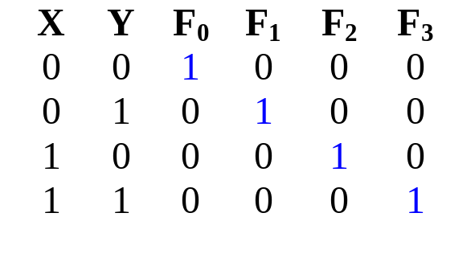
Decoders
Example: if codes 00, 01, 10, 11 are used to identify four light bulbs, we may use a 2-bit decoder:
2x4
Dec
F₀ F₁ F₂ F₃
Bulb 0
Bulb 1
Bulb 2
Bulb 3
2-bit code
X
Y
This is a 2×4 decoder which selects an output line based on the 2-bit code supplied.
Truth table:
FLB 20203 DIGITAL SYSTEMS
Combinational Circuits: MSI Components

Slide 27
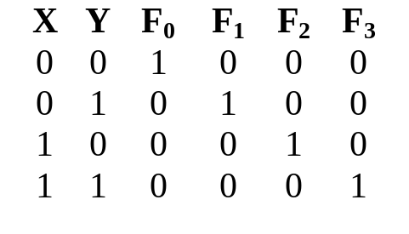
Decoders
From truth table, circuit for 2×4 decoder is:
Note: Each output is a 2-variable minterm (X'.Y', X'.Y, X.Y' or X.Y)
F₀ = X'.Y'
F₁ = X'.Y
F₂ = X.Y'
F₃ = X.Y
X
Y
FLB 20203 DIGITAL SYSTEMS
Combinational Circuits: MSI Components

Slide 28
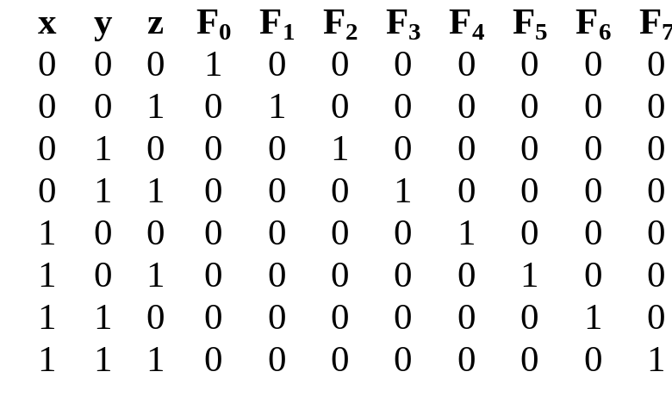
Decoders
Design a 3×8 decoder.
F₀ = x'.y'.z'
F₁ = x'.y'.z
F₂ = x'.y.z'
F₃ = x'.y.z
F₄ = x.y'.z'
F₅ = x.y'.z
Application? Binary-to-octal conversion.
F₆ = x.y.z'
F₇ = x.y.z
x
y
z
FLB 20203 DIGITAL SYSTEMS
Combinational Circuits: MSI Components

Slide 29
Decoders: Implementing Functions
A Boolean function, in sum-of-minterms form  decoder to generate the minterms, and an OR gate to form the sum.
Any combinational circuit with n inputs and m outputs can be implemented with an n:2^{n} decoder with m OR gates.
Good when circuit has many outputs, and each function is expressed with few minterms.
FLB 20203 DIGITAL SYSTEMS
Combinational Circuits: MSI Components

Slide 30
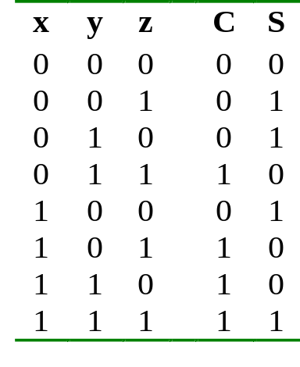
Decoders: Implementing Functions
Example: Full adder
  S(x, y, z) = Σ m(1,2,4,7)
  C(x, y, z) = Σ m(3,5,6,7)
3x8
Dec
0
1
2
3
4
5
6
7
S
x
S₂
S₁
S₀
y
z
C
FLB 20203 DIGITAL SYSTEMS
Combinational Circuits: MSI Components

Slide 31
Decoders: Implementing Functions
3x8
Dec
0
1
2
3
4
5
6
7
1
0
0
0
0
0
0
0
S
0
0
0
0
x
S₂
S₁
S₀
y
C
0
z
FLB 20203 DIGITAL SYSTEMS
Combinational Circuits: MSI Components

Slide 32
Decoders: Implementing Functions
3x8
Dec
0
1
2
3
4
5
6
7
0
1
0
0
0
0
0
0
S
1
0
0
1
x
S₂
S₁
S₀
y
C
0
z
FLB 20203 DIGITAL SYSTEMS
Combinational Circuits: MSI Components

Slide 33
Decoders: Implementing Functions
3x8
Dec
0
1
2
3
4
5
6
7
0
0
0
0
0
0
0
1
S
1
1
1
1
x
S₂
S₁
S₀
y
C
1
z
FLB 20203 DIGITAL SYSTEMS
Combinational Circuits: MSI Components

Slide 34
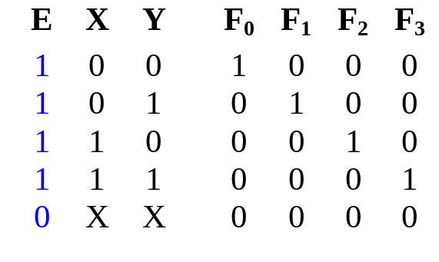
Decoders with Enable
Decoders often come with an enable signal, so that the device is only activated when the enable, E=1.
Truth table:
F₀ = EX'Y'
F₁ = EX'Y
F₂ = EXY'
F₃ = EXY
Circuit:
X
Y
E
FLB 20203 DIGITAL SYSTEMS
Combinational Circuits: MSI Components

Slide 35
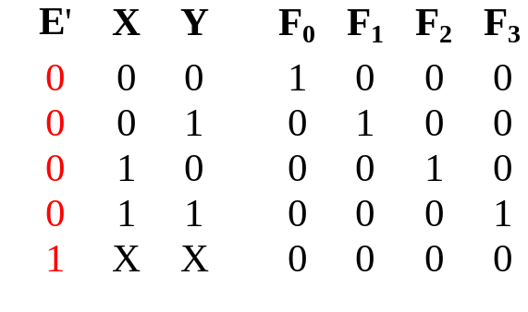
Decoders with Enable
In the previous slide, the decoder has a one-enable signal, that is, the decoder is enabled with E=1.
In most MSI decoders, enable signal is zero-enable, usually denoted by E’ (or E). The decoder is enabled when the signal is zero.
Decoder with 1-enable
Decoder with 0-enable
FLB 20203 DIGITAL SYSTEMS
Combinational Circuits: MSI Components

Slide 36
Larger Decoders
Larger decoders can be constructed from smaller ones.
For example, a 3-to-8 decoder can be constructed from two 2-to-4 decoders (with one-enable), as follows:
3x8
Dec
0
1
:
:
7
F₀ = w'x'y'
F₁ = w'x'y
:
:
F₇ = wxy
w
x
y
S₂
S₁
S₀
2x4
Dec
w
x
y
0
1
2
3
F₀ = w'x'y'
F₁ = w'x'y
F₂ = w'xy'
F₃ = w'xy
S₁
S₀
E
2x4
Dec
0
1
2
3
F₄ = wx'y'
F₅ = wx'y
F₆ = wxy'
F₇ = wxy
S₁
S₀
E
FLB 20203 DIGITAL SYSTEMS
Combinational Circuits: MSI Components

Slide 37
Larger Decoders
3x8
Dec
0
1
:
:
7
F₀ = w'x'y'
F₁ = w'x'y
:
:
F₇ = wxy
w
x
y
S₂
S₁
S₀
0
0
0
2x4
Dec
1
0
0
0
w
x
y
0
1
2
3
F₀ = w'x'y'
F₁ = w'x'y
F₂ = w'xy'
F₃ = w'xy
S₁
S₀
E
1 = enabled
2x4
Dec
0
0
0
0
0
1
2
3
F₄ = wx'y'
F₅ = wx'y
F₆ = wxy'
F₇ = wxy
S₁
S₀
E
0 = disabled
FLB 20203 DIGITAL SYSTEMS
Combinational Circuits: MSI Components

Slide 38
Larger Decoders
3x8
Dec
0
1
:
:
7
F₀ = w'x'y'
F₁ = w'x'y
:
:
F₇ = wxy
w
x
y
S₂
S₁
S₀
0
0
1
2x4
Dec
0
1
0
0
w
x
y
0
1
2
3
F₀ = w'x'y'
F₁ = w'x'y
F₂ = w'xy'
F₃ = w'xy
S₁
S₀
E
1 = enabled
2x4
Dec
0
0
0
0
0
1
2
3
F₄ = wx'y'
F₅ = wx'y
F₆ = wxy'
F₇ = wxy
S₁
S₀
E
0 = disabled
FLB 20203 DIGITAL SYSTEMS
Combinational Circuits: MSI Components

Slide 39
Larger Decoders
3x8
Dec
0
1
:
:
7
F₀ = w'x'y'
F₁ = w'x'y
:
:
F₇ = wxy
w
x
y
S₂
S₁
S₀
1
1
0
2x4
Dec
0
0
0
0
w
x
y
0
1
2
3
F₀ = w'x'y'
F₁ = w'x'y
F₂ = w'xy'
F₃ = w'xy
S₁
S₀
E
0 = disabled
2x4
Dec
0
0
1
0
0
1
2
3
F₄ = wx'y'
F₅ = wx'y
F₆ = wxy'
F₇ = wxy
S₁
S₀
E
1 = enabled
FLB 20203 DIGITAL SYSTEMS
Combinational Circuits: MSI Components

Slide 40
Larger Decoders
Construct a 4x16 decoder from two 3x8 decoders with 1-enable.
4x16
Dec
w
x
y
z
S₃
S₂
S₁
S₀
0
1
:
:
15
F₀
F₁
:
:
F₁₅
3x8
Dec
w
x
y
z
0
1
:
7
F₀
F₁
:
F₇
S₂
S₁
S₀
E
3x8
Dec
S₂
S₁
S₀
0
1
:
7
F₈
F₉
:
F₁₅
E
FLB 20203 DIGITAL SYSTEMS
Combinational Circuits: MSI Components

Slide 41
Larger Decoders
Note: The input, w and its complement, w', is used to select either one of the two smaller decoders.
Decoders may also have zero-enable and/or negated outputs. (Normal outputs = active high; negated outputs = active low.)
Exercise: What modifications must be made to provide an ENABLE input for the 3x8 decoder (2 slides ago) and the 4x16 decoder (previous slide) created?
Exercise: How to construct a 4x16 decoder using five 2x4 decoders with enable?
FLB 20203 DIGITAL SYSTEMS
Combinational Circuits: MSI Components

