Slide 1
Topic 6:
MSI Components
FLB 20203 DIGITAL SYSTEMS
Combinational Circuits: MSI Components

Slide 2
Combinational Circuits: MSI Components
Adders/Substractors
Half/Full/Ripple Adders
Substractors
Using Adders as Substractors
Comparators
FLB 20203 DIGITAL SYSTEMS
Combinational Circuits: MSI Components

Slide 3
Combinational Circuits: MSI Components
Decoders
Implementing Functions with Decoders
Decoders with Enable
Larger Decoders
Standard MSI Decoders
Implementing Functions with Decoders (2)
Useful MSI circuits
Reducing Decoders
FLB 20203 DIGITAL SYSTEMS
Combinational Circuits: MSI Components

Slide 4
Combinational Circuits: MSI Components
Encoder
Demultiplexer
Multiplexer
Multiplexer IC Package
Larger Multiplexers
Standard MSI Multiplexer
Implementing Functions with Multiplexers
Implementing Functions with Smaller Multiplexers
FLB 20203 DIGITAL SYSTEMS
Combinational Circuits: MSI Components

Slide 5
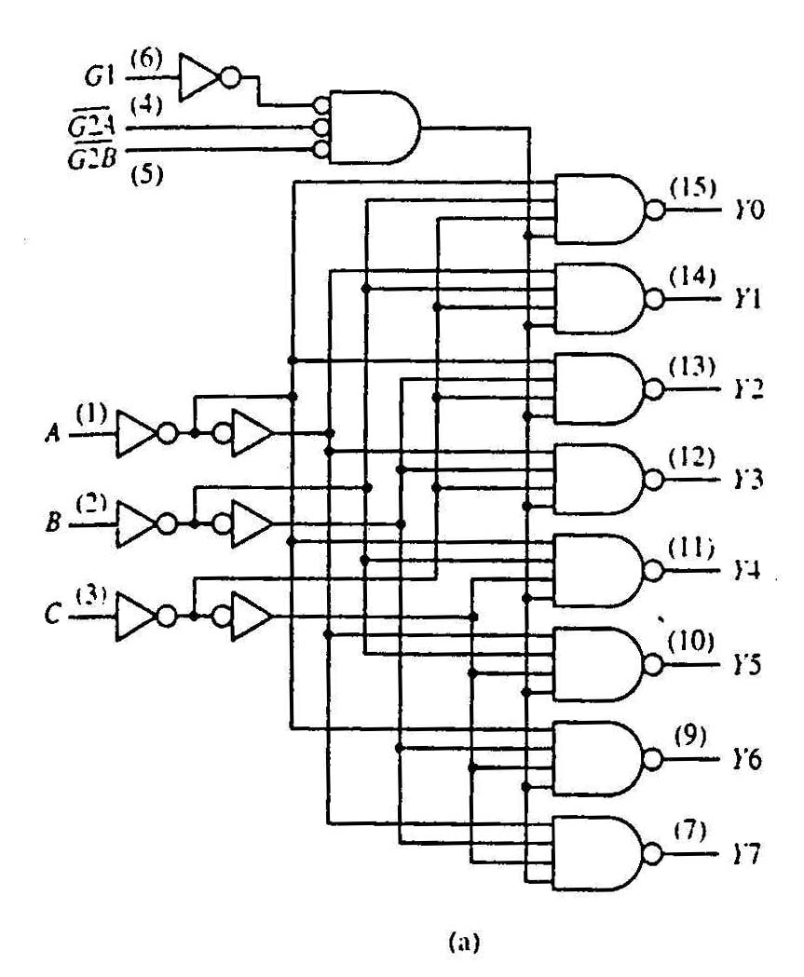
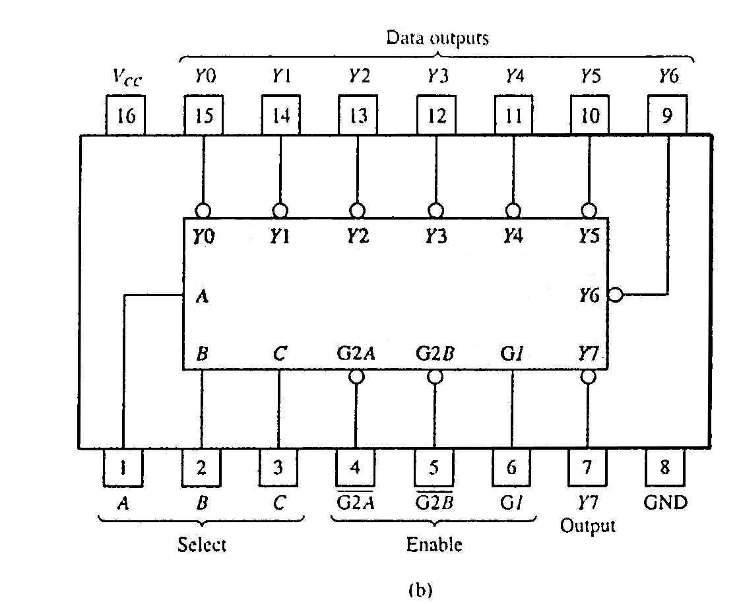
Standard MSI Decoders
74138 (3-to-8 decoder)
74138 decoder module.
(a) Logic circuit.
(b) Package pin configuration.
FLB 20203 DIGITAL SYSTEMS
Combinational Circuits: MSI Components

Slide 6
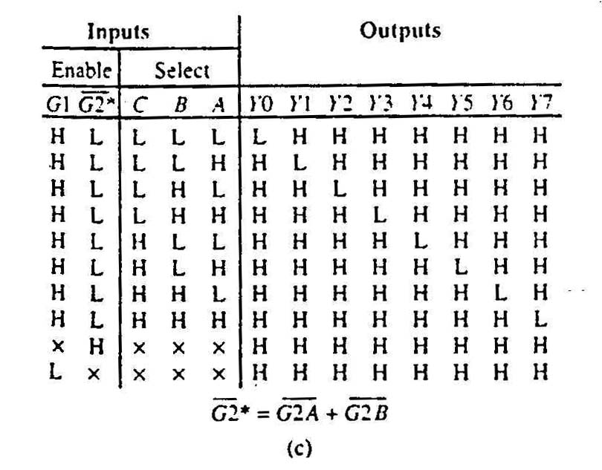
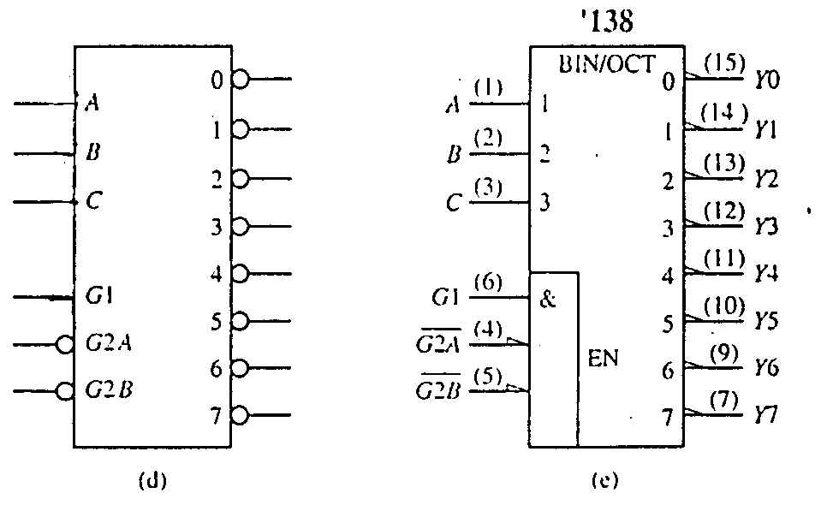
Standard MSI Decoders
74138 decoder module.
(c) Function table.
Negated outputs
74138 decoder module.
(d) Generic symbol.
(e) IEEE standard logic symbol.
Source:The Data Book Volume 2, Texas Instruments Inc.,1985
FLB 20203 DIGITAL SYSTEMS
Combinational Circuits: MSI Components

Slide 7
Decoders: Implementing Functions (2)
Example: Implement the following logic function using decoders and logic gates
f(Q,X,P) = ∑ m(0,1,4,6,7) = ∏ M(2,3,5)
We may implement the function in several ways:
  Use a decoder (with active-high outputs) with an OR gate:
  f(Q,X,P) = m₀ + m₁ + m₄ + m₆ + m₇
  Use a decoder (with active-low outputs) with a NAND gate:
  f(Q,X,P) = ( m₀' . m₁' . m₄' . m₆' . m₇' )'
  Use a decoder (with active-high outputs) with a NOR gate:
  f(Q,X,P) = ( m₂ + m₃ + m₅ )' [ = M₂.M₃.M₅]
  Use a decoder (with active-low outputs) with an AND gate:
  f(Q,X,P) = m₂' . m₃' . m₅'
FLB 20203 DIGITAL SYSTEMS
Combinational Circuits: MSI Components

Slide 8
Decoders: Implementing Functions (2)
f(Q,X,P)
= ∑ m(0,1,4,6,7)
0
1
2
3
4
5
6
7
0
1
2
3
4
5
6
7
3x8
Dec
3x8
Dec
Q
X
P
A
B
C
f(Q,X,P)
Q
X
P
A
B
C
f(Q,X,P)
(a) Active-high decoder with OR gate.
(b) Active-low decoder with NAND gate.
0
1
2
3
4
5
6
7
0
1
2
3
4
5
6
7
3x8
Dec
3x8
Dec
f(Q,X,P)
f(Q,X,P)
Q
X
P
A
B
C
Q
X
P
A
B
C
(c) Active-high decoder with NOR gate.
(d) Active-low decoder with AND gate.
FLB 20203 DIGITAL SYSTEMS
Combinational Circuits: MSI Components

Slide 9
Reducing Decoders
Example:
F(a,b,c) = ∑ m(4,6,7)
Using a 3×8 decoder (assuming 1-enable and active-high outputs).
3x8
Dec
0
1
2
3
4
5
6
7
a
S₂
S₁
S₀
b
F
c
EN
1
FLB 20203 DIGITAL SYSTEMS
Combinational Circuits: MSI Components

Slide 10
Reducing Decoders
We have seen that a decoder may be constructed from smaller decoders.
Below are just some ways of constructing a 3×8 decoder. (Explore other ways youself!)
  Using two 2×4 decoders with an inverter.
2x4
Dec
a
b
c
0
1
2
3
S₁
S₀
E
a'
2x4
Dec
0
1
2
3
S₁
S₀
E
a
FLB 20203 DIGITAL SYSTEMS
Combinational Circuits: MSI Components

Slide 11
Reducing Decoders
  Using two 2×4 decoders and a 1×2 decoder.
2x4
Dec
0
1
2
3
b
c
S₁
S₀
1x2
Dec
E
0
1
a'
a
S
E
2x4
Dec
0
1
2
3
1
S₁
S₀
E
a
Verify this circuit yourself!
FLB 20203 DIGITAL SYSTEMS
Combinational Circuits: MSI Components

Slide 12
Reducing Decoders
  Using four 1×2 decoders and a 2×4 decoder.
1x2
Dec
c
S
0
1
E
1x2
Dec
c
S
0
1
2x4
Dec
0
1
2
3
E
a
b
S₁
S₀
1x2
Dec
E
0
1
c
S
1
E
1x2
Dec
c
S
0
1
Verify this circuit yourself!
E
FLB 20203 DIGITAL SYSTEMS
Combinational Circuits: MSI Components

Slide 13
Reducing Decoders
Using smaller decoders, sometimes we may be able to save some decoders.
Example: F(a,b,c) = ∑ m(4,6,7)
2x4
Dec
0
1
2
3
Question: Do we really need this decoder for F?
b
c
S₁
S₀
1x2
Dec
E
0
1
a'
a
S
E
2x4
Dec
0
1
2
3
1
S₁
S₀
F
E
a
FLB 20203 DIGITAL SYSTEMS
Combinational Circuits: MSI Components

Slide 14
Reducing Decoders
So we can save a decoder.
1x2
Dec
2x4
Dec
a
S
0
1
0
1
2
3
b
c
S₁
S₀
F
E
1
E
Similarly, we can save 2 small decoders below.
1x2
Dec
2x4
Dec
c
S
0
1
0
1
2
3
a
b
S₁
S₀
E
F
E
1x2
Dec
c
S
0
1
1
E
FLB 20203 DIGITAL SYSTEMS
Combinational Circuits: MSI Components

Slide 15
Reducing Decoders
Second example: F(a,b,c) = ∑ m(0,1,2,3,6)
2x4
Dec
0
1
2
3
b
c
S₁
S₀
Question: Can we do something about this?
E
1x2
Dec
2x4
Dec
a
S
0
1
0
1
2
3
b
c
S₁
S₀
F
E
1
E
FLB 20203 DIGITAL SYSTEMS
Combinational Circuits: MSI Components

Slide 16
Reducing Decoders
Second example: F(a,b,c) = ∑ m(0,1,2,3,6)
Yes, we may remove the top 2×4 decoder, and connect the appropriate output from the 1×2 decoder directly to the OR gate.
1x2
Dec
2x4
Dec
a
S
0
1
0
1
2
3
b
c
S₁
S₀
E
F
1
E
Verify that this circuit is correct!
FLB 20203 DIGITAL SYSTEMS
Combinational Circuits: MSI Components

Slide 17
Reducing Decoders
Third example: F(a,b,c) = ∑ m(0,3,4,7)
We have the same pattern of outputs from the 2 decoders (i.e. we take the first and fourth outputs from each decoder). Can we do something about it?
2x4
Dec
0
1
2
3
b
c
S₁
S₀
E
1x2
Dec
2x4
Dec
a
S
0
1
0
1
2
3
F
b
c
S₁
S₀
E
1
E
FLB 20203 DIGITAL SYSTEMS
Combinational Circuits: MSI Components

Slide 18
Reducing Decoders
Third example: F(a,b,c) = ∑ m(0,3,4,7)
If we have the same pattern of outputs from 2 or more decoders at the second level, we may keep one decoder, and use an OR gate on the corresponding outputs from the first-level decoder.
Additional OR gate
1x2
Dec
2x4
Dec
a
S
0
1
0
1
2
3
F
b
c
S₁
S₀
E
1
E
Verify that this circuit is correct!
FLB 20203 DIGITAL SYSTEMS
Combinational Circuits: MSI Components

Slide 19
Reducing Decoders
Third example: F(a,b,c) = ∑ m(0,3,4,7)
Can we still simplify the circuit?
This may be eliminated. (why?)
1x2
Dec
2x4
Dec
a
S
0
1
0
1
2
3
F
b
c
S₁
S₀
E
1
E
Because this is (a' + a) = 1
2x4
Dec
0
1
2
3
F
b
c
S₁
S₀
E
1
FLB 20203 DIGITAL SYSTEMS
Combinational Circuits: MSI Components

Slide 20
Reducing Decoders
Summary:
  If no outputs are needed from a 2nd-level decoder, just remove the decoder.
  If all outputs are needed from a 2nd-level decoder, remove the decoder, and connect the corresponding output from the 1st-level decoder to the OR gate.
  If the set of outputs is the same for 2 or more decoders at the 2nd level, keep one of the decoders and remove the rest. Add an OR gate to take in the appropriate outputs from the 1st-level decoder.
The above procedure may not guarantee a circuit that has the least number of decoders. However, it is easy to follow. (To obtain the optimal circuit in general, we need to play around with the inputs to the decoders, which may be hard.)
FLB 20203 DIGITAL SYSTEMS
Combinational Circuits: MSI Components

Slide 21
Reducing Decoders
Apply what you learned to verify the circuit below for this function: F(a,b,c,d) = ∑ m(0,1,2,3,4,5,12,13)
2x4
Dec
0
1
2
3
a
b
S₁
S₀
2x4
Dec
0
1
2
3
F
E
c
d
S₁
S₀
1
E
FLB 20203 DIGITAL SYSTEMS
Combinational Circuits: MSI Components

