Slide 1
Topic 6:
MSI Components
FLB 20203 DIGITAL SYSTEMS
Combinational Circuits: MSI Components

Slide 2
Combinational Circuits: MSI Components
Encoder
Demultiplexer
Multiplexer
Multiplexer IC Package
Larger Multiplexers
Standard MSI Multiplexer
Implementing Functions with Multiplexers
Implementing Functions with Smaller Multiplexers
FLB 20203 DIGITAL SYSTEMS
Combinational Circuits: MSI Components

Slide 3
Encoder
Encoding is the converse of decoding.
Given a set of input lines, where one has been selected, provide a code corresponding to that line.
Contains 2^{n} (or fewer) input lines and n output lines.
Implemented with OR gates.
An example:
F₀
D₀
Select via switches
F₁
4-to-2 Encoder
F₂
2-bits code
F₃
D₁
FLB 20203 DIGITAL SYSTEMS
Combinational Circuits: MSI Components

Slide 4
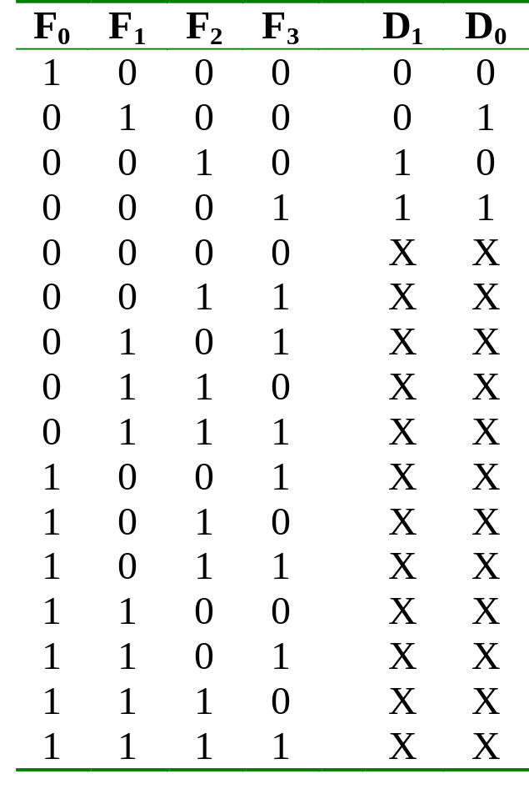
Encoder
Truth table:
FLB 20203 DIGITAL SYSTEMS
Combinational Circuits: MSI Components

Slide 5
Encoder
With the help of K-map (and don’t care conditions), can obtain:
D₀ = F1 + F3
D₁ = F2 + F3
which correspond to circuit:
F₀
F₁
D₀
Simple 4-to-2 encoder
F₂
F₃
D₁
FLB 20203 DIGITAL SYSTEMS
Combinational Circuits: MSI Components

Slide 6
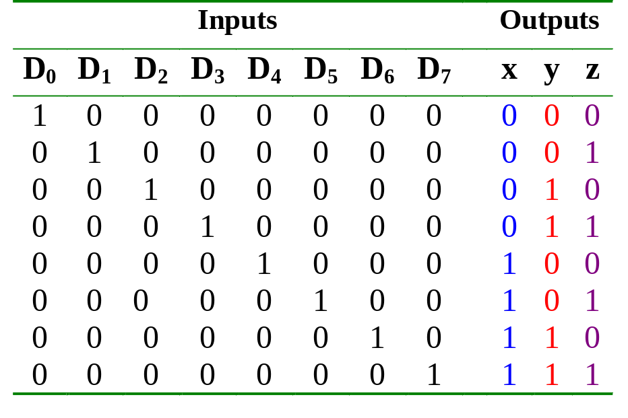
Encoder
Example: Octal-to-binary encoder.
  At any one time, only one input line has a value of 1.
  Otherwise, need priority encoder (not covered).
FLB 20203 DIGITAL SYSTEMS
Combinational Circuits: MSI Components

Slide 7
Encoder
Example: Octal-to-binary encoder.
D₀
D₁
D₂
D₃
D₄
D₅
D₆
D₇
x = D₄ + D₅ + D₆ + D₇
y = D₂ + D₃ + D₆ + D₇
z = D₁ + D₃ + D₅ + D₇
8-to-3 encoder
Exercise: Can you design a 2^{n}-to-n encoder without the K-map?
FLB 20203 DIGITAL SYSTEMS
Combinational Circuits: MSI Components

Slide 8
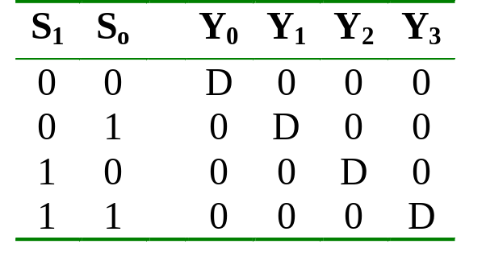
Demultiplexer
Given an input line and a set of selection lines, the demultiplexer will direct data from input to a selected output line.
An example of a 1-to-4 demultiplexer:
Outputs
Y₀ = D.S₁'.S₀'
Y₁ = D.S₁'.S₀
Data D
demux
Y₂ = D.S₁.S₀'
Y₃ = D.S₁.S₀
S₁ S₀
select
FLB 20203 DIGITAL SYSTEMS
Combinational Circuits: MSI Components

Slide 9
Demultiplexer
The demultiplexer is actually identical to a decoder with enable, as illustrated below:
Y₀ = D.S₁'.S₀'
2x4 Decoder
S₁
S₀
Y₁ = D.S₁'.S₀
Y₂ = D.S₁.S₀'
E
Y₃ = D.S₁.S₀
D
Exercise: Provide the truth table for above demultiplexer.
FLB 20203 DIGITAL SYSTEMS
Combinational Circuits: MSI Components

Slide 10
Multiplexer
A multiplexer is a device which has
(i) a number of input lines
(ii) a number of selection lines
(iii) one output line
It steers one of 2^{n} inputs to a single output line, using n selection lines. Also known as a data selector.
2^{n}:1
Multiplexer
inputs
output
:
...
select
FLB 20203 DIGITAL SYSTEMS
Combinational Circuits: MSI Components

Slide 11
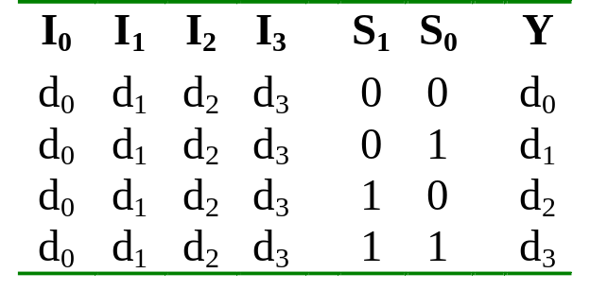
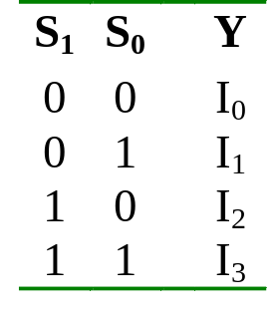
Multiplexer
Truth table for a 4-to-1 multiplexer:
Inputs
Inputs
I₀
0
1
2
3
I₀
I₁
4:1
MUX
I₁
I₂
Y
Output
I₂
mux
Y
I₃
I₃
S₁ S₀
S₁ S₀
select
select
FLB 20203 DIGITAL SYSTEMS
Combinational Circuits: MSI Components

Slide 12
Multiplexer
Output of multiplexer is
“sum of the (product of data lines and selection lines)”
Example: the output of a 4-to-1 multiplexer is:
Y = I₀.(S₁’.S₀') + I₁.(S₁’.S₀) + I₂.(S₁.S₀') + I₃.(S₁.S₀)
A 2^{n}-to-1-line multiplexer, or simply 2^{n}:1 MUX, is made from an n: 2^{n} decoder by adding to it 2^{n} input lines, one to each AND gate.
FLB 20203 DIGITAL SYSTEMS
Combinational Circuits: MSI Components

Slide 13
Multiplexer
I₀
I₀
I₁
I₁
Y
Y
I₂
I₂
I₃
I₃
0 1 2 3
2-to-4 Decoder
S₁
S₀
S₁
S₀
Four-to-one multiplexer design.
FLB 20203 DIGITAL SYSTEMS
Combinational Circuits: MSI Components

Slide 14
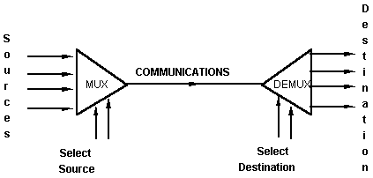
Multiplexer
An application:
Helps share a single communication line among a number of devices.
At any time, only one source and one destination can use the communication line.
FLB 20203 DIGITAL SYSTEMS
Combinational Circuits: MSI Components

Slide 15
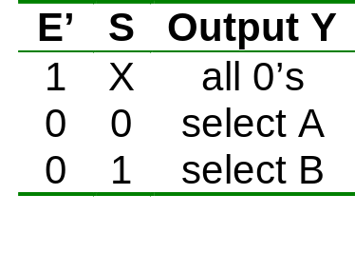
Multiplexer IC Package
Some IC packages have a few multiplexers in each package. The selection and enable inputs are common to all multiplexers within the package.
A₀
A₁
A₂
A₃
Y₀
Y₁
Y₂
Y₃
B₀
B₁
B₂
B₃
S
(select)
E'
(enable)
Quadruple 2:1 multiplexer
FLB 20203 DIGITAL SYSTEMS
Combinational Circuits: MSI Components

Slide 16
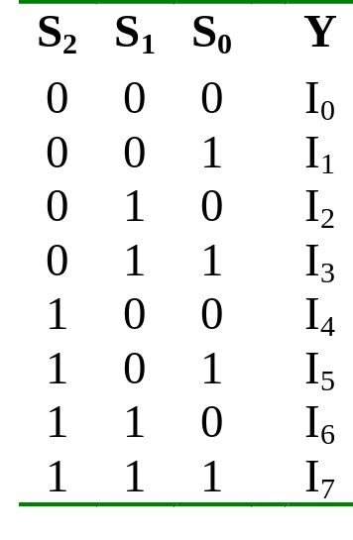
Larger Multiplexers
Larger multiplexers can be constructed from smaller ones.
An 8-to-1 multiplexer can be constructed from smaller multiplexers like this (note placement of selector lines):
I₀
I₁
I₂
I₃
4:1 MUX
2:1 MUX
S₁ S₀
Y
I₄
I₅
I₆
I₇
4:1 MUX
S₂
S₁ S₀
FLB 20203 DIGITAL SYSTEMS
Combinational Circuits: MSI Components

Slide 17
Larger Multiplexers
When
S₂S₁S₀ = 000
I₀
I₁
I₂
I₃
4:1 MUX
I₀
I₀
2:1 MUX
S₁ S₀
Y
I₄
I₅
I₆
I₇
4:1 MUX
I₄
S₂
S₁ S₀
FLB 20203 DIGITAL SYSTEMS
Combinational Circuits: MSI Components

Slide 18
Larger Multiplexers
When
S₂S₁S₀ = 001
I₀
I₁
I₂
I₃
4:1 MUX
I₁
I₁
2:1 MUX
S₁ S₀
Y
I₄
I₅
I₆
I₇
4:1 MUX
I₅
S₂
S₁ S₀
FLB 20203 DIGITAL SYSTEMS
Combinational Circuits: MSI Components

Slide 19
Larger Multiplexers
When
S₂S₁S₀ = 110
I₀
I₁
I₂
I₃
4:1 MUX
I₂
I₆
2:1 MUX
S₁ S₀
Y
I₄
I₅
I₆
I₇
4:1 MUX
I₆
S₂
S₁ S₀
FLB 20203 DIGITAL SYSTEMS
Combinational Circuits: MSI Components

Slide 20
Larger Multiplexers
Another implementation of an 8-to-1 multiplexer using smaller multiplexers:
When
S₂S₁S₀ = 000
I₀
I₁
2:1 MUX
I₀
I₂
I₃
2:1 MUX
I₂
S₀
4:1 MUX
I₀
S₀
Y
I₄
I₅
2:1 MUX
I₄
S₂ S₁
S₀
I₆
I₇
2:1 MUX
I₆
Q: Can we use only 2:1 multiplexers?
S₀
FLB 20203 DIGITAL SYSTEMS
Combinational Circuits: MSI Components

Slide 21
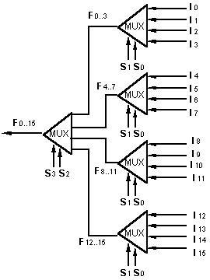
Larger Multiplexers
A 16-to-1 multiplexer can be constructed from five 4-to-1 multiplexers:
FLB 20203 DIGITAL SYSTEMS
Combinational Circuits: MSI Components

Slide 22
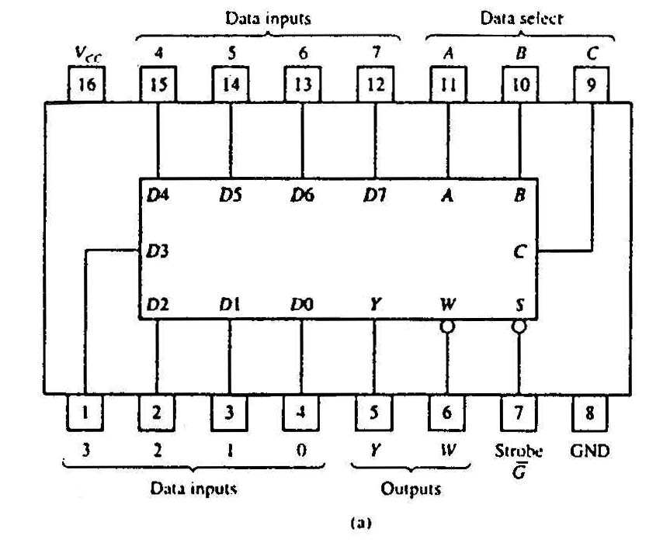
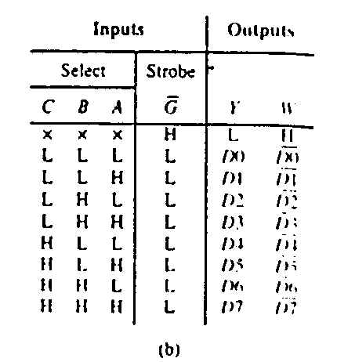
Standard MSI Multiplexer
74151A 8-to-1 multiplexer. (a) Package configuration. (b) Function table.
FLB 20203 DIGITAL SYSTEMS
Combinational Circuits: MSI Components

Slide 23
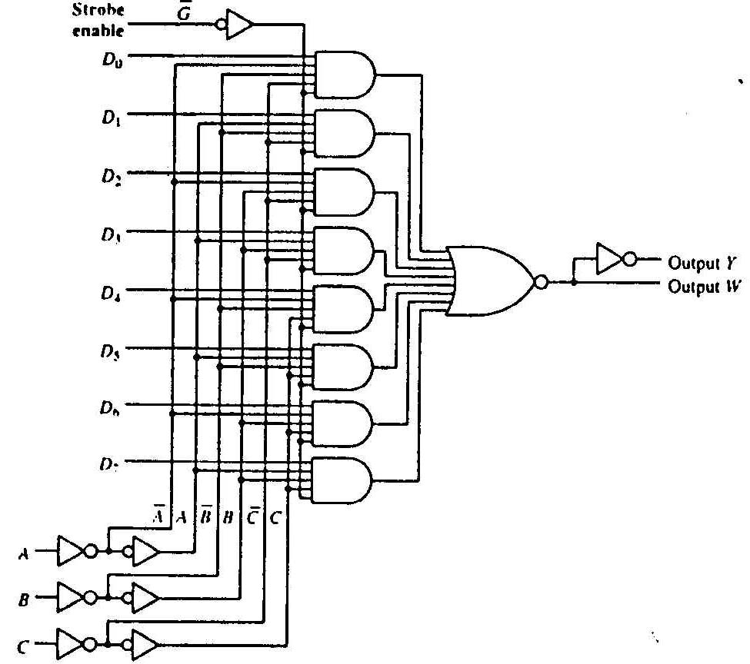
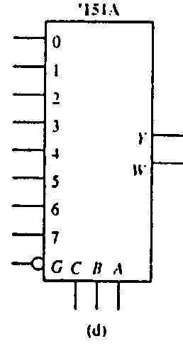
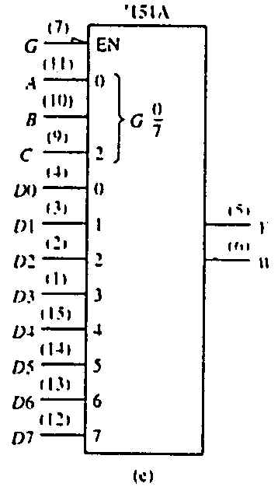
Standard MSI Multiplexer
74151A 8-to-1 multiplexer. (c) Logic diagram. (d) Generic logic symbol. (e) IEEE standard logic symbol.
Source: The TTL Data Book Volume 2. Texas Instruments Inc.,1985.
FLB 20203 DIGITAL SYSTEMS
Combinational Circuits: MSI Components

Slide 24
Multiplexers: Implementing Functions
A Boolean function can be implemented using multiplexers.
A 2^{n}-to-1 multiplexer can implement a Boolean function of n input variables, as follows:
  (i) Express in sum-of-minterms form.
Example: F(A,B,C) = A'B'C + A'BC + AB'C + ABC'
= Σ m(1,3,5,6)
  (ii) Connect n variables to the n selection lines.
  (iii) Put a '1' on a data line if it is a minterm of the function, '0' otherwise.
FLB 20203 DIGITAL SYSTEMS
Combinational Circuits: MSI Components

Slide 25
Multiplexers: Implementing Functions
F(A,B,C) = Σ m(1,3,5,6)
This method works because:
Output = m₀.I₀ + m₁.I₁ + m₂.I₂ + m₃.I₃ + m₄.I₄ + m₅.I₅ + m₆.I₆ + m₇.I₇
Supplying ‘1’ to I₁,I₃,I₅,I₆ , and ‘0’ to the rest:
Output = m₁ + m₃ + m₅ + m₆
0
1
0
1
0
1
1
0
0
1
2
3
4
5
6
7
F
mux
A B C
FLB 20203 DIGITAL SYSTEMS
Combinational Circuits: MSI Components

Slide 26
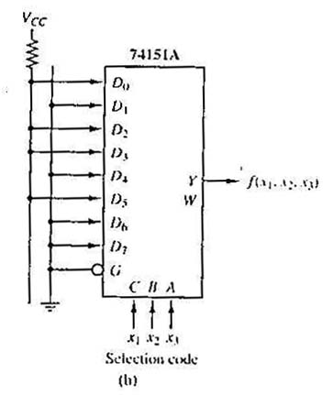
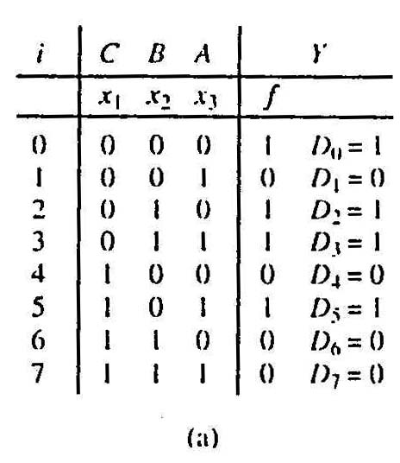
Multiplexers: Implementing Functions
Example: Use a 74151A to implement:
f(x₁,x₂,x₃) = ∑ m(0,2,3,5)
Realization of f(x₁,x₂,x₃) = ∑m(0,2,3,5).
(a)Truth table.
(b)Implementation with 74151A.
FLB 20203 DIGITAL SYSTEMS
Combinational Circuits: MSI Components

Slide 27
Using Smaller Multiplexers
Earlier, we saw how a 2^{n}-to-1 multiplexer can be used to implement any Boolean function of n (input) variables.
However, we can use a single smaller 2^{(n-1)}-to-1 multiplexer to implement any Boolean function of n (input) variables.
In particular, the earlier function
F(A,B,C) = ∑ m(1,3,5,6)
can be implemented using a 4-to-1 multiplexer (rather than an 8-to-1 multiplexer).
FLB 20203 DIGITAL SYSTEMS
Combinational Circuits: MSI Components

Slide 28
Using Smaller Multiplexers
Let’s look at this example:
F(A,B,C) = Σ m(0,1,3,6) = A’B’C’ + A’B’C + A’BC + ABC’
A’B’
1
1
0
1
0
0
1
0
0
1
2
3
4
5
6
7
1
C
0
C'
0
1
2
3
F
mux
F
mux
A B C
A B
Note: Two of the variables, A, B, are applied as selection lines of the multiplexer, while the inputs of the multiplexer contain 1, C, 0 and C'.
FLB 20203 DIGITAL SYSTEMS
Combinational Circuits: MSI Components

Slide 29
Using Smaller Multiplexers
Procedure
  1) Express boolean function in “sum-of-minterms” form.
  e.g. F(A,B,C)= Σ m(0,1,3,6)
  2) Reserve one variable (in our example, we take the least significant one) for input lines of multiplexer, and use the rest for selection lines.
  e.g. C is for input lines, A and B for selection lines.
FLB 20203 DIGITAL SYSTEMS
Combinational Circuits: MSI Components

Slide 30
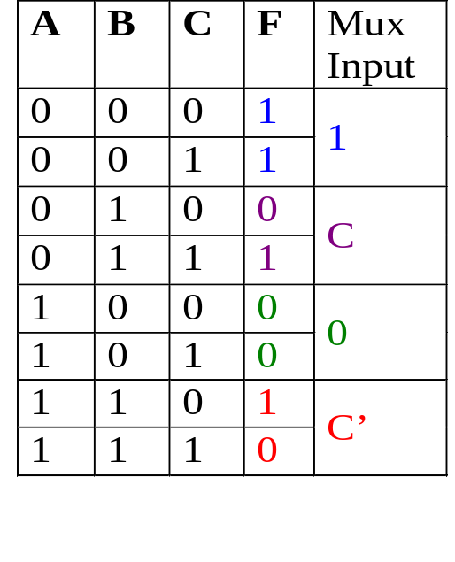
Using Smaller Multiplexers
  3) Draw the truth table for function, but grouping inputs by selection line values, and then determine multiplexer inputs by comparing input line (C) and function (F) for corresponding selection line values.
1
0
0
1
2
3
C
F
mux
A B
FLB 20203 DIGITAL SYSTEMS
Combinational Circuits: MSI Components

Slide 31
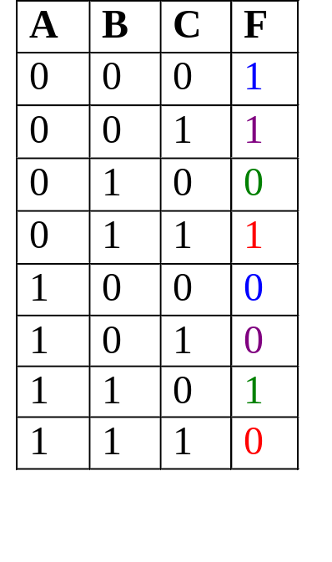
Using Smaller Multiplexers
Alternative: What if we use A for input lines, and B, C for selector lines?
A’ (when BC = 00)
A’ (when BC = 01)
A (when BC = 10)
A
0
1
2
3
F
A’ (when BC = 11)
mux
B C
FLB 20203 DIGITAL SYSTEMS
Combinational Circuits: MSI Components

Slide 32
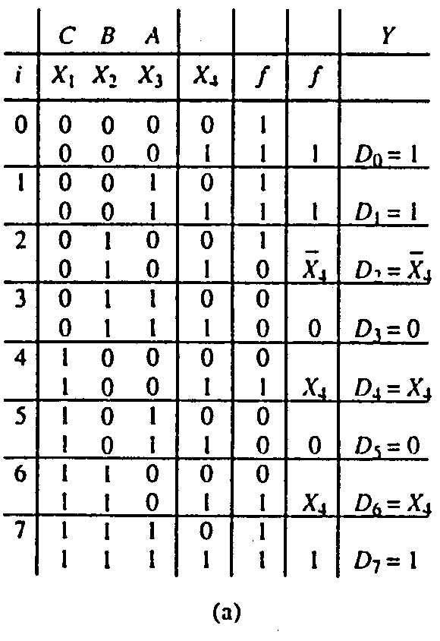
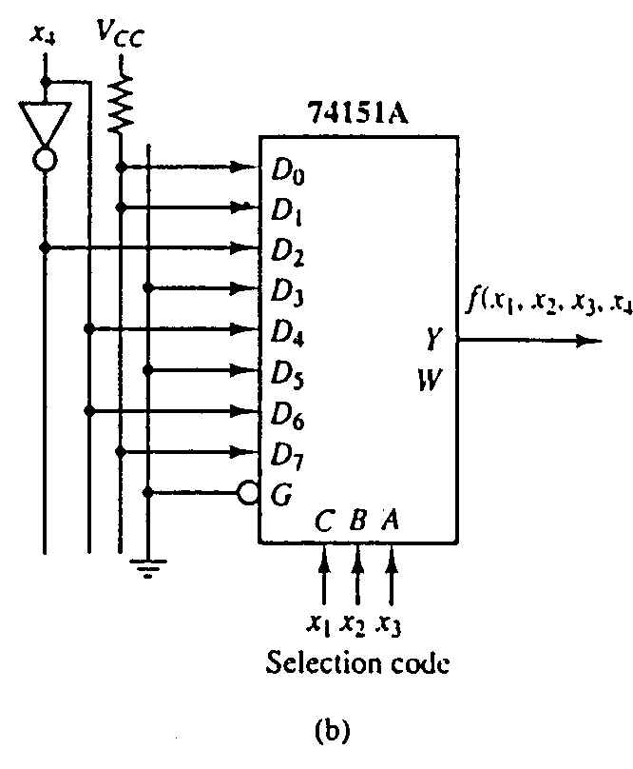
Using Smaller Multiplexers
Example: Implement using a 74151A the function:
f(x₁,x₂,x₃,x₄) = ∑ m(0,1,2,3,4,9,13,14,15)
FLB 20203 DIGITAL SYSTEMS
Combinational Circuits: MSI Components

